Slide 1
NodeJS and HTTPS
Markus Veijola March 2014

Slide 2
Introduction
Hypertext Transfer Protocol Secure (HTTPS) is a communications protocol for secure communication over a computer network, with especially wide deployment on the Internet.
Technically, it is not a protocol in and of itself; rather, it is the result of simply layering the Hypertext Transfer Protocol (HTTP) on top of the SSL/TLS protocol, thus adding the security capabilities of SSL/TLS to standard HTTP communications.
The main motivation for HTTPS is to prevent wiretapping and man-in-the-middle attacks.

Slide 3
Introduction
X.509 certificates are used to guarantee one is talking to the partner with whom one wants to talk. As a consequence, certificate authorities and a public key infrastructure are necessary to verify the relation between the owner of a certificate and the certificate, as well as to generate, sign, and administer the validity of certificates.

Slide 4
Introduction
First of all we need associated SSL certificates for our HTTPS web server.
The recommended way is to get your certificate signed by a Certificate Authority, but for testing purposes we will sign it ourselves.
Windows users will need Cygwin tool to generate these files (or use IIS server). You can find Cygwin from here: https://www.cygwin.com/
After downloading install the Cygwin package.

Slide 5
Generating The Keys
Open Cygwin terminal.
We need to install openssl library.
To do this first install apt-cyg with next commands:
svn --force export http://apt-cyg.googlecode.com/svn/trunk/ /bin/
chmod +x /bin/apt-cyg

Slide 6
Generating The Keys
Then install opessl:
apt-cyg install openssl
Then generate the keys with next commands:
openssl genrsa -des3 -out server.key 1024
openssl req -new -key server.key -out server.csr
cp server.key server.key.org
openssl rsa -in server.key.org -out server.key
openssl x509 -req -days 365 -in server.csr -signkey server.key -out server.crt

Slide 7
Generating The Keys
Now create a working directory for your HTTPS server.
Copy the generated files from C:\cygwin64\home\Opiframe to your working directory.
In your working directory create app.js file with next content.

Slide 8
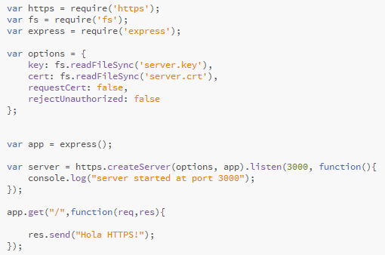
Testing

Slide 9
Testing
Start the server.
Open browser and enter next url: https://localhost:3000
You should see that browser is complaining about certificate, but make an exception rule for this domain (because this is just for testing purposes).
Then you should see the text “Hola HTTPS!” in browser window.

