Slide 1
Relevant graphs found within
Dr Connolly’s proof and rebuttals
Representing the `say no’ rule 6 party and the residents of Monton and surrounding areas

Slide 2
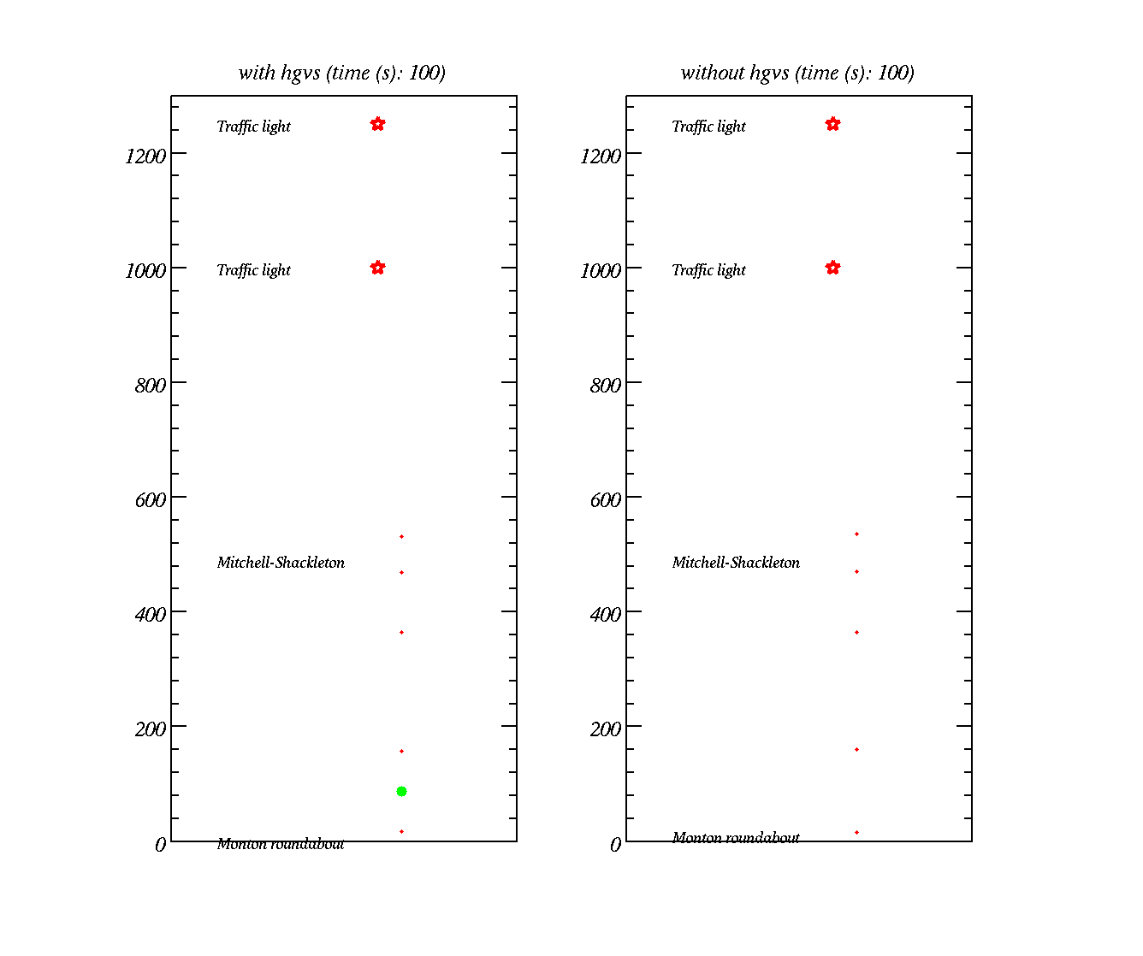
Modelling the flow of traffic
(peak hours)
Traffic lights
Cars – red dots
HGVs – green dots
Distance along road (m)

Slide 3
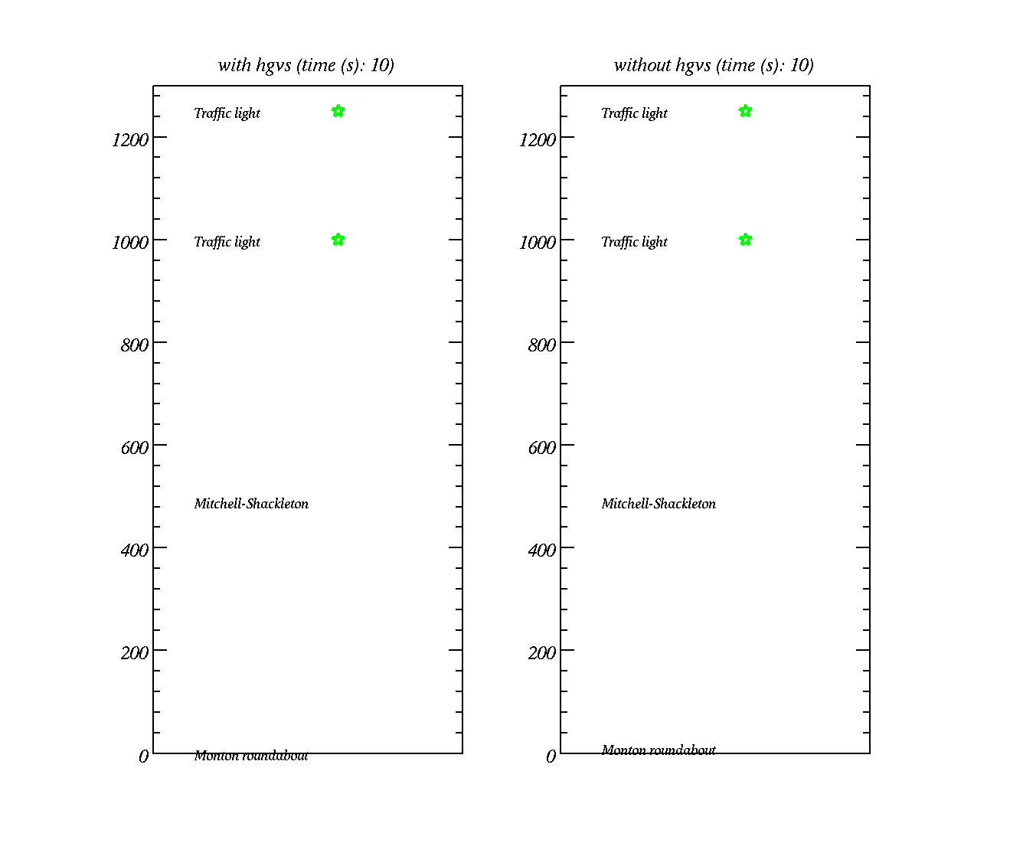
Modelling the flow of traffic
(peak hours)
Traffic lights
Cars – red dots
HGVs – green dots
Distance along road (m)

Slide 4
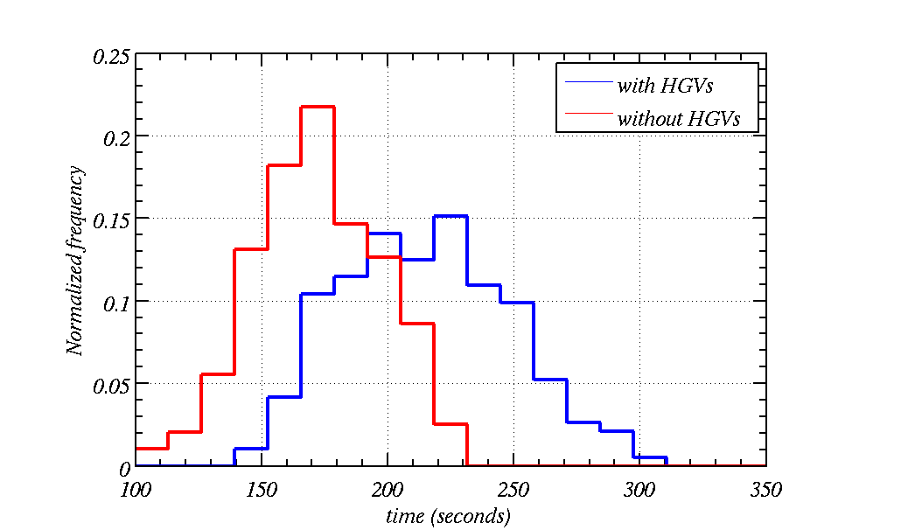
Histogram of time-taken to drive down Green Lane
(south bound only)
Some times it could take up to 5 minutes to drive down Green Lane
Fraction of vehicles
Much shorter times when there are no HGVs (165 seconds on average)
Much longer times when there are HGVs (210 seconds on average)
Notes:
22 % take between 165 and 180 seconds
Cars:
1. 4 m/s%2
2. 8 m/s^2
HGVs:
Braking 6 m/s^2
Accelerating: 2 m/s^2

Slide 5
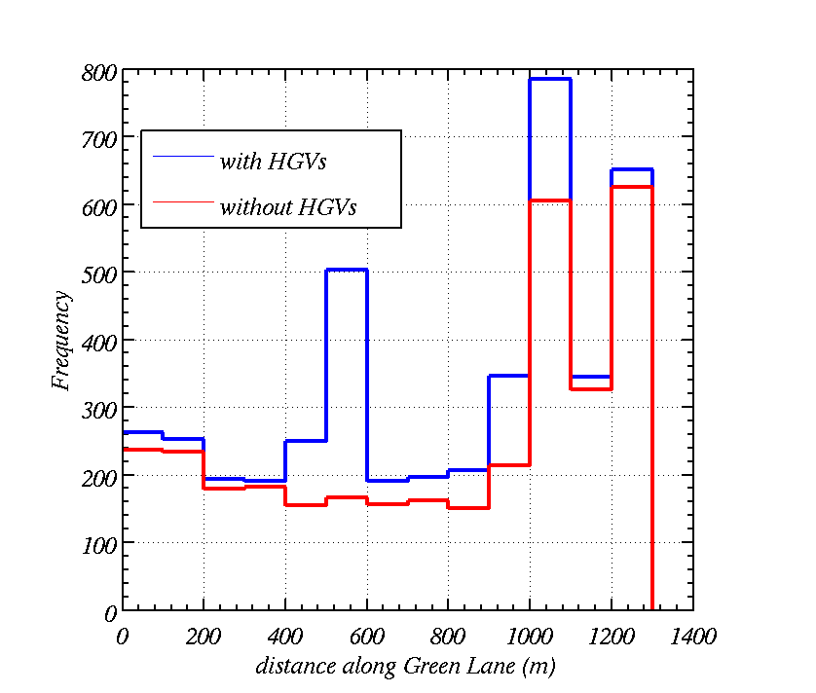
Histogram of clustering along Green Lane
(south bound only)
Even causes higher densities at the traffic lights
Number of vehicles per 100 m of road per hour
Clusters build up at the Mitchell Shackleton site and traffic density / frequency is higher everywhere. It works out at 30% higher on average!
Traffic density is higher at the roundabout

Slide 6
What if the HGVs come at a rate of 1 a minute?
(a reasonable worse case scenario)

Slide 7
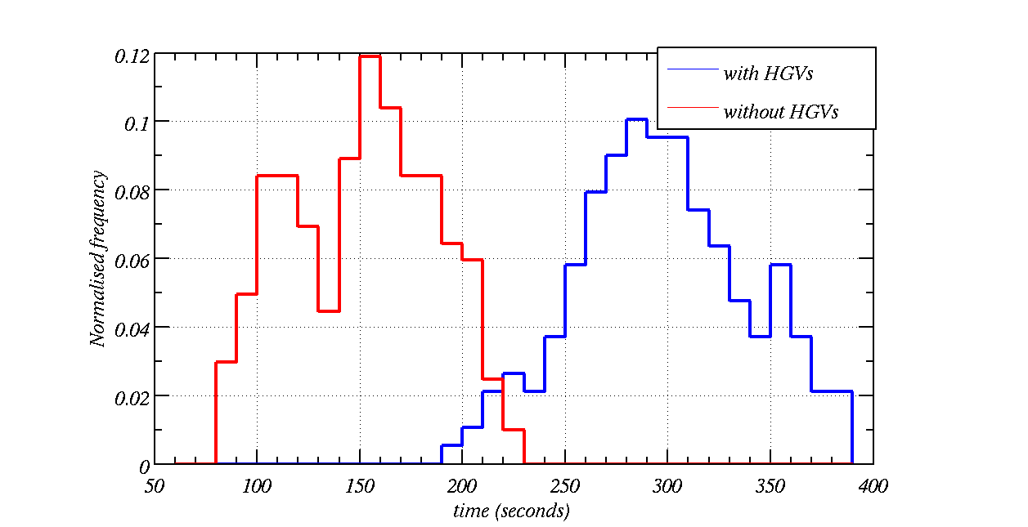
Histogram of time-taken to drive down Green Lane (HGV every minute)
(south bound only)
HGVs effectively double the time taken to drive down Green Lane (290s on average)
Fraction of vehicles
Much shorter times when there are no HGVs (150 seconds on average)
Notes:
12 % take between 160 and 170 seconds

Slide 8
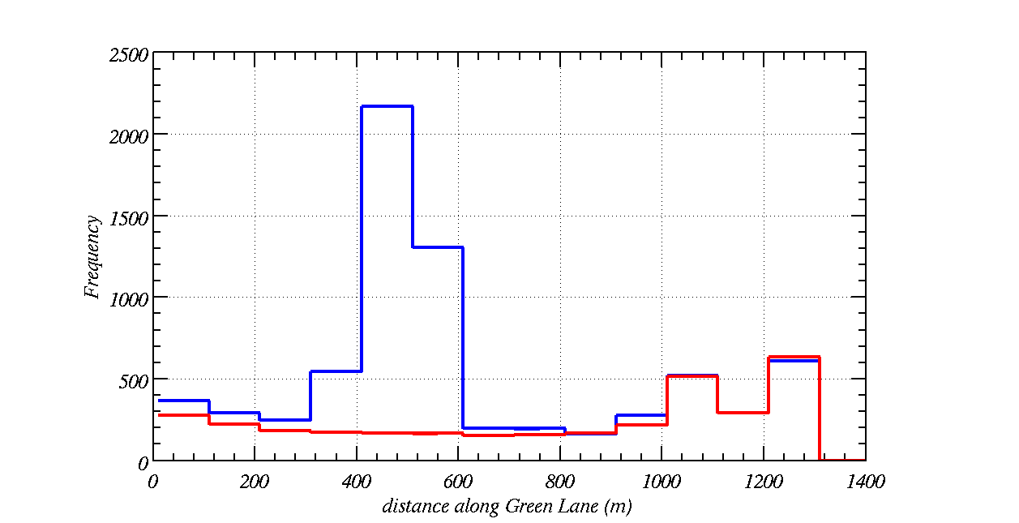
Histogram of clustering along Green Lane (HGV every minute)
(south bound only)
Number of vehicles per 100 m of road per hour
Clusters build up at the Mitchell Shackleton site and traffic density / frequency is higher. It works out at 2 times higher on average!
Traffic density is higher at the roundabout

Slide 9
Cars and HGVs are point sound sources and receptors are house on Canal Bank
Cars are 60 dB(A) at 10 m.
HGVs are 84 dB(A) at 15 m.
The house is 10 m off the road side.
I have only considered south bound flow.
Sound pressure level due to multiple sources:

Slide 10
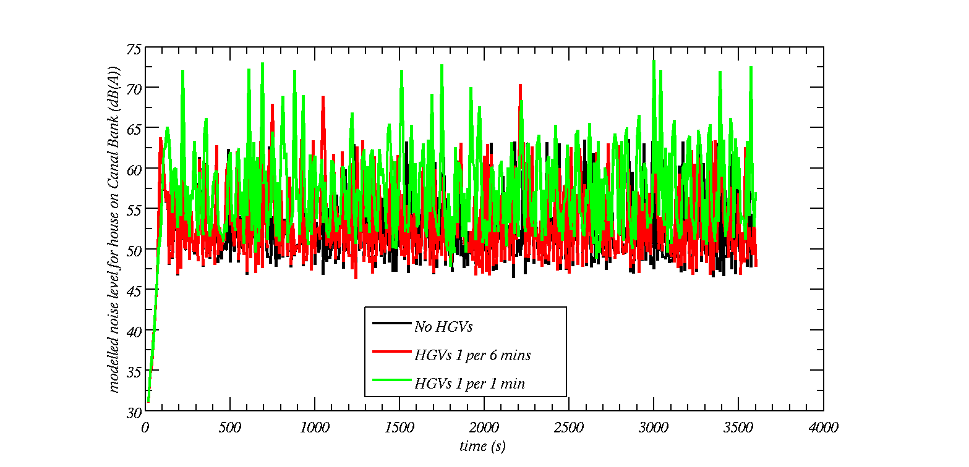
Traffic modelling with steady flow
(these numbers agree with CRTN)
L10 = 64.0 dB(A)
L10 = 61.7 dB(A)
L10 = 60.7 dB(A)
Notes:
Error bars show LAeq (horizontal line), LA10 (top) and LA90 (bottom)

Slide 11
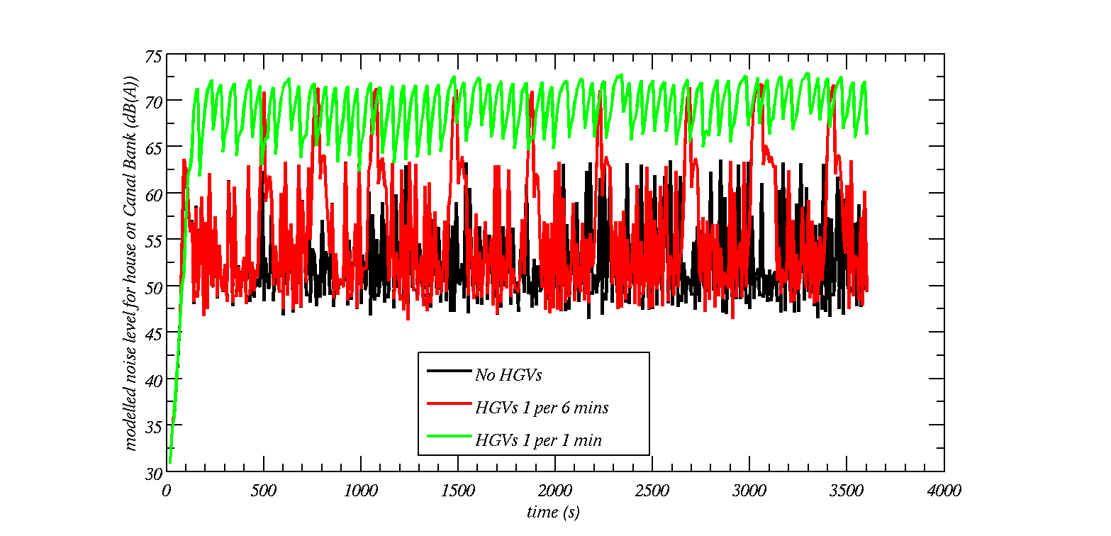
Traffic modelling with HGVs slowing
(these numbers do not agree with CRTN)
L10 = 72.1 dB(A)
L10 = 63.9 dB(A)
L10 = 60.7 dB(A)
Notes:
Error bars show LAeq (horizontal line), LA10 (top) and LA90 (bottom)

Slide 12
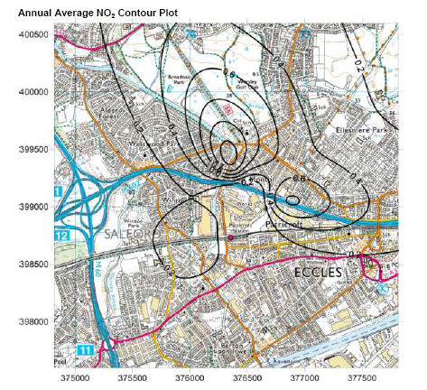
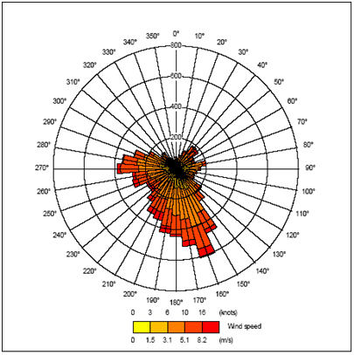
South-westerly winds?
In the Air quality witness proof it says the wind direction was south-westerly, but the wind direction is input as south-easterly. I question the validity of the data
Contours spread out in north-north-west direction
Source of pollution (stack)

Slide 13
Met Office proof
WIND ROSE FOR RINGWAY
N.G.R: 3814E 3844N ALTITUDE: 69 metres a.m.s.l.
Note the winds have a variable flag of 0.1%
85732 OBS.
1.9% CALM
0.1% VARIABLE
Met office say:
“spot winds shouldn’t be used for wind analysis”
“Ringway is only reporting METAR and closed as an official Met Office station in 2004”
>33
20%
28-33
17-27
10%
11-16
5%
1-10
SEASON: ANNUAL
0%
KNOTS
Period of data: Jan 1995 - Oct 2004

Slide 14
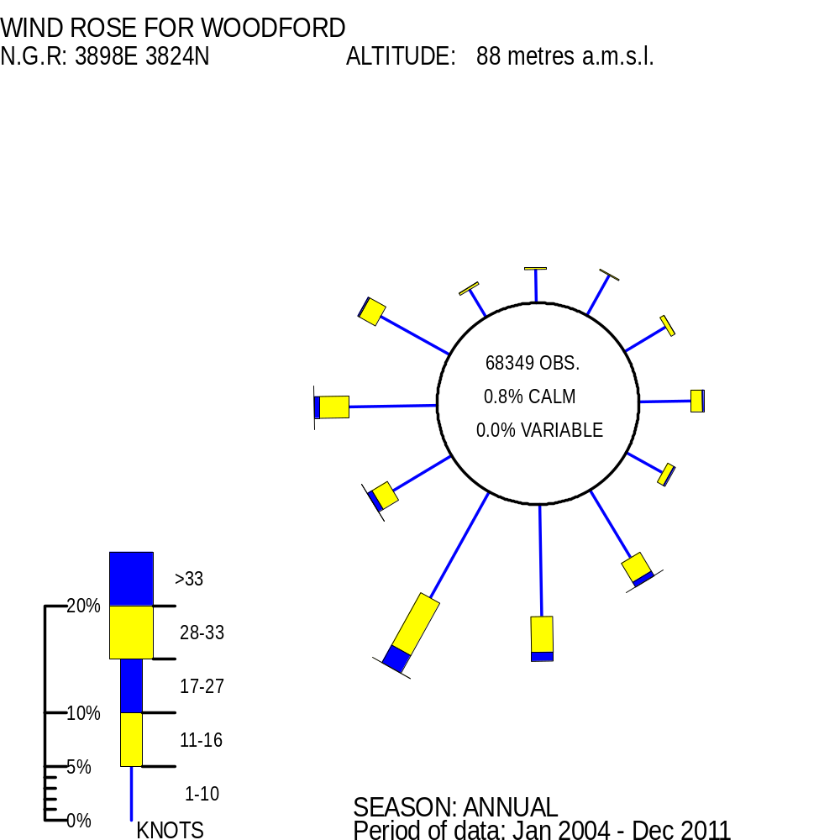
Met Office proof
Note the winds have a variable flag of 0.0% - less than Manchester – so likely the winds do not disperse the pollutants as well as the Manchester airport winds
The significance of this is that the wind blows the pollutant over more residential areas where there are more receptors

Slide 15
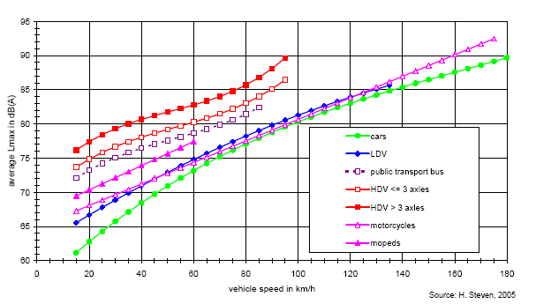

Noise level vs speed

Slide 16
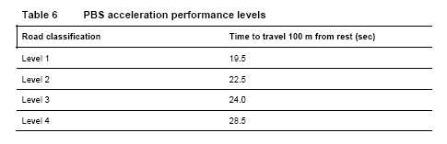
PBS (performance based standards)
Acceleration ~ 0.5 m/s^2

