Slide 1
Modelling of traffic flow and noise down Green Lane
Monton `Say No’ group

Slide 2
Contents
Animation of traffic flow from Monton to Liverpool Road
  Complicated by HGVs stopping at proposed site and cars stopping at two sets of traffic lights.
  Bunching of cars when HGVs there may mean more accidents.
Histogram of times taken for cars to travel from one end of Green Lane to the other
  1% increase in traffic does not mean 1% increase in time it takes
Histogram of traffic density along Green Lane.
  1% increase in HGVs means 30% increase in traffic density
Modelling of noise pollution

Slide 3
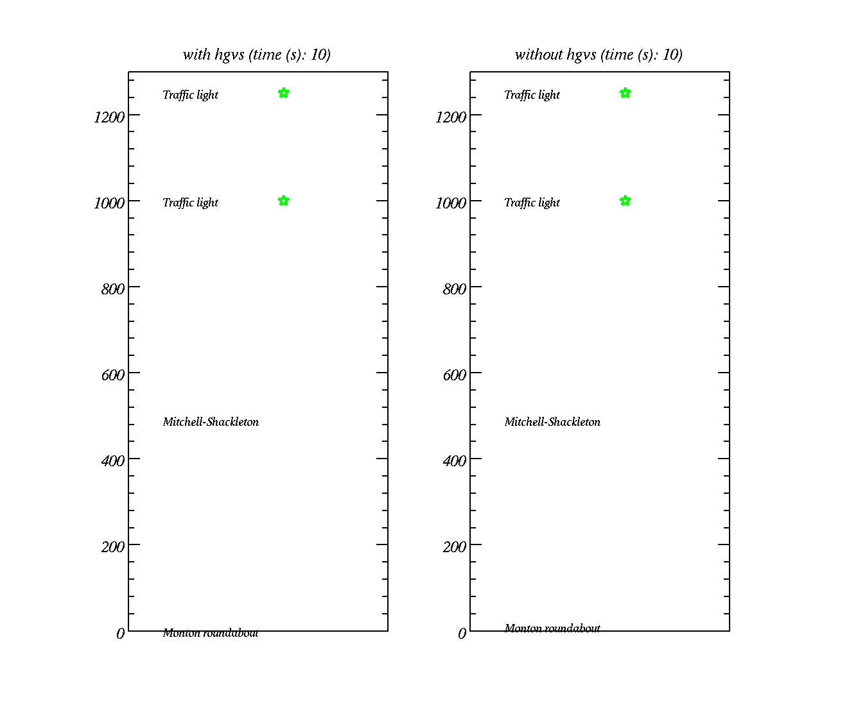
Animation
Stars – traffic lights
Red dots – cars
Green dots – HGVs
distance along Green Lane (m)

Slide 4
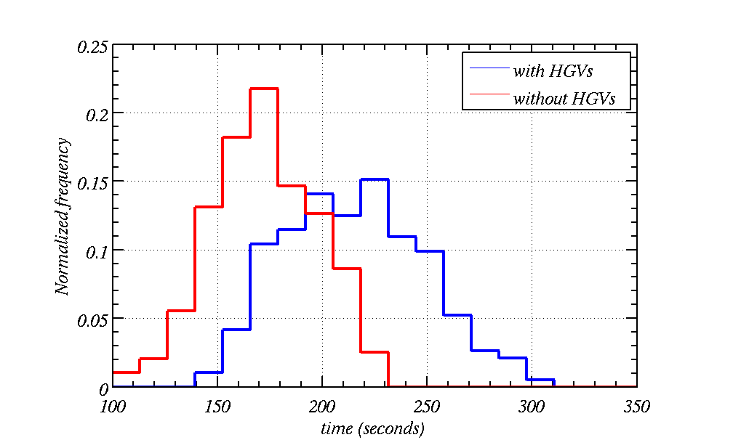
Histogram of time-taken to drive down Green Lane
Some times it could take up to 5 minutes to drive down Green Lane
Much shorter times when there are no HGVs (165 seconds on average)
Much longer times when there are HGVs (210 seconds on average)

Slide 5
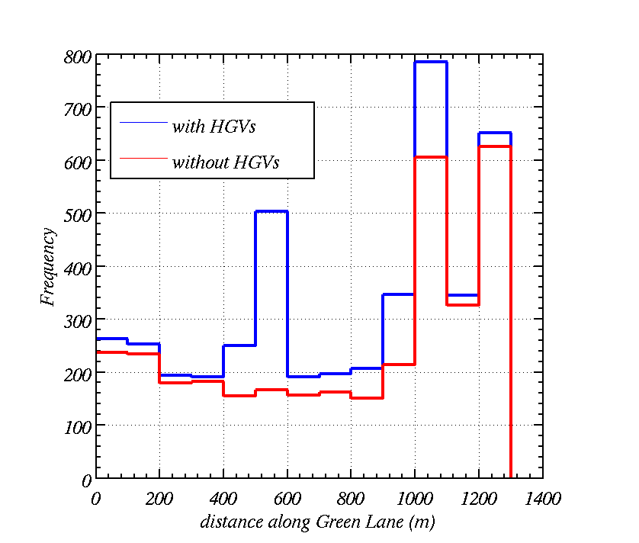
Histogram of clustering along Green Lane
Even causes higher densities at the traffic lights
Clusters build up at the Mitchell Shackleton site and traffic density / frequency is higher everywhere. It works out at 30% higher on average!
Traffic density is higher at the roundabout

Slide 6
What if the HGVs come at a rate of 1 a minute – a reasonable worse case scenario

Slide 7
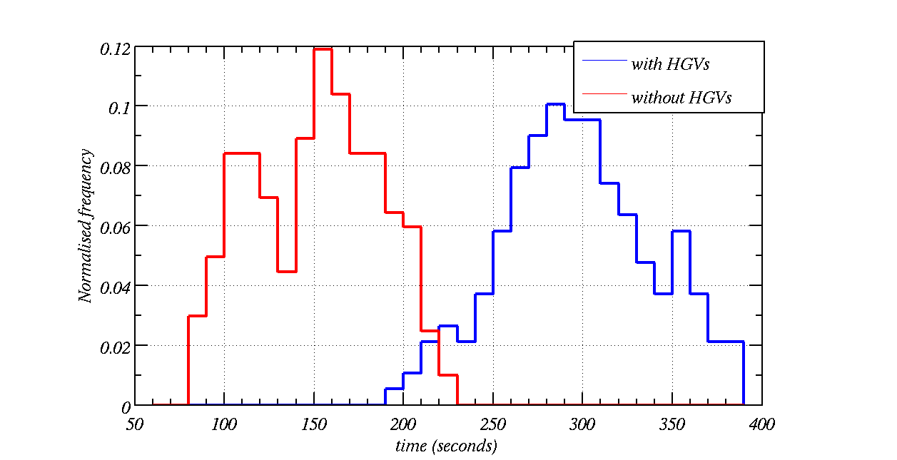
Histogram of time-taken to drive down Green Lane (HGV every minute)
HGVs effectively double the time taken to drive down Green Lane (290s on average)
Much shorter times when there are no HGVs (150 seconds on average)

Slide 8
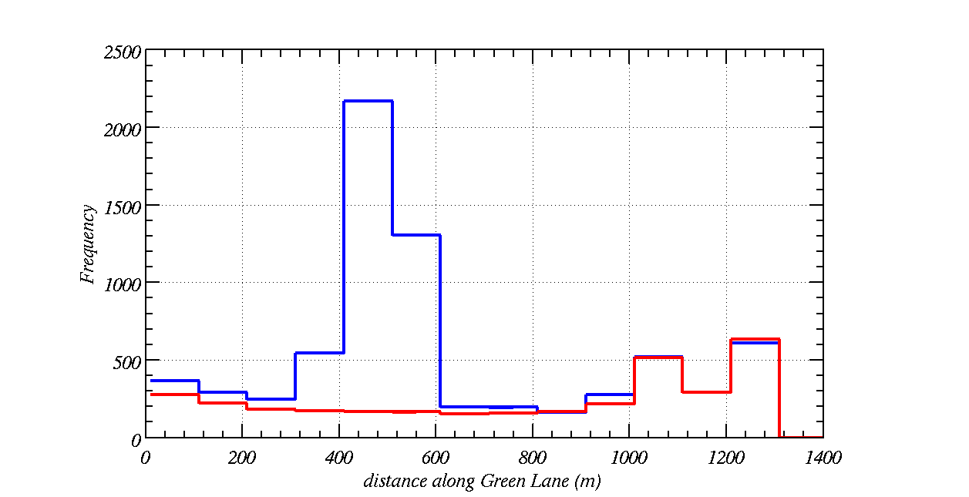
Histogram of clustering along Green Lane (HGV every minute)
Clusters build up at the Mitchell Shackleton site and traffic density / frequency is higher. It works out at 2 times higher on average!
Traffic density is higher at the roundabout

Slide 9
To assess the impact that the HGVs will have on noise consider
Sound pressure levels transmit as an inverse distance law
A car at 10 m has a sound level of 60 dB
An HGV at 15 m has a sound level of 84 dB.
Assume that the sound pressure levels have random phase when they arrive at a house on Canal Bank (ie a receptor) and add both constructively and destructively

Slide 10
Cars and HGVs are point sound sources and receptors are house on Canal Bank
Cars are 60 dB(A) at 10 m.
HGVs are 84 dB(A) at 15 m.
The house is 10 m off the road side.
Sound pressure level due to multiple sources:

Slide 11
Guidelines from Entecs document

Slide 12
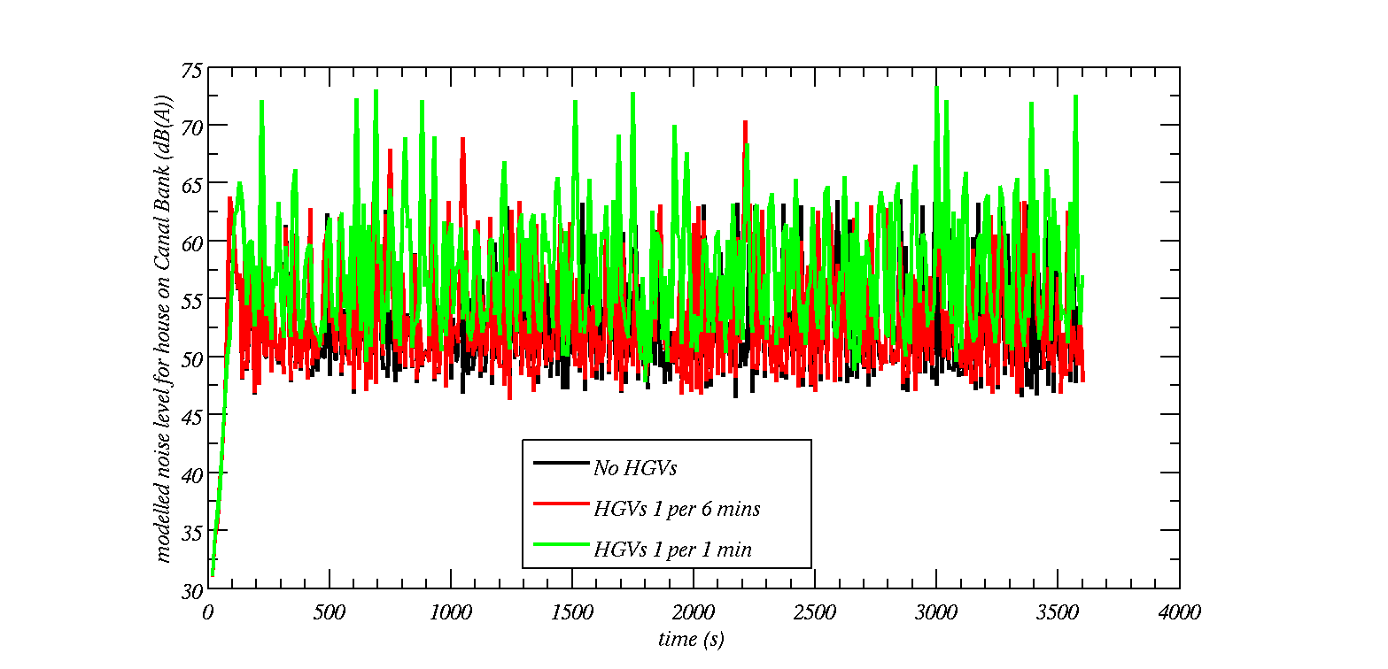
Traffic modelling with steady flow
L10 = 64.0 dB(A)
L10 = 61.7 dB(A)
L10 = 60.7 dB(A)
Notes:
Error bars show LAeq (horizontal line), LA10 (top) and LA90 (bottom)

Slide 13
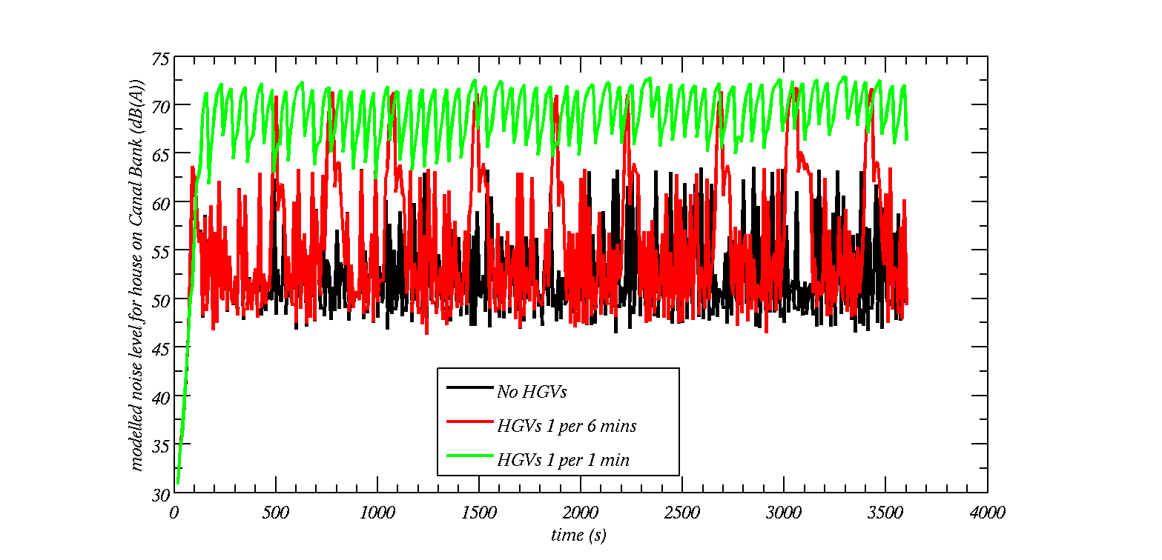
Traffic modelling with HGVs slowing
L10 = 72.1 dB(A)
L10 = 63.9 dB(A)
L10 = 60.7 dB(A)
Notes:
Error bars show LAeq (horizontal line), LA10 (top) and LA90 (bottom)

Slide 14
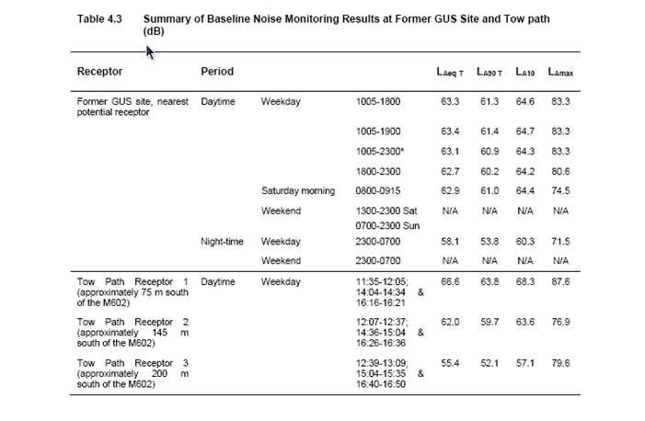

Slide 15
Summary
A 1% increase in HGV traffic can be very significant in terms of the flow of traffic down Green Lane
  25% longer time to drive down Green Lane on average
  More bunching of traffic: accidents
  In some instances more than double the time it takes to drive down Green Lane.
  About 30% higher traffic density
This doesn’t take into account rush hour where peak flow rates will be higher and the effect will be worse.
  For HGVs every minute the consequences are severe and result in a doubling of the traffic density and a doubling of the time it take to travel down Green Lane – highly significant!
This also doesn’t take into account HGVs leaving the plant so it is a conservative estimate of the amount of disruption. In fact it would be worse.

