Slide 1
Professional Development
Write a Research Proposal
Week 1: Getting Started with Research Proposals
Dr Paul Connolly
Centre for Atmospheric Science

Slide 2
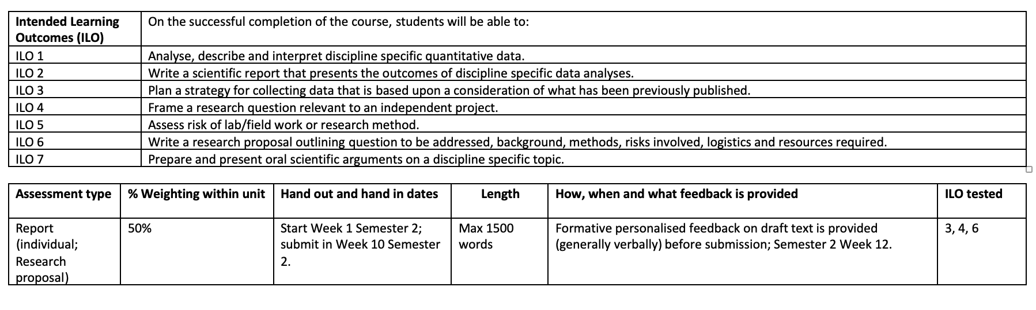
Learning and Assessment
ILOs 3, 4, and 6 are tested in semester 2.
The ILOs give the basic summary of what you should learn / achieve.
We will go into proposal writing deeper during the tutorials.
You should plan to watch a very short video, and do some reading in between tutorials.

Slide 3

Useful Reading
Although focussed on research funding for academics, many of the points are relevant in writing effective research proposals
I will be setting reading from this book throughout the tutorials
You will pick up useful tips each week, which we will consolidate by discussing in the synchronous sessions
Recommended book – I read last semester and has a lot of useful tips

Slide 4
Who writes Proposals?
(from my experience)
Academics in Universities
Postdoctoral students
Undergraduate students
Post doctoral researchers
Volunteer organisations
Private sector / businesses – e.g. developers

Slide 5
How are Research Proposals decided?
(from my experience)
Referee reports / Peer review
  May or may not be experts in the field
Panel meeting that discuss the proposals (and maybe rank them)
Academics at Universities
Other funding decisions are usually a similar set-up

Slide 6
What makes a good proposal?
(from Research Toolkit)
Invest in the best research. Does the proposal offer a realistic promise of an answer to an important question?
Four key propositions:
Importance:
  The proposal asks an important question
Success:
  The project is likely to answer the question
Value:
  The likely gain from this project is worth the resources requested
Competence:
  The applicant are competent to carry out the project

Slide 7
Your proposal should …
(from Research Toolkit)
Be easy to read / “speed-read”
Be easy for a non-specialist to remember, understand and summarise.
Make it easy for readers to reconstruct the essence or your proposal and communicate how it meets the 4 key propositions.
Provide an “at a glance” overview of your project to others.
We will cover top-tips on how to achieve this in the tutorials.

Slide 8
Main points
You have to convince decision makers that your proposal is worth investing in.
There is usually some level of competition that you will have to compete with for limited resources.
There are 4 key propositions
  Importance
  Success
  Value
  Competence
Your proposal needs to be easy to read, and remember.
Choose a topic and discuss in groups what you could write about the 4 key propositions.

Slide 9
Some past projects
(mainly atmospheric)
Evaluation of low-cost metal oxide sensors to measure air quality
An investigation into the drivers of seasonal variation in aerosol optical properties in the North East Atlantic region
Analysis of cold pools and dust uplift in the Sahara
Pockets of Open Cells: the control on the formation of gaps in clouds in the South-East Pacific.
Modelling concentration of PM2.5 with social development of China through supervised learning techniques.
Quantifying the effectiveness of HEPA air cleaners at removing particulate matter and black carbon from classrooms
A cost-benefit analysis of marine cloud brightening
Quantification of the relative contribution of aerosol and cloud factors to rain on the ground.
Analysis of ice nucleation data from the FIN-02 experiment.
The effect of ultra-viscous aerosol on the formation of cirrus clouds
Road traffic pollution modelling: a case study on princess parkway
Investigating the relationship of ice nucleating particles and soil dust
The impact of restaurants on particulate matter levels in Manchester city centre.
An observational study of atmospheric ice nucleating particles on polluted days.
The Glaciation of mixed-phase clouds
Dynamics of Rossby waves and shear instability of Saturn’s Hexagon

