Slide 1
Professional Development
Write a Research Proposal
Week 3: How to Convince Decision-Makers
Dr Paul Connolly
Centre for Atmospheric Science

Slide 2

Useful Reading
Much of the material comes from chapter 9 of this book.
Really useful summary of “how to convince decision-makers”
Read / scan chapter 9 of this book.
  Activity are tools 13 and 14
You have to produce a research proposal
  This week (although not assessed) will really help you get started
  Make writing it much easier
  Give you the best chance of a good grade

Slide 3
Again we go back to 4 propositions
Importance – this proposal asks an important question
Success – this project is likely to answer the question
Value – the likely gain is worth the resources requested
Competence – the applicant (and team) are competent

Slide 4
Information and evidence
You must produce the right information and evidence (“this project is the solution”)
  Describe in enough detail so that it could be replicated by a colleague.
  Defend parts that will attract criticism by defensive writing.
You must help busy readers find the information they need
You must help readers understand and remember the information you present

Slide 5
Important information
Some parts of your proposal will be read in more detail than others (and by different people)
Speed-readers are more likely to read the first sentence of a section or paragraph than the last:
  important messages must come first!
Works better if you think of it as either “convincing” or “defensive”.
  Convincing arguments must be remembered
  Defensive arguments are read by keen referee, they can be forgotten once they serve their purpose.
  E.g. As a scientist with x experience, y can be trusted to design the experiment with appropriate parameters (see p111)

Slide 6
Understandable and memorable
There is a limit to the number of items that we can retain in working memory!
The limit is seven! So it should be less, really
“Chunking” is an effective way of putting items together as a memorable chunk.
  E.g. bullet points numbered list.
  Can be used for objectives for instance
  Can have main questions (numbered) and sub-questions (bullets) to have another level of chunking.

Slide 7
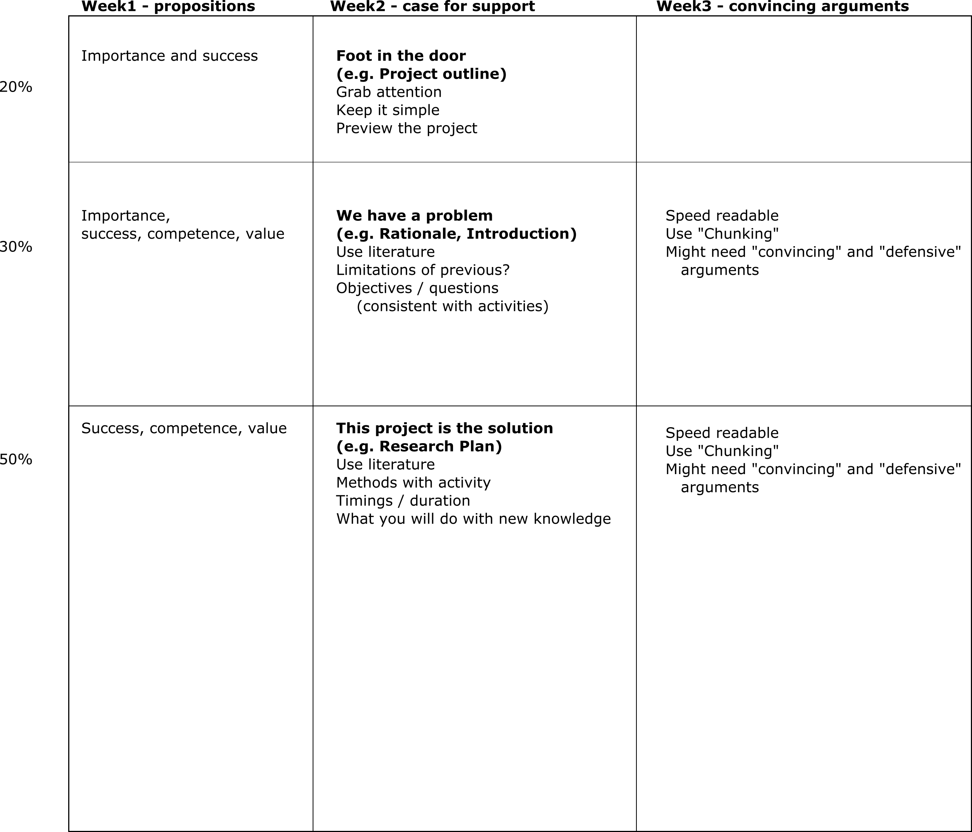
Our proposal plan so far

Slide 8
Main points
Need to provide the right information and evidence
  Break it down into Convincing and Defensive arguments.
  Put the most important point at the start of sentences.
Make information memorable by using chunking (e.g. we have a problem)
  no more than 7 points (and hopefully less)
  Bullet points / numbered lists
Develop tool 13 for yourselves. Start in tutorial
  Can use topics given in week 1
  Use 4 propositions as shown
  Ignore points that are not relevant to you (e.g. publication?)
  Tool 14 – use to identify supporting evidence / weaknesses
  You may need to do a literature search to help you.
  Finish this off and send me a copy – deadline TBD – you can work in groups.
  The above will be the asynchronous activity during the hand-in week.

Slide 9
Example projects from week 1
(mainly atmospheric)
Evaluation of low-cost metal oxide sensors to measure air quality
An investigation into the drivers of seasonal variation in aerosol optical properties in the North East Atlantic region
Analysis of cold pools and dust uplift in the Sahara
Pockets of Open Cells: the control on the formation of gaps in clouds in the South-East Pacific.
Modelling concentration of PM2.5 with social development of China through supervised learning techniques.
Quantifying the effectiveness of HEPA air cleaners at removing particulate matter and black carbon from classrooms
A cost-benefit analysis of marine cloud brightening
Quantification of the relative contribution of aerosol and cloud factors to rain on the ground.
Analysis of ice nucleation data from the FIN-02 experiment.
The effect of ultra-viscous aerosol on the formation of cirrus clouds
Road traffic pollution modelling: a case study on princess parkway
Investigating the relationship of ice nucleating particles and soil dust
The impact of restaurants on particulate matter levels in Manchester city centre.
An observational study of atmospheric ice nucleating particles on polluted days.
The Glaciation of mixed-phase clouds
Dynamics of Rossby waves and shear instability of Saturn’s Hexagon

