Slide 1
Professional Development
Write a Research Proposal
Week 4: Useful tips for Language and style
Dr Paul Connolly
Centre for Atmospheric Science

Slide 2
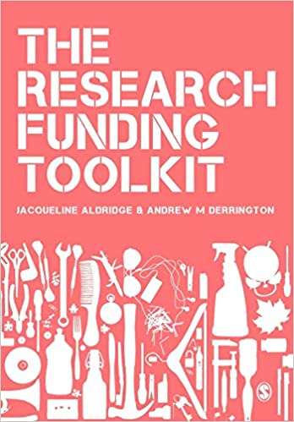
Useful Reading
Much of the material comes from chapter 10 of this book.
Some excellent tips on“how to write for funding agencies”
Read / scan chapter 10 of this book.
Proposals need to be
  Easy to read
  Easy to understand
  Convincing

Slide 3
The 6 “core” writing techniques
Assert-justify:
  Tell the readers the point, and then give detail
Priming:
  Give readers advance information so they accept the key arguments later
Signposting:
  Tell readers what information is coming.
Linking:
  How to create connected arguments across the document
Labelling:
  Demonstrate consistent and logical project structure
Summary:
  Create a strong, high-level, project summary
  not needed for your proposal.

Slide 4
Assert-Justify
This is a very useful technique in research proposals (see example 30, page 120)
Opposite to traditional “argue-conclude” model used in papers.
Advantage is that:
  Speed-readers pick up the main messages very quickly
  Detail-readers can read on.
  Assertions can be lifted out and used in a high level summary (some proposals require a high-level summary)

Slide 5
Priming (we have a problem)
Give reader evidence that will make them likely to agree with your proposal. This can seem subtle at first…
Success: Prime your important question(s):
  E.g. make the reader worried that there is an important question that needs answering before you state what the problem actually is (“we have a problem”)
  How many people are affected?
  How much money is lost because of something?
  How is the environment affected?
  By providing evidence for why we need to know the answers you are priming the ”this project is the solution”.
Success: Prime your research plan
  E.g. give evidence that points to a lack of understanding,
  Or that there are inconsistencies that require investigation in a certain way.
Competence:
  tell the reader that the investigator has necessary skills to to deliver.

Slide 6
Priming (this project is the solution)
You need to convince your referee that the project is good value. In funding proposals there will be a separate “resource” document, but it is important to recognise you cannot separate the two… you must prime the reader so they accept your resource requirement
Resources / Value:
  In the research plan mention what the requested resources are used for.
  Try to weave in why. You don’t need to mention costs here.

Slide 7
Signposting
More explicit that priming.
Priming is giving information so reader makes up their mind - subtle.
Signposting can be used to tell a reader what information is coming next:
  E.g. in this section we…
  … we now move to explaining….
Or to summarise information:
  …these experiments assess the importance of…

Slide 8
Linking
The sections of the proposal should link together effectively.
Straightforward linking:
  This will be done in approach 2…
  Approach 1 does address …; in order to address … we propose another study (approach 2)
  The results of approach 1 informs the starting assumptions in approach 2.

Slide 9
Labelling
Consistent labelling should be used throughout.
A good way to do this is to label descriptions with “tag-phrases”. ‘
Tag-phrases’ are also useful for key technical terms that may challenge non-specialists.
  E.g. you can label different approaches with shorter tag-phrases and refer to them throughout.
  You can ask questions in the ‘we have a problem’ section, give them tags, and then refer to the same tags in your research plan.
This gives the impression of a well-planned project.

Slide 10
Main points
Adopting the techniques below goes a long way to creating an ‘easy to read’ proposal
  Assert-Justify
  Linking
  Labelling
Further points:
  Use adjectives sparingly (e.g. exciting; significant; profound) – focus on evidence instead.
  Try not to overuse typography to emphasise text
  Use bullet-points and numbered lists “Chunking”
  Use short paragraphs – six lines maximum
  Use short sentences – 20 words are too long
  Use present tense “this project asks” instead of “this project is asking the following question”
  Repetition is good.
You should have a rough idea of what your research proposal will be about and may have thought about activities too. Discuss in groups where you will use:
  Assert-justify
  Labelling using tag-phrases
  Priming, Linking, and signposting

