Slide 1
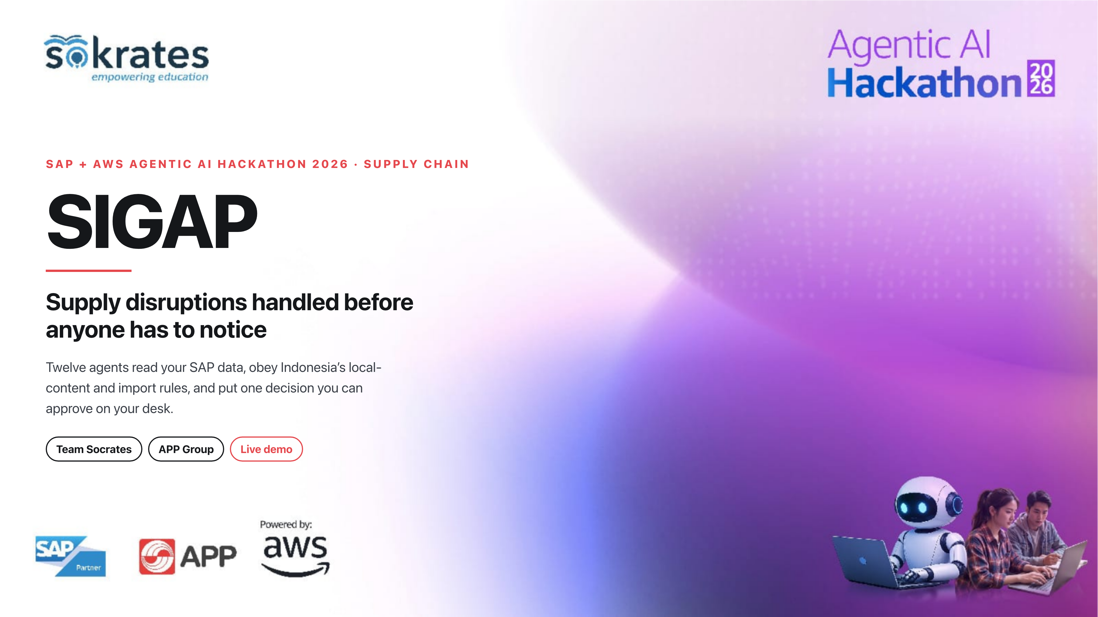
Notes:
Hello, we are Team Socrates. SIGAP: supply disruptions handled before anyone has to notice. Ten pages, one of them a live demo. Let me start with why this is hard.

Slide 2
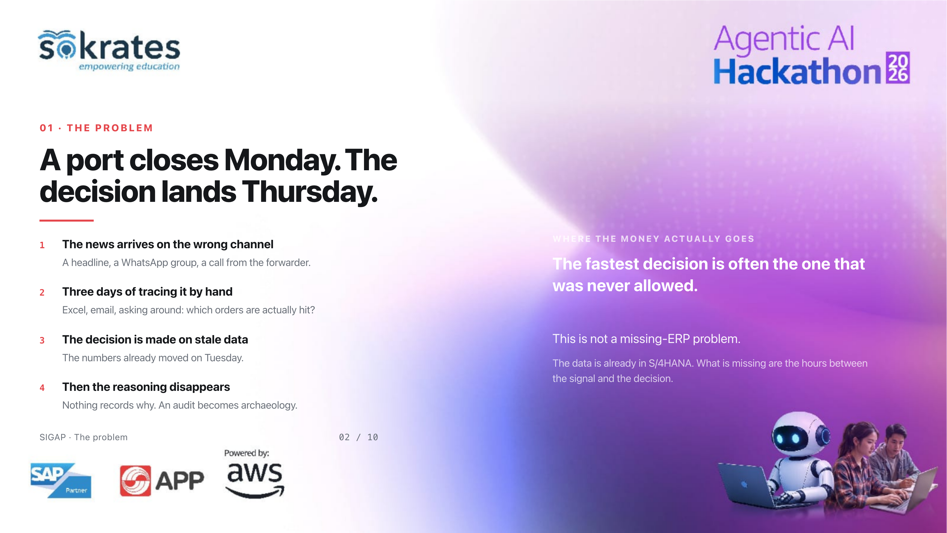
Notes:
When a port closes, dozens of materials stop with it. The expensive part is not the typhoon. It is three days of Excel and WhatsApp to find out which orders are hit, then deciding on numbers that moved two days ago, with nothing recording why. The data is already in S/4HANA. What is missing are the hours between the signal and the decision.

Slide 3
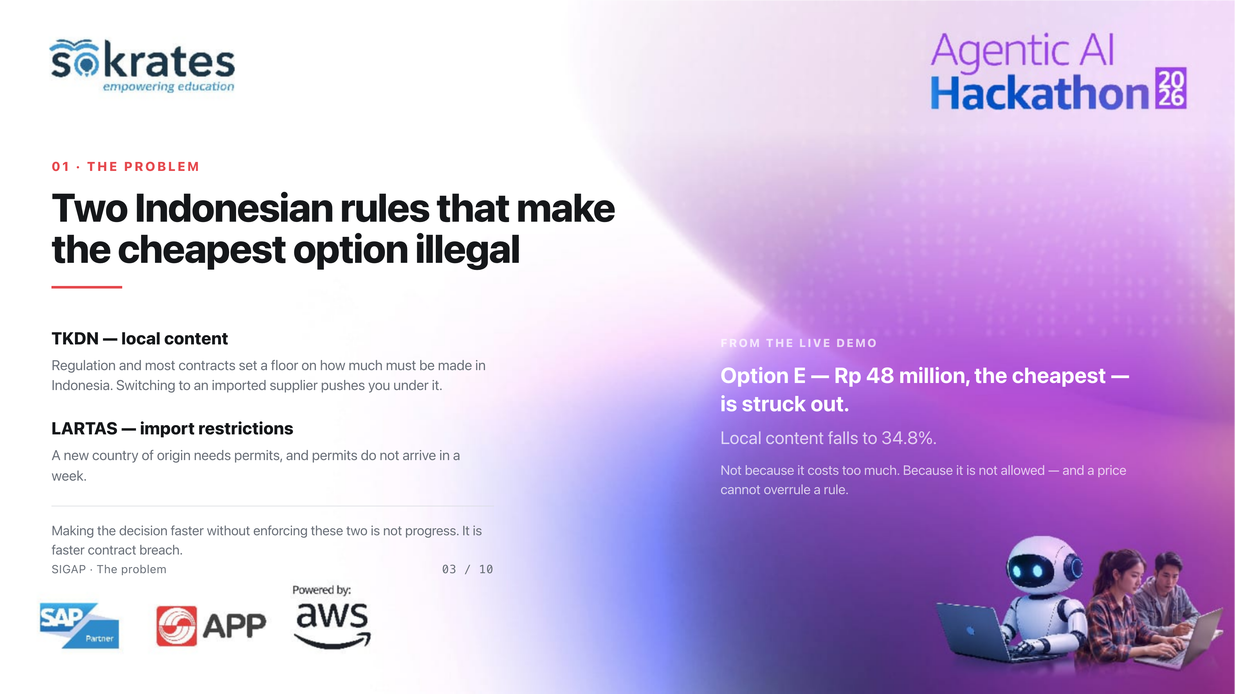
Notes:
And there is a dimension that is specific to Indonesia. The cheapest replacement is almost always imported, and importing cuts your local-content score and runs into import restrictions. In the demo you will see option E, the cheapest at 48 million rupiah, struck out because local content falls to 34.8 per cent. Not because it costs too much. Because it is not allowed. So making the decision faster without enforcing these rules is not progress.

Slide 4
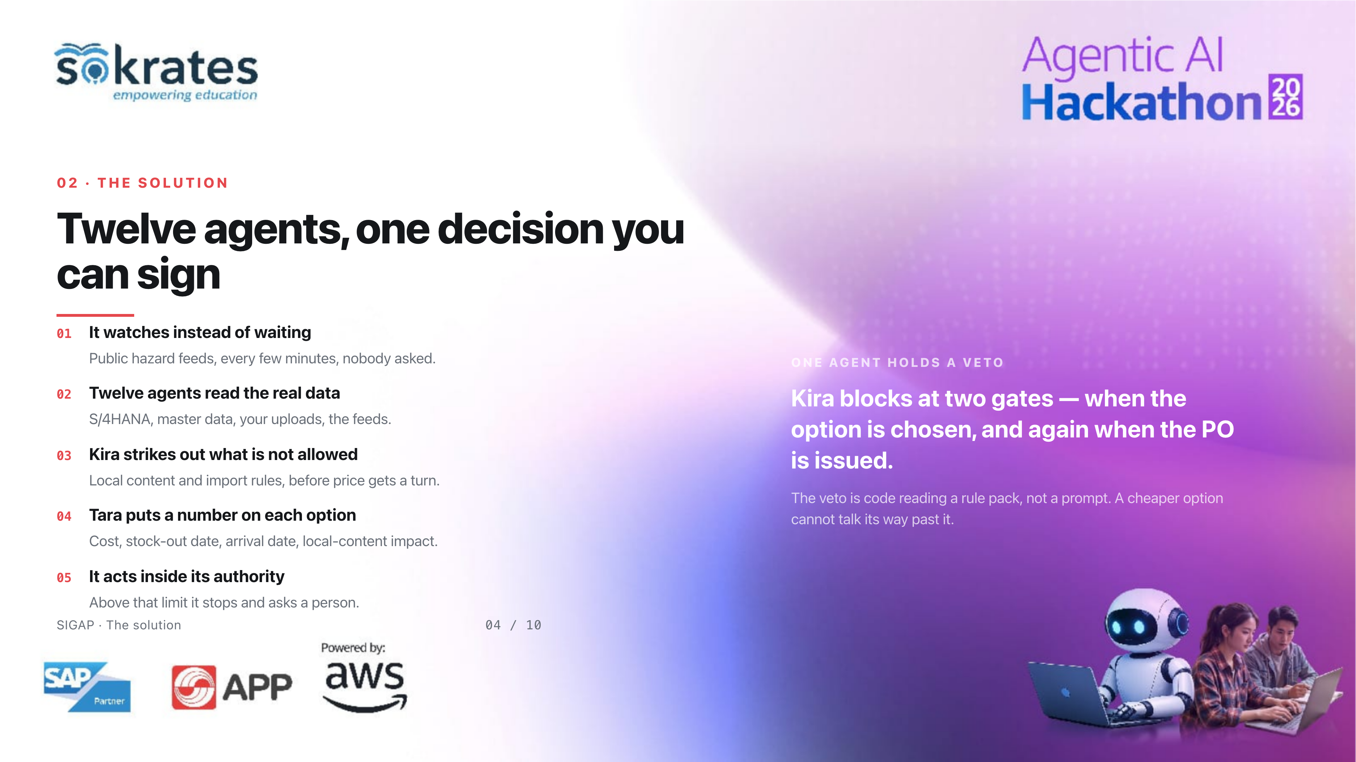
Notes:
SIGAP closes those hours. It watches public hazard feeds without being asked. Twelve agents read SAP and the supporting data. Kira strikes out what is not allowed before price gets a turn, and her veto sits at two gates: when the option is chosen, and again when the purchase order is issued. Tara puts a number on each surviving option. Then the system acts inside its authority, and stops to ask above it.

Slide 5
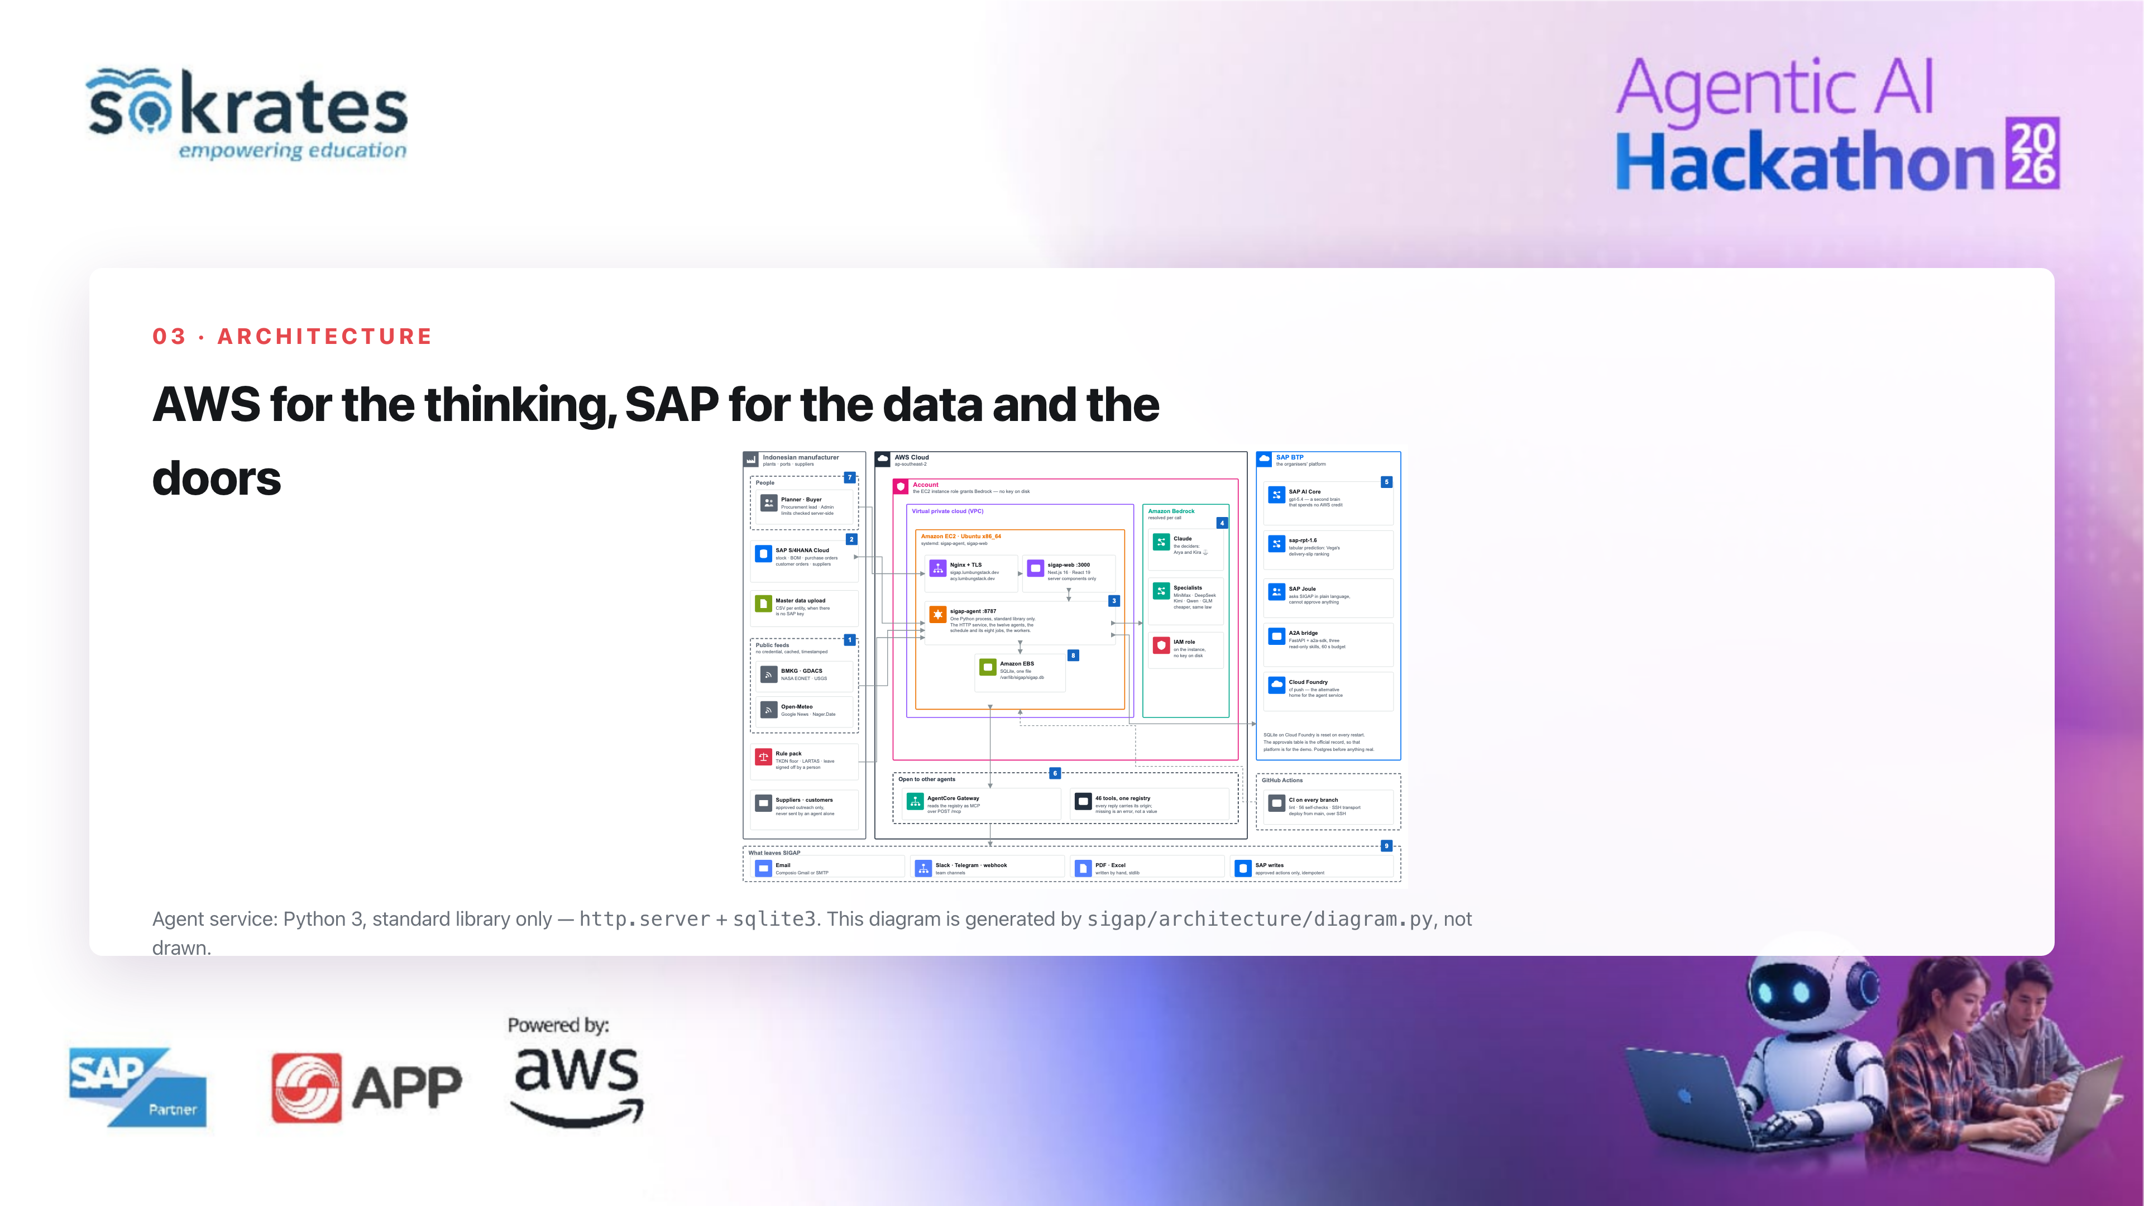
Notes:
The architecture: AWS for the thinking, Bedrock and AgentCore, and SAP for the data and the doors, S/4HANA and AI Core. The agent service is Python standard library only, http.server and sqlite3 — no orchestrator, no message broker. This diagram is generated from the code, not drawn by hand.

Slide 6
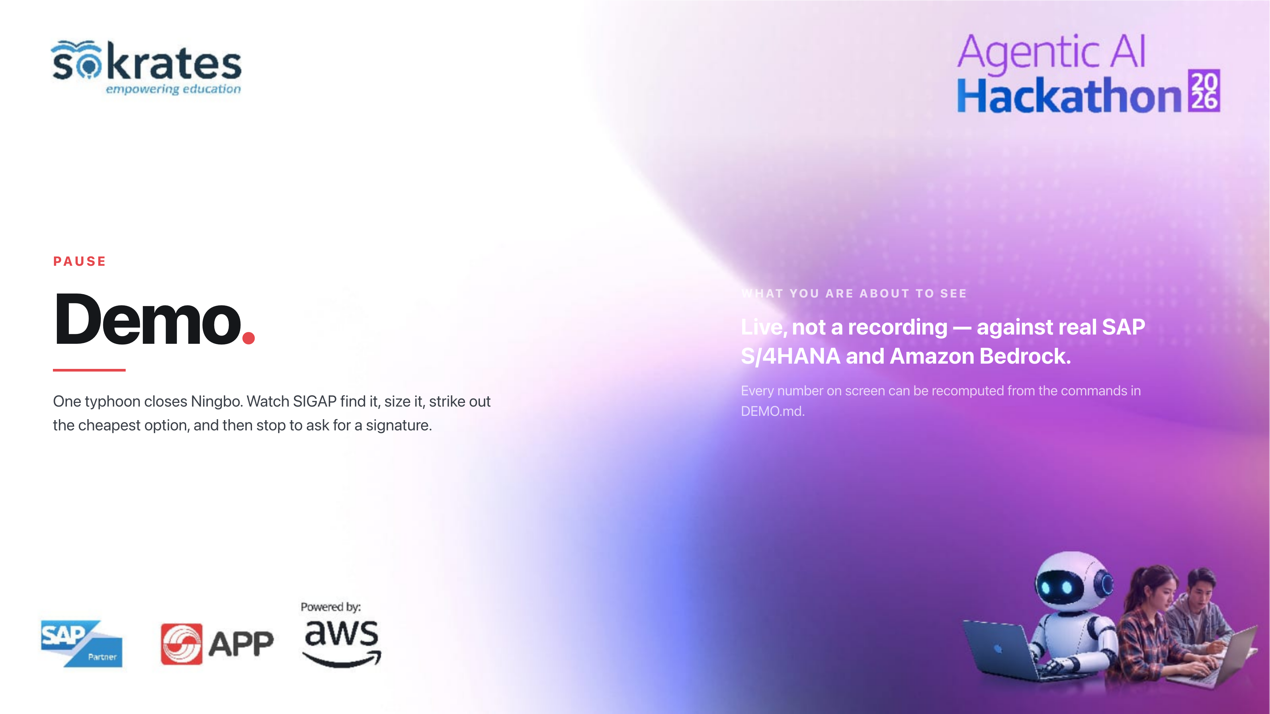
Notes:
Now the demo. One typhoon closes Ningbo. This is live against real SAP and real Bedrock. Watch three things: where each number comes from, where Kira strikes an option out, and where the system stops and asks for a signature.

Slide 7
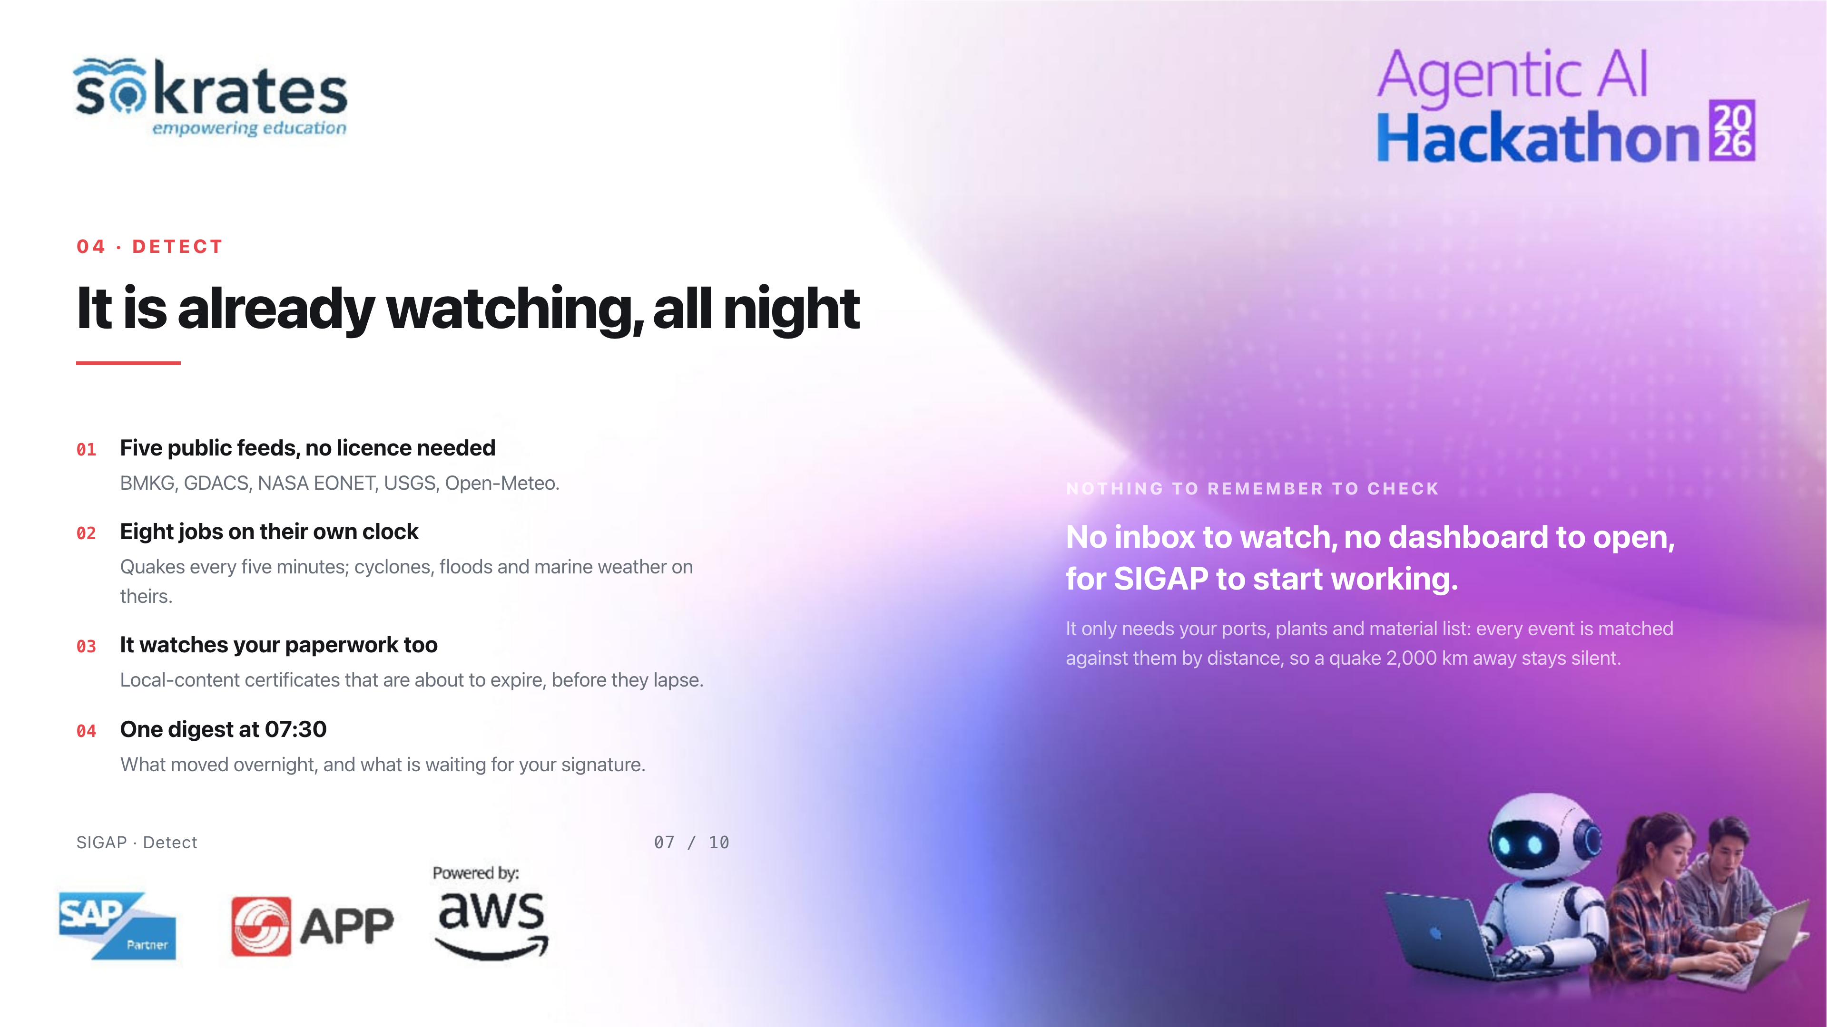
Notes:
Let me show you the features behind what you just saw. First, detection. SIGAP watches five public feeds — BMKG for quakes in Indonesia, GDACS, NASA EONET, USGS and Open-Meteo — on eight scheduled jobs. It also watches your own paperwork: local-content certificates about to expire. And at half past seven every morning it sends one digest of what moved overnight. Nobody has to remember to check anything.

Slide 8
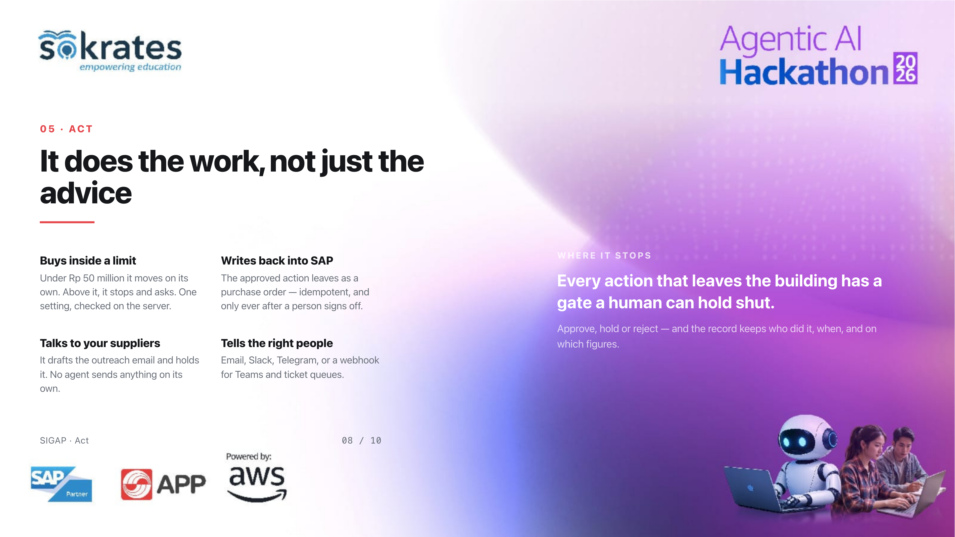
Notes:
Second, acting. Under 50 million rupiah it moves on its own; above that it stops and asks, and that limit is checked on the server, not in the prompt. The approved action leaves as a real purchase order into SAP. Supplier emails are drafted and held — no agent sends anything by itself. And the people who need to know are told, over email, Slack, Telegram or a webhook.

Slide 9
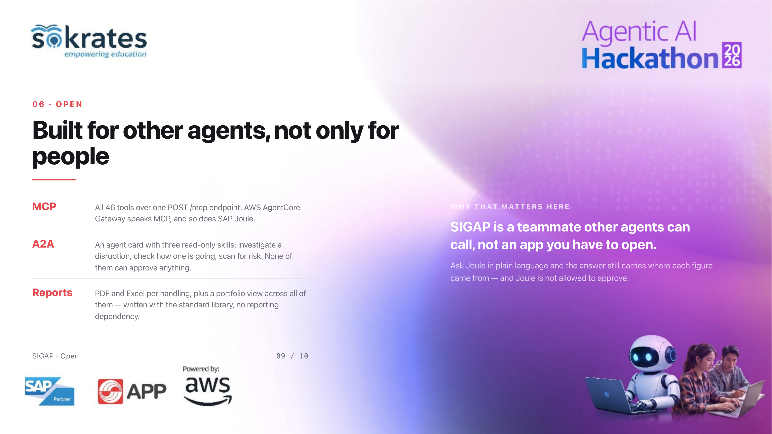
Notes:
Third, and this is the part we are proudest of in an agentic track: SIGAP is open. All 46 tools are exposed over a single MCP endpoint, which is what AWS AgentCore Gateway and SAP Joule both speak. There is an A2A agent card with three read-only skills, so another agent can hand SIGAP work. And every handling comes out as a PDF and an Excel file, with a portfolio view across all of them.

Slide 10
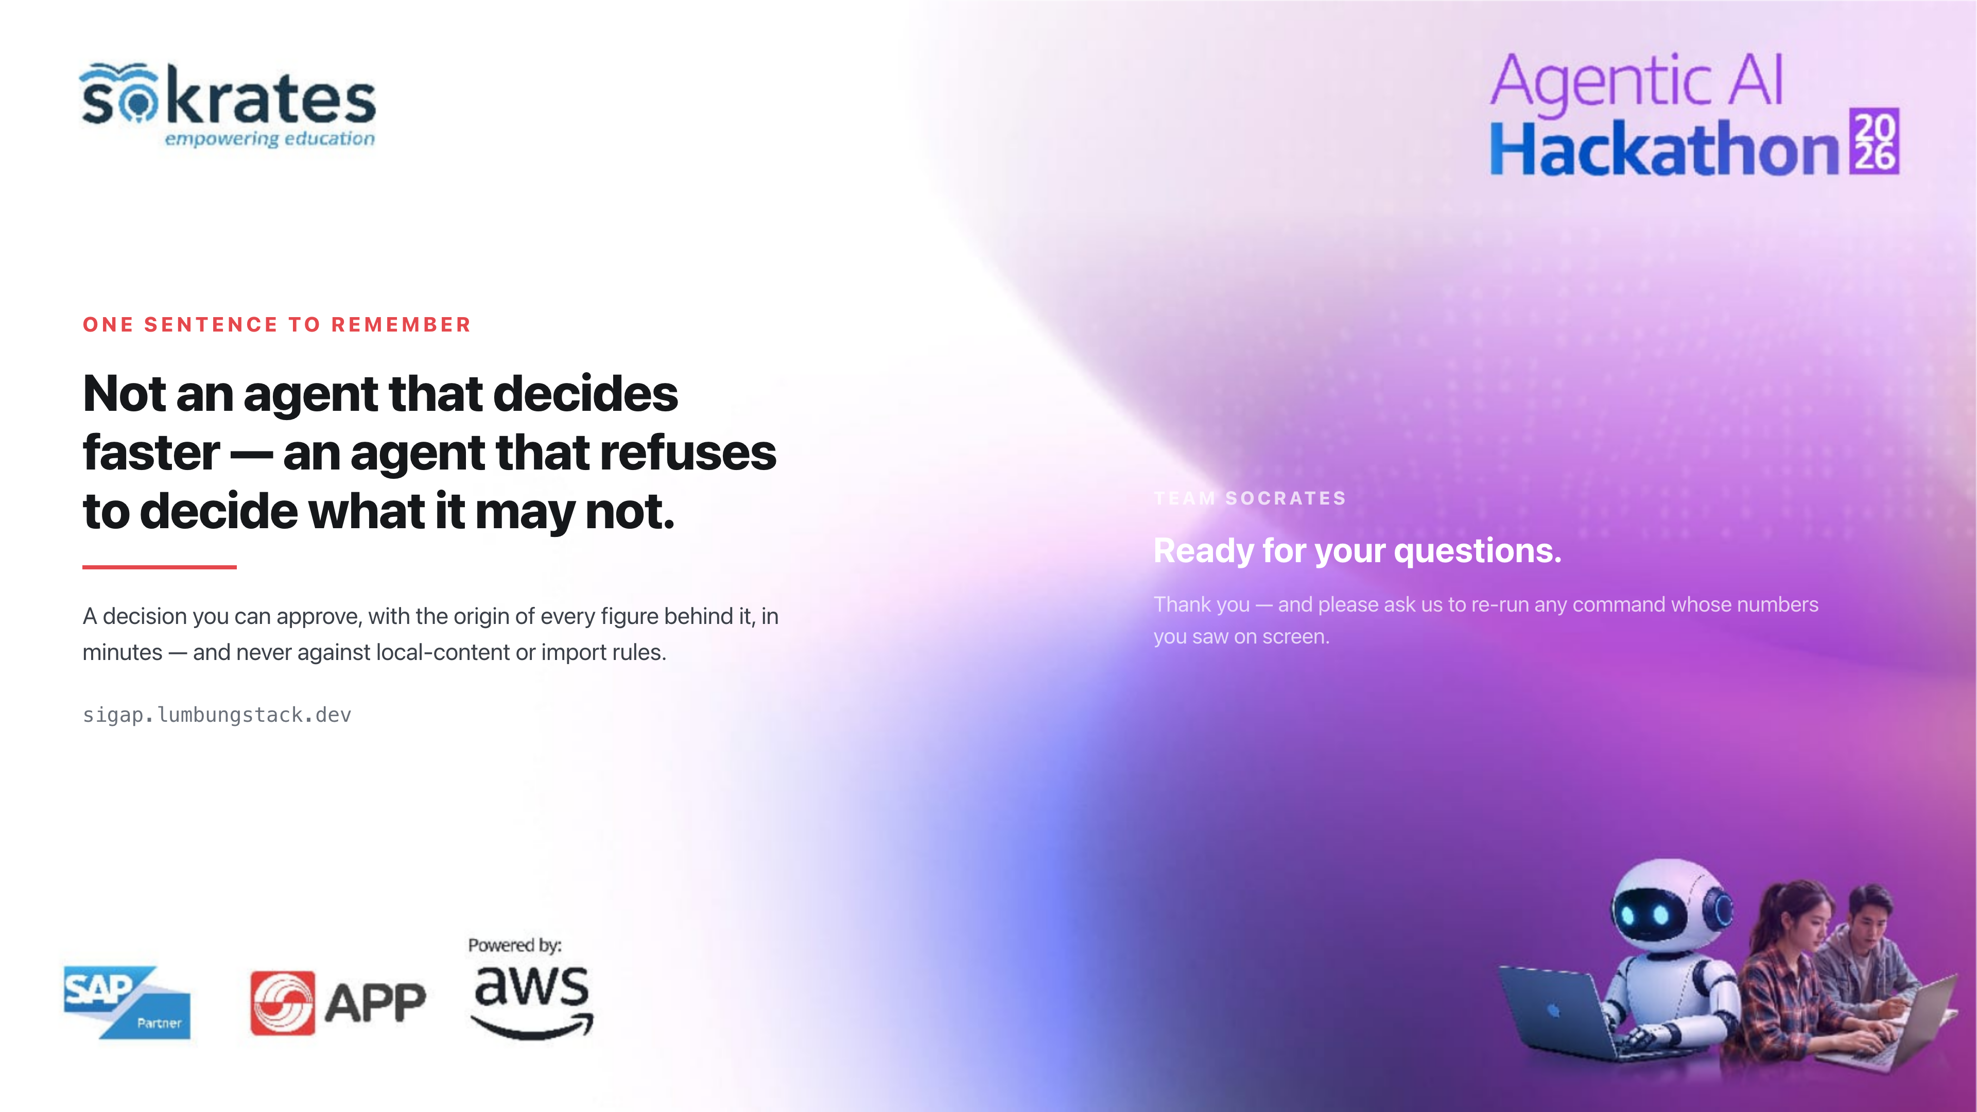
Notes:
One sentence to take away: this is not an agent that decides faster, it is an agent that refuses to decide what it may not. A decision you can approve, with the origin of every figure behind it, in minutes. Please ask us to re-run any command whose numbers you saw. Thank you.

