Slide 1

SAP + AWS AGENTIC AI HACKATHON 2026 · SUPPLY CHAIN
SIGAP
Supply disruptions handled before
anyone has to notice
Twelve agents read your SAP data, obey Indonesia’s local-
content and import rules, and put one decision you can
approve on your desk.
Team Socrates
APP Group
Live demo
Notes:
Hello, we are Team Socrates. SIGAP: supply disruptions handled before anyone has to notice. Ten pages, one of them a live demo. Let me start with why this is hard.

Slide 2
01 · THE PROBLEM
A port closes Monday. The
decision lands Thursday.
1
The news arrives on the wrong channel
WHERE THE MONEY ACTUALLY GOES
A headline, a WhatsApp group, a call from the forwarder.
The fastest decision is often the one that
was never allowed.
2
Three days of tracing it by hand
Excel, email, asking around: which orders are actually hit?
3
The decision is made on stale data
This is not a missing-ERP problem.
The numbers already moved on Tuesday.
The data is already in S/4HANA. What is missing are the hours between
the signal and the decision.
4
Then the reasoning disappears
Nothing records why. An audit becomes archaeology.
SIGAP · The problem
02 / 10
Notes:
When a port closes, dozens of materials stop with it. The expensive part is not the typhoon. It is three days of Excel and WhatsApp to find out which orders are hit, then deciding on numbers that moved two days ago, with nothing recording why. The data is already in S/4HANA. What is missing are the hours between the signal and the decision.

Slide 3
01 · THE PROBLEM
Two Indonesian rules that make
the cheapest option illegal
TKDN — local content
FROM THE LIVE DEMO
Regulation and most contracts set a floor on how much must be made in
Indonesia. Switching to an imported supplier pushes you under it.
Option E — Rp 48 million, the cheapest —
is struck out.
LARTAS — import restrictions
Local content falls to 34.8%.
A new country of origin needs permits, and permits do not arrive in a
week.
Not because it costs too much. Because it is not allowed — and a price
cannot overrule a rule.
Making the decision faster without enforcing these two is not progress. It is
faster contract breach.
SIGAP · The problem
03 / 10
Notes:
And there is a dimension that is specific to Indonesia. The cheapest replacement is almost always imported, and importing cuts your local-content score and runs into import restrictions. In the demo you will see option E, the cheapest at 48 million rupiah, struck out because local content falls to 34.8 per cent. Not because it costs too much. Because it is not allowed. So making the decision faster without enforcing these rules is not progress.

Slide 4
02 · THE SOLUTION
Twelve agents, one decision you
can sign
01
It watches instead of waiting
Public hazard feeds, every few minutes, nobody asked.
ONE AGENT HOLDS A VETO
02
Twelve agents read the real data
Kira blocks at two gates — when the
option is chosen, and again when the PO
is issued.
S/4HANA, master data, your uploads, the feeds.
03
Kira strikes out what is not allowed
Local content and import rules, before price gets a turn.
Tara puts a number on each option
The veto is code reading a rule pack, not a prompt. A cheaper option
cannot talk its way past it.
04
Cost, stock-out date, arrival date, local-content impact.
05
It acts inside its authority
Above that limit it stops and asks a person.
SIGAP · The solution
04 / 10
Notes:
SIGAP closes those hours. It watches public hazard feeds without being asked. Twelve agents read SAP and the supporting data. Kira strikes out what is not allowed before price gets a turn, and her veto sits at two gates: when the option is chosen, and again when the purchase order is issued. Tara puts a number on each surviving option. Then the system acts inside its authority, and stops to ask above it.

Slide 5
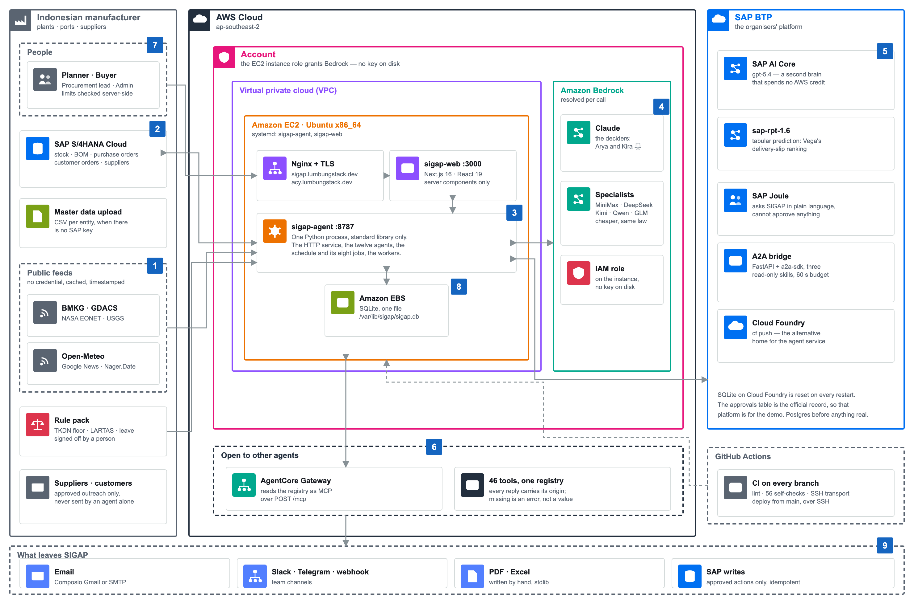
03 · ARCHITECTURE
AWS for the thinking, SAP for the data and the
doors
Agent service: Python 3, standard library only — http.server + sqlite3. This diagram is generated by sigap/architecture/diagram.py, not
drawn.
Notes:
The architecture: AWS for the thinking, Bedrock and AgentCore, and SAP for the data and the doors, S/4HANA and AI Core. The agent service is Python standard library only, http.server and sqlite3 — no orchestrator, no message broker. This diagram is generated from the code, not drawn by hand.

Slide 6
PAUSE
Demo.
WHAT YOU ARE ABOUT TO SEE
Live, not a recording — against real SAP
S/4HANA and Amazon Bedrock.
One typhoon closes Ningbo. Watch SIGAP find it, size it, strike out
the cheapest option, and then stop to ask for a signature.
Every number on screen can be recomputed from the commands in
DEMO.md.
Notes:
Now the demo. One typhoon closes Ningbo. This is live against real SAP and real Bedrock. Watch three things: where each number comes from, where Kira strikes an option out, and where the system stops and asks for a signature.

Slide 7
04 · DETECT
It is already watching, all night
01
Five public feeds, no licence needed
BMKG, GDACS, NASA EONET, USGS, Open-Meteo.
NOTHING TO REMEMBER TO CHECK
02
Eight jobs on their own clock
No inbox to watch, no dashboard to open,
for SIGAP to start working.
Quakes every five minutes; cyclones, floods and marine weather on
theirs.
03
It watches your paperwork too
It only needs your ports, plants and material list: every event is matched
against them by distance, so a quake 2,000 km away stays silent.
Local-content certificates that are about to expire, before they lapse.
04
One digest at 07:30
What moved overnight, and what is waiting for your signature.
SIGAP · Detect
07 / 10
Notes:
Let me show you the features behind what you just saw. First, detection. SIGAP watches five public feeds — BMKG for quakes in Indonesia, GDACS, NASA EONET, USGS and Open-Meteo — on eight scheduled jobs. It also watches your own paperwork: local-content certificates about to expire. And at half past seven every morning it sends one digest of what moved overnight. Nobody has to remember to check anything.

Slide 8
05 · ACT
It does the work, not just the
advice
Buys inside a limit
Writes back into SAP
WHERE IT STOPS
Under Rp 50 million it moves on its
own. Above it, it stops and asks. One
setting, checked on the server.
The approved action leaves as a
purchase order — idempotent, and
only ever after a person signs off.
Every action that leaves the building has a
gate a human can hold shut.
Approve, hold or reject — and the record keeps who did it, when, and on
which figures.
Talks to your suppliers
Tells the right people
It drafts the outreach email and holds
it. No agent sends anything on its
own.
Email, Slack, Telegram, or a webhook
for Teams and ticket queues.
SIGAP · Act
08 / 10
Notes:
Second, acting. Under 50 million rupiah it moves on its own; above that it stops and asks, and that limit is checked on the server, not in the prompt. The approved action leaves as a real purchase order into SAP. Supplier emails are drafted and held — no agent sends anything by itself. And the people who need to know are told, over email, Slack, Telegram or a webhook.

Slide 9
06 · OPEN
Built for other agents, not only for
people
MCP
All 46 tools over one POST /mcp endpoint. AWS AgentCore
Gateway speaks MCP, and so does SAP Joule.
WHY THAT MATTERS HERE
SIGAP is a teammate other agents can
call, not an app you have to open.
A2A
An agent card with three read-only skills: investigate a
disruption, check how one is going, scan for risk. None of
them can approve anything.
Ask Joule in plain language and the answer still carries where each figure
came from — and Joule is not allowed to approve.
Reports
PDF and Excel per handling, plus a portfolio view across all of
them — written with the standard library, no reporting
dependency.
SIGAP · Open
09 / 10
Notes:
Third, and this is the part we are proudest of in an agentic track: SIGAP is open. All 46 tools are exposed over a single MCP endpoint, which is what AWS AgentCore Gateway and SAP Joule both speak. There is an A2A agent card with three read-only skills, so another agent can hand SIGAP work. And every handling comes out as a PDF and an Excel file, with a portfolio view across all of them.

Slide 10
ONE SENTENCE TO REMEMBER
Not an agent that decides
faster — an agent that refuses
to decide what it may not.
TEAM SOCRATES
Ready for your questions.
A decision you can approve, with the origin of every figure behind it, in
minutes — and never against local-content or import rules.
Thank you — and please ask us to re-run any command whose numbers
you saw on screen.
sigap.lumbungstack.dev
Notes:
One sentence to take away: this is not an agent that decides faster, it is an agent that refuses to decide what it may not. A decision you can approve, with the origin of every figure behind it, in minutes. Please ask us to re-run any command whose numbers you saw. Thank you.

