Slide 1

ASTANA IT UNIVERSITY
TITLE
Development of an Intelligent Assistant for Data Preparation Automation in Urban Transportation Management Systems
Flowmatic - master's thesis defence | 7M06105 Computer Science and Engineering
Candidate: Ramazan Seiitbek
Supervisor: Aivar Sakhipov
School of Software Engineering, Astana IT University
Astana, Kazakhstan
June 2026
Problem
Method
Implementation
Evidence
Limits
Flowmatic master's thesis defence
Thesis v3 title page; official AITU template
01
Notes:
Takeaway: Flowmatic is presented as an evaluated research prototype, not as a production-certified municipal system. Explain the title, candidate, programme, supervisor, and year. Transition: the defence begins with the operational problem that motivates the platform.

Slide 2
ASTANA IT UNIVERSITY
RELEVANCE
Dirty transport data breaks the path from operations to analytics.
The research problem is not just missing values; it is the missing auditable preparation-to-inference chain.
CSV exports
API feeds
WebSocket telemetry
Sensor simulators
Research problem
Urban-transport preparation is often performed outside the model workflow, leaving weak lineage, inconsistent quality measurement, and unclear downstream impact.
Missing
Duplicates
Invalid GPS
Stale time
Forecasting
Anomaly detection
Imputation
Routing
Flowmatic master's thesis defence
Thesis v3 Sec. 1.1; recommendations: problem -> method -> result
02
Notes:
Takeaway: Flowmatic addresses the preparation chain, not generic traffic prediction. Explain heterogeneous sources, defects, and the downstream consequence. Limitation: no external accident statistics are used because the thesis evidence is about data preparation and analytics reliability. Transition to the gap.

Slide 3
ASTANA IT UNIVERSITY
GAP
The gap is measurement linkage, not a claim that no tools exist.
Existing systems solve parts of the workflow; the thesis evaluates the chain end to end within a prototype.
Existing solutions
Typical limit
Research gap
Flowmatic contribution
Scripts / notebooks
Hard to audit and replay
No shared evidence trail
DQI + cleaning + export records
ETL / MLOps tools
Model and prep tracked apart
Weak transport-specific validation
Preparation tied to model registry
ITS analytics
Models evaluated separately
Unclear impact of data defects
Stress tests + ablation + routing check
Contribution boundary: Flowmatic does not claim a new universal neural architecture, new DQI theory, or production-certified ITS deployment.
Flowmatic master's thesis defence
Thesis v3 Sec. 2.12-2.17; review Q1 risk S03/S07
03
Notes:
Takeaway: the novelty is framed against nearby systems without pretending they do not exist. Explain the four columns. This pre-empts 'why not pandas, Airflow, MLflow, or AutoML'. Transition to aim and research questions.

Slide 4
ASTANA IT UNIVERSITY
AIM
The aim is implemented through six objectives and four scoped questions.
Each research question is tied to measurable evidence and a visible limitation.
Aim
Develop and evaluate an intelligent software platform for automated transport-data preparation with DQI, reproducible preprocessing, and downstream model integration.
Object
Data preparation process in urban transportation management systems.
Subject
Software mechanisms for quality assessment, preprocessing, routing, and model-ready data preparation.
RQ1
DQI recovery under corruption
RQ2
Batch and streaming prototype operation
RQ3
Model portfolio vs simple baselines
RQ4
Rule-router policy conformance
Flowmatic master's thesis defence
Thesis v3 Sec. 1.2, 3.3, 5.9
04
Notes:
Takeaway: the thesis is research because objectives are tested through measurable protocols. State aim in one sentence. Explain object and subject. Transition to novelty boundaries.

Slide 5
ASTANA IT UNIVERSITY
NOVELTY
The scientific claim is the evaluated chain, not the existence of the platform.
Prior publications and standard components are separated from thesis-new evidence.
Scientific contribution
Linked evaluation protocol: DQI recovery, downstream-model effect, routing conformance, and reproducibility artifacts.
Engineering contribution
Containerised Flowmatic prototype: Vue, NestJS, PostgreSQL, MinIO, RabbitMQ, simulators, inference service.
Thesis-new evidence
Corruption stress test, baseline tables, preparation ablation, 140-event routing check, explicit limitation ledger.
Not claimed: new neural architecture, learned router, universal DQI theory, or live municipal production deployment.
Flowmatic master's thesis defence
Thesis v3 Sec. 1.3, 2.13.1, Appendix A; review W1
05
Notes:
Takeaway: this slide answers 'what is new compared with your prior publication'. Explain that platform concepts are continued, while the defence rests on new evaluation: stress tests, baselines, ablation, routing conformance, and reproducibility. Transition to method.

Slide 6
ASTANA IT UNIVERSITY
METHODOLOGY
The research workflow tests the artefact under controlled, reproducible conditions.
Literature + gap
Artifact design
Implementation
Dataset prep
Corruption injection
Temporal splits
Baselines
Ablations
Routing replay
Latency checks
Hugging Face artifacts
Threats to validity
Falsifiable centre: if preparation does not improve quality or downstream behavior under controlled defects, the main thesis claim weakens.
Flowmatic master's thesis defence
Thesis v3 Ch. 3, Ch. 5; recommendations: research pipeline
06
Notes:
Takeaway: design-build-evaluate is made scientific through testable protocols. Walk from literature to artifact to stress tests, baselines, ablations, and reproducibility. Transition to data scope.

Slide 7
ASTANA IT UNIVERSITY
DATA SCOPE
The evidence is reproducible, but not all data are externally real-world validated.
This slide makes semi-synthetic and simulated data visible before results appear.
Dataset
Provenance
Scale
Use
Limit
Astana traffic
NDA-derived semi-synthetic
30,000 rows
Batch API, stress, forecasting
Reproducible CSV; source calibration limited
HF weather / ETT / traffic
Public bundles
Offline windows
Neural training
Not all re-uploaded through Nest API
Simulator events
Generated HTTP/WebSocket
140 routing events
Auto routing check
Policy-aligned labels
Injected defects/anomalies
Controlled perturbation
0-20% corruption
Stress / TranAD AUROC
Not municipal incident labels
Flowmatic master's thesis defence
Thesis v3 Sec. 3.4, 5.2.1, Appendix C
07
Notes:
Takeaway: trust comes from transparent provenance, not pretending the data are fully public municipal logs. Explain Astana semi-synthetic, HF datasets, simulated feeds, injected anomalies, and rule labels. Transition to DQI method.

Slide 8
ASTANA IT UNIVERSITY
PREPARATION
DQI makes preparation auditable before data reach models.
Six dimensions are operationalised through profiling, rules, cleaning, and export records.
Raw input
Profiling
Six-D DQI
Repair / reject
Prepared data
Audit artifact
Completeness
Consistency
Accuracy
Timeliness
Uniqueness
Validity
Important boundary: at 20% corruption, quality recovery includes row rejection; it is not purely in-place imputation.
Flowmatic master's thesis defence
Thesis v3 Sec. 3.6-3.7; quality.service.ts; cleaning.service.ts
08
Notes:
Takeaway: the DQI is an operational adaptation of known data-quality dimensions. Explain six dimensions and the raw->profile->DQI->repair/reject->prepared->audit flow. Transition to architecture.

Slide 9
ASTANA IT UNIVERSITY
ARCHITECTURE
Flowmatic connects auditable preparation with task-specific inference.
PostgreSQL
metadata + tenancy
Vue frontend
Upload + smart-city workbench
NestJS API
Auth, ingestion, quality, cleaning, export
Model registry
local + HF metadata
Inference service
TorchScript/Python API
MinIO/S3
raw + cleaned files
RabbitMQ
async jobs
Optional / not central evaluation: LLM narration and federated coordinator demo. They are prototype features, not the basis of the scientific claim.
Flowmatic master's thesis defence
docker-compose.yml; Prisma schema; backend smart-city/model registry modules
09
Notes:
Takeaway: this is a real multi-service prototype. Walk left to right: frontend, backend modules, queue/storage/db, simulator, inference, registry. Clarify optional LLM and federated demo are not central evaluated claims. Transition to intelligence definition.

Slide 10
ASTANA IT UNIVERSITY
ASSISTANT
The system is intelligent as a bounded hybrid assistant, not as general AI.
Automation combines deterministic diagnostics, policy routing, learned models, and operator control.
Profiling
DQI rules
Preparation decisions
Payload profile
Policy routing
Learned inference
Operator output
Deterministic automation
schema checks, missing values, duplicates, ranges, stale records
Policy decisions
Manual or Auto routing through metadata and priority rules
Task-specific learning
forecasting, anomaly, imputation, severity classification
LLM narration is optional and not used as the scientific basis of the thesis.
Flowmatic master's thesis defence
pipeline-model-router.service.ts; model registry; thesis v3 Sec. 3.11
10
Notes:
Takeaway: answer 'why intelligent assistant?' precisely. Deterministic checks and rules are legitimate automation; learned components are task-specific. Operator remains in control. Transition to experimental protocol.

Slide 11
ASTANA IT UNIVERSITY
PROTOCOL
The experiment design separates leakage control from statistical strength.
Temporal hold-out is strong; three-seed variability should be read descriptively.
Leakage controls
Temporal split, scalers fitted on train, fixed test tail, identical partition for baselines.
70% train
15% validation
15% test
Seeds
42, 7, 2026
Metrics
RMSE, macro-F1, AUROC, masked MSE
Caution
No broad significance claim from n=3
Flowmatic master's thesis defence
Thesis v3 Sec. 5.2.2; review W3
11
Notes:
Takeaway: the split prevents direct row leakage, but n=3 is limited. Say values are multi-seed descriptive variability, not broad statistical significance. Transition to stress test results.

Slide 12
ASTANA IT UNIVERSITY
RQ1
Preparation recovered measurable quality, partly by rejecting invalid records.
At 20% corruption, DQI improved from 0.788 to 0.833 while 987 rows were dropped.
0%
0.833 -> 0.833
0.788
0.833
Before
After
1%
0.831 -> 0.833
20% corruption
cleaning
5%
0.823 -> 0.833
987
10%
0.811 -> 0.833
Rows dropped
9.87% of 10,000
20%
0.788 -> 0.833
Interpretation
Quality recovery is measurable, but the mechanism is auditably conservative: reject or repair defective records.
Flowmatic master's thesis defence
thesis_v2_evidence.json; generated_tables.tex
12
Notes:
Takeaway: the best preparation evidence is the stress test, not the clean 100/100 upload. Explain red/green bars and row drops. Scope boundary: row rejection can remove potentially useful rare records. Transition to model evidence.

Slide 13
ASTANA IT UNIVERSITY
RQ3
Downstream results support capability, with explicit task limits.
Metrics are separated by task to avoid pretending RMSE, F1, AUROC, and MSE are comparable.
Task
Model
Headline
Scope note
Forecast
PatchTST density
0.561 RMSE
vs naive z-RMSE 1.063
Classification
Transformer severity
0.911 macro-F1
rule-based labels
Anomaly
TranAD
0.841 AUROC
injected point anomalies
Imputation
SAITS
0.640 masked MSE
vs mean baseline 1.000
Defence framing: the models certify task slots inside Flowmatic; they do not establish a new forecasting or classification algorithm.
Flowmatic master's thesis defence
multi_seed_aggregate.md; generated_baselines.tex; thesis_v2_evidence.json
13
Notes:
Takeaway: the portfolio is evidence for integrated task slots, not SOTA benchmarking. Mention key comparators and caveats: rule labels, injected anomalies, z-score windows. Transition to ablation.

Slide 14
ASTANA IT UNIVERSITY
ABLATION
Preparation improved forecasting under a controlled upper-bound experiment.
PatchTST RMSE dropped from 0.9045 to 0.5802 after oracle-style restoration on 20% corrupted data.
Prep off
0.9045
0.3243
20%
RMSE delta
Corruption
lower is better
controlled input
Prep on
0.5802
What it proves
Restoring lost information improves downstream prediction under controlled corruption.
What it does not prove
A deployable imputation method will recover the same amount on live municipal data.
Flowmatic master's thesis defence
thesis_v2_evidence.json; generated_prep_ablation.tex
14
Notes:
Takeaway: this is the strongest preparation-to-downstream linkage, but it is not deployable imputation performance. State 'oracle restoration upper-bound' before the examiner does. Transition to implementation/performance.

Slide 15
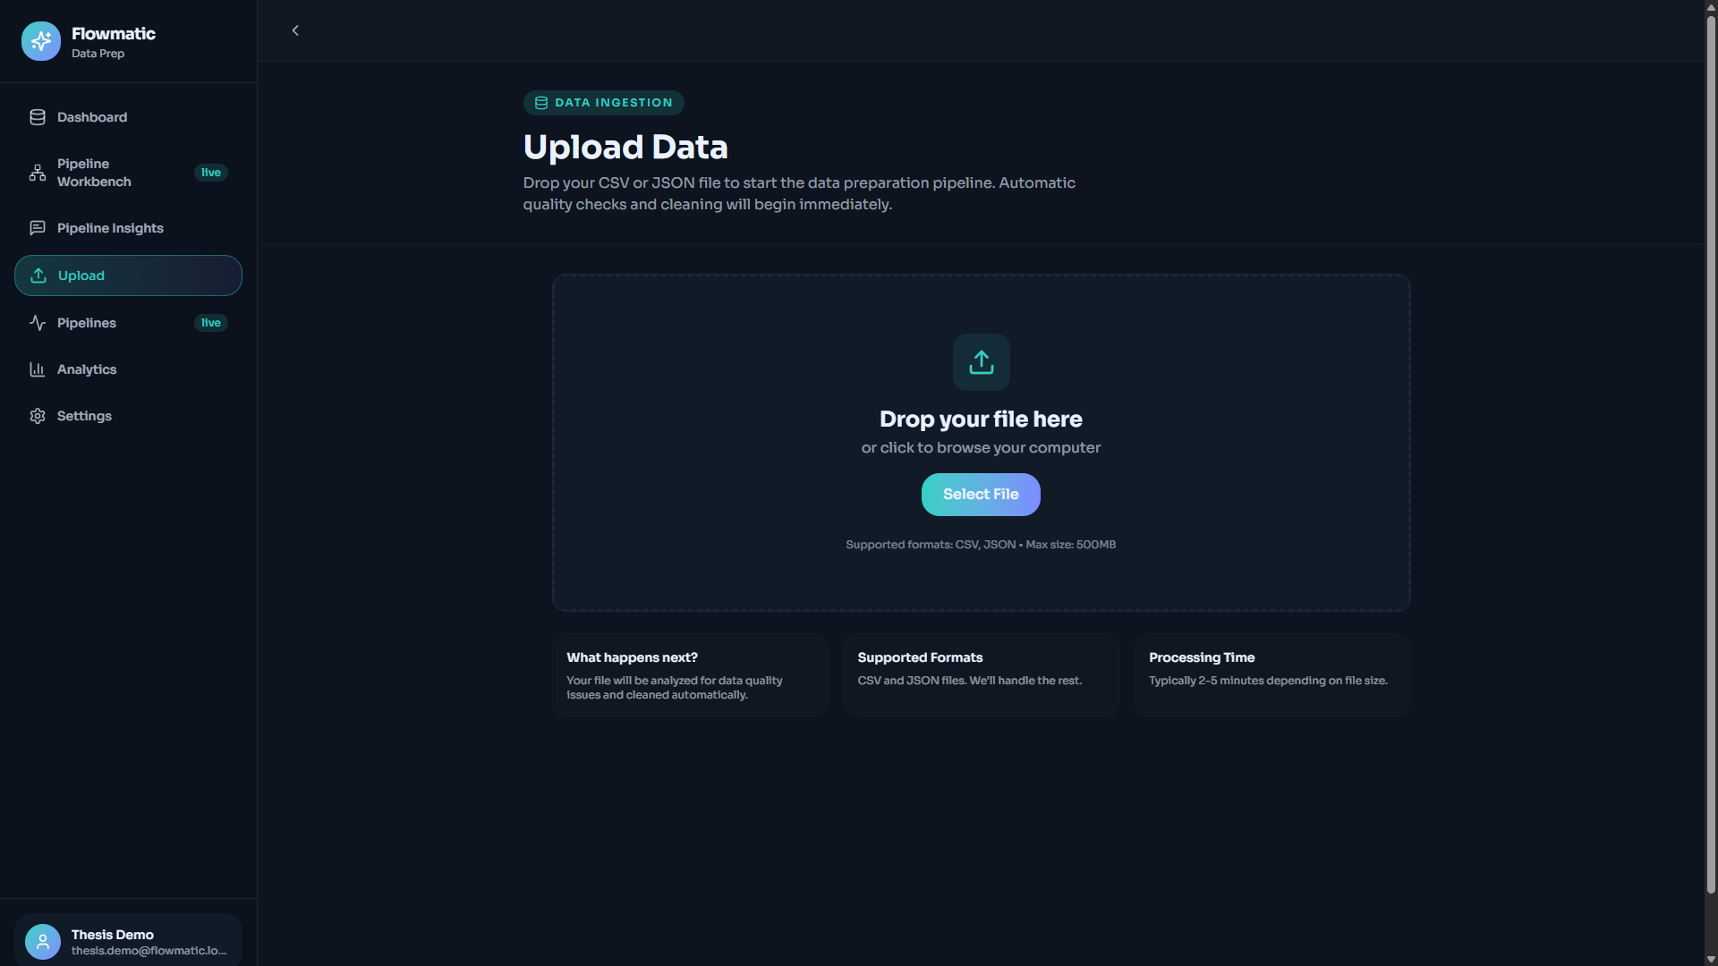
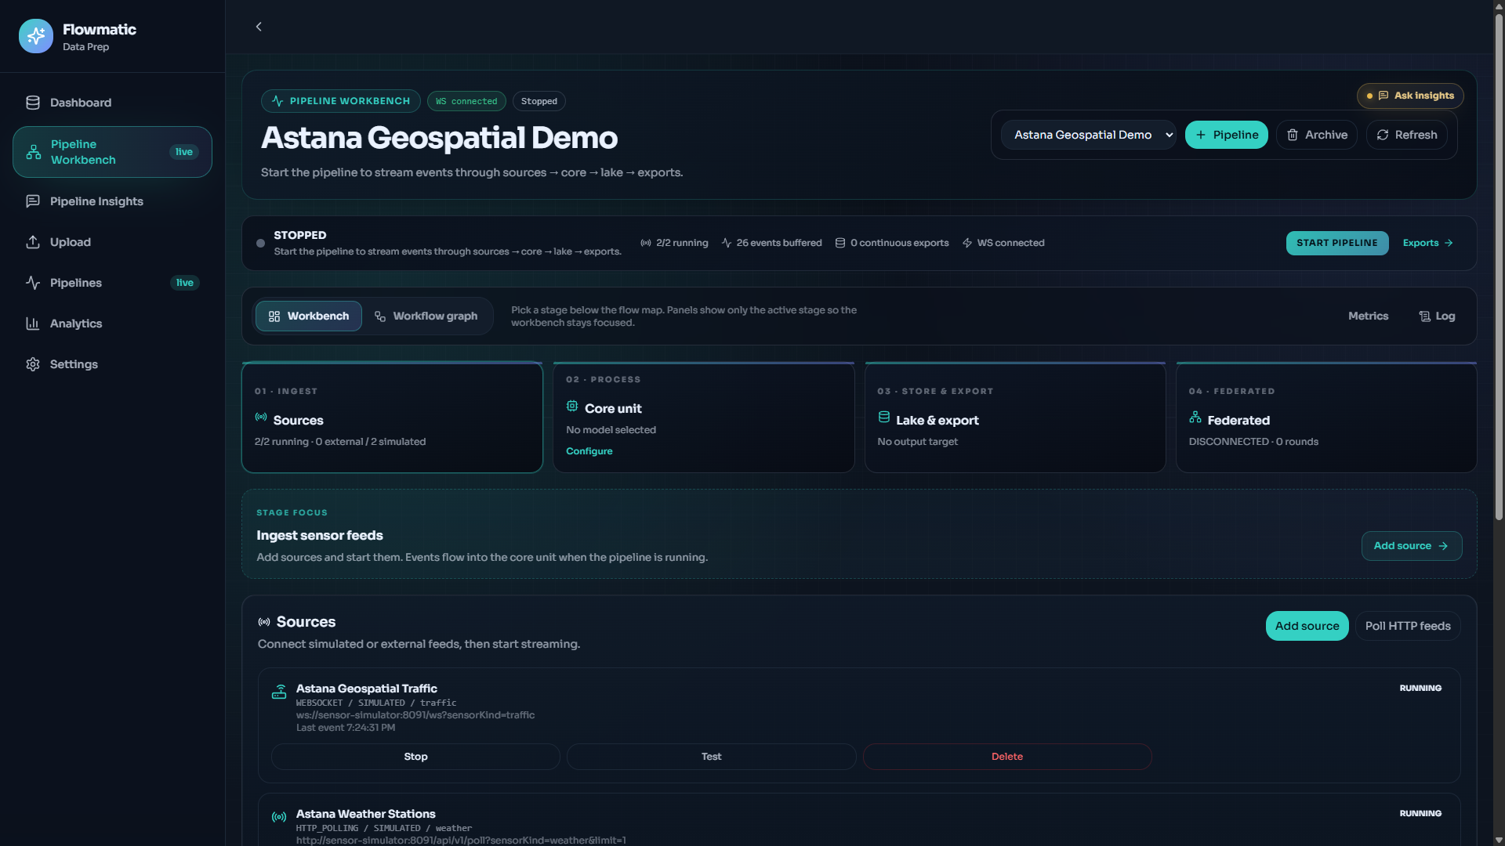
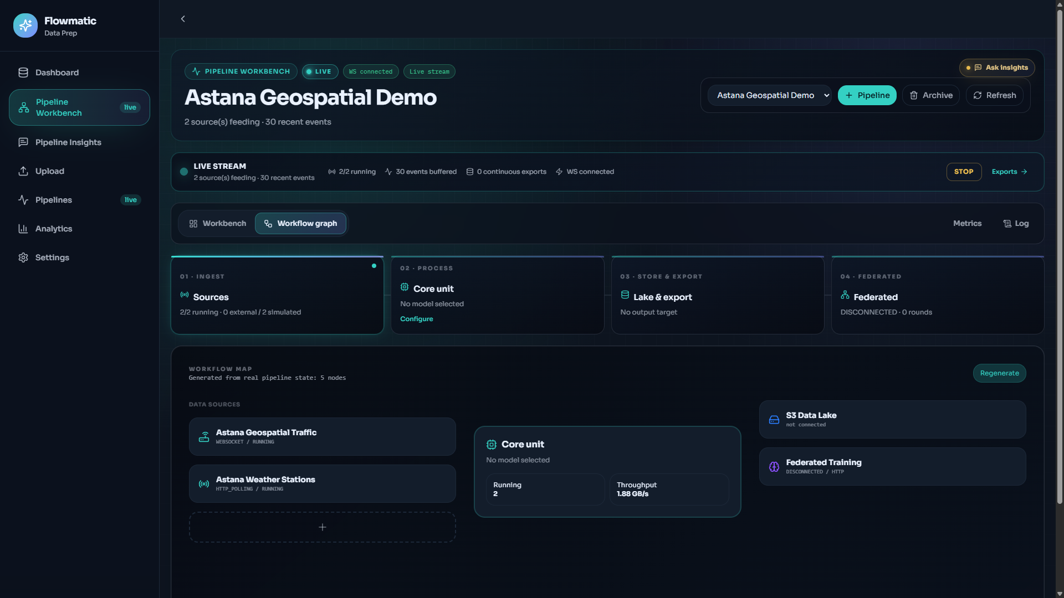
ASTANA IT UNIVERSITY
IMPLEMENTATION
The prototype works, but the measured boundary matters.
Use core processing and inference-latency numbers without turning them into production SLA claims.
406 ms
<2 ms
Docker
Not claimed
No HA, SLA, penetration test, formal municipal deployment, or concurrency p95/p99 study.
Batch processing
Compact inference
Prototype stack
30,000-row Astana export
single-event benchmark
local Compose topology
Flowmatic master's thesis defence
UPLOAD_PIPELINE_REPORT.md; streaming_benchmark.csv; thesis screenshots
15
Notes:
Takeaway: Flowmatic is real and measurable, but not production certified. Explain the timing boundaries: 406 ms batch processing, TorchScript latency from benchmark, not full wall-clock SLA. Transition to RQ closure.

Slide 16
ASTANA IT UNIVERSITY
CLOSURE
Each research question has evidence and an explicit scope limit.
RQ
Evidence
Outcome
Scope limit
RQ1
DQI before/after stress test
Supported under corruption
clean files show ceiling effect
RQ2
406 ms batch + smart-city demo
Supported for prototype
Astana API validation only
RQ3
baselines, portfolio, ablations
Supported by task
limited baselines / n=3
RQ4
140-event routing replay
Supported as conformance
not expert-labelled accuracy
Flowmatic master's thesis defence
Thesis v3 Table 5.19 / Sec. 5.9
16
Notes:
Takeaway: this is the defence consolidation slide. Walk each row quickly: supported, evidence, scope limit. Transition to personal contribution and publications.

Slide 17
ASTANA IT UNIVERSITY
CONTRIBUTION
My contribution is the integrated implementation and thesis-new evaluation package.
Prior publications are supporting context; thesis claims are tied to new or extended artefacts.
Personal thesis work
Architecture integration, backend/frontend modules, data-quality and routing logic, experiment scripts, evidence audit, thesis narrative.
Shared / prior work
Co-authored publications, standard neural architectures, open-source frameworks, and source data constraints.
Thesis-new evidence
Stress tests, baseline comparisons, ablation, routing-conformance evaluation, limitation framing, reproducibility pack.
Defence line: the publications show continuity; the thesis is defended through the new evaluated preparation-to-inference evidence chain.
Flowmatic master's thesis defence
Thesis v3 Appendix A; review W1/S05
17
Notes:
Takeaway: do not say 'I did everything'. Say exactly what belongs to the thesis: platform integration, scripts, experiments, analysis, and defensible writing. Transition to conclusion.

Slide 18
ASTANA IT UNIVERSITY
CONCLUSION
Flowmatic is an evaluated research prototype for auditable transport-data preparation.
The strongest claim is narrow and defensible: controlled preparation evidence can be linked to downstream model behaviour.
Achieved
Working prototype, DQI workflow, model registry, inference service, reproducible experiments.
Evidence supports
Quality recovery under controlled defects, model-slot capability, and policy-conformant routing.
Remaining work
Real external data, independent labels, deployable imputation, operator study, security/scale tests.
Core statement: Flowmatic makes preparation measurable, reproducible, and connected to downstream analytics - with limitations visible rather than hidden.
Flowmatic master's thesis defence
Thesis v3 Ch. 6; review final verdict
18
Notes:
Takeaway: finish with the honest thesis-level statement. What was achieved: platform, methodology, evidence, reproducibility. What remains: real external data, independent labels, stronger baselines, operator study, security and scaling validation. Invite questions.

Slide 19
ASTANA IT UNIVERSITY
BACKUP
Backup slides for commission questions
Definitions, reconciliations, evidence tables, architecture limits, and exact numbers.
Flowmatic master's thesis defence
19
Notes:
Use these slides only when asked. They are designed to answer the adversarial question bank without overloading the main deck.

Slide 20
ASTANA IT UNIVERSITY
BACKUP
DQI definitions and formula
Pre-empts: why these dimensions and why equal weights.
Composite DQI = sum(w_i Q_i) / sum(w_i), Q_i in [0,1]. Default weights are equal. Dimensions: completeness, consistency, accuracy, timeliness, uniqueness, validity.
Pre-empts: why these dimensions and why equal weights.
Source: Thesis Sec. 3.6
Flowmatic master's thesis defence
Thesis Sec. 3.6
20
Notes:
Backup takeaway: DQI definitions and formula. Direct answer: Composite DQI = sum(w_i Q_i) / sum(w_i), Q_i in [0,1]. Default weights are equal. Dimensions: completeness, consistency, accuracy, timeliness, uniqueness, validity. Scope: use only when asked and keep the main narrative concise.

Slide 21
ASTANA IT UNIVERSITY
BACKUP
Clean 100/100 vs stress-test 0.833
Pre-empts: DQI inconsistency question.
Clean batch 100/100 is the platform quality score for a pristine 30,000-row upload. Stress-test 0.833 is the composite formula where timeliness is zero in that generated sample.
Pre-empts: DQI inconsistency question.
Source: Table 4.1; Table 5.9; evidence JSON
Flowmatic master's thesis defence
Table 4.1; Table 5.9; evidence JSON
21
Notes:
Backup takeaway: Clean 100/100 vs stress-test 0.833. Direct answer: Clean batch 100/100 is the platform quality score for a pristine 30,000-row upload. Stress-test 0.833 is the composite formula where timeliness is zero in that generated sample. Scope: use only when asked and keep the main narrative concise.

Slide 22
ASTANA IT UNIVERSITY
BACKUP
Dataset facts
Pre-empts: why trust semi-synthetic data.
Astana: 30,000 semi-synthetic NDA-derived rows. HF weather, ETT, traffic graph: offline neural bundles. Simulator: HTTP/WebSocket events. Labels and anomalies are generated or injected where stated.
Pre-empts: why trust semi-synthetic data.
Source: Appendix C; Sec. 5.2.1
Flowmatic master's thesis defence
Appendix C; Sec. 5.2.1
22
Notes:
Backup takeaway: Dataset facts. Direct answer: Astana: 30,000 semi-synthetic NDA-derived rows. HF weather, ETT, traffic graph: offline neural bundles. Simulator: HTTP/WebSocket events. Labels and anomalies are generated or injected where stated. Scope: use only when asked and keep the main narrative concise.

Slide 23
ASTANA IT UNIVERSITY
BACKUP
Split, leakage, uncertainty
Pre-empts: n=3 CI and leakage questions.
Temporal 70/15/15 split; scalers fit on training data; three seeds 42, 7, 2026. Treat +/- values as descriptive multi-seed variability, not strong significance testing.
Pre-empts: n=3 CI and leakage questions.
Source: Sec. 5.2.2
Flowmatic master's thesis defence
Sec. 5.2.2
23
Notes:
Backup takeaway: Split, leakage, uncertainty. Direct answer: Temporal 70/15/15 split; scalers fit on training data; three seeds 42, 7, 2026. Treat +/- values as descriptive multi-seed variability, not strong significance testing. Scope: use only when asked and keep the main narrative concise.

Slide 24
ASTANA IT UNIVERSITY
BACKUP
Baseline table
Pre-empts: compared to what?
Naive z-RMSE 1.063 vs PatchTST 0.5609; majority 0.317, logistic 0.449, random forest 0.627, Transformer 0.911; mean imputation 1.000 vs SAITS 0.640.
Pre-empts: compared to what?
Source: generated_baselines.tex
Flowmatic master's thesis defence
generated_baselines.tex
24
Notes:
Backup takeaway: Baseline table. Direct answer: Naive z-RMSE 1.063 vs PatchTST 0.5609; majority 0.317, logistic 0.449, random forest 0.627, Transformer 0.911; mean imputation 1.000 vs SAITS 0.640. Scope: use only when asked and keep the main narrative concise.

Slide 25
ASTANA IT UNIVERSITY
BACKUP
Neural portfolio
Pre-empts: model zoo and registry questions.
Seven primary slots plus auxiliary iTransformer: PatchTST, TranAD, TimesBlock, STGCN, SAITS, Transformer classifier, DLinear, iTransformer speed slot.
Pre-empts: model zoo and registry questions.
Source: production_portfolio.json
Flowmatic master's thesis defence
production_portfolio.json
25
Notes:
Backup takeaway: Neural portfolio. Direct answer: Seven primary slots plus auxiliary iTransformer: PatchTST, TranAD, TimesBlock, STGCN, SAITS, Transformer classifier, DLinear, iTransformer speed slot. Scope: use only when asked and keep the main narrative concise.

Slide 26
ASTANA IT UNIVERSITY
BACKUP
iTransformer interpretation
Pre-empts: why keep weak model.
Level-speed RMSE is near 1.0; first-difference retune reaches 0.7586. The slot is retained as auxiliary/deployment parity, not as a headline success.
Pre-empts: why keep weak model.
Source: generated_itransformer_retrain.tex
Flowmatic master's thesis defence
generated_itransformer_retrain.tex
26
Notes:
Backup takeaway: iTransformer interpretation. Direct answer: Level-speed RMSE is near 1.0; first-difference retune reaches 0.7586. The slot is retained as auxiliary/deployment parity, not as a headline success. Scope: use only when asked and keep the main narrative concise.

Slide 27
ASTANA IT UNIVERSITY
BACKUP
Routing scope
Pre-empts: is 100% circular?
140 simulator events: 7 scenarios x 20 events. 100% policy conformance checks implementation consistency against documented scenario oracles; not optimal routing accuracy.
Pre-empts: is 100% circular?
Source: generated_tables.tex
Flowmatic master's thesis defence
generated_tables.tex
27
Notes:
Backup takeaway: Routing scope. Direct answer: 140 simulator events: 7 scenarios x 20 events. 100% policy conformance checks implementation consistency against documented scenario oracles; not optimal routing accuracy. Scope: use only when asked and keep the main narrative concise.

Slide 28
ASTANA IT UNIVERSITY
BACKUP
Oracle restoration ablation
Pre-empts: did you use ground truth?
20% corrupted Astana density, PatchTST RMSE 0.9045 -> 0.5802. This is an upper-bound controlled information-recovery experiment, not deployable imputation proof.
Pre-empts: did you use ground truth?
Source: generated_prep_ablation.tex
Flowmatic master's thesis defence
generated_prep_ablation.tex
28
Notes:
Backup takeaway: Oracle restoration ablation. Direct answer: 20% corrupted Astana density, PatchTST RMSE 0.9045 -> 0.5802. This is an upper-bound controlled information-recovery experiment, not deployable imputation proof. Scope: use only when asked and keep the main narrative concise.

Slide 29
ASTANA IT UNIVERSITY
BACKUP
Prior publication vs thesis-new
Pre-empts: overlap with [15].
Prior work: concept/platform continuity and co-authored publications. Thesis-new: stress tests, baselines, ablation, 140-event routing check, reproducibility and limitation framing.
Pre-empts: overlap with [15].
Source: Appendix A; Sec. 2.13.1
Flowmatic master's thesis defence
Appendix A; Sec. 2.13.1
29
Notes:
Backup takeaway: Prior publication vs thesis-new. Direct answer: Prior work: concept/platform continuity and co-authored publications. Thesis-new: stress tests, baselines, ablation, 140-event routing check, reproducibility and limitation framing. Scope: use only when asked and keep the main narrative concise.

Slide 30
ASTANA IT UNIVERSITY
BACKUP
Personal contribution matrix
Pre-empts: what exactly did you do?
Own work: integration, implementation, scripts, experiments, analysis, defence framing. Shared: supervisor guidance, co-authored papers, public models/libraries, NDA-derived data source.
Pre-empts: what exactly did you do?
Source: Appendix A; repository evidence
Flowmatic master's thesis defence
Appendix A; repository evidence
30
Notes:
Backup takeaway: Personal contribution matrix. Direct answer: Own work: integration, implementation, scripts, experiments, analysis, defence framing. Shared: supervisor guidance, co-authored papers, public models/libraries, NDA-derived data source. Scope: use only when asked and keep the main narrative concise.

Slide 31
ASTANA IT UNIVERSITY
BACKUP
Technology roles
Pre-empts: why this stack?
Vue for workbench; NestJS for API; PostgreSQL for metadata; MinIO for object storage; RabbitMQ for jobs; Python service for TorchScript inference; HF for model publication.
Pre-empts: why this stack?
Source: docker-compose.yml; Prisma schema
Flowmatic master's thesis defence
docker-compose.yml; Prisma schema
31
Notes:
Backup takeaway: Technology roles. Direct answer: Vue for workbench; NestJS for API; PostgreSQL for metadata; MinIO for object storage; RabbitMQ for jobs; Python service for TorchScript inference; HF for model publication. Scope: use only when asked and keep the main narrative concise.

Slide 32
ASTANA IT UNIVERSITY
BACKUP
Codebase/module map
Pre-empts: walk through the code.
Backend: auth, ingestion, quality, cleaning, export, smart-city, registry/router. Frontend: upload, connectors, dashboard, insights. Services: simulator, inference, federated demo.
Pre-empts: walk through the code.
Source: repo map
Flowmatic master's thesis defence
repo map
32
Notes:
Backup takeaway: Codebase/module map. Direct answer: Backend: auth, ingestion, quality, cleaning, export, smart-city, registry/router. Frontend: upload, connectors, dashboard, insights. Services: simulator, inference, federated demo. Scope: use only when asked and keep the main narrative concise.

Slide 33
ASTANA IT UNIVERSITY
BACKUP
Failure handling limits
Pre-empts: production architecture attack.
Current prototype has queues and storage, but no full DLQ/retry/idempotency proof, no p95/p99 concurrency benchmark, and preview loading can buffer large result files.
Pre-empts: production architecture attack.
Source: code audit
Flowmatic master's thesis defence
code audit
33
Notes:
Backup takeaway: Failure handling limits. Direct answer: Current prototype has queues and storage, but no full DLQ/retry/idempotency proof, no p95/p99 concurrency benchmark, and preview loading can buffer large result files. Scope: use only when asked and keep the main narrative concise.

Slide 34
ASTANA IT UNIVERSITY
BACKUP
Security and production roadmap
Pre-empts: production readiness.
Current auth and org scoping exist. Needed before municipal pilot: threat model, upload sandboxing, model artifact validation, secret governance, HA, backup/restore, audit logs.
Pre-empts: production readiness.
Source: Prisma schema; security middleware
Flowmatic master's thesis defence
Prisma schema; security middleware
34
Notes:
Backup takeaway: Security and production roadmap. Direct answer: Current auth and org scoping exist. Needed before municipal pilot: threat model, upload sandboxing, model artifact validation, secret governance, HA, backup/restore, audit logs. Scope: use only when asked and keep the main narrative concise.

Slide 35
ASTANA IT UNIVERSITY
BACKUP
Reproducibility and exact numbers
Pre-empts: exact-number questions.
Exact numbers to remember: 30,000 rows; 406 ms; DQI +0.045 at 20%; 987 rows dropped; PatchTST 0.5609; F1 0.911; AUROC 0.8411; routing 140/140.
Pre-empts: exact-number questions.
Source: evidence JSON; tables
Flowmatic master's thesis defence
evidence JSON; tables
35
Notes:
Backup takeaway: Reproducibility and exact numbers. Direct answer: Exact numbers to remember: 30,000 rows; 406 ms; DQI +0.045 at 20%; 987 rows dropped; PatchTST 0.5609; F1 0.911; AUROC 0.8411; routing 140/140. Scope: use only when asked and keep the main narrative concise.

