Slide 1
Data Visualization
Maulik Pandya

Slide 2
Agenda
Data
Need for Visualization
Visualization Tools
Data visualization using Python

Slide 3

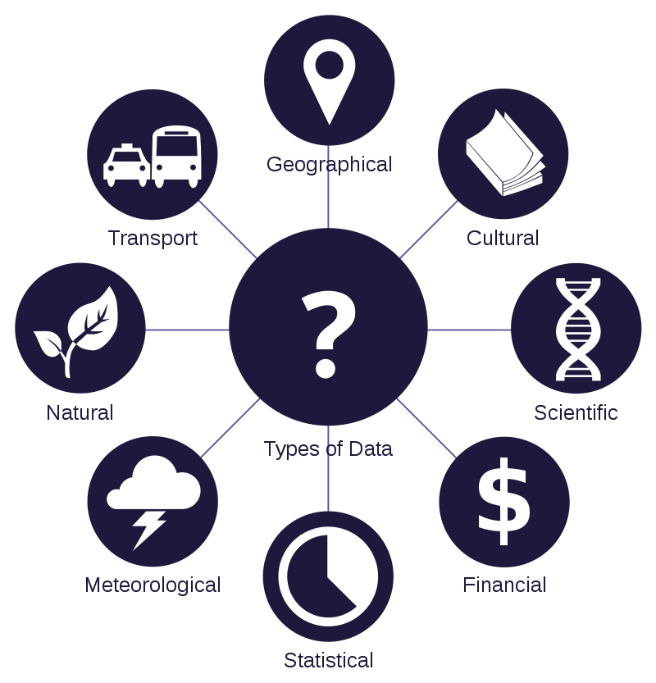
DATA IS THE NEW OIL OF THE 21ST CENTURY
Data are individual facts, statistics, or items of information, often numeric, that are collected through observation.
In a more technical sense, data are a set of values of qualitative or quantitative variables about one or more persons or objects

Slide 4
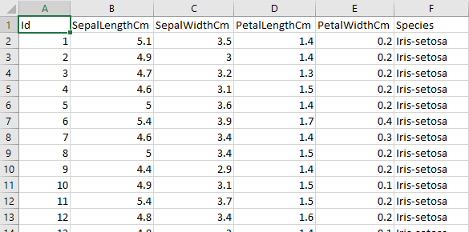
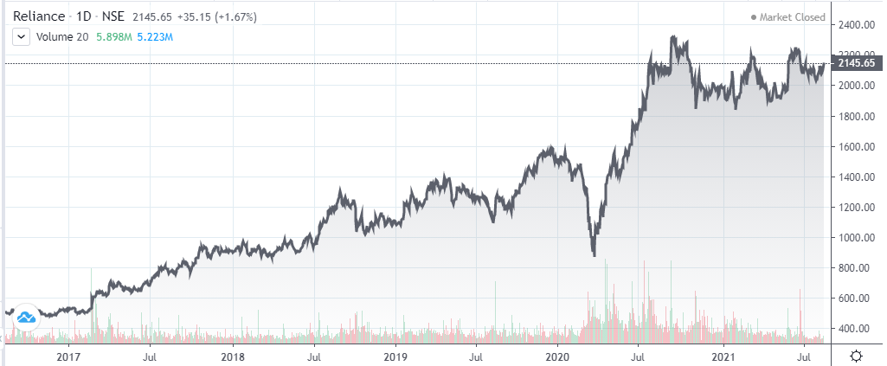
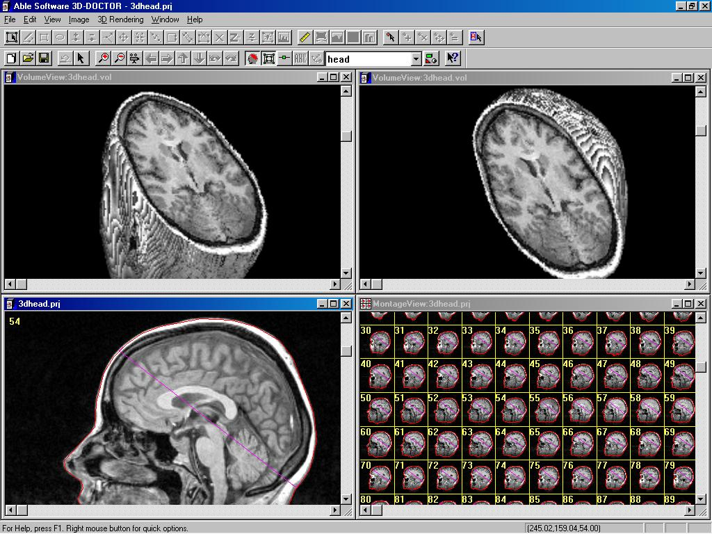
Types of Data

Slide 5



Need for Visualization
In general, there are two different types of data visualization:
exploration, which helps find a story the data is telling you
i.e., Exploratory Data Analysis (EDA)
explanation, which tells a story to an audience.
i.e., Communicate data clearly
Share unbiased data representation
Choosing the right type of visualization depends on what you need to show (comparison, distribution, composition, or relationship)
https://www.klipfolio.com/resources/articles/what-is-data-visualization
Notes:
plots and graphs can be very effective in conveying a clear description of the data especially when disclosing findings

Slide 6
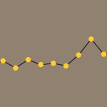
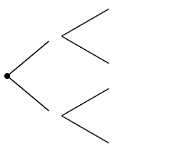
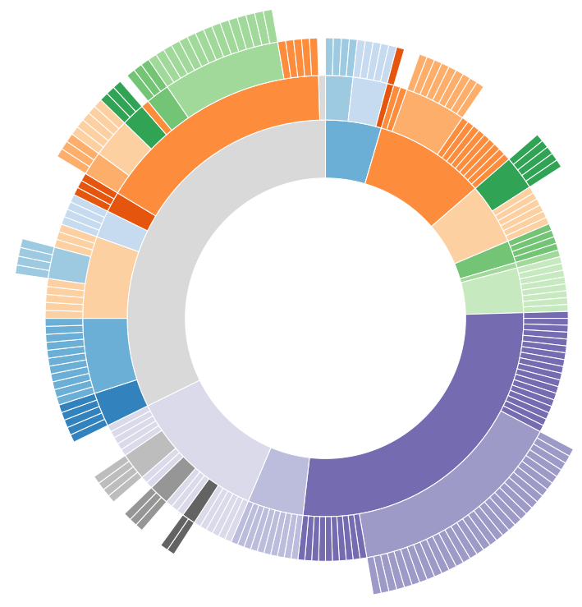


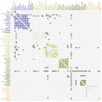
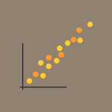
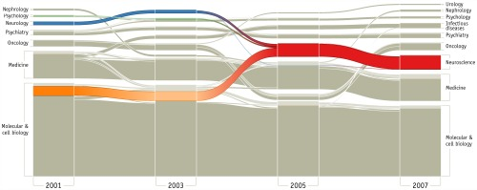

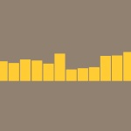

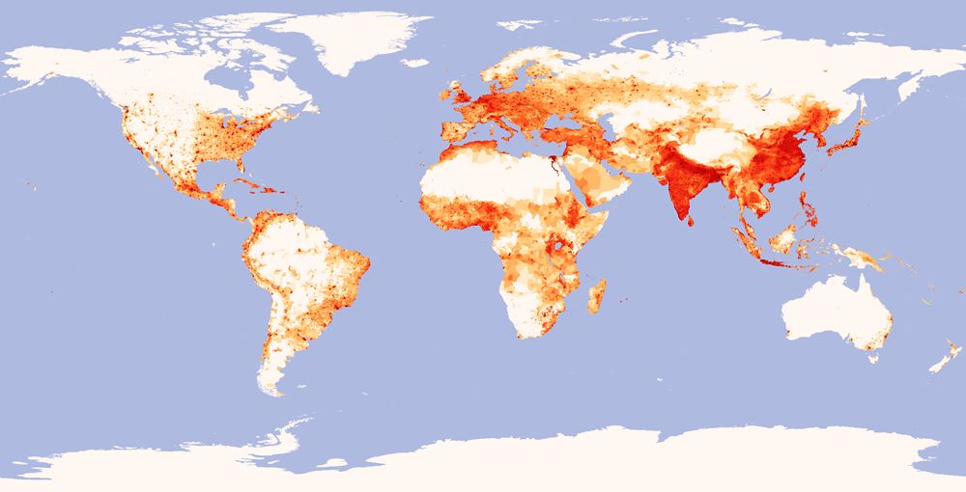
Types of Visualization Categories
Temporal
Scatter plots
Polar area diagrams
Time series sequences
Timelines
Line graphs
Hierarchical
Tree diagrams
Ring charts
Sunburst diagrams
Network
Matrix charts
Node-link diagrams
Word clouds
Alluvial diagrams
Multidimensional
Scatter plots
Pie charts
Venn diagrams
Stacked bar graphs
Histograms
Geospatial
Flow map
Density map
Cartogram
Heat map
https://www.klipfolio.com/resources/articles/what-is-data-visualization
https://www.datalabsagency.com/2014/12/22/15-most-common-types-of-data-visualisation/

Slide 7
Data Visualization Tools
Software
MS Excel
Tableau (Public)
Microsoft Power BI
Google Data Studio
Python Libraries
Matplotlib
Seaborn
Plotly
Ggplot

Slide 8
Excel Data Visualization Exercise !!!

Slide 9
Python for Data Visualization
Access Jupyter notebook from git link
Pre-requisite to run module
Python environment with Jupyter-notebook
Matplotlib
Open Jupyter-notebook and open ‘’ file

Slide 10
https://github.com/TannerGilbert/Tutorials/tree/master/Introduction%20to%20Data%20Visualization%20in%C2%A0Python
https://www.kaggle.com/jchen2186/machine-learning-with-iris-dataset
https://www.kaggle.com/roshansharma/immigration-to-canada-ibm-dataset

Slide 11
SHAP feature Visualization
Access Jupyter notebook from git link
Pre-requisite to run module
Python environment with Jupyter-notebook
Matplotlib
Open Jupyter-notebook and open ‘’ file

Slide 12

Thank you

Slide 13
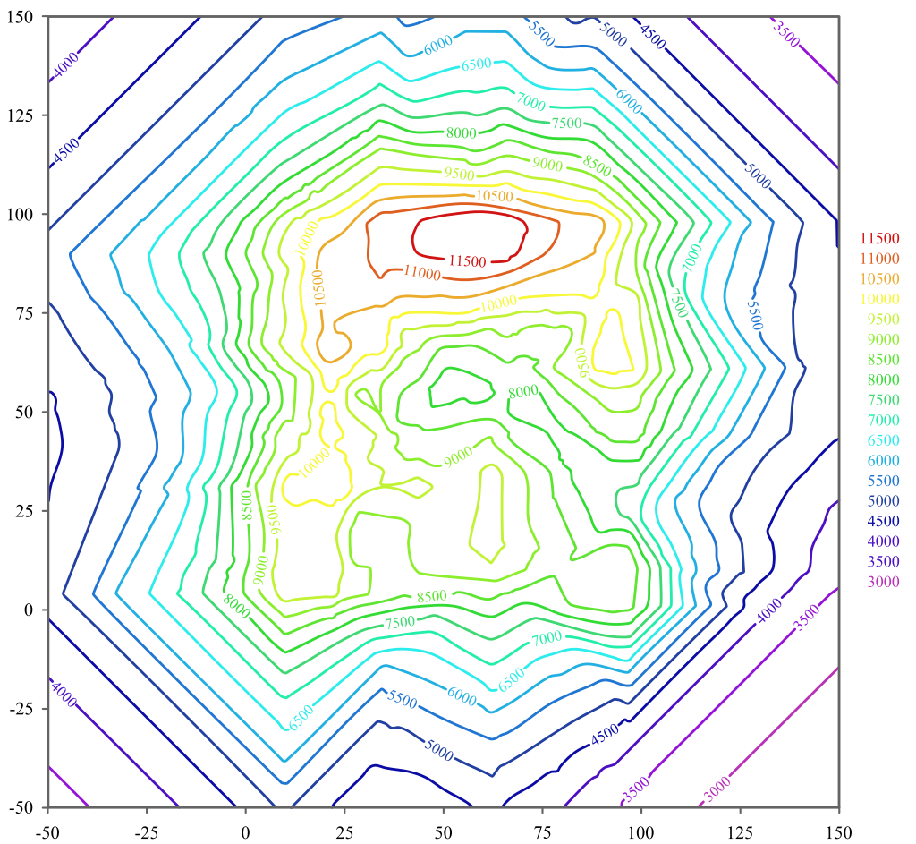

Slide 14
In general, there are two different types of data visualization: exploration, which helps find a story the data is telling you, and an explanation, which tells a story to an audience. Both types of data visualization must consider the audience’s expectations.
most common types of data visualization that fall under the 2D area, temporal, multidimensional, hierarchical, and network categories
Choosing the right type of visualization depends on what you need to show (comparison, distribution, composition, or relationship), how much detail the audience needs, and what information the audience needs in order to be successful.

Slide 15
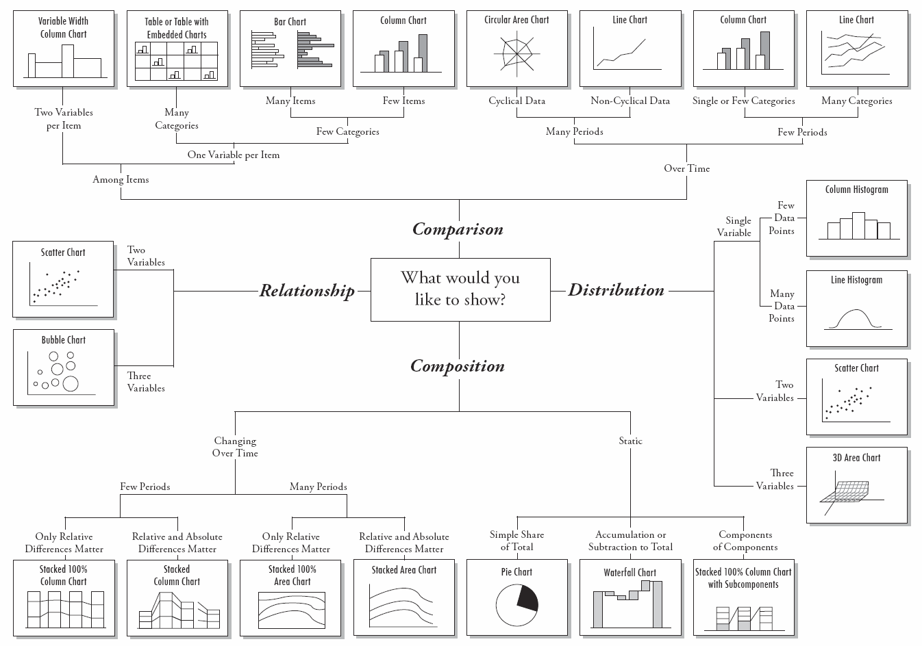

Slide 16
1D - Linear
2D - Planar
3D - Volumetric
Temporal
Multidimensional
Tree/Hierarchical
most common types of data visualization that fall under the 2D area, temporal, multidimensional, hierarchical, and network categories
Data Types are an important concept of statistics, which needs to be understood, to correctly apply statistical measurements to your data and therefore to correctly conclude certain assumptions about it.

