Slide 1
BIG DATA ANALYTICS CAPSTONE · HCL GUVI × JAIN UNIVERSITY
Healthcare Analytics & Disease Prediction
Heart Disease Risk Analytics Pipeline
HDFS · Hive · Spark MLlib · YARN · HBase
PRESENTED BY
Himani Tuli · Akash · Anshuman · Aditya · Maulik
Notes:
Introduce the team and the project: a Big Data pipeline that stores patient records in HDFS, analyses them with Hive and Spark, and predicts heart disease with Spark MLlib.

Slide 2
WHY IT MATTERS
Why heart disease risk analytics
WHAT THE RESULTS SUPPORT
THE PROBLEM
Hospitals hold huge volumes of patient records, yet high-risk patients are often found late. Cardiovascular disease is a leading cause of death worldwide.
High-risk age / sex groups
Prioritise screening campaigns
Strong symptom indicators
Add to triage checklists
THE OBJECTIVE
Most predictive features
Store, analyse and model patient data at scale to find risk factors and flag high-risk patients early.
Focus data collection on key tests
Predicted high-risk patients
Refer to cardiology follow-up
Notes:
Hospitals hold large volumes of patient data but high-risk patients are often found late. Link each finding to a business action. Insights are associations, not diagnosis.

Slide 3
DATA
Dataset and data quality
918
12
917
55.29%
raw patient records
columns
records after cleaning
have heart disease
DATA-QUALITY ISSUES HANDLED
FEATURES AND TARGET
Cholesterol = 0 is impossible: imputed with median 237.0 and flagged
RestingBP = 0: one record removed
Duplicates checked and dropped
11 features: 6 numeric, 5 categorical
Target HeartDisease: 1 = disease, 0 = normal
Public Kaggle / UCI file heart.csv
Notes:
Kaggle Heart Failure Prediction (UCI sources), 918 rows, 12 columns. Zero cholesterol and zero resting BP are physiologically impossible. Raw 918 -> clean 917.

Slide 4
ARCHITECTURE
End-to-end Big Data architecture
Hive
SQL analytics
heart.csv
HDFS
Spark
Results
patient records
raw/ processed/ results/
PySpark: clean, analyse, MLlib
insights + metrics
HBase
risk-score lookup
YARN manages cluster resources. Built to scale: same pipeline for millions of records using Parquet, Hive partitions and more Spark workers.
Notes:
Walk left to right: CSV into HDFS zones, then three consumers. YARN allocates resources. Same pipeline scales to millions of records.

Slide 5
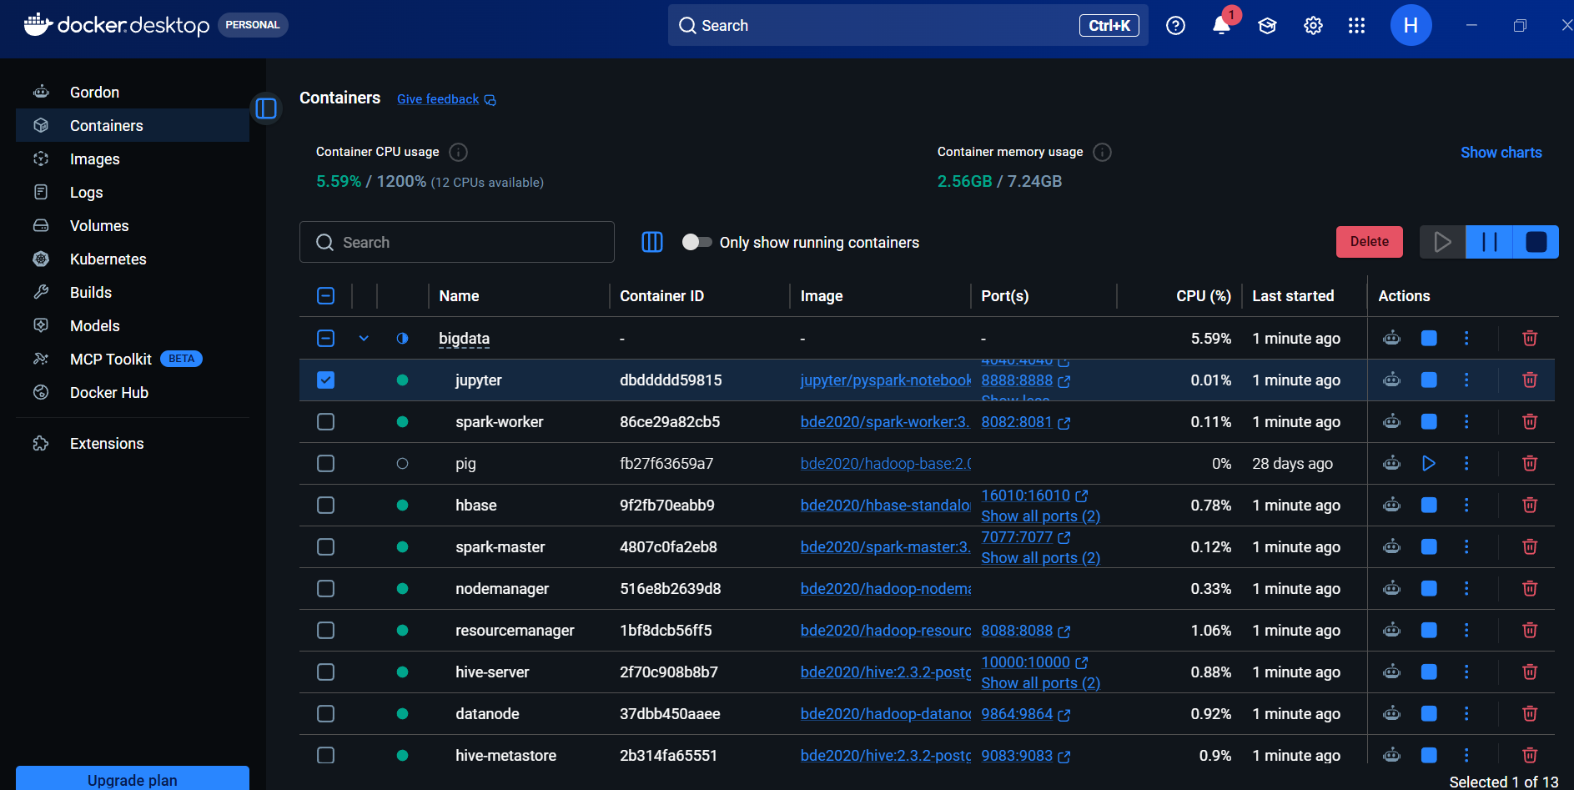
EVIDENCE · ENVIRONMENT
Big Data stack running in Docker
WHAT IT SHOWS
Project bigdata with 13 containers
Green: Jupyter, Spark master and worker, HBase, Hive, YARN, DataNode
pig is stopped (not used in this run)

Slide 6
STORAGE & SQL
HDFS storage and Hive SQL layer
HDFS: DISTRIBUTED STORAGE
HIVE: SQL OVER THE SAME FILES
/data/healthcare/
raw/ heart.csv (35.9 kB)
processed/ heart_clean (Parquet)
results/ rate_by_*, rf_predictions
External table on /data/healthcare/raw (schema-on-read, header skipped)
9 queries: prevalence, rates by sex, age, chest pain, angina x ST slope, zero-value checks
Window function: RANK() OVER (PARTITION BY sex)
Summary saved as managed table chest_pain_summary
Loaded with docker cp, then hdfs dfs -put
Verified with -ls, -du and fsck
Separate zones for raw, cleaned and output data
Notes:
HDFS: NameNode holds metadata, DataNodes hold blocks; separate zones. Hive: external table points at the directory, header skipped.

Slide 7
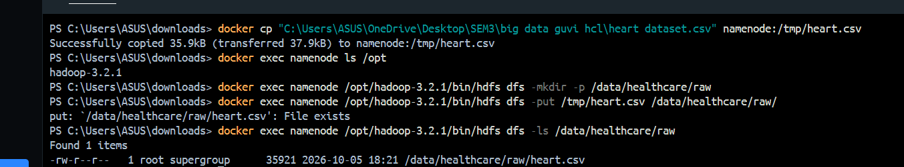
EVIDENCE · HDFS
HDFS load verified in the terminal
WHAT IT SHOWS
docker cp copied the dataset (35.9 kB) into the namenode container
Hadoop 3.2.1 hdfs created /data/healthcare/raw; put reported File exists, so it was already loaded
-ls lists heart.csv, 35,921 bytes, in /data/healthcare/raw

Slide 8
PROCESSING
Spark: clean, derive, analyse
1
2
3
4
5
Read & profile
Clean
Derive
Analyse
Persist
CSV from hdfs://namenode:8020 with inferSchema; null, duplicate, zero checks
Drop duplicates, remove RestingBP = 0, impute cholesterol median 237.0 with a flag
age_group, chol_category and bp_category columns
Patients, cases and disease % for 7 factors
Parquet to processed/; rate tables and predictions to results/
Performance: cache() on the cleaned data, repartition(4) on write, explain() for the physical plan
Notes:
Transformations are lazy; actions like count() trigger execution. cache() helps because the cleaned DataFrame is reused.

Slide 9
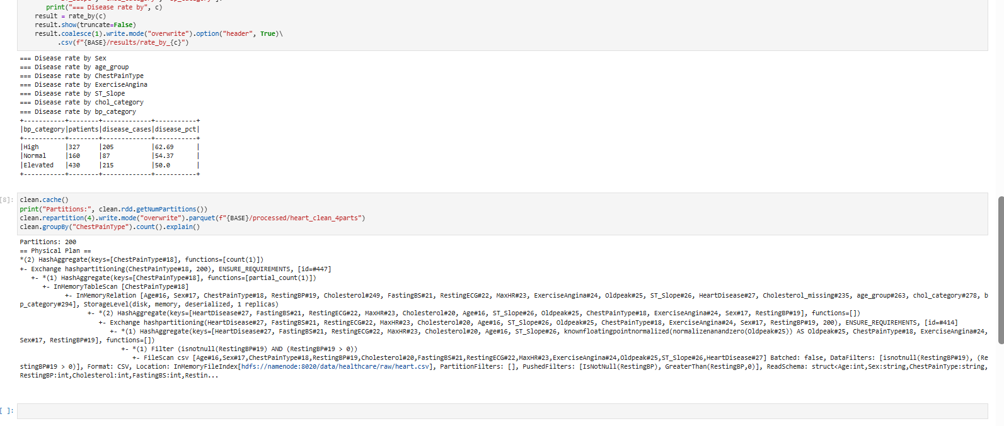
EVIDENCE · SPARK
Spark output and execution plan

Slide 10
INSIGHT 1
Risk rises with age and is higher in men
55.29%
of all 917 patients: 507 with disease
63.12%
of men (724 patients)
25.91%
of women (193 patients)
Notes:
Overall 507 of 917 (55.29%). 32.5% under 40 to 73.12% at 60+. Men 63.12% vs women 25.91%; data is ~79% male so treat sex gap as association.

Slide 11
INSIGHT 2
Symptoms and ECG findings separate risk
READING THE CHART
Red: high-risk findings; mint: low-risk
Asymptomatic chest pain is riskiest, not typical angina
BP and cholesterol show weaker, non-linear patterns
Notes:
Exercise angina 85.18%, flat ST slope 82.79%, asymptomatic chest pain 79.03%. Low-risk: upsloping ST 19.75%, atypical angina 13.87%.

Slide 12
INSIGHT 3
Cholesterol and BP: weaker signals
Cholesterol: 146 / 408 / 363 patients (Normal / Borderline / High)
Blood pressure: 160 / 430 / 327 patients (Normal / Elevated / High)
Notes:
Imputed cholesterol median (237) falls inside Borderline, inflating that group. BP does not rise cleanly.

Slide 13
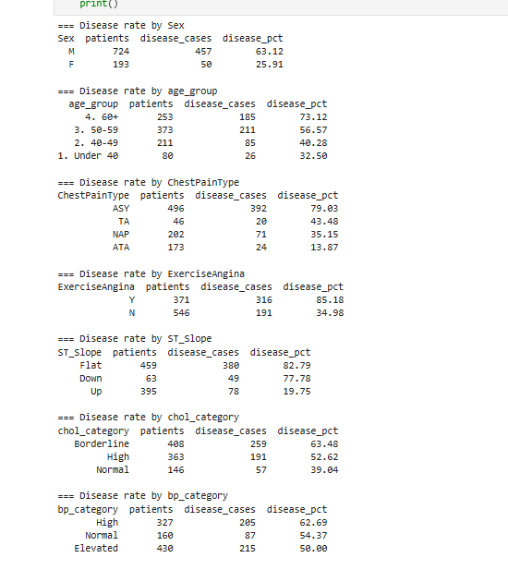
EVIDENCE · SPARK ANALYTICS
Disease-rate tables from our PySpark run
KEY READINGS
Sex: men 63.12%, women 25.91%
Age: 32.50% under 40 rising to 73.12% at 60+
Chest pain: ASY 79.03%, ATA 13.87%
Exercise angina Yes 85.18%; ST slope Flat 82.79%, Up 19.75%
Cholesterol and BP: weaker, non-linear patterns

Slide 14
PREDICTION
Random Forest beats Logistic Regression
ML PIPELINE
StringIndexer, OneHotEncoder, VectorAssembler
80/20 split, seed 42: 728 train, 189 test
Random Forest: 100 trees
Random Forest wins on every metric
Notes:
Both models use the same Spark ML Pipeline. RF AUC 0.9052, accuracy 0.8466, F1 0.8461. LR AUC 0.8964, accuracy 0.8148. Weighted recall equals accuracy in Spark.

Slide 15
PREDICTION
Where the models err: confusion matrices
Logistic Regression
Random Forest
Predicted normal
Predicted disease
Predicted normal
Predicted disease
67
23
72
18
Actual normal
Actual normal
true negative
false alarm
true negative
false alarm
12
87
11
88
Actual disease
Actual disease
missed case
true positive
missed case
true positive
Disease recall 87 / 99 = 0.879
Disease recall 88 / 99 = 0.889
Notes:
In screening, recall on disease matters more than accuracy. RF found 88 of 99 and missed 11; LR found 87 and missed 12, with 23 false alarms vs 18.

Slide 16
EXPLAINABILITY
What drives the Random Forest
KEY TAKEAWAYS
ST slope is the strongest signal
Asymptomatic chest pain ranks third
Exercise angina and oldpeak follow
Model agrees with Hive and Spark analytics
Notes:
The model and the Hive/Spark analytics agree on the drivers: ST slope, asymptomatic chest pain, exercise angina.

Slide 17
SERVING LAYER
HBase risk lookup and component roles
HBASE: patient_risk TABLE
HOW THE PIECES FIT
Column families info and risk; two real Random Forest test predictions loaded.
HDFS
stores raw, cleaned and result data
Row key | Patient | Actual | Predicted
P0001 | 41, M, ASY | 1 | 1 (correct)
P0004 | 61, M, ASY | 1 | 0 (missed)
Hive
SQL analytics over the files
Spark
cleaning, aggregation and MLlib
Row-key lookup is what HBase is built for; Hive and plain files are not.
YARN
resource management
HBase
fast risk-score lookup
Notes:
HBase stores predicted risk by row key. P0004 is a real missed case from the test set. Keys are demo IDs: dataset has no patient ID.

Slide 18
WRAP-UP
Conclusions
0.905
84.7%
88 of 99
AUC, Random Forest
test accuracy
disease cases found
LIMITATIONS
NEXT STEPS
Small single-source data: 917 rows, 79% male
Imputed cholesterol all lands in Borderline
One split, no clinical validation: a prototype, not a diagnosis
Larger EHR data such as CDC BRFSS
Hive partitioning and cross-validation
Threshold tuning to raise recall
Notes:
Analytics and model agree: flat or down ST slope, asymptomatic chest pain, exercise angina, older age and male sex are most associated with disease. Be honest about limitations.

Slide 19
Thank You
Healthcare Analytics & Disease Prediction
Himani Tuli · Akash · Anshuman · Aditya · Maulik
Notes:
Thank the audience.

