Slide 1

Could we try an inverted button here, green frame/text, off withe inner fill?
Overall: Homepage – when going into an inner page. And click on return arrow – You end up back in top section of home page – Would it be possible to end up in the same section you left the page from?
(e.g. click on news articles – go to inner – click back – would be good to return to ”news articles on home page”
This is general for all sections on home page…
Movement of main picture –manual movement probably better. (Or much slower automatic)

Slide 2
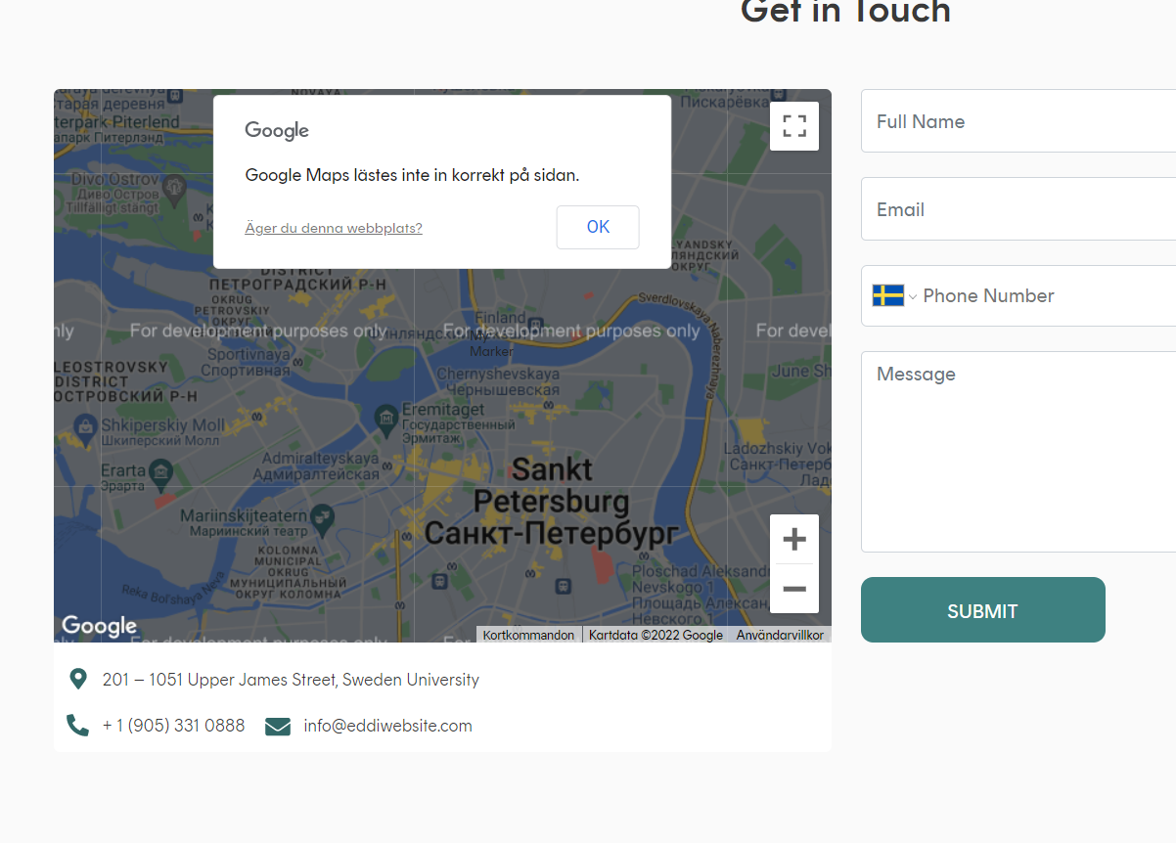
Size and font (all should be same as Home page) - Light (semi- bold – be consequent)
MAP: 83Wv+JW Stockholm
59.3465133, 18.0948041
Brantingsgatan 19
115 35 Stockholm
+ 46 76 111 2341
kundtjkundtjanst@eddi.nuanst@eddi.nu
ZZA

Slide 3
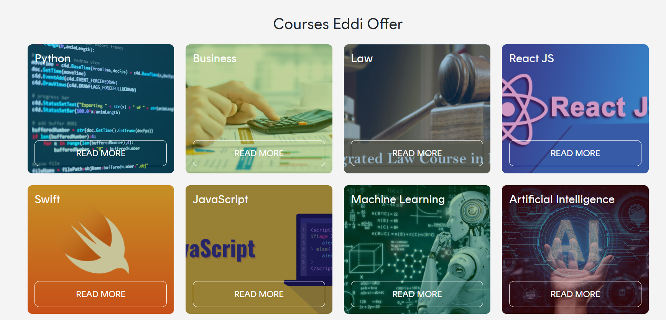
Home Page: You still end up with log-in page here – should be open/inner for everyone to read

Slide 4
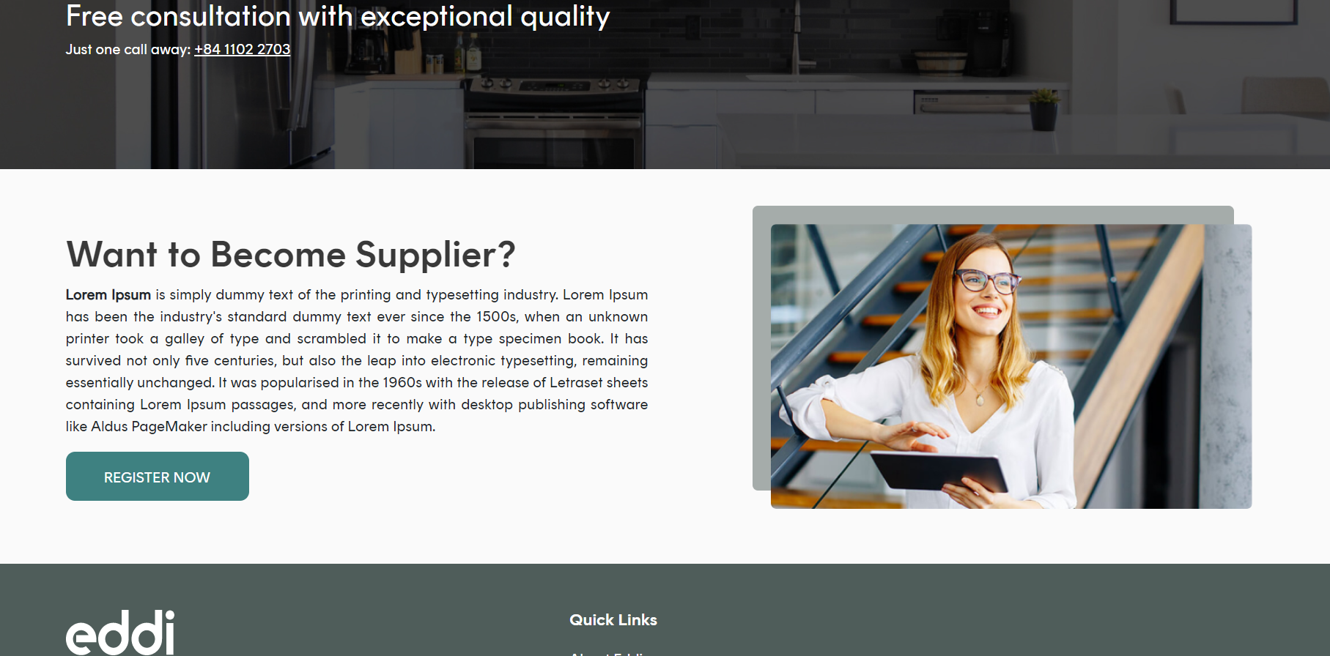
Same size and font as above

Slide 5
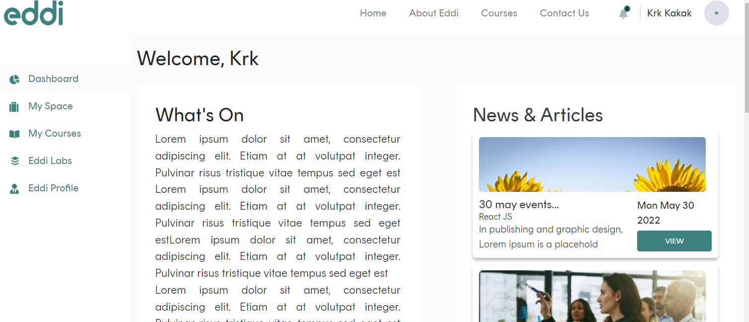
I created a New email – and created a new account..
News and events (not articles)
Layout in one flow – looks ok! – let’s comment on this
When creating an account – is it now necessary to verify through email link before ”credentials” are working in login page? Right? No notification was given… just ended up in login page… But verification is working…
Requesting new password – working !! Great – Logo in notification looks strange though.
Should be ”my profile”

Slide 6
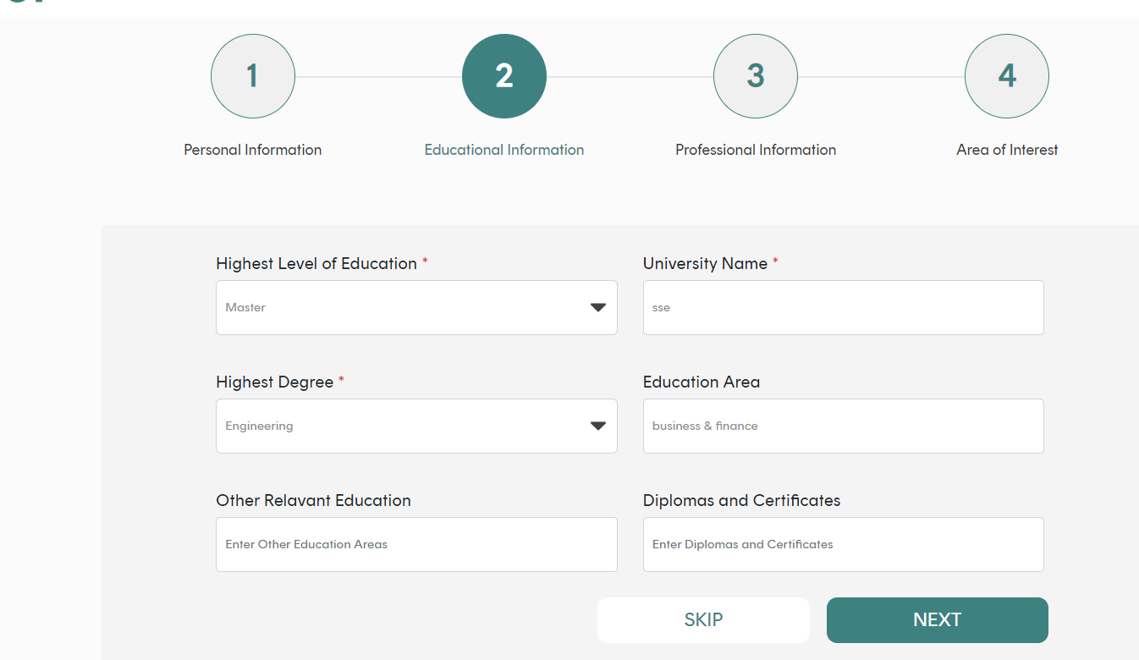
What differ between highest level of education (should add PhD here as well) and Highest degree… Same thing NO?

Slide 7
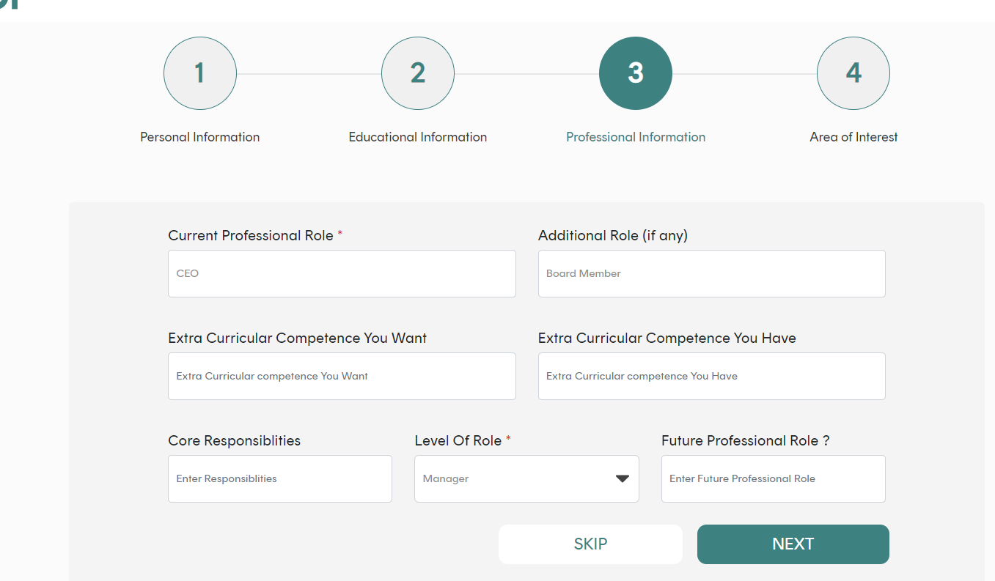
Future professional role should be second row – (where extra curricular competence you want) – Also Extra curricular competence you want might be enough?

Slide 8
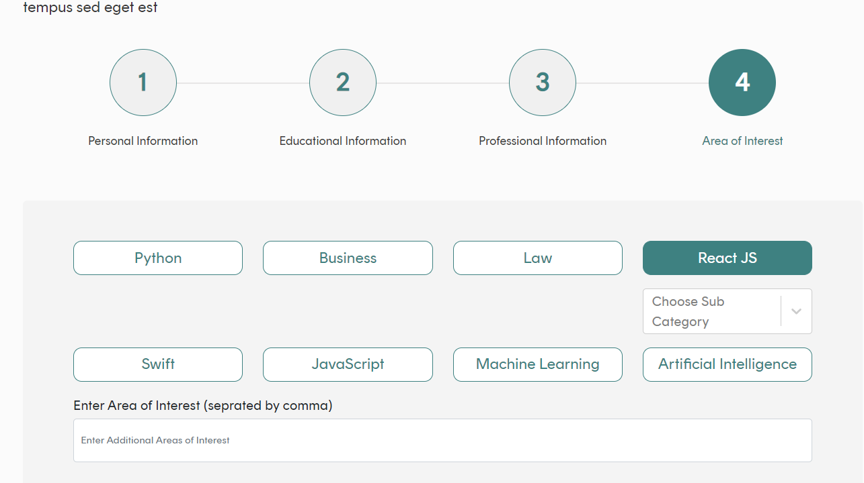
Areas of interest didn’t save – and when I turned back to ”edit” no content on that row was updated….
Not possible to ”choose” click and pick sub-categories

Slide 9
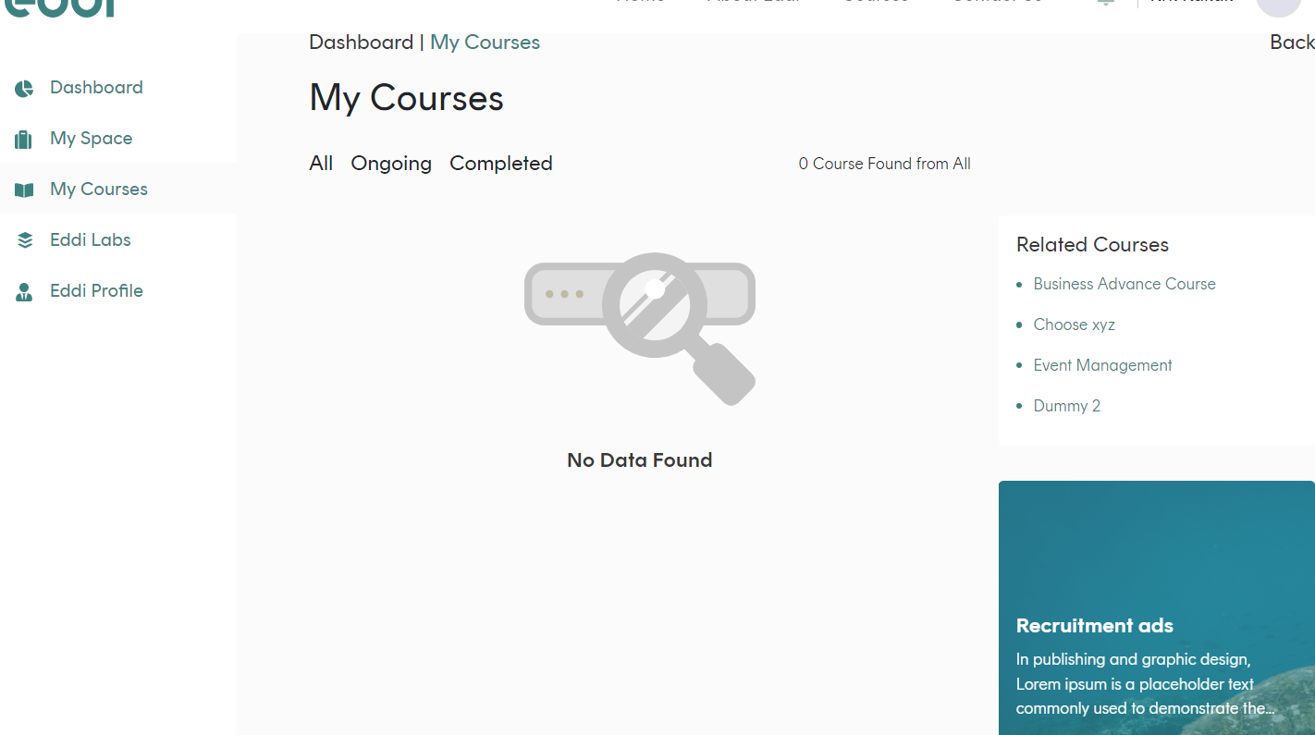
Into – My courses
What’s inner page of recruitment – should almost be a list – or how will it be presented?
Need for entry from left navtigation bar??

Slide 10
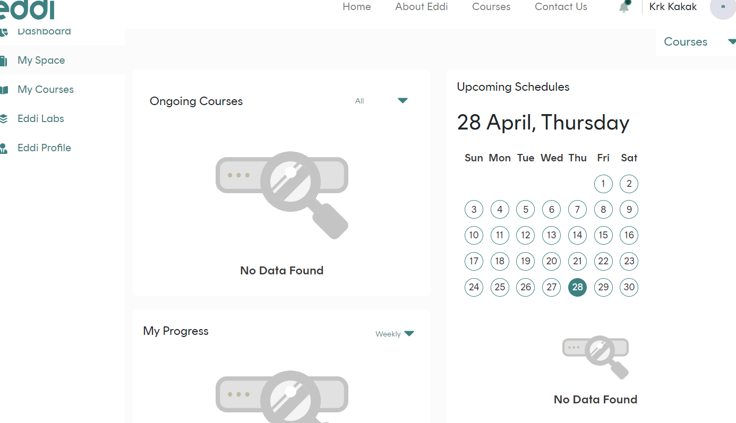
My space
What will be shown here – under ”progress”?

Slide 11
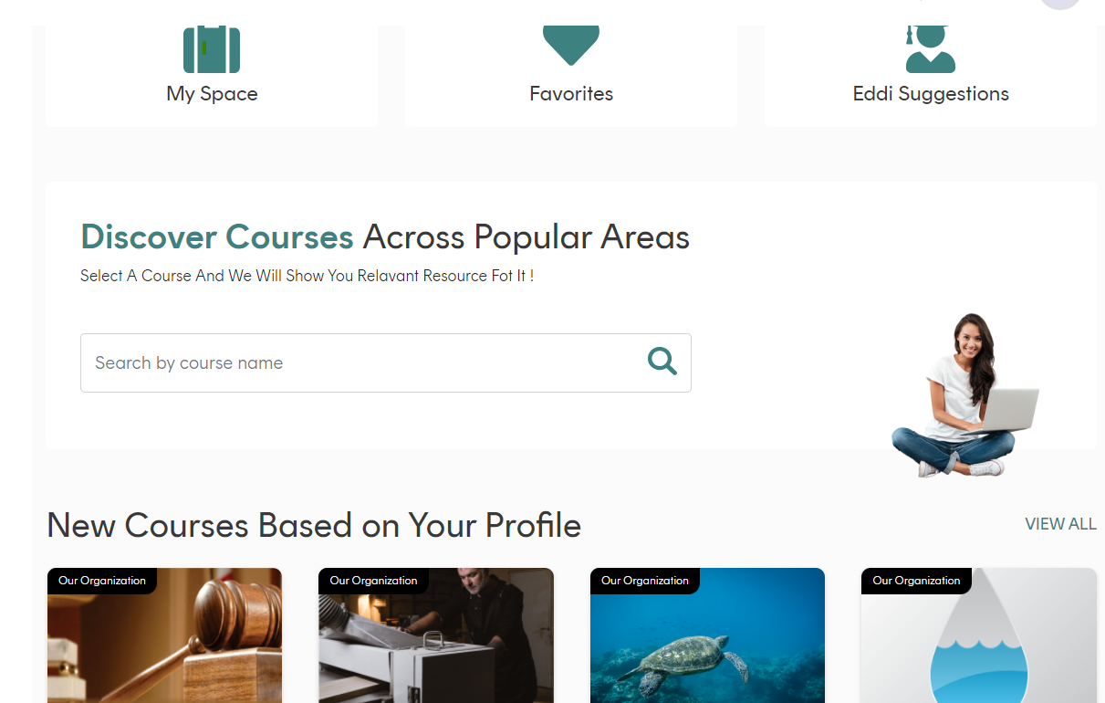
From dashboard
Dahsboard, and course listings (should be nice with more air on right margin (all inner personal pages)… Content too much close to the right margin..
Not really working – get random courses suggested… (based on my business& finance profile)
Legal och law (there are suggestions in the search bar – but no courses) not really working yet..

Slide 12
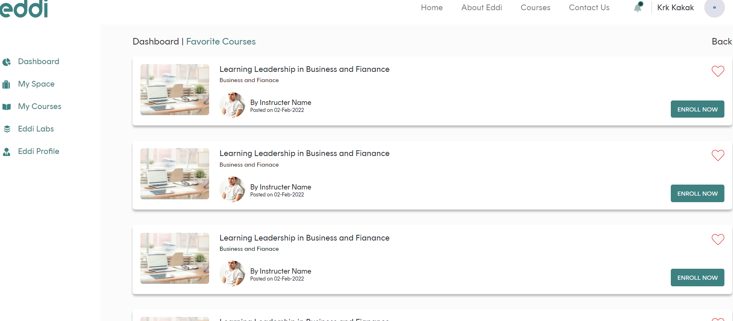
Is this a filled heart? That could be un-clicked (so course disappear from ”favourites”? Let’s make it a green (not read” heart..
Must be entry directly (add) on left navigation bar. If user is e.g. in my space, or my courses (enrolled to) we need a quick entry to courses they like…
This could as well be ”third party provider” and their logo – right?

