Slide 1
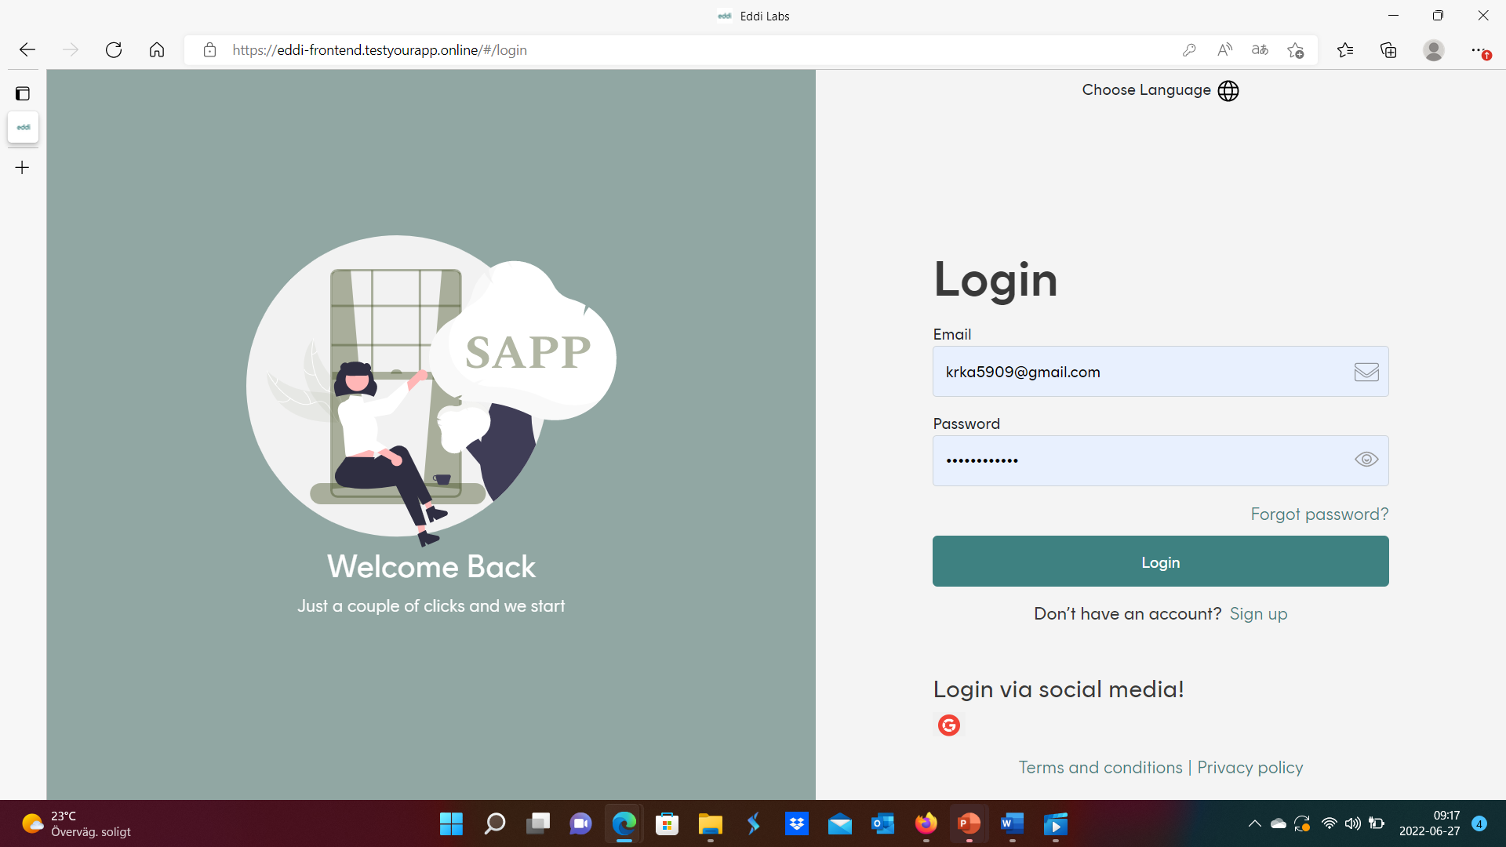

If we are using this one.. Put eddi logo here

Slide 2
Notification layout.. You decide – but let’s keep it simple..
Hi Kristian
Sdfdsfsdfsdfdfsdf
Dsfdsfsdf
Sdfsdf
Link (no need for URL:
Perhaps need to write (copy password to login)
The Eddi Team etc etc..

