Slide 1
Minor comments on profile steps – then it is just PERFECT ☺
21 june 2022

Slide 2
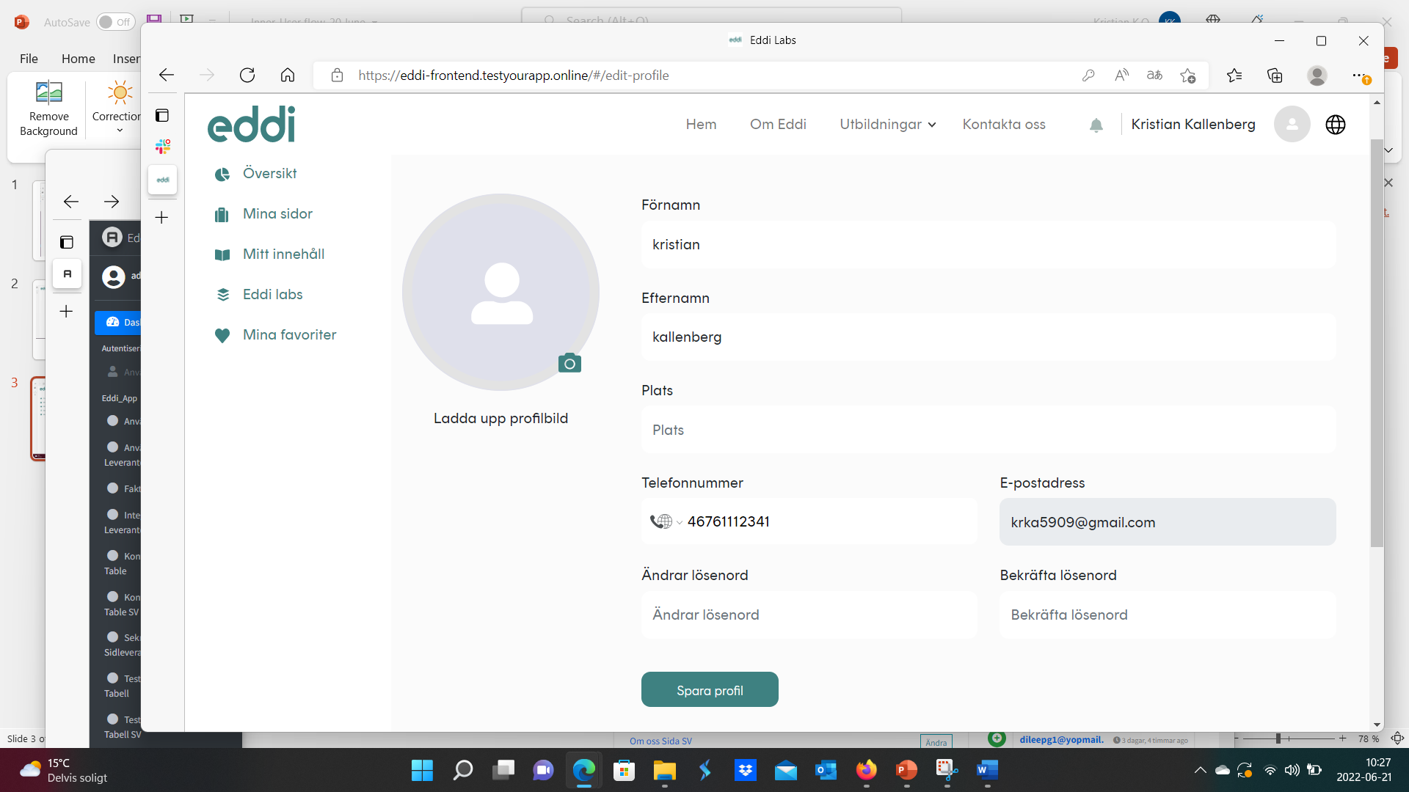
Ändra lösenord

Slide 3
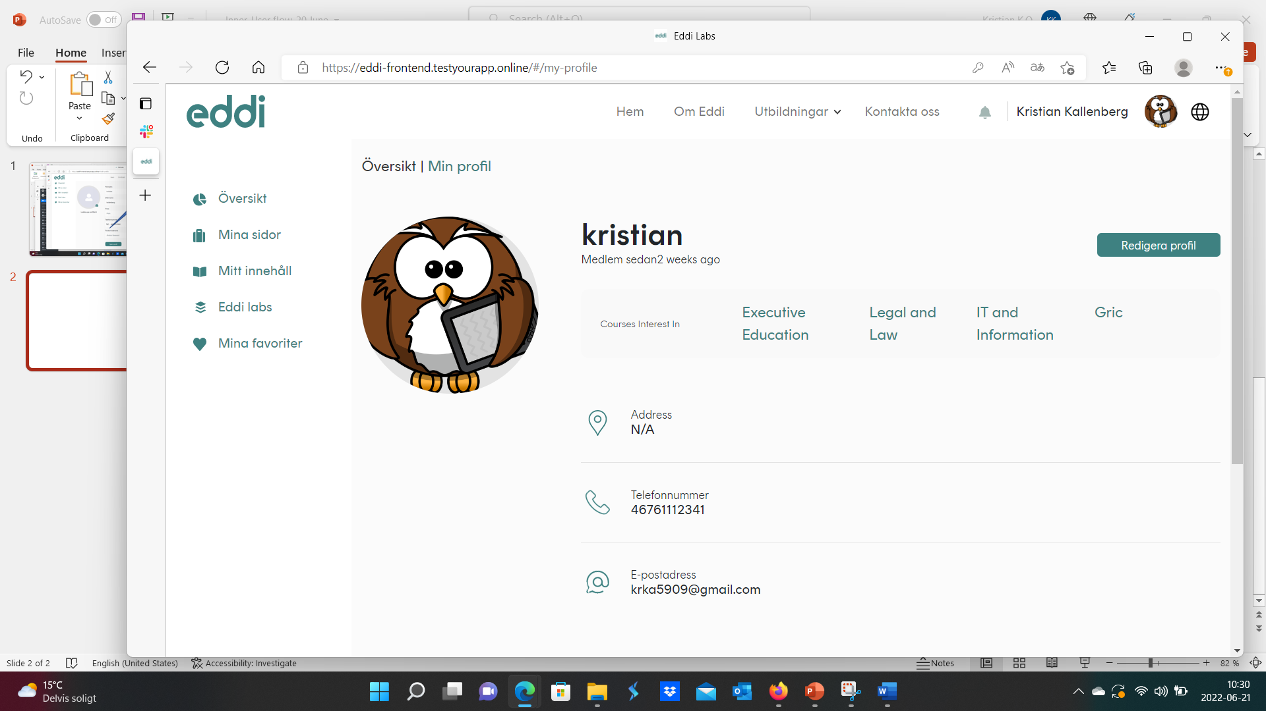
In swedish
Medlem sedan (spacing) 2 veckor
Intresseområden
In swedish (one d) Adress

Slide 4
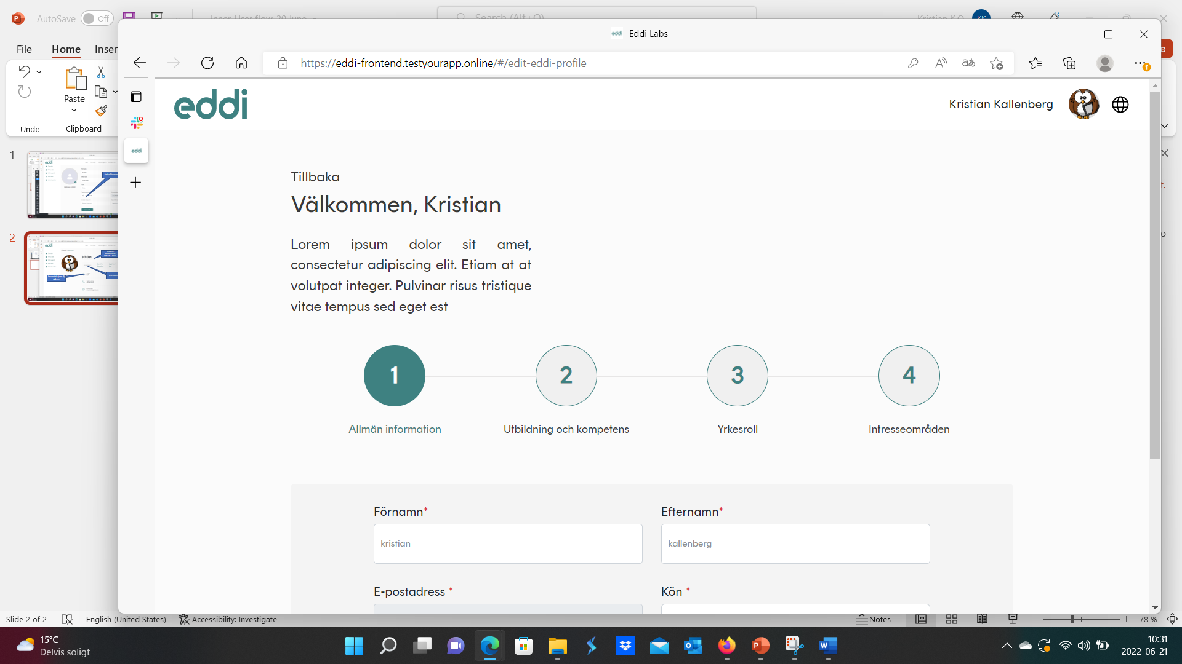
Back / Tillbaka – hard to find on page move to here…

Slide 5
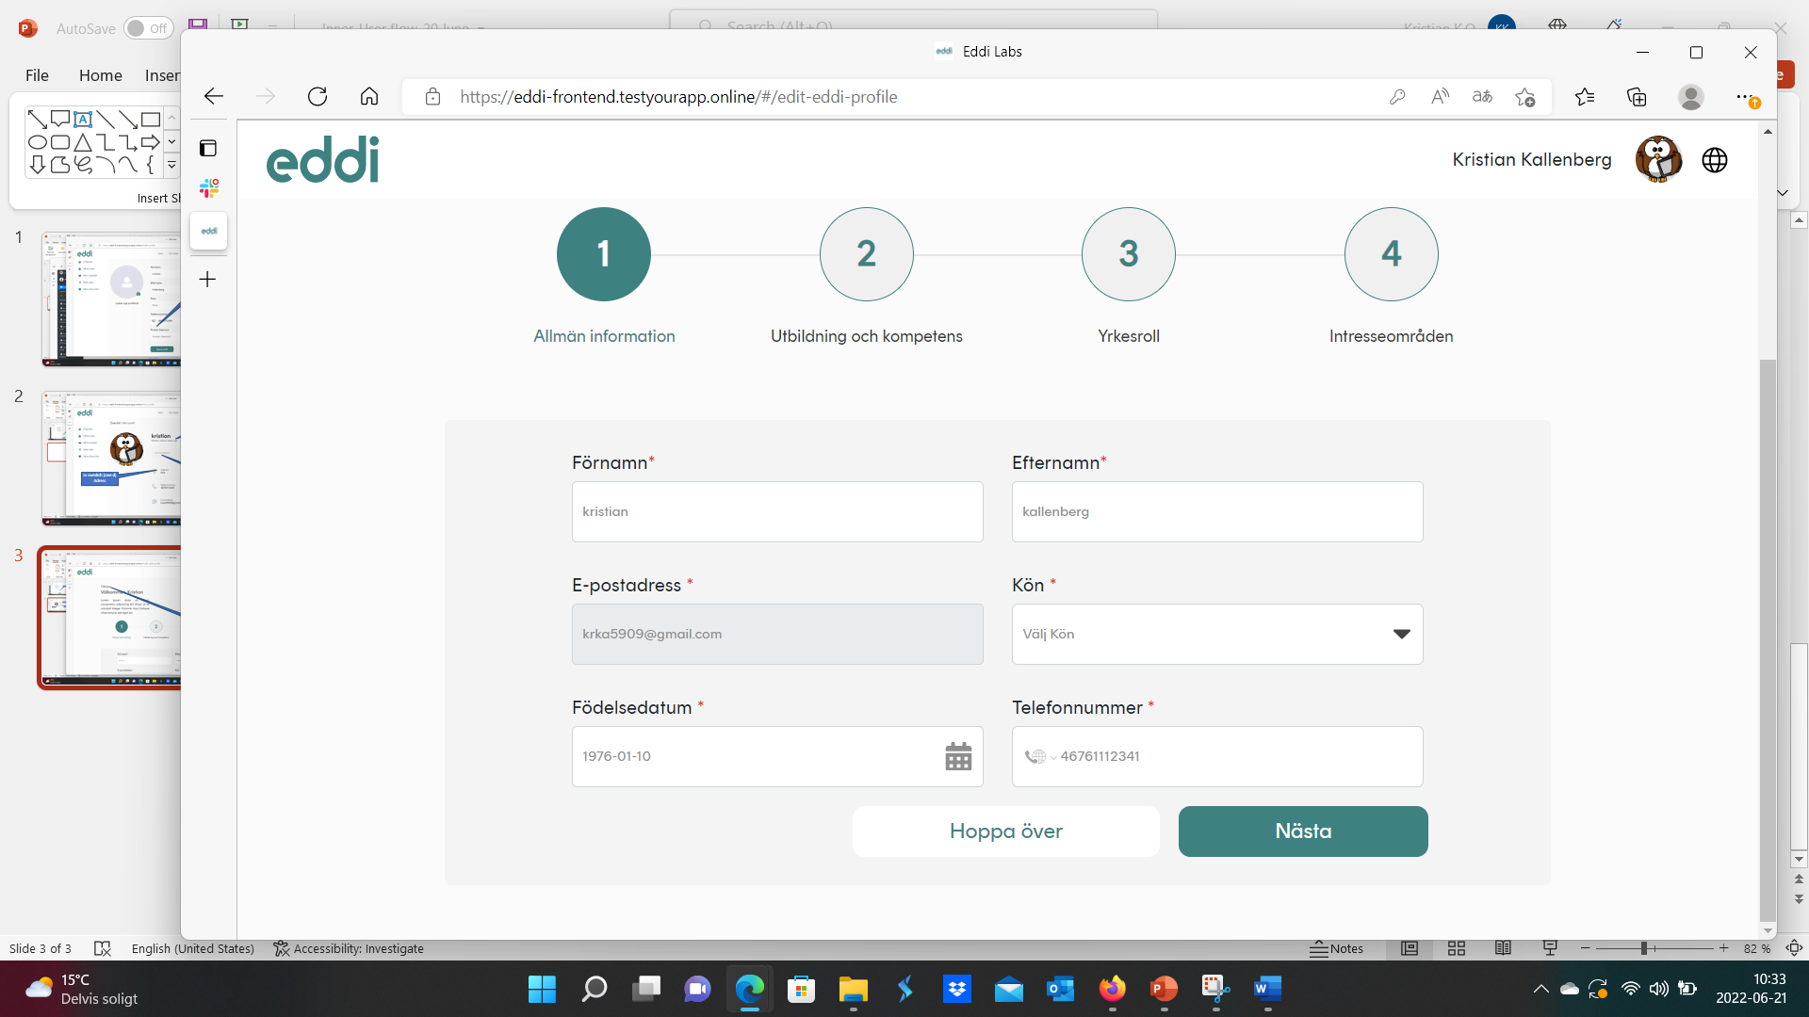
Välj kön

Slide 6
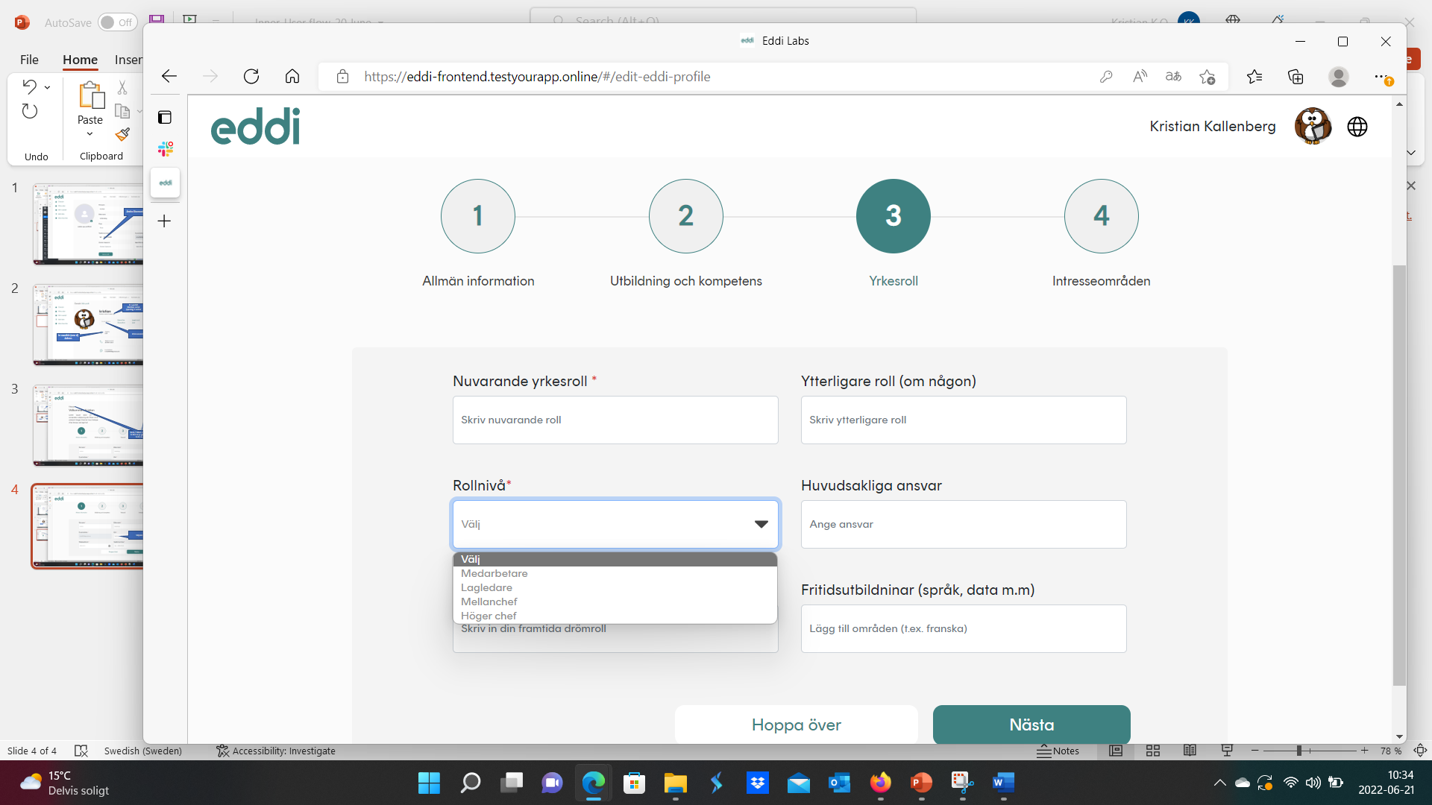
Högre chef

Slide 7
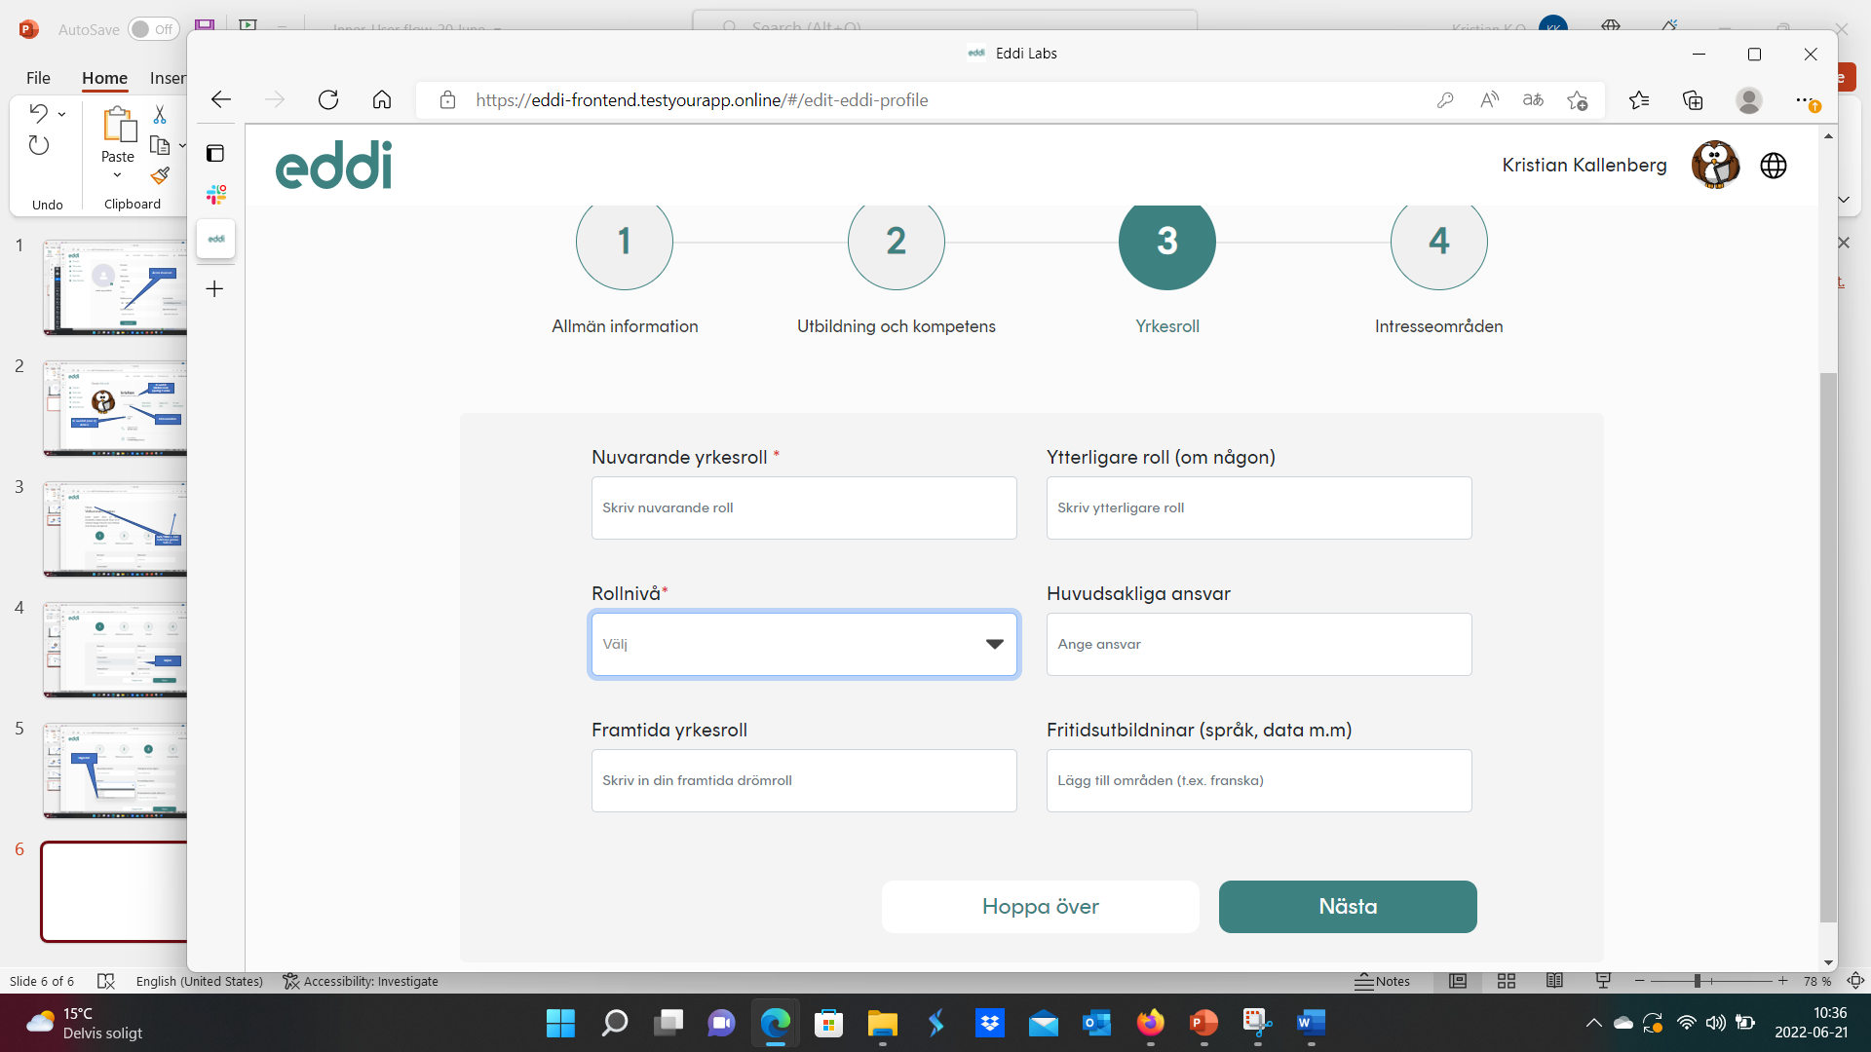
Fritidsutbildningar

