Slide 1
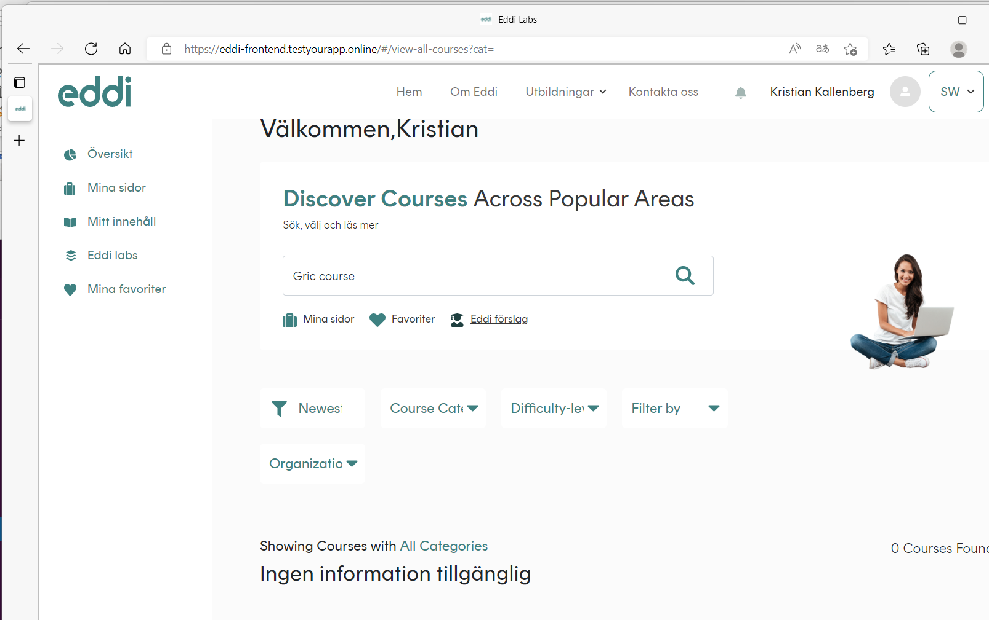
Swedish inner - Text should be in swedish
We normally use ”spacing” before name here… looks strange with name after comma…
Different font/colors on symbols.. (underlined )
Mix of swedish and english translations
Despite ”size” of window… Need to see the whole text… is text size/font fixed in the boxes? Will not work for different resolution then..

Slide 2
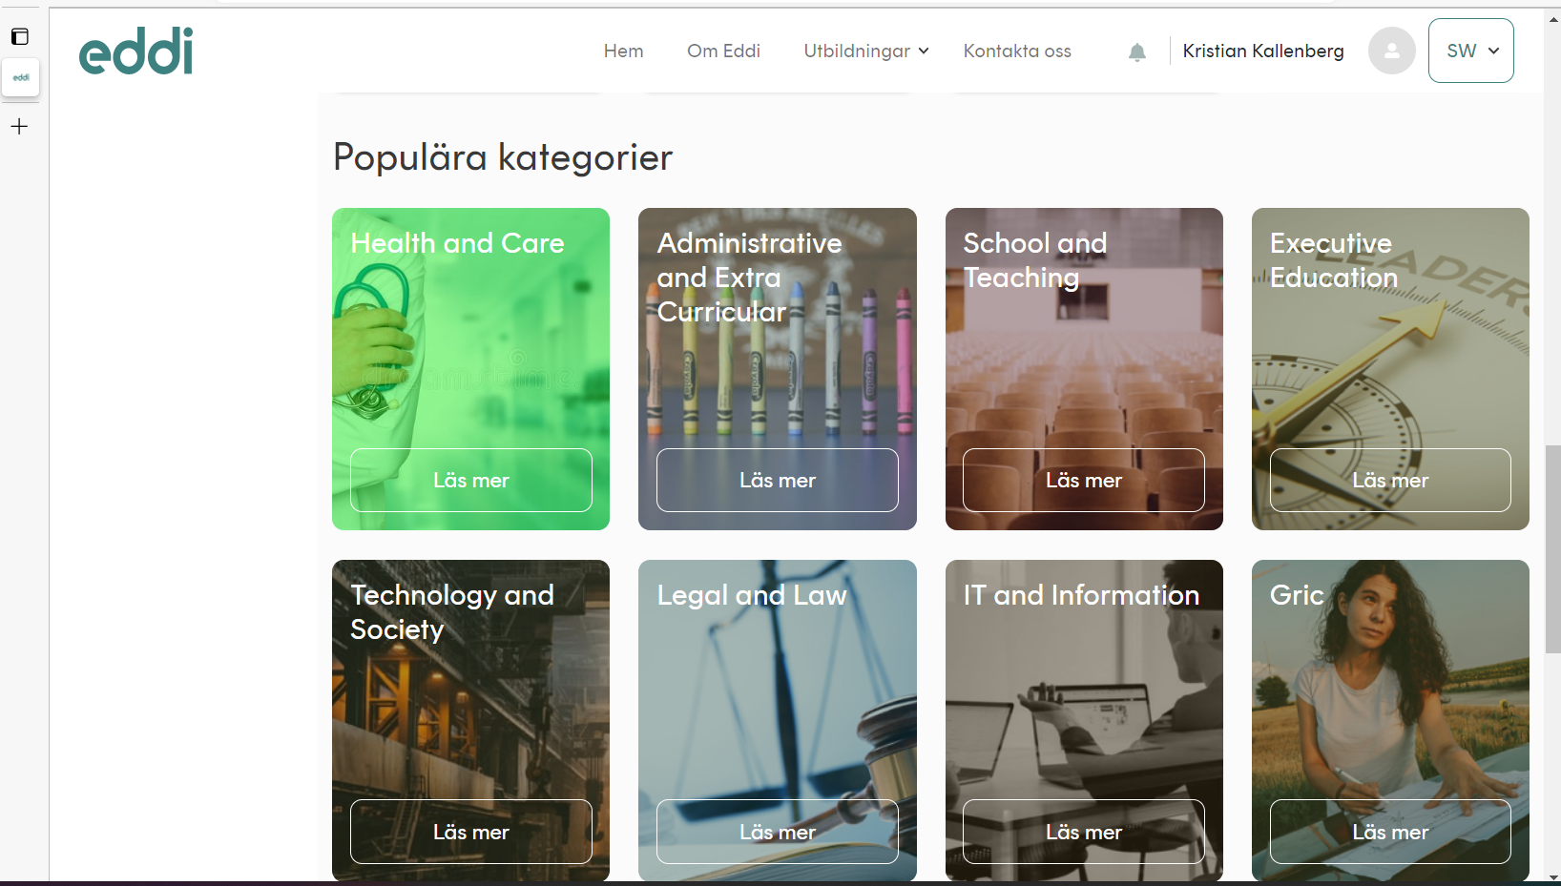
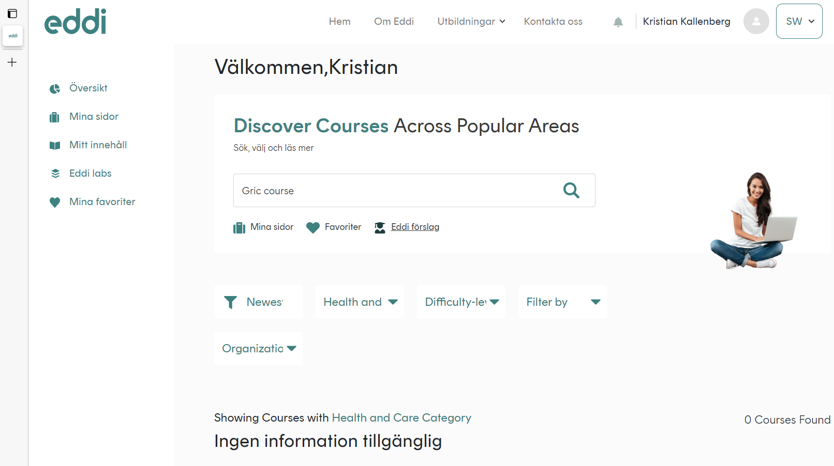
CMS flow works now – i.e.. When you click on Eddi Categories – you are directed to the inner ”category page”… BUT… when in logged in mode… Also.. Popular categories – should be directed to ”inner category page” and then a button – ”serach for e.g. health and care courses… ending up in ”filtered view”/search as outlined below… we can discuss tomorrow..

