Slide 1
Comments on Eddi 5-6 May
General concerns and comments
Specific - Admin
Specific - Security login
Specific - Front/user flow (not possible to complete due to ”credentials not working” and Password (request new) not possible to reset.

Slide 2
General concerns/comments
Overall deliveries sprint three – what’s done, what’s pending? I feel that some things are ”stuck” in progress and we need to address this to modify time-plan and delieveries..
Not tested on my side – matching functionality – as this is core to the whole project I would like a comment on status here – Any problems faced? Important main, as well as sub-category, and free text of “area of interest” is used for matching against course content and recruitment ads.
Notifications not updated fully (UK/SWE) (KK input from last weeks). Also - Need to “select” a language as “set language” when registering your profile – so all notifications come in “selected” language. If you register your account using the “Swedish view” (“SKAPA KONTO”) (create account) must be in Swedish, and also the verification/welcome notifications sent to that user.
“Forms” need to remember data filled in into fields. E.g. when you go back and forth when creating your profile, or when creating account and “reviewing “ terms and conditions” (see page 5 in this document)

Slide 3
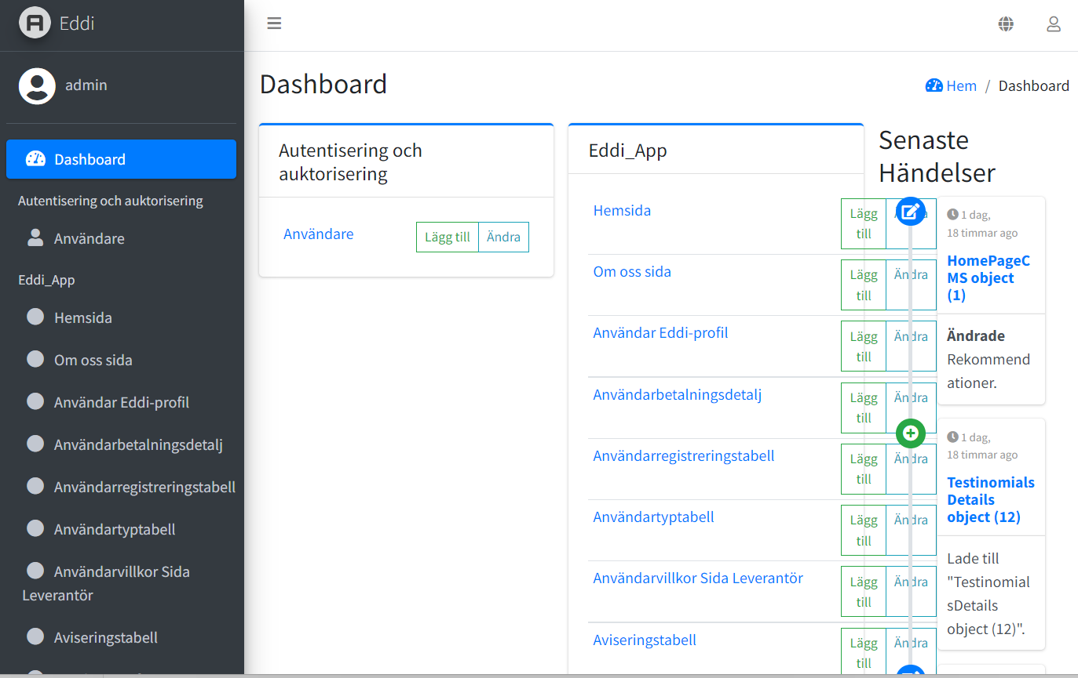
When reducing the size of the page in admin, Current event climbs in over Eddi app – Lägg till /ändra boxes
Translation according to previous document (pending)

Slide 4
Comments on security and loging in..
NEW SUPPLIER FLOW
Outside platform – a new supplier is ”contracted”
Admin adds a supplier profile…. (in ”leverantörsprofil”
Email – sent to supplier. Welcome… click this link to register your profile…
Supplier clicks link and gets to ”loginpage” /their profile where a password is created.
Supplier creates a ”profile”
Admin approves New supplier (notification of completed onboarding)
SECURITY ON ADMIN LOGIN
BEYOND PASSWORD LOGIN – DOUBLE VERIFICATION THROUGH GOOGLE OR OTHER SOLUTION…
MUST have a double verification of admin sides. Not only first time, every log in we need a higher degree of security for admin.
See next page..

Slide 5
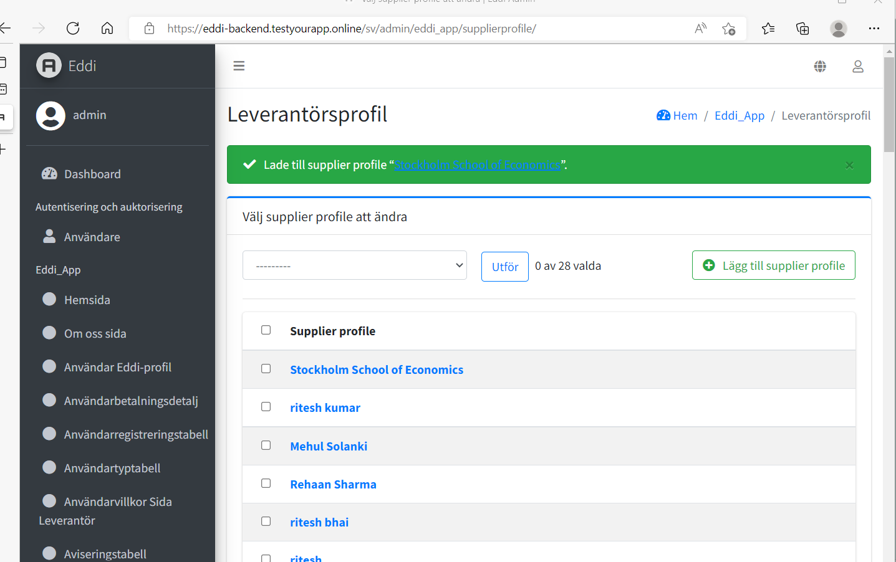
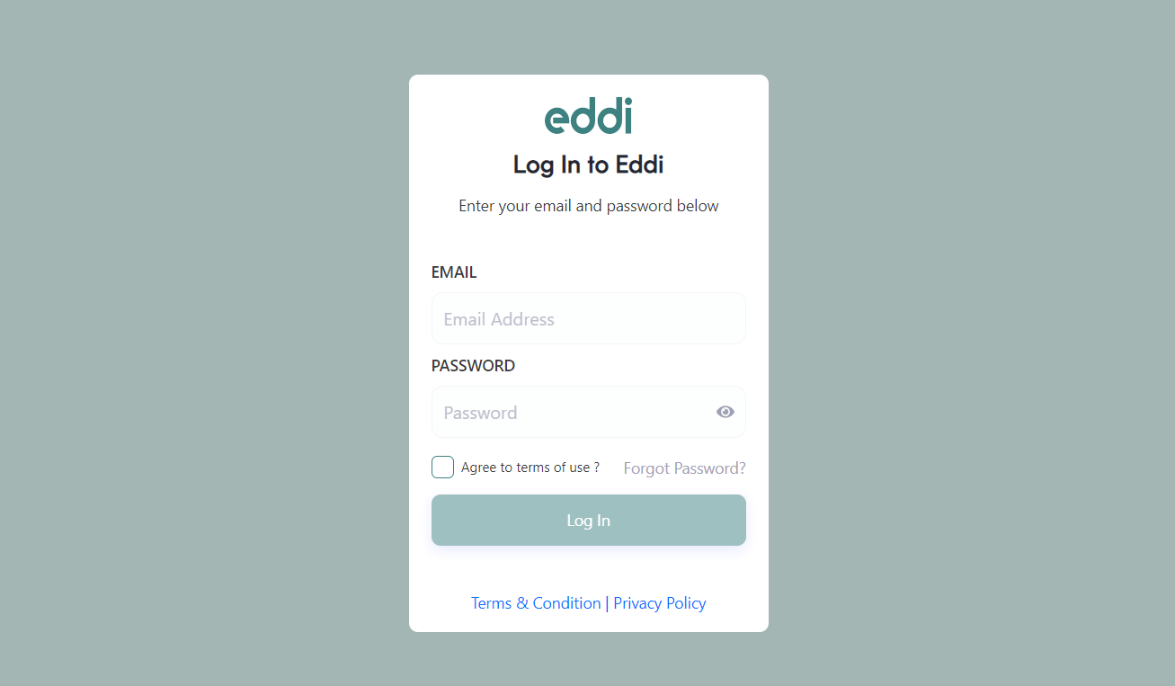
Created a new supplier profile from admin. However, how does notification – i.e. how will new supplier be notified, to start register their profile? As we have decided – Supplier is ”invited” by admin to register their profile. What’s still pending in this functionality?
Login start page for supplier….
Do we need to separate user and supplier privacy/terms conditions?
I have written one document which covers both users and suppliers..
NB: When filling in info – and then opens up terms/conditions, when going back to accept… System must remember info already put in.. E.g. email/passsword. Same problem as for ”ind user” login.

Slide 6
FRONT – User flow
Kristian sent a document last week + extra comments – let’s review on Thuesday what’s pending.. ☺

Slide 7
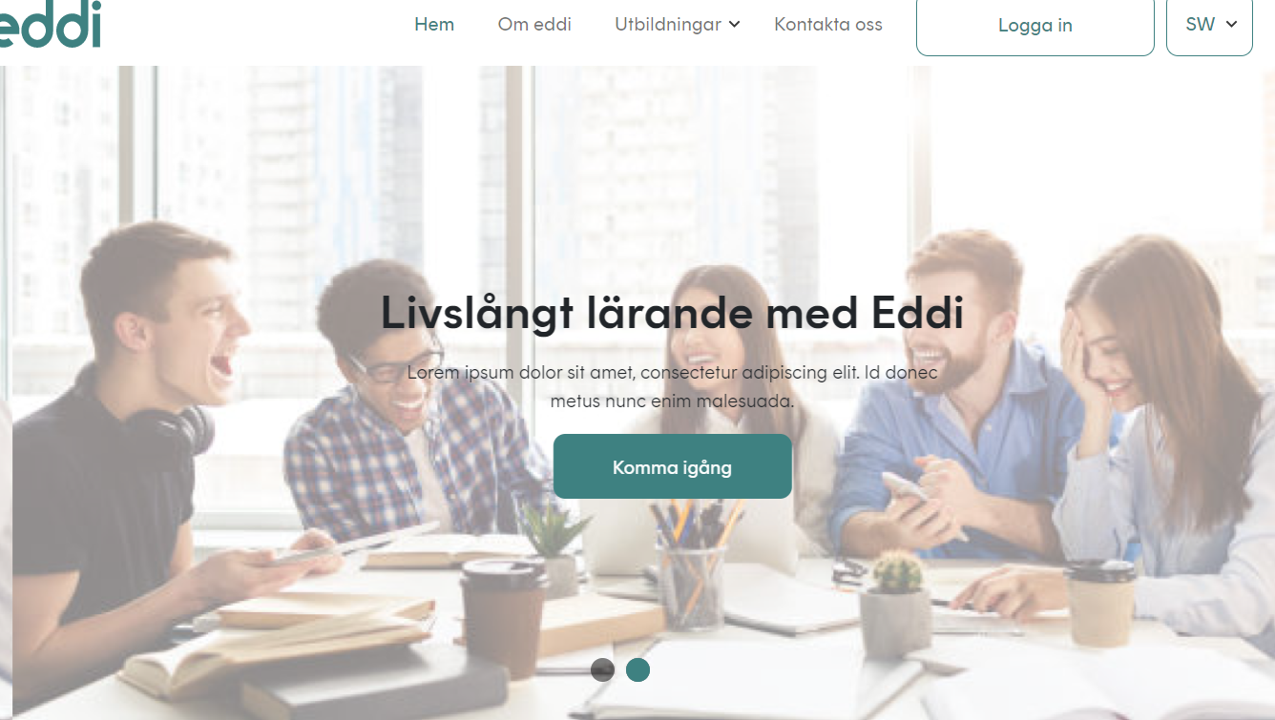
Layout according to last weeks document
Kom igång

Slide 8
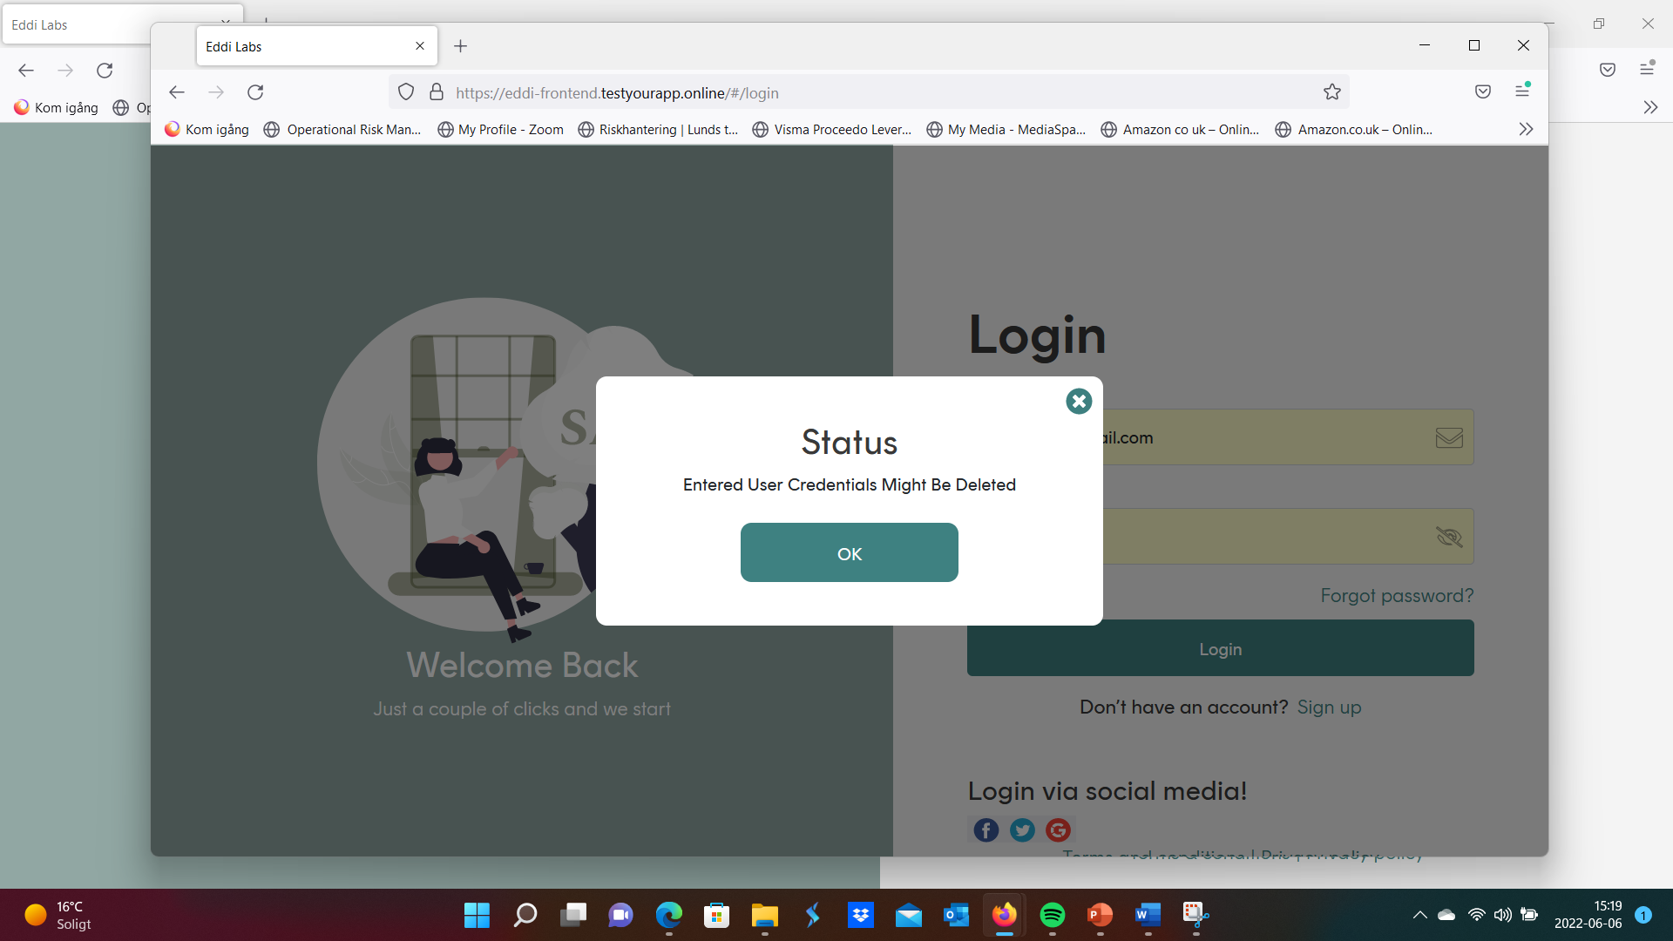
Using my latest credentials to my krka5909@gmail.com account – Get this notification.

Slide 9
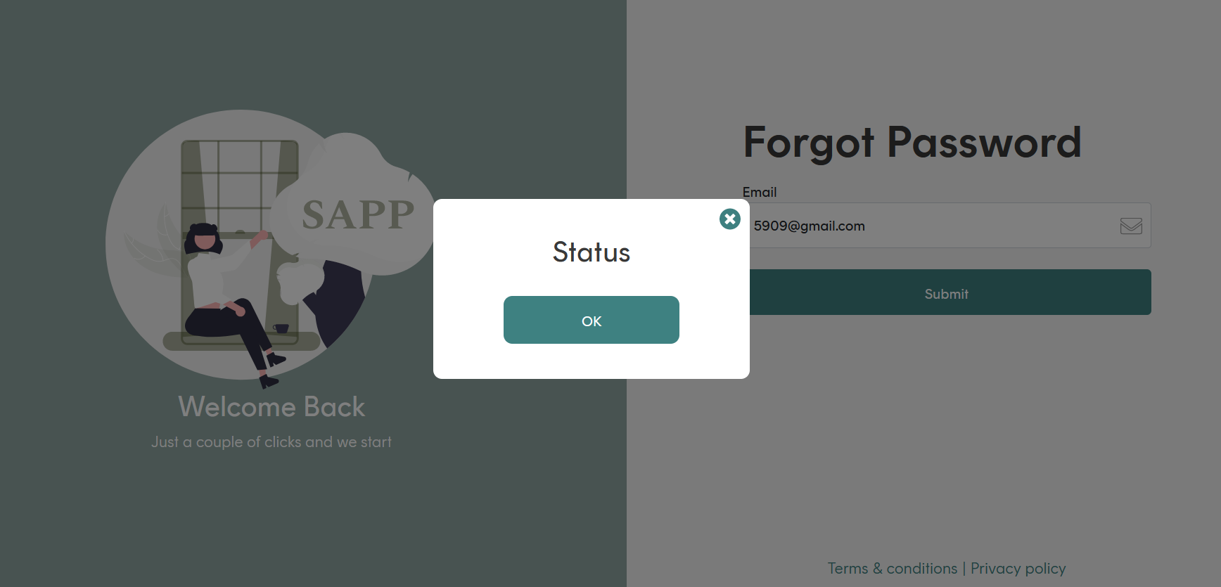
Requesting a new password… Says Status OK, but no link. Notification should be – validation… email.. Etc..

Slide 10
Have some important input to the inner pages – mostly wording, and a few fields that needs to be fixed (e.g. profile 1-4).. And some swedish translation to inner pages that is faulty.
Best, K

