Slide 1
Comments on Eddi 7 May
Notification general to CMS – do we need info about cookies. Will and third party, e.g. google collect cookies – then we might need that general info? What do you say?
FRONT END – INNER
General comment on inner ”profile” – Need for saving functionality/ info saving in various steps ”temporarily” before ”creating the profile” – If you move from professional info – back to e.g. personal info (all info in previous is lost) – (need to fill in again).
This is a problem faced also when logging in to the platform and you read the terms & conditions – when you return to login view – info e.g. (email and password) is gone. ==> its working as i have showed in demo also we are saving the data as well
KK: Ok will check – perfect!!

Slide 2
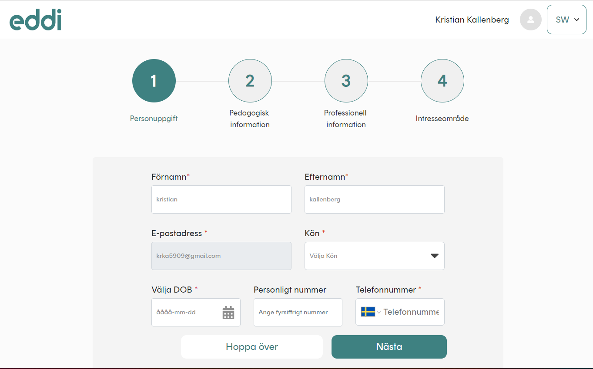
Rename:
Utbildning och kompetens-Done
Rename:
Yrkesroll-Done
Layout (according to previous comment)
Rename:
Allmän information-Done
Rename:
Intresseområden-Done
REMOVE:
Remove personligt nr and box (swedish and ENG). We might need it as compulasry info in the invoices – but remove from here
(other two boxes can be enlarged) ==> need to discuss
COMMENT: Talked with Max – and it can be that users feel we ask for too much information. We don’t need it for creating the profile-
Done
O
New Comment. This is in English –
Should be: Födelsedatum---
Done
New Comment.
Same size font as other..-Done

Slide 3
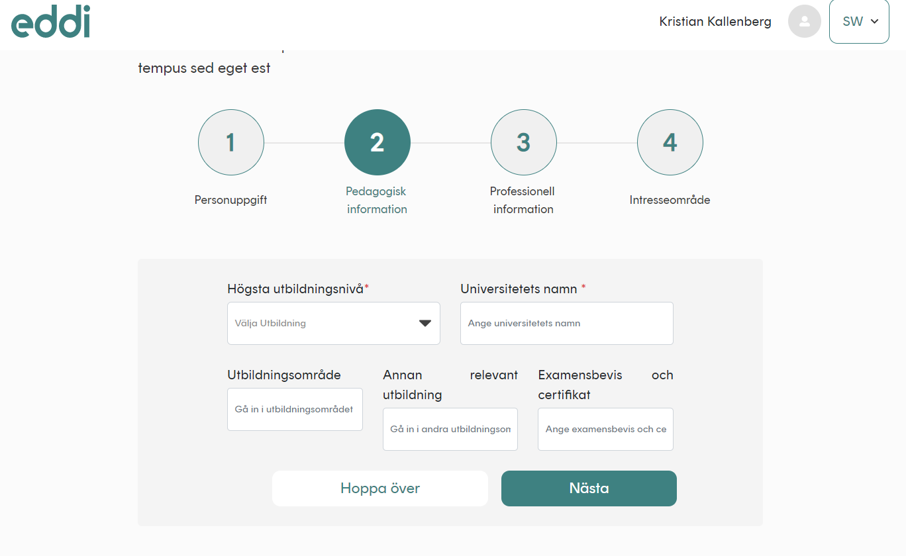
What is this text here, what kind of info? Dynamic?
THIS IS OK
In drop down here – add:
Doktorsexamen (bottom/last option)-Done
1, 2,3,4 See comments page 2 in this document-Done
Välj utbildning-Done
(plural) Andra relevanta utbildningar-Done
Not sure it’s a uni –
Rename:
Utbildningsinstitution-Done
Skriv utbildningsområde-Done
Ange namn-Done
LAYOUT…. Text and boxes… text should be one row… Pending
Skriv andra utbildningar du har-Done

Slide 4
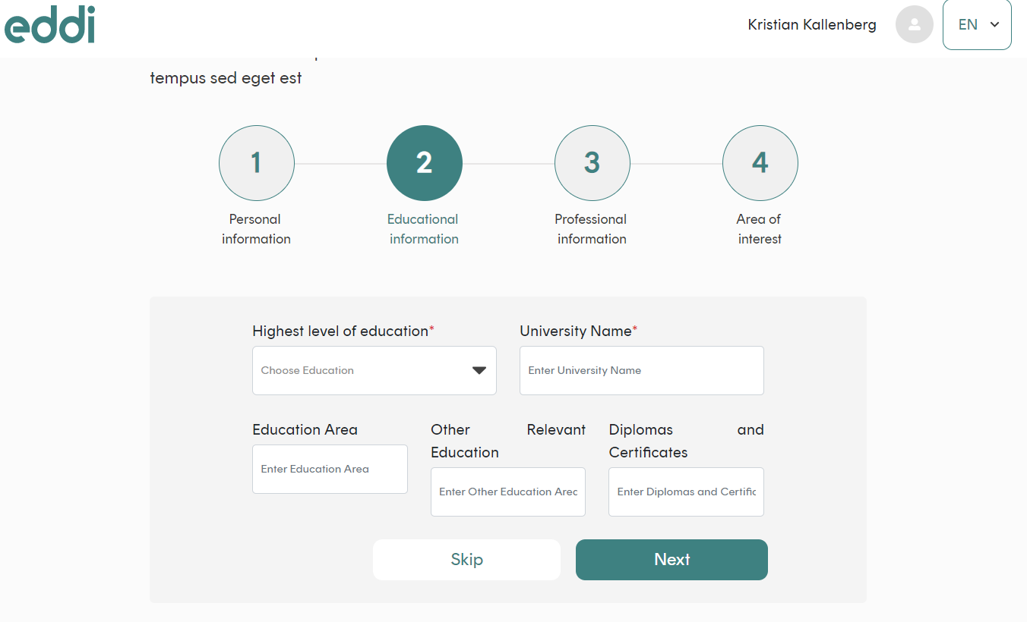
UK version (eng) – same comments (as to the swedish version) to layout etc.
Educational institution=Done
In drop down here – add:
Phd-Done
These three boxes – possible to add, several? Or ONLY ONE Other education?
Should then be areas (plural). Make sure layout is consistent, and ”inbox text” fits into the box..
New Comment
First letter CAPITAL.. Others small --
Done

Slide 5
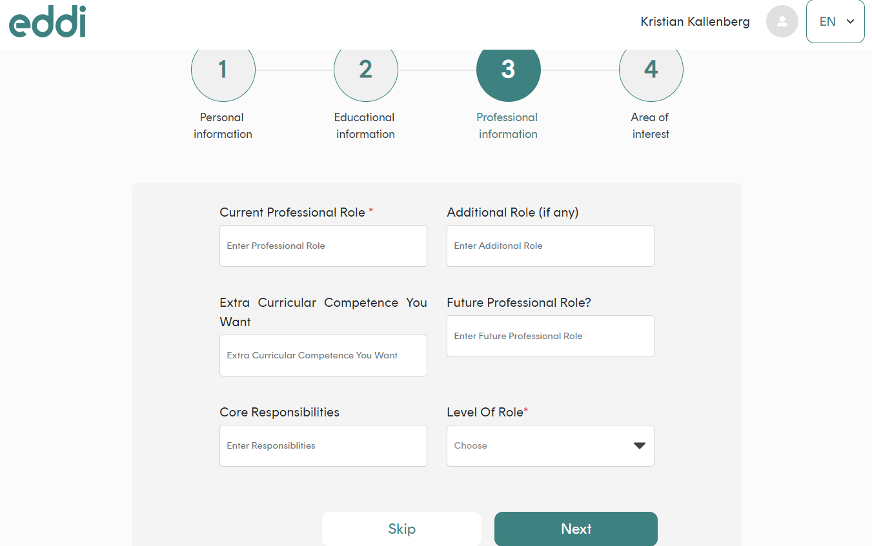
Eng version ok –
Minor fix –
Put boxes in order of relevance) same for sw version –
(row one ok, row two (core responsibilities and level of role (small ”o”) in header..
Row three Future professional role, then finally, box nr 6 - extra curricular box… ==> what screen resoultion you are using ? OK so that’s the problem? --Done
Previous comment to the right… NB: order here same as in the swedish flow… see next page..
Current professtional, 1, additional, 3, Core/level of role, then Future, professional, and last field extra curricular

Slide 6
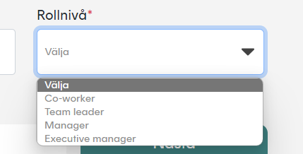
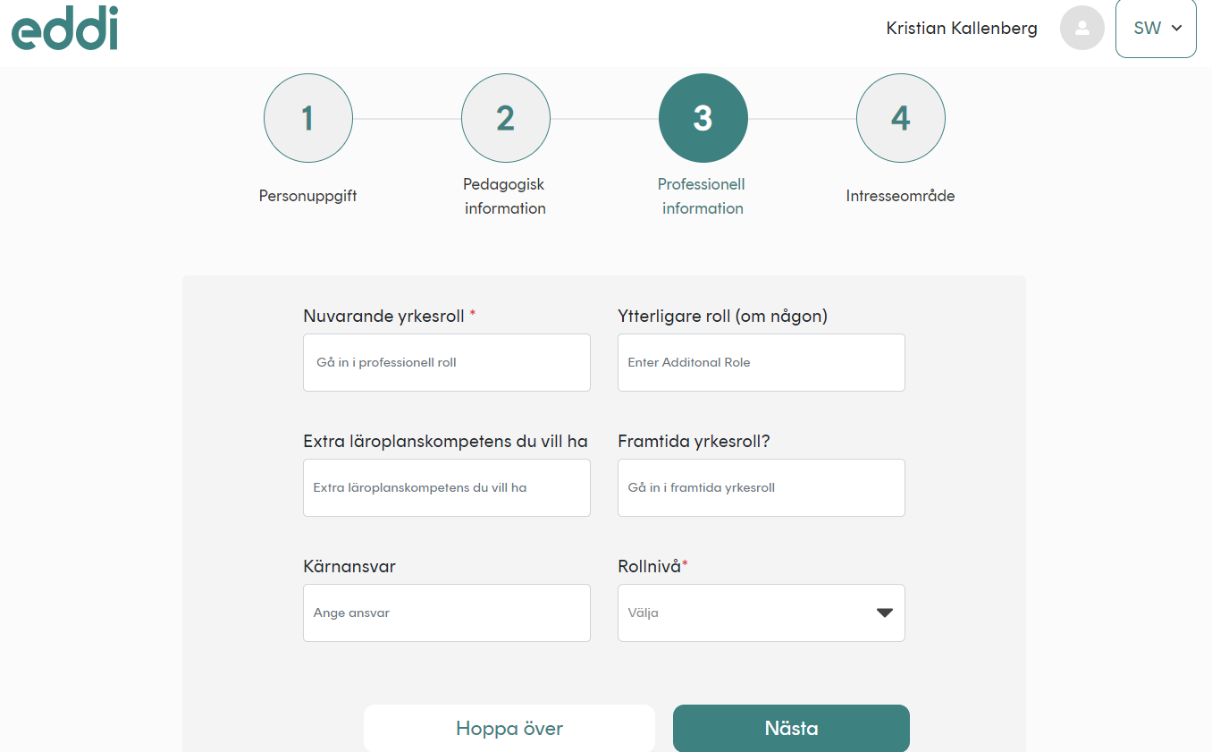
Co-worker = Medarbetare
Team leader = Gruppchef
Manager= Mellanchef
Executive manager = Högre chef-Done
Skriv ytterligare roll
Done
Skriv nuvarande roll
Done
Framtida yrkesroll (remove ?- questionmark)-Done
Put as last box (now rollnivå)
Reame:
Fritidsutbildninar (språk, data m.m)
Done
Reverse these four boxes…extra curricular last..
Skriv in din framtida drömroll
Done
Lägg till områden (t.ex. franska)
Done
Huvudsakliga ansvar
(could be plural yes?)
Done
Välj-Done

Slide 7
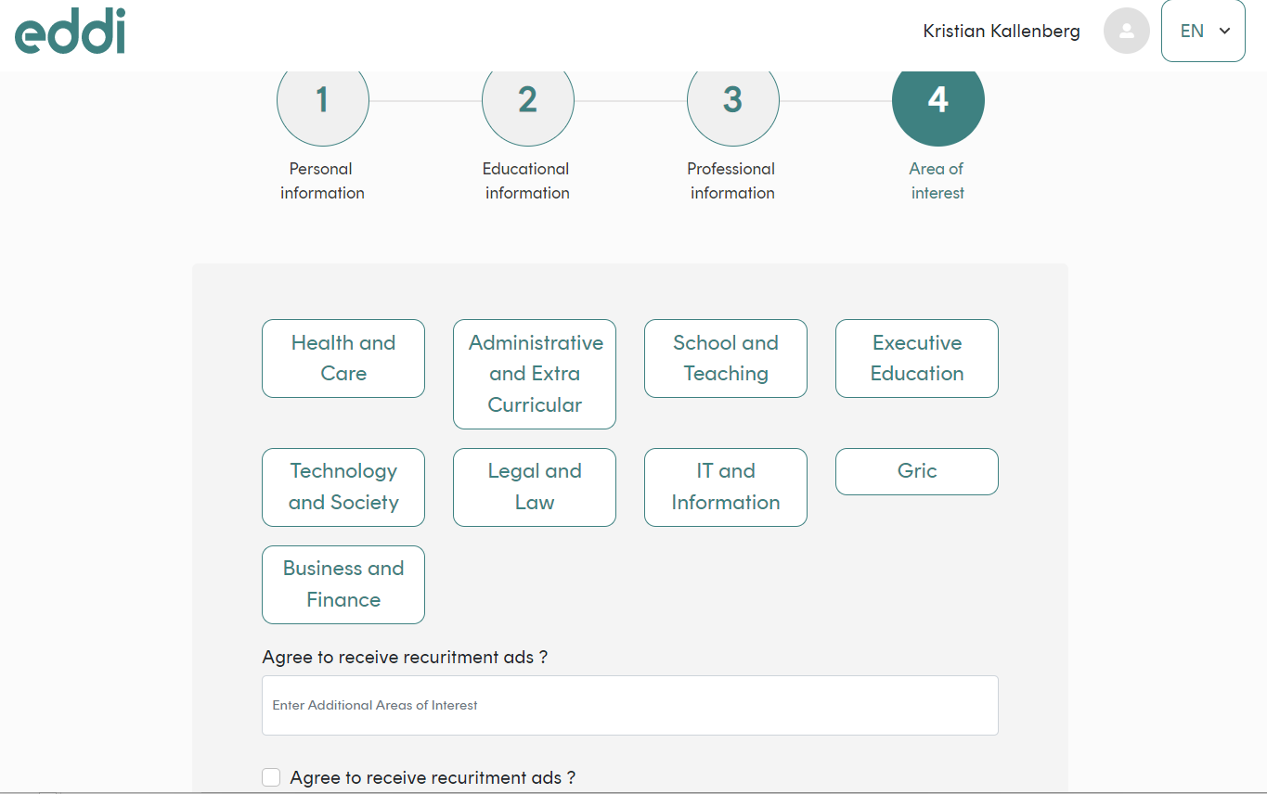
Should likely be ”areas” of interestDone
Layout – boxes must be the same… smaller text font? Or how to solve – it looks vey fuzzy with various sizes..
Use same (Capital/non capital letter) as on other places)
(capital letter on first)
Add (separated by comma)-Done
Not recruitment ads here…
Should be:
Additional areas of interest-Done
(capital letter on first)
We talked about a full bar/other layout to highligt this choice…Maybe not agree to receive… (I am also interested in recruitment information)

Slide 8
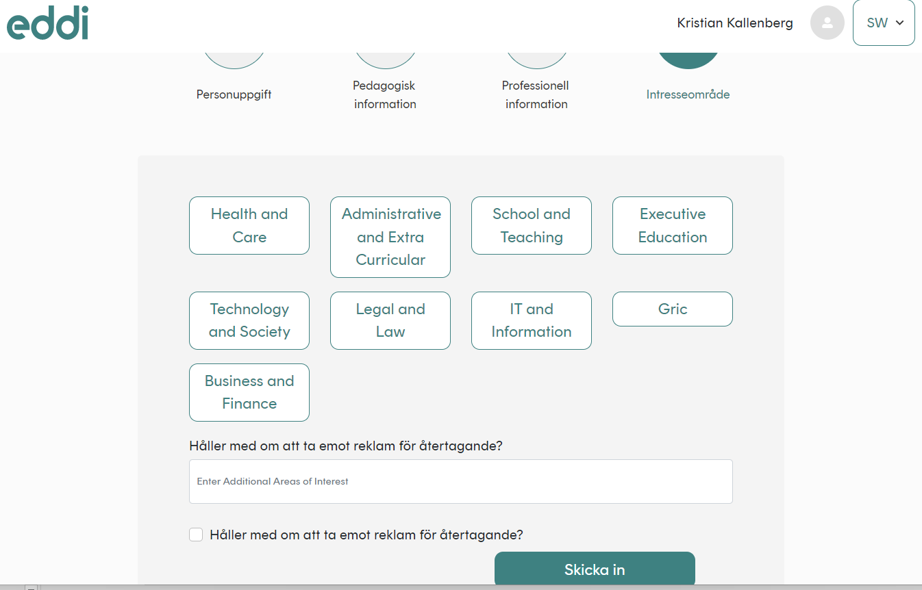
1, 2,3,4 See comments page 2 in this document
Same as for UK – layout…
(fixed boxes – smaller font? ) we can’t have three/four sizes of boxes.. ☺
Lägg till ytterligare områden-Done
(Not about ads here)
Lägg till ytterligare områden du är intresserad av-Done
As for eng version – layout more pronounced…
Text: Vill du ta emot information om nya arbetsmöjligheter? -Done

Slide 9
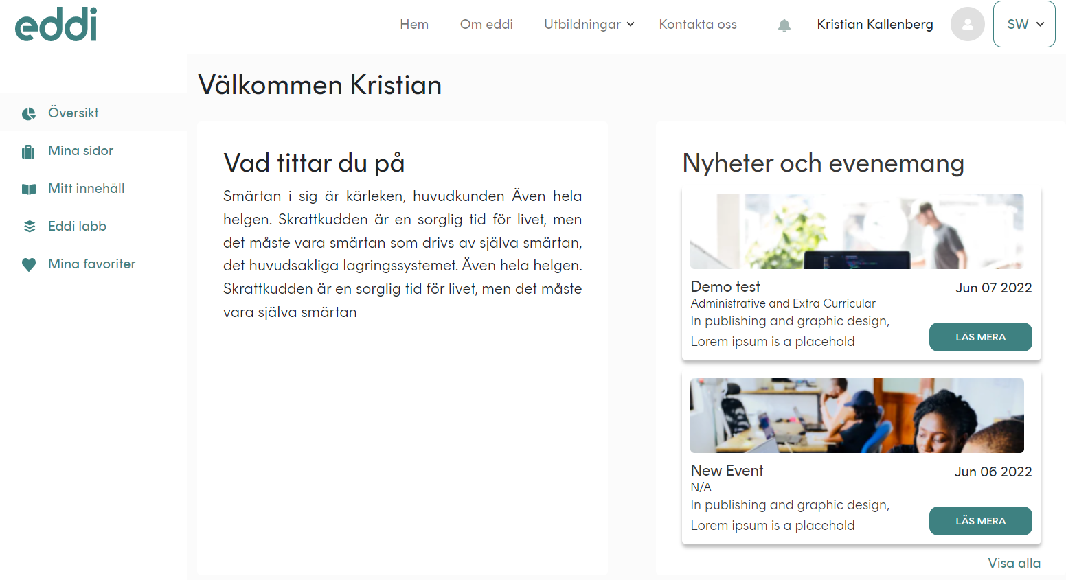
Översikt (is in off white area – move down to other side bars below.. White are…)(Background color) ==> i didn’t get you here ?
Om Eddi (Eddi is a name)-Done
Bigger Font size – Is all this Font ”rund”? -
Eddi labs-Done
New Comment
´It might be ok – but Översikt/dashboard is placed on “off white frame… (as is Välkomment Kristian)… Might be ok.. But thinking if it looks better to move down to the other side bar headings… In “white/white” field… ☺ It’s only a layout issue

Slide 10
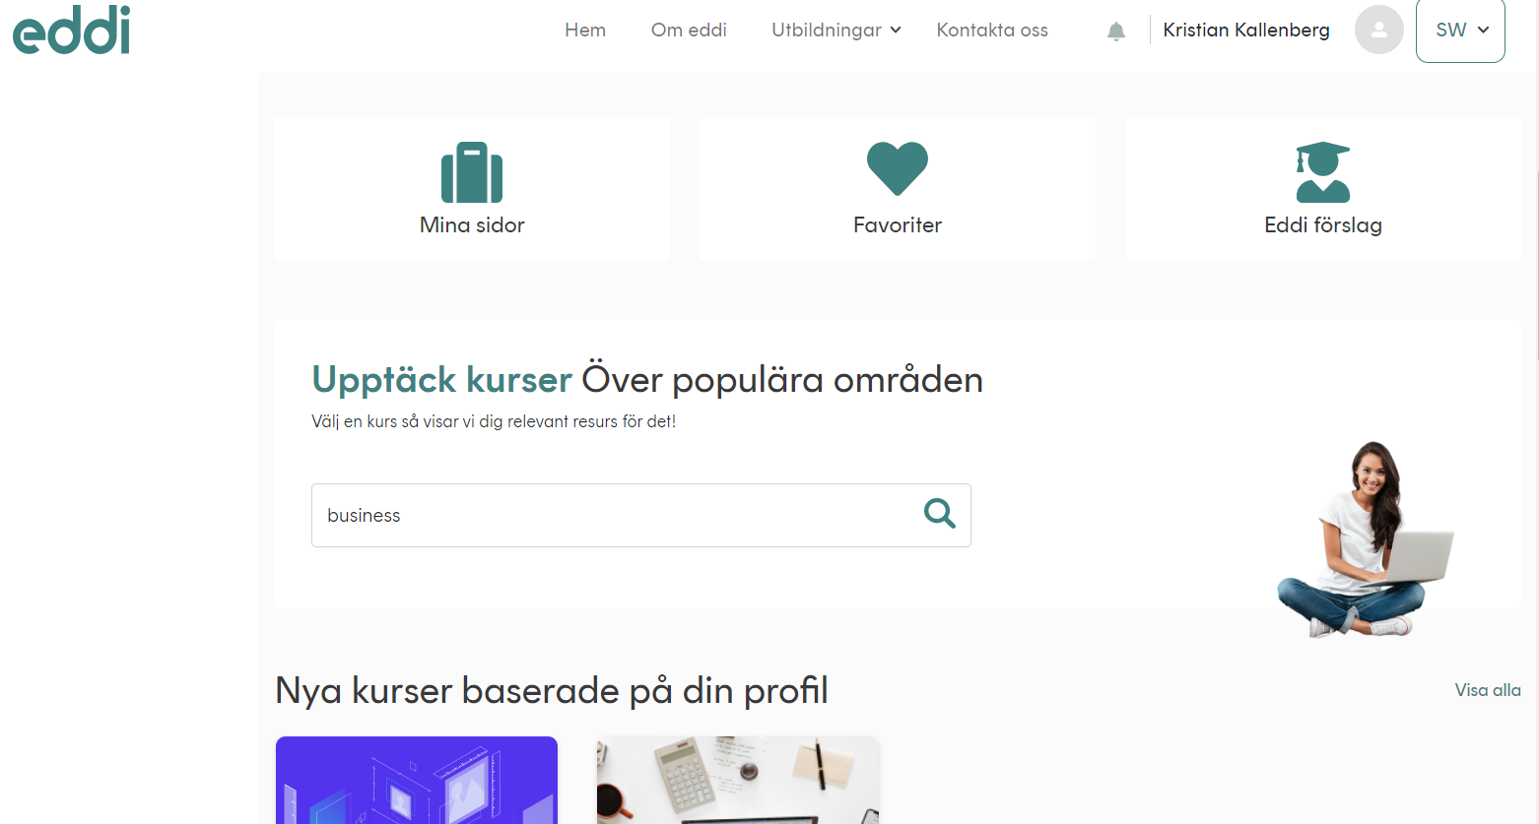
Hitta utbildningar som passar dig-Done
Sök, välj och läs mer-Done
Search bar bigger or move ”girl” a bit to the left?
Nya utbildningar baserade på din profil-Done

Slide 11
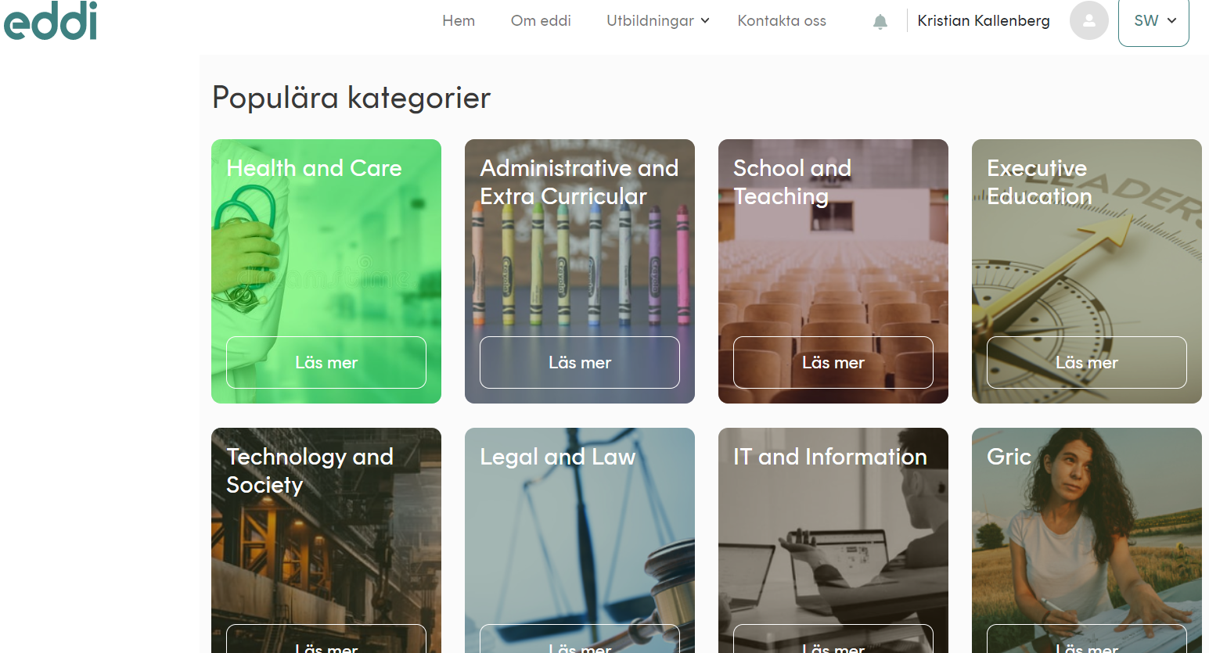
We decided ”read more” läs mer” about a course category should be landing in ”info” category pages (same as from CMS/home) – Then directed to search functionality (filtered) for that specific course category… Now – you are directed from swedish dashboard (översikt) to English search funcationality (same as you find just above this field… ) ==> can you breif again ?
New Comment
If you click read more/or läs mer in CMS or when in login mode….you end up in searchbar… Popular categories…should be linked to inner page with info about that educational area… Then in step two, if in CMS you end up (with pop up info: in order to search for courses you need to be logged in), if in inner (already logged in) you are still able to read about the “categories” but then a button search courses within xyz, you end up in filter/search bar (as now)

Slide 12
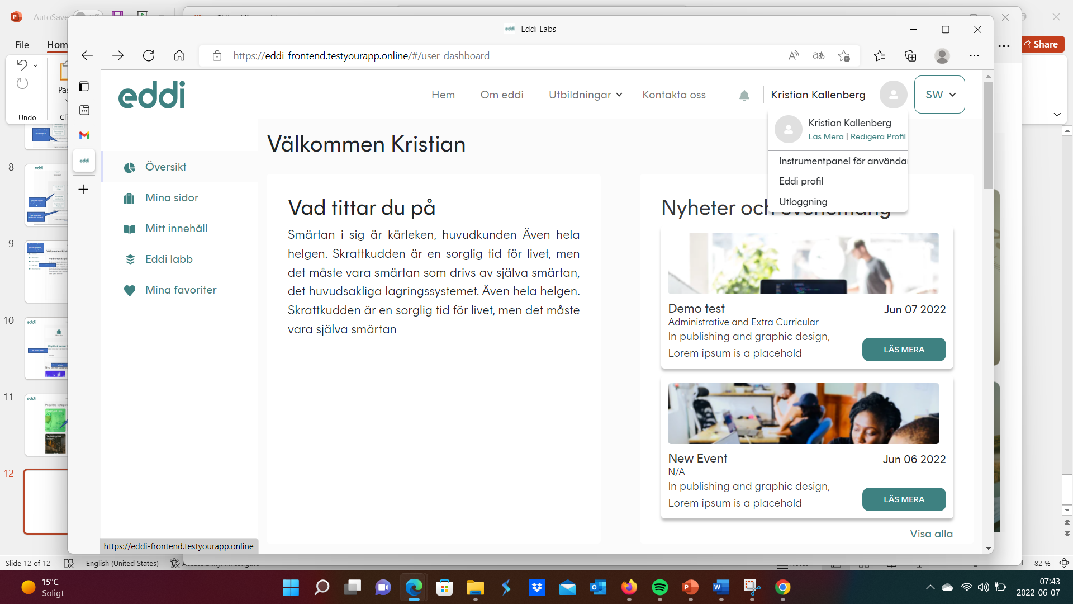
Läs Mera should be = Läs mer
Redigera Profil = Redigera profil
Instrumentpanel….= Översikt
Eddi profil = Min profil
Utloggning = Logga ut-Done

Slide 13
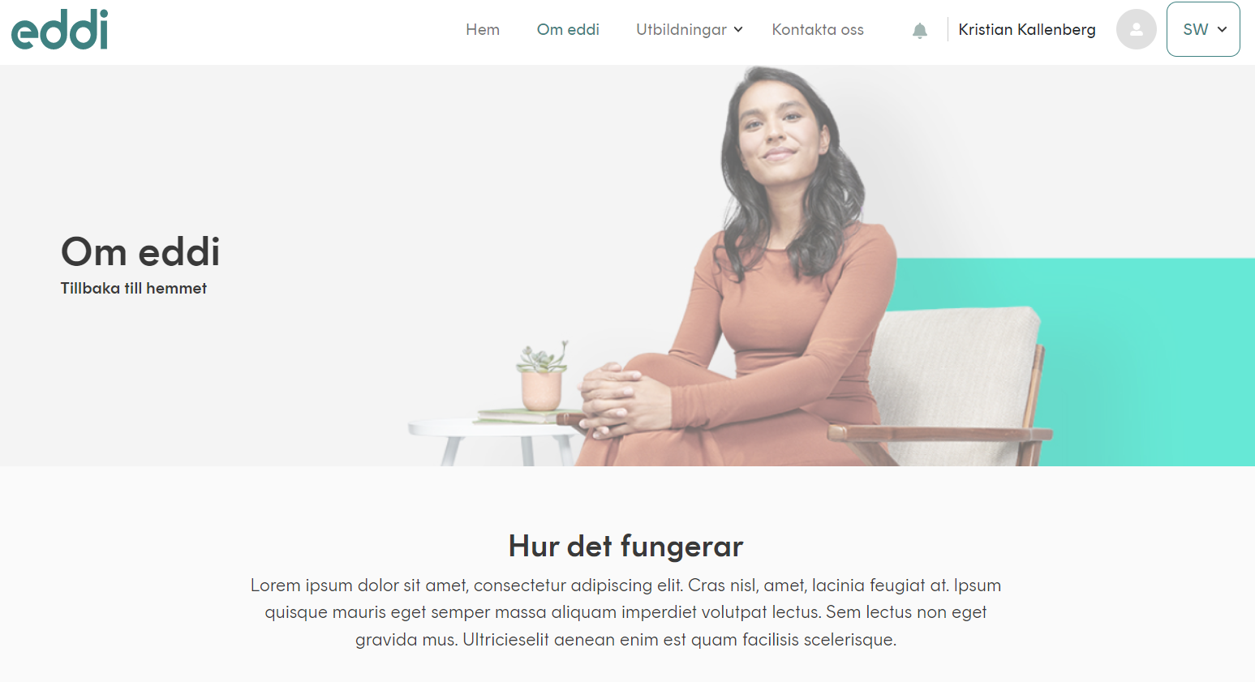
Only for about eddi/om eddi – When using swe version – and you click on ”om eddi” (about eddi) – you first see the English version – must be direct display of swedish content. Works for all other pages..
As before… Remove (tillbaka till hemet) and Home on English pages.. Done
New Comment
Please also check privacy/terms – when I checked this morning it was still there (tillbaka/bock to home)

