Slide 1
Input course presentation.. 11 Aug

Slide 2
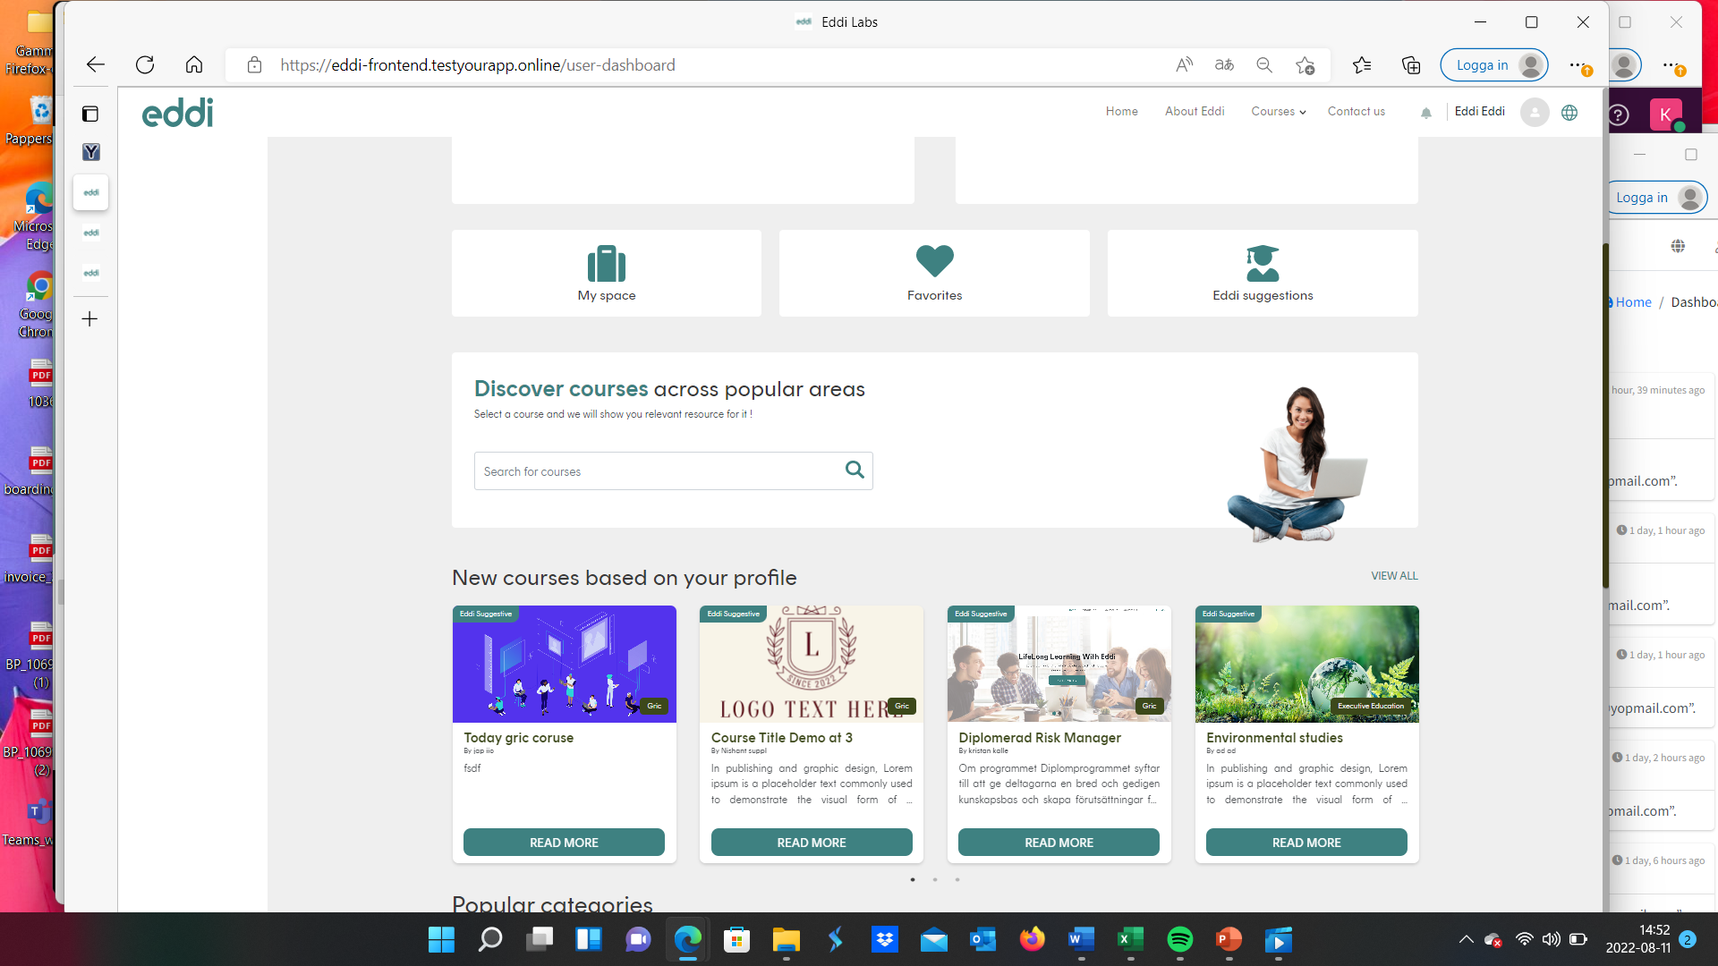
If you click on View all then it is the same as clicking above on Eddi Suggestions… There we present ”all relevant courses” to the student… AS NOW… We present ”all categories”… Which is not relevant to the user… VALUE is our suggested courses based on their profile
In dashboard … First page… Here are ”eddi suggestions” (not Eddi Suggestive)… Presented in ”one” row.. This row is not restricted to 4 or 6 courses. Is that possible? It therefore need ”arrows” to move left or right in this ”one row”….

Slide 3
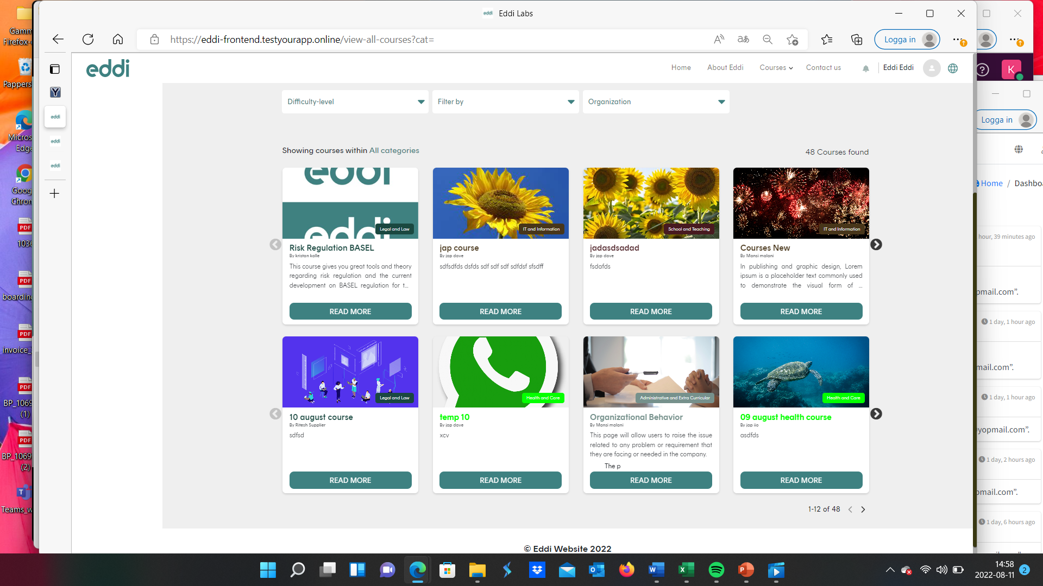
In this view – It’s eddis suggestions.. Should only be relevant courses aligned with the profile…
With regard to layout and presentation… I DON’t think this way of presenting is the best.. As it will be unclear to user.. How many courses there are in each row..
I would therfore sugest we have a FIXED presentation (I have shared input in previous PPT:s)
SO, Preferably – 4 in a row – with three rows.. 12 in total for ”one page”..( In WEB mode).. In Ipad mode – 2 in a row, 6 rows.. (one page)… and mobile: … 1 in a row, 12 rows… (or perhaps only 6 rows for each ”page”..
There is no logic in these inner page.. To show 8 where 4 is ”hidden”… (2 are hidden in each row)

Slide 4
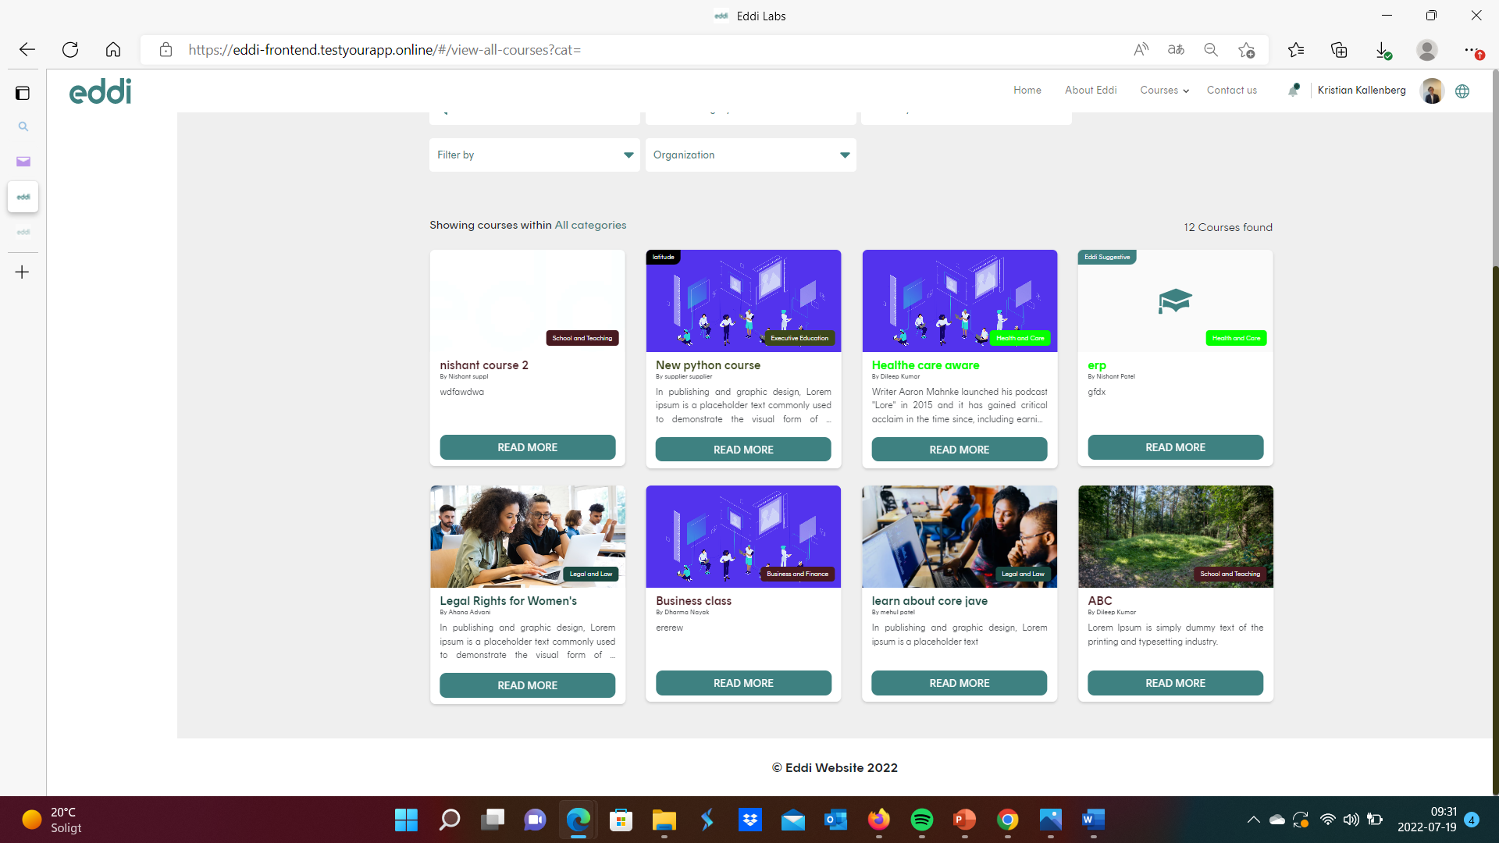
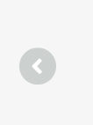

If we go for 12 (or 18) courses in ”full page” presentation… we will probably need to scroll that full page of 12 (18) courses… Still… it is ”locked” content.. Always showing 12 (18) courses in one ”page view”…
YOU decide if we go for 12 (4 times three) in one page..
If 12 (4 x3) we might need this arrow navigation both in top an bottom of ”content”
Showing.1-8 of 12

Slide 5
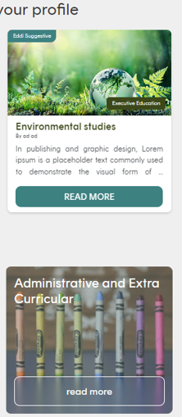
Showing.1-8 of 40
Showing.1-8 of 40
MOBILE FLOW…. Same for newest, eddi suggested, filtered etc… always… fall down… courses one in a row… and locked to 6 (12 will probably be to many) in a row (falling)… then arrows in top and in bottom… to move the whole ”6” group of courses… to see 6 totally new…
If better, and aligned with desktop… we could choose a maximum of 12 in a row… (corresponding to a full view in desktop where we present 12 courses full screen.
In ipad – guess 2 in a row or 3 is good, then ”full view” will be 4 rows.. And each page is then 12 courses..
Showing.1-8 of 40
Showing.1-8 of 40

