Slide 1
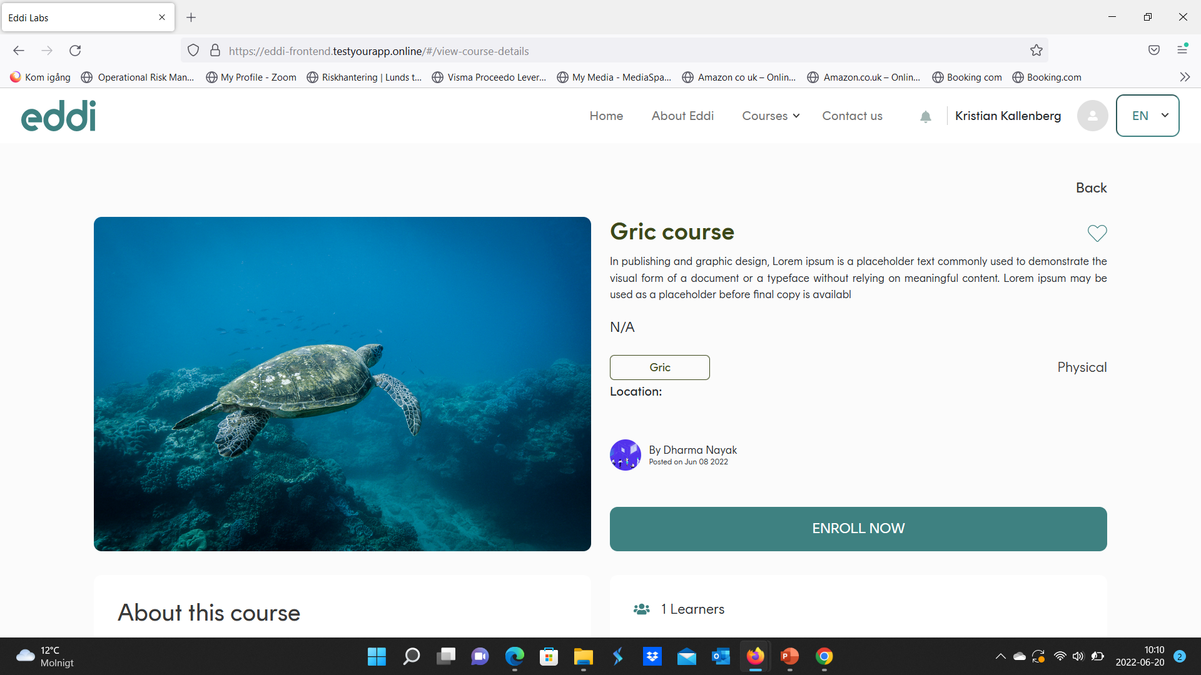
Would perhaps be good with a comment/title: what is not n/a?
The categories are physical/online/hybrid?
Do we need a Title above? (e.g. Type of course: )

Slide 2
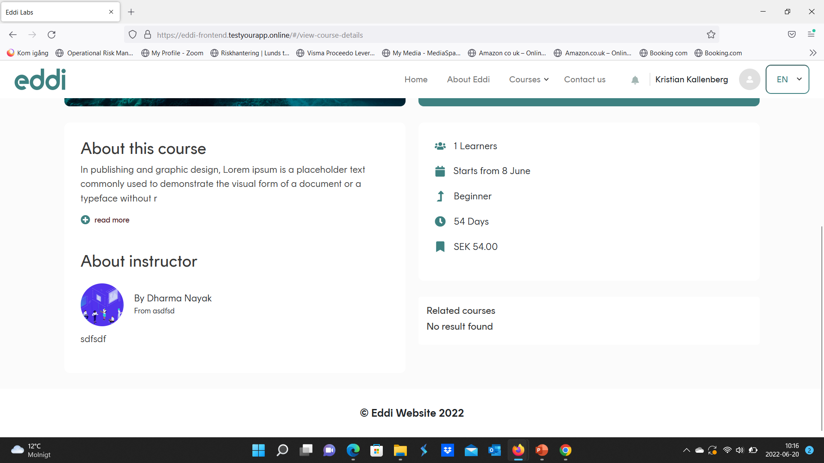
Possible to use smaller font for (No results found) (

Slide 3

Swedish flow…. More personal and engouraging (use: REGISTRERA DIG NU)

Slide 4
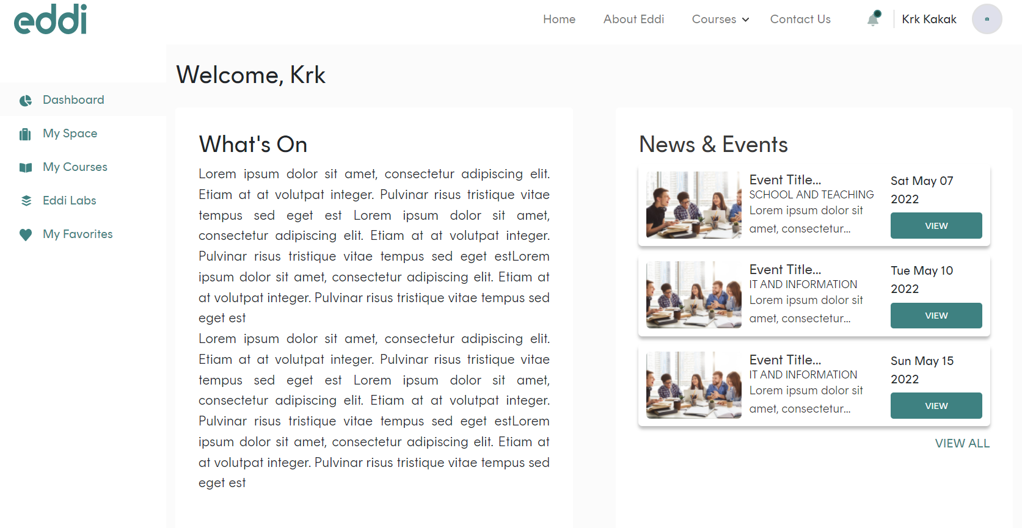
Would be better (gramatically) with: ”Läs mer” (not ”mera”)
Läs mera
Läs mera
Läs mera
Se allt innehåll

