Slide 1
ADVANCED SQL – IMDB DATASET
MAUL SRI M
21/01/2025
DA & DS – JULY B5

Slide 2
INTRODUCTION
Reinforce key SQL concepts such as joins, aggregation, filtering, and grouping.
Analyze and extract meaningful insights from a real-world movie dataset.
Discuss any potential implications or future research areas.

Slide 3





Overview
GENRE
ROLE MAPPING
DIRECTOR MAPPING
NAME
RATINGS
MOVIE

Slide 4
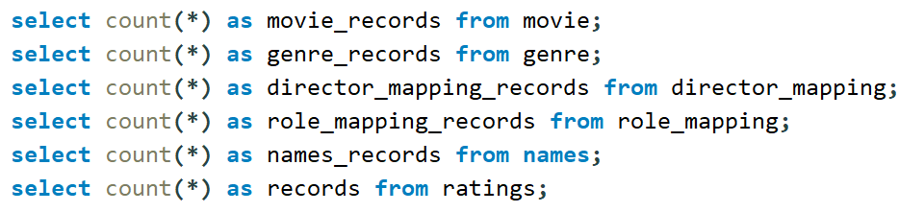






1. Count the total number of records in each table of the database
OUTPUT:

Slide 5
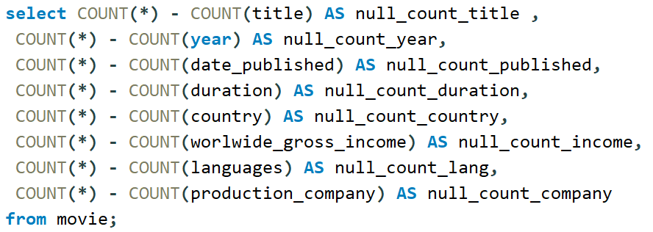
2. Identify which columns in the movie table contain null values.
OUTPUT:

Slide 6
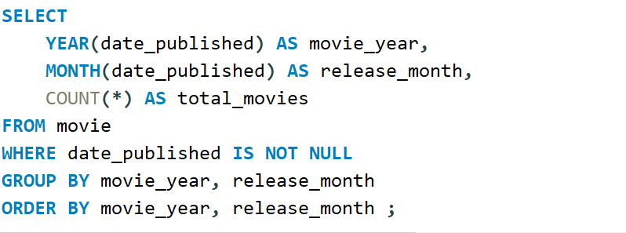
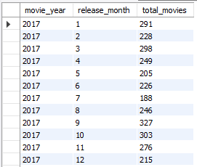
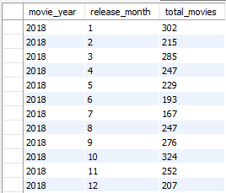
3. Determine the total number of movies released each year, and analyze how the trend changes month-wise.
OUTPUT:

Slide 7
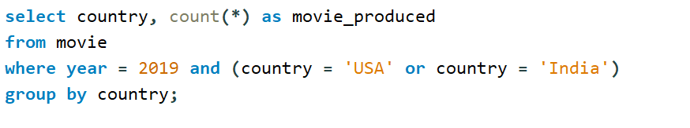

4. How many movies were produced in either the USA or India in the year 2019?
OUTPUT:

Slide 8
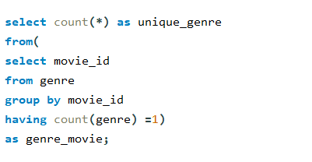

5. List the unique genres in the dataset, and count how many movies belong exclusively to one genre.
QUERY:
OUTPUT:

Slide 9
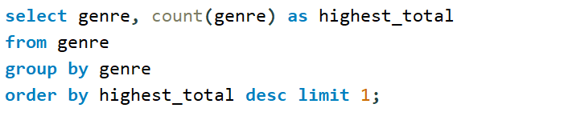

6. Which genre has the highest total number of movies produced?
OUTPUT:

Slide 10
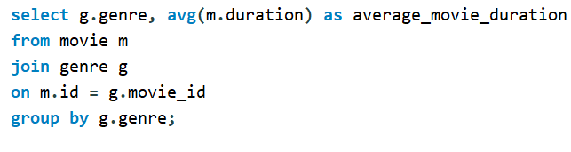
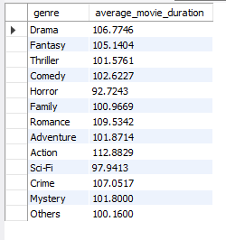
7. Calculate the average movie duration for each genre.
OUTPUT:
OUTPUT:

Slide 11
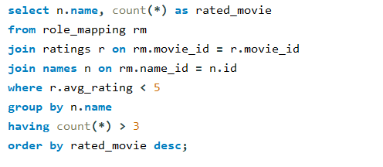
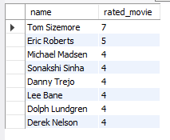
8. Identify actors or actresses who have appeared in more than three movies with an average rating below 5.
QUERY:
OUTPUT:

Slide 12
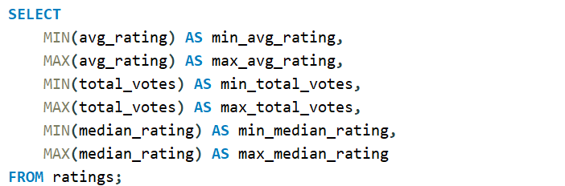
9. Find the minimum and maximum values for each column in the ratings table, excluding the movie_id column.
OUTPUT:

Slide 13
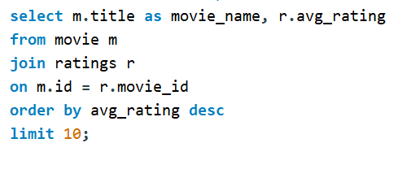
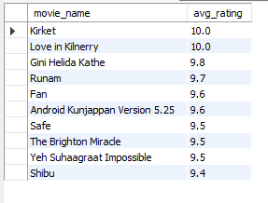
10. Which are the top 10 movies based on their average rating?
QUERY:
OUTPUT:

Slide 14
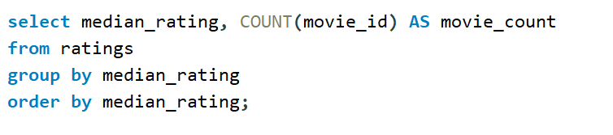
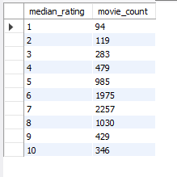
11. Summarize the ratings table by grouping movies based on their median ratings.
QUERY:
OUTPUT:

Slide 15
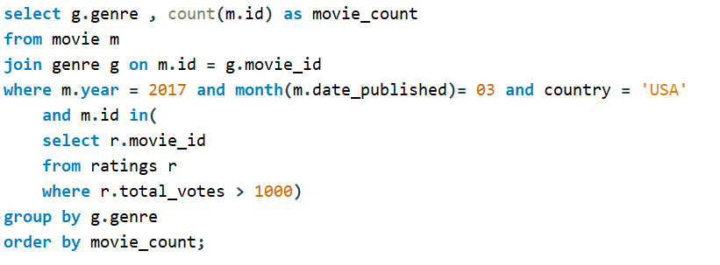
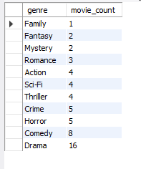
12. How many movies, released in March 2017 in the USA within a specific genre, had more than 1,000 votes?
QUERY:
OUTPUT:

Slide 16
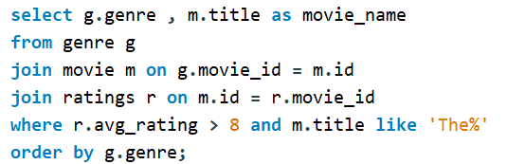
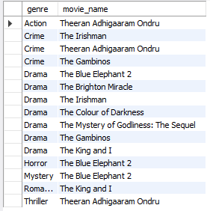
13. Find movies from each genre that begin with the word “The” and have an average rating greater than 8.
QUERY:
OUTPUT:

Slide 17
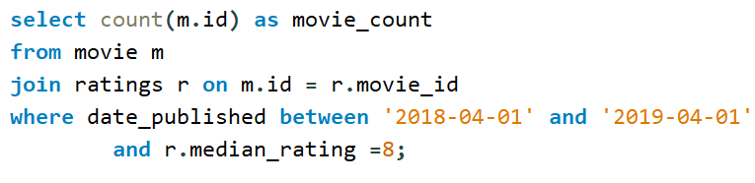

14. Of the movies released between April 1, 2018, and April 1, 2019, how many received a median rating of 8?
OUTPUT:

Slide 18
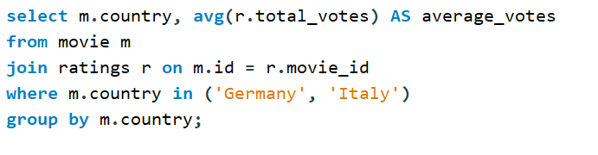

15. Do German movies receive more votes on average than Italian movies?
OUTPUT:

Slide 19
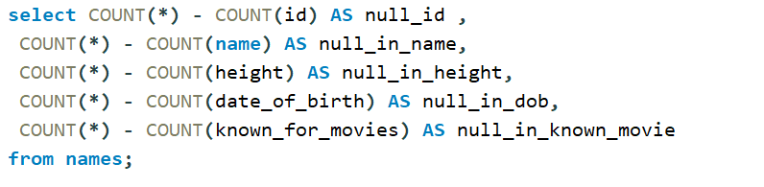

16. Identify the columns in the names table that contain null values.
OUTPUT:

Slide 20
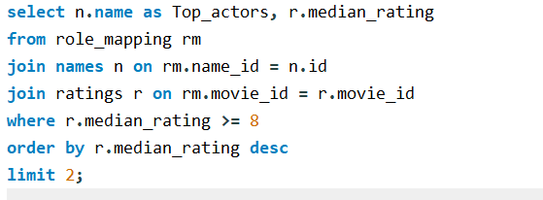

17. Who are the top two actors whose movies have a median rating of 8 or higher?
OUTPUT:

Slide 21
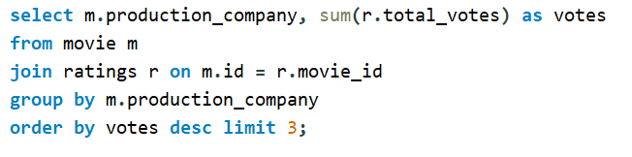

18. Which are the top three production companies based on the total number of votes their movies received?
OUTPUT:

Slide 22
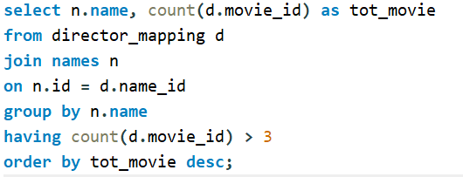
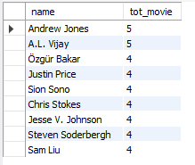
19. How many directors have worked on more than three movies?
OUTPUT:

Slide 23
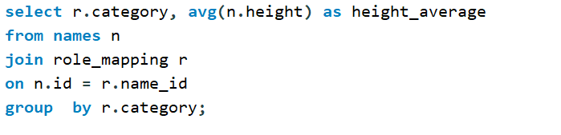

20. Calculate the average height of actors and actresses separately.
OUTPUT:

Slide 24
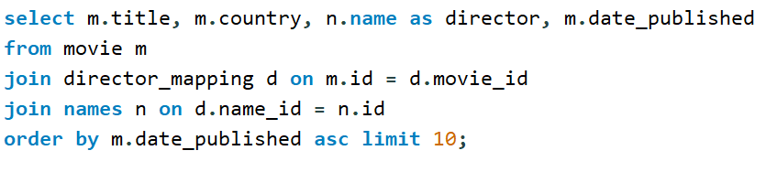
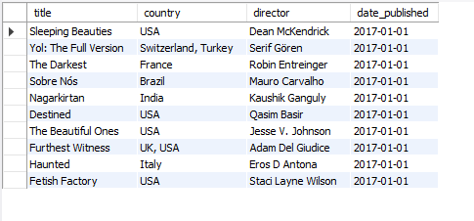
21. List the 10 oldest movies in the dataset along with their title, country, and director.
OUTPUT:

Slide 25
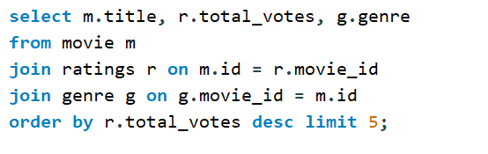
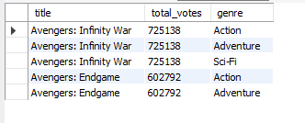
22. List the top 5 movies with the highest total votes, along with their genres.
OUTPUT:

Slide 26
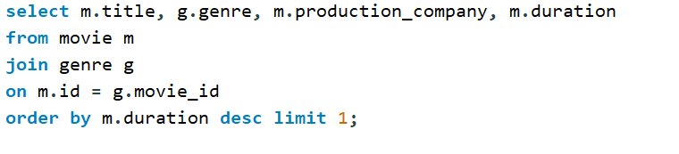

23. Identify the movie with the longest duration, along with its genre and production company
OUTPUT:

Slide 27
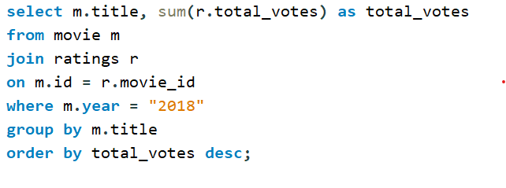
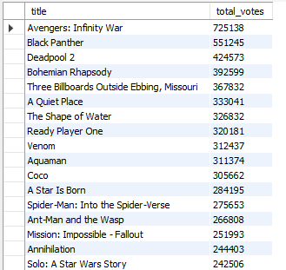
24. Determine the total number of votes for each movie released in 2018.
QUERY:
OUTPUT:

Slide 28
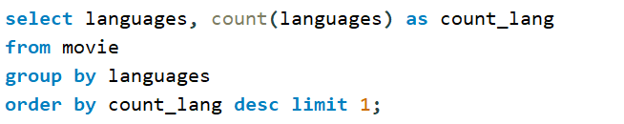

25. What is the most common language in which movies were produced?
OUTPUT:

Slide 29
KEY INSIGHTS
The title of drama genre is mostly start with the word “The”.
391 movies are released between April 1,2018 and April 1, 2019.
German movies receive more average votes than Italian movies.
Marvel Studios is the top production company.

Slide 30
CONCLUSION
Extracted meaningful data from complex datasets.
Examined movie ratings and genres
Analyzed the performance of actor/actress.
Better understand patterns in movie production

Slide 31
THANK YOU

