Slide 1

ANALYSIS OF CAREER TRAJECTORIES
MAUL SRI M
DA/DS - B5
13/02/2025

Slide 2
INTRODUCTION
Analyzing salary survey data to uncover trends across global industries.
Exploring salary trends and gender disparities across industries and job titles.
Cleaned dataset, SQL queries, Tableau visualizations, story and insights on career trajectories and salary factors.

Slide 3
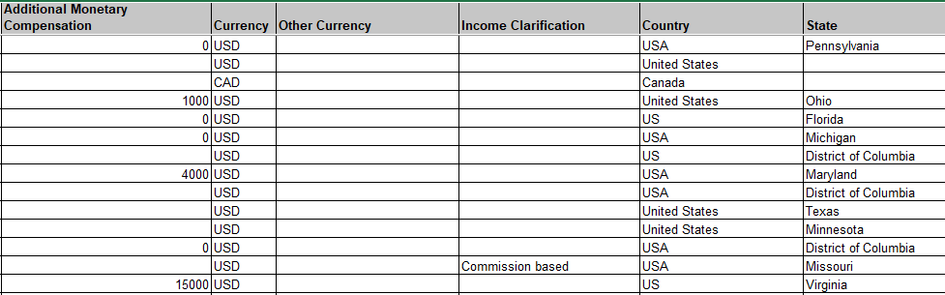
Data cleaning
Ensures text data follows consistent capitalization.
Blank fields are marked as “unknown”
Nearly 200 duplicated rows were removed.
Outliers are detected and removed.

Slide 4
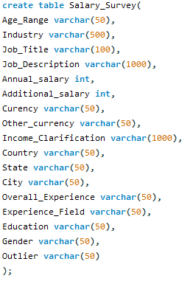
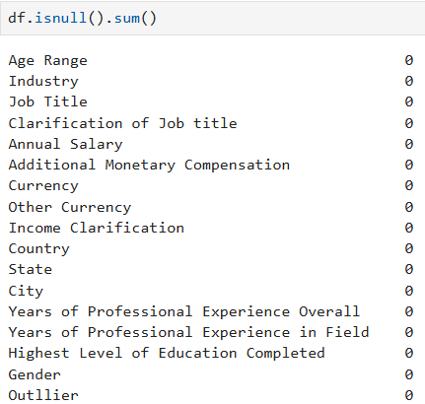
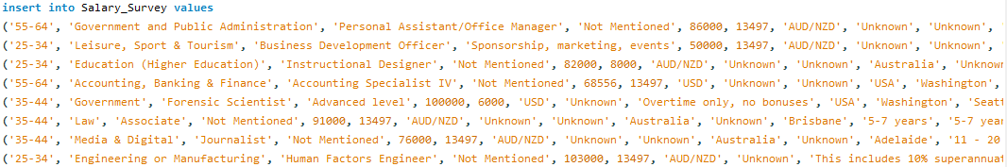
DATA IMPORTING
Create table
Check null
Convert into text
Load into mysql

Slide 5

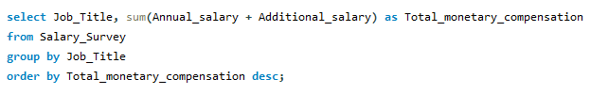
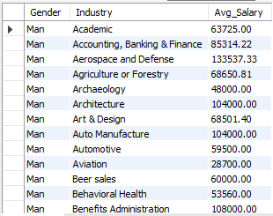
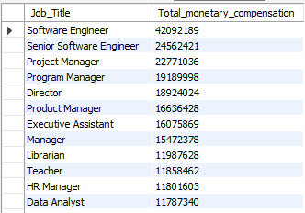
SQL QUERY
Cleaned csv file was loaded.
Performing queries to gathered insights.
Average salary split by gender
Total Salary Compensation by Job Title

Slide 6

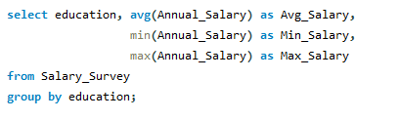
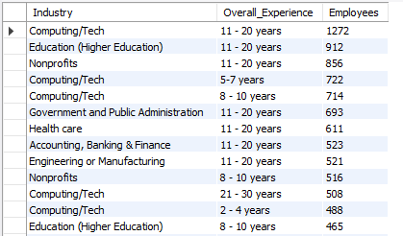
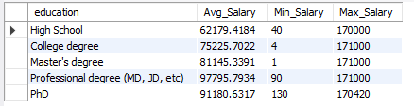
QUERY DATA
Number of Employees by Industry
Salary Distribution by Education Level
Found more experienced profession
Understood correlation between education and salary

Slide 7
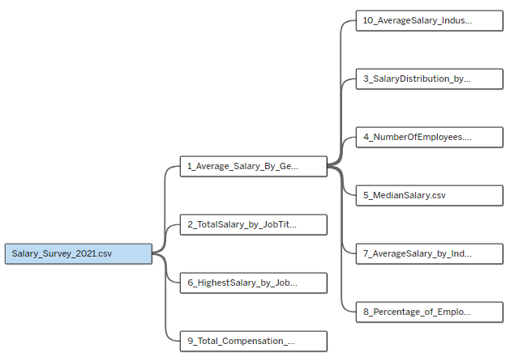
TABLEAU
Dashboard and story plays a major role
Creating a relationship among 10 query data with updated csv data
Creating many to many as well as many to one for connection

Slide 8
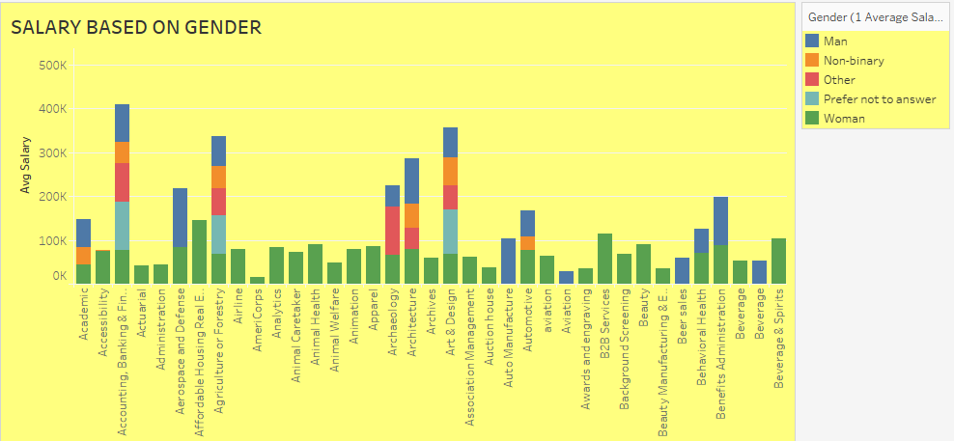
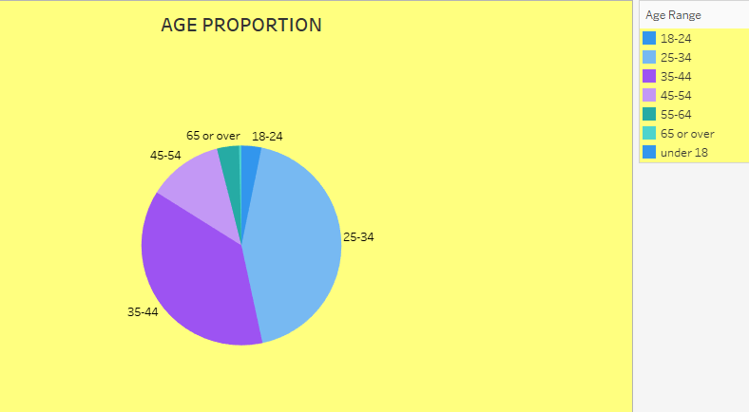
INSIGHT VISUALIZATION

Slide 9
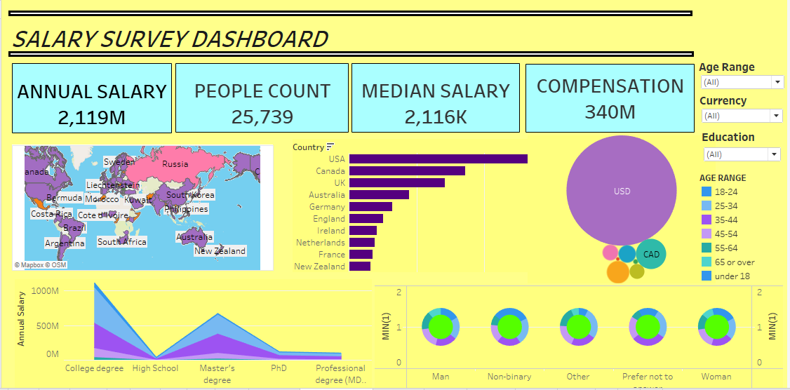
DASHBOARD

Slide 10
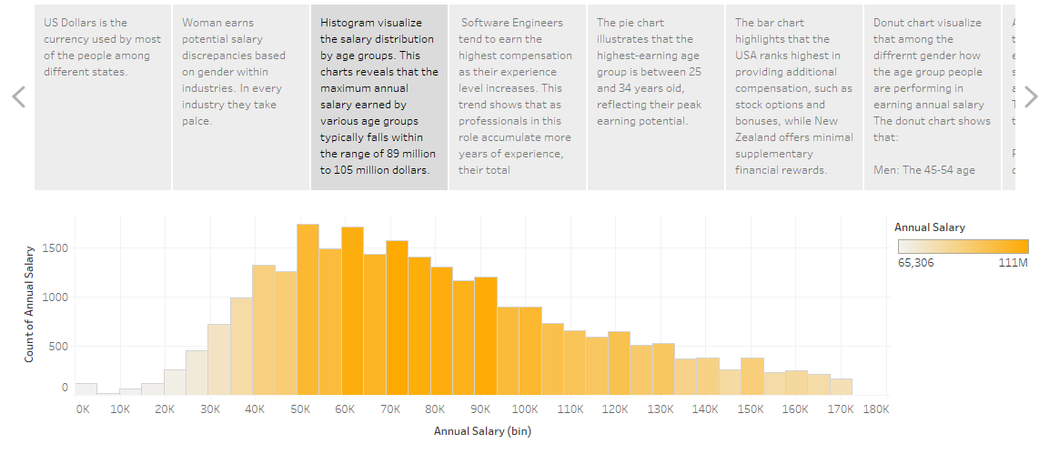
TABLEAU STORY

Slide 11
KEY INSIGHTS
Persist gender pay gaps.
Experienced Professionals in Tech industy.
Software Engineer have the highest overall compensation.
Irvine, Santa Claura offer higher salaries within each industry.
Business and Consulting, Renewable energy, International Organisation are the multiple factors that influence salary.

Slide 12
CONCLUSION
The analysis reveals clear trends in salary distribution.
Reflecting the value placed on their expertise
Higher education levels correlate with higher salaries.
Salary trends shows job satisfaction and company culture.

Slide 13
THANK YOU

