Slide 1
CNN-Based Road Signs Classification
MAUL SRI M
DA&DS B5
02-04-2025

Slide 2
INTRODUCTION
Contribute to traffic management and systems.
Assist in autonomous driving and navigation.
Classify road signs into 30 distinct categories for traffic safety
Used in autonomous vehicles, traffic monitoring, and driver assistance systems to enhance road safety.

Slide 3
OBJECTIVE
Ensuring reliable and efficient road sign classification
Enhancing traffic safety.
Automate road sign recognition.
Intelligent transportation systems.
Deploying it through an interactive interface.

Slide 4
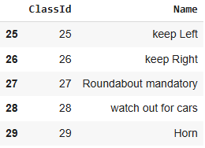
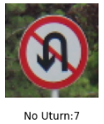
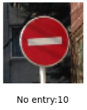
DATA UNDERSTANDING
1.Labels (CSV File)
Mapping between images and their corresponding class labels.
Each image representing a specific road sign category.
2.Image Folders
DATA Folder: Contains images categorized into subdirectories
TEST Folder: Holds separate images used for evaluation

Slide 5
DATA PREPROCESSING
Extract images and labels from the dataset.
Resize all images to 64×64 pixels for consistency.
Normalize pixel values to scale between 0 and 1.
Augment images using flipping, rotation, zooming, and cropping.
Split the dataset into training, validation, and test sets.

Slide 6
METHODOLOGY
Tuning-Adjusted layers, dropout rates, and learning rate for optimal performance.
Accuracy-Achieved through fine-tuning and augmentation.
Flatten Layer-Converts feature maps into a 1D vector for classification.
Softmax outputs probabilities for multiple classes
Adam Optimizer-Adaptive learning rate for faster convergence and better generalization.

Slide 7
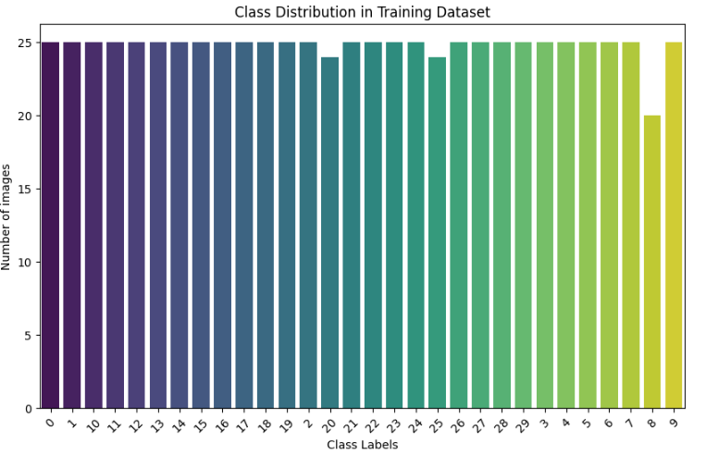
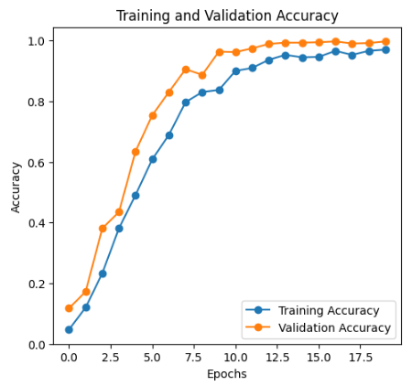
VISUALIZATION

Slide 8
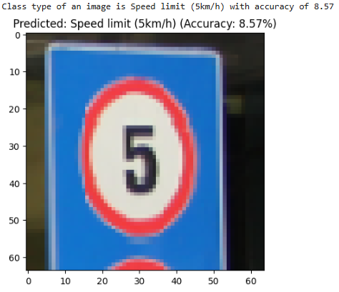
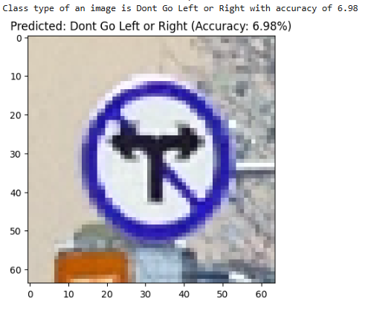
RESULT
TRAIN DATA
TEST DATA

Slide 9
FUTURE STEPS
AWS SageMaker, Google AI Platform, or Streamlit Sharing.
Serve the model as a REST API using Flask or FastAPI,
Dashboards to monitor accuracy, precision.
Incorporate a feedback mechanism in your deployed UI.

Slide 10
CONCLUSION
Real-world applications in image classification
Used effectively by non-technical users.
Model accessible to end-users for practical applications.
Architecture was chosen to capture hierarchies in the image data.

Slide 11
THANK YOU

