Slide 1
Micro-services Architecture Solution Proposals
Author: Maria Perez
Email: maria.perez.cv@gmail.com
Notes:
UNCLASSIFIED
1

Slide 2
Proposals
A solution for streaming large number of events into a data store and allowing querying of the data.
The patterns and anti-patterns for implementing micro-services; including handing load balancing and a circuit breaker.
A continuous integration, test and deployment solution that assumes the use of Docker/Kubernetes.

Slide 3
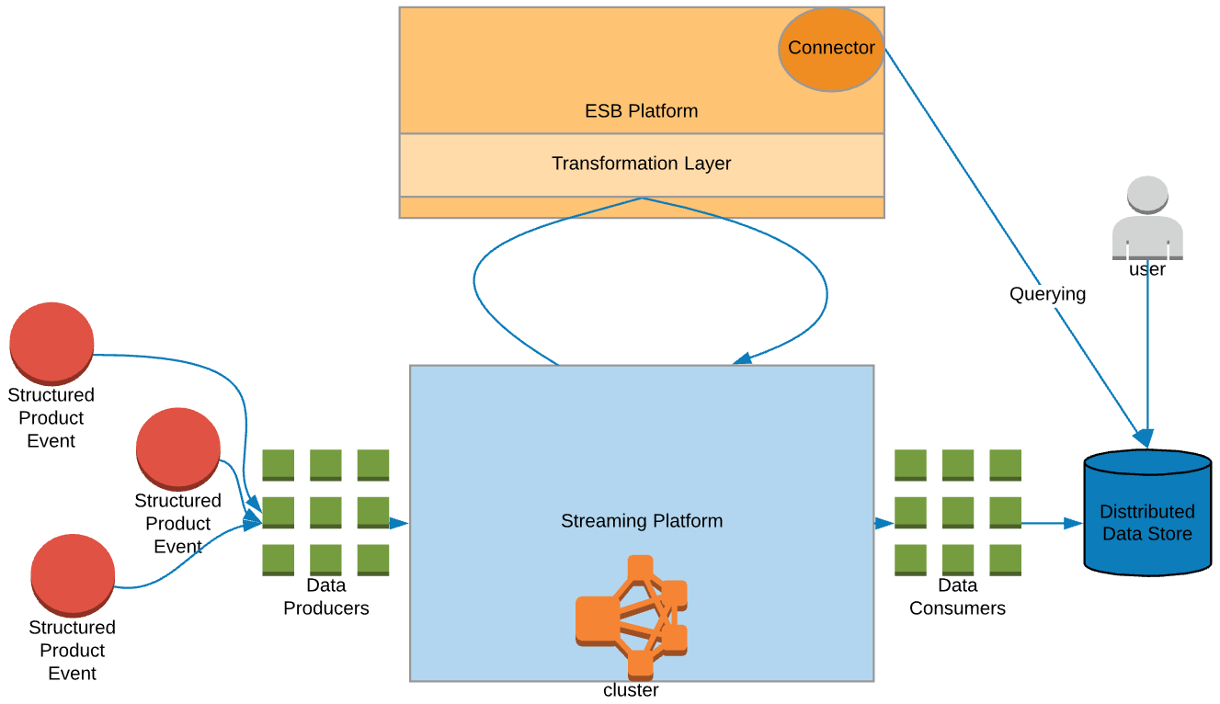
A solution to stream data events into a data store
Streaming Platforms:
Kinesis data delivery stream:
Up to 24h storage
Record size 1,000KB
PutRecordBatch size of 500 records per call or 4 MB per call
Kafka can be configured for data storage & record size according to your cluster’s capacity.
=> Know-Your-Data
Notes:
The following two streaming platforms are proposed for analysis. This solution considers an technological stack including an ESB Platform. Please note that both MuleSoft and WSO2 already provide Kafka connectors.
Kafka enables the building of streaming data pipelines — the E and L in ETL — through the Kafka Connect API. The Connect API leverages Kafka for scalability, builds upon Kafka’s fault-tolerance model, and provides a uniform method to monitor all of the connectors. Stream processing and transformations can be implemented using the Kafka Streams API — this provides the T in ETL. Using Kafka as a streaming platform eliminates the need to create (potentially duplicate) bespoke extract, transform, and load components for each destination sink, data store, or system. Data from a source can be extracted once as a structured event into the platform, and any transforms can be applied via stream processing.
Amazon Kinesis Data Firehose is a fully managed service for delivering real-time streaming data to destinations such as Amazon Simple Storage Service (Amazon S3), Amazon Redshift, Amazon Elasticsearch Service (Amazon ES), and Splunk. Kinesis Data Firehose is part of the Kinesis streaming data platform, along with Kinesis Streams and Amazon Kinesis Data Analytics. With Kinesis Data Firehose, you don't need to write applications or manage resources. You configure your data producers to send data to Kinesis Data Firehose, and it automatically delivers the data to the destination that you specified. You can also configure Kinesis Data Firehose to transform your data before delivering it.
Kinesis Data Firehose can invoke your Lambda function to transform incoming source data and deliver the transformed data to destinations. You can enable Kinesis Data Firehose data transformation when you create your delivery stream.

Slide 4
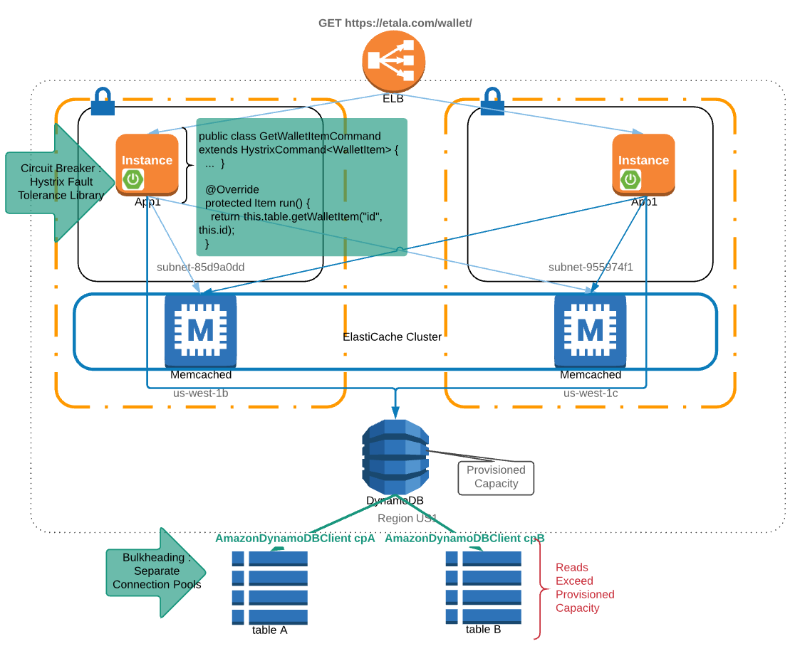
Patterns with Microservices
Circuit-Breaker Pattern
Hystrix Library
Bulkheading Pattern
Connection Pool Segregation
Load Balancing
ELB
Caching
ElastiCache
Notes:
# Fault tolerance in a high volume distributed system.
A solution that implements a combination of approaches:
network timeouts and retries
separate threads on per-dependency thread pools
semaphores (via a tryAcquire, not a blocking call)
circuit breakers
exception strategy and exception lineage tracing.
#Martin Fowler: A more sophisticated approach might look at frequency of errors, tripping once you get, say, a 50% failure rate. You might also have different thresholds for different errors, such as a threshold of 10 for timeouts but 3 for connection failures.

Slide 5
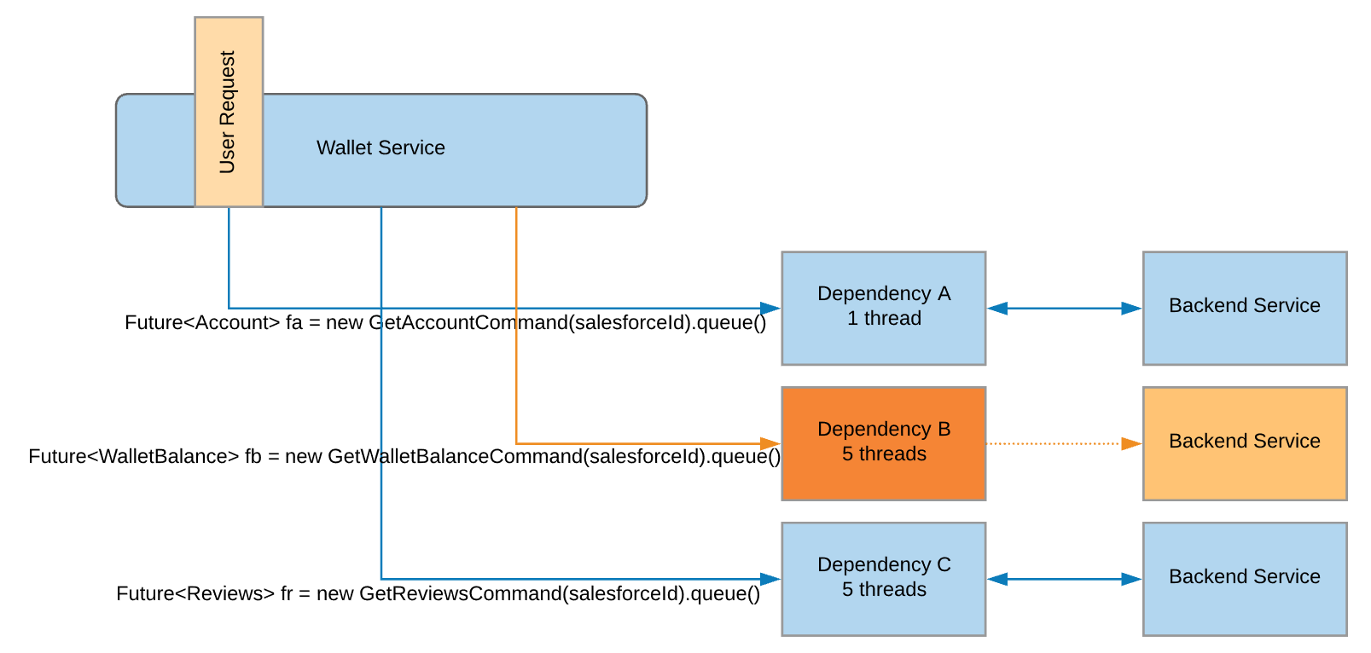
Pattern: Hystrix Circuit Breaker
When Dependency B gets saturated by latent network connections, the service using Hystrix would now throw an exception (or return fall-back) immediately due to queue rejection.
Notes:
# Hystrix Circuit Breaker
Threads & Thread Pools
Clients (libraries, network calls, etc) execute on separate threads. This isolates them from the calling thread (Tomcat thread pool) so that the caller may “walk away” from a dependency call that is taking too long.
Hystrix uses separate, per-dependency thread pools as a way of constraining any given dependency so latency on the underlying executions will saturate the available threads only in that pool.
It is possible for you to protect against failure without the use of thread pools, but this requires the client being trusted to fail very quickly (network connect/read timeouts and retry configuration) and to always behave well.

Slide 6
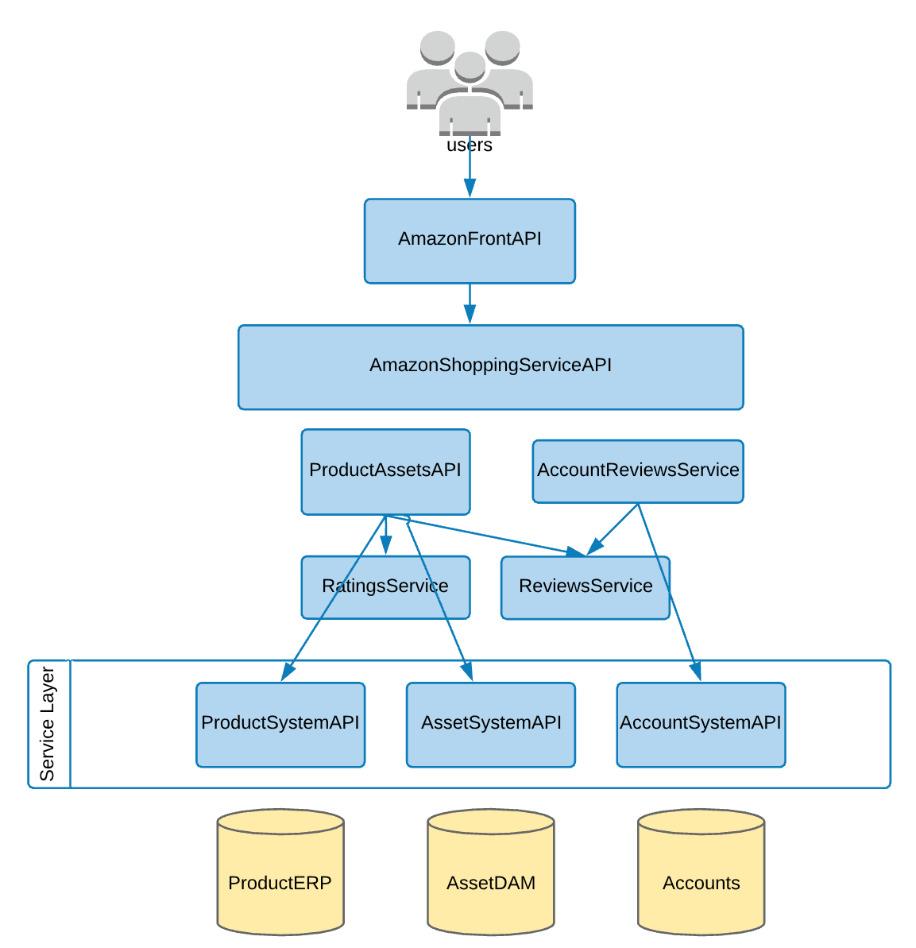
Anti-Patterns with Microservices
Entity Services Pattern:
It's an Enterprise Architecture ANTIPATTERN
It's a common pattern used in SOA.
MuleSoft ESB and other SOA Providers promote it as a Service Layer API
These dependencies lead to an operational & semantic coupling which will affect availability, performance and capacity, and changes in one service may ripple through to other services
Notes:
-> Enterprise Architecture ANTIPATTERN
Most features will require aggregates consisting of more than one entity, thus creating dependencies between two or more entity services. One example is setting the price on a cart which will involve many more additional services.
It is very common for Entity Services to support CRUD interface at the entity level, and add additional domain-specific operations needed to address the problem-domain and support the application's features and use cases.
An example of a domain-specific operation is a customers service that exposes a method called FindCustomerByLocation that can locate a customer's ID given the customer's address.
-> Application Architecture PATTERN :
+ Helpful when migrating systems (Can be used when an application goes into disinvest phase)
+ Helpful when creating or "Shifting and Lifting" LoB Applications.

Slide 7
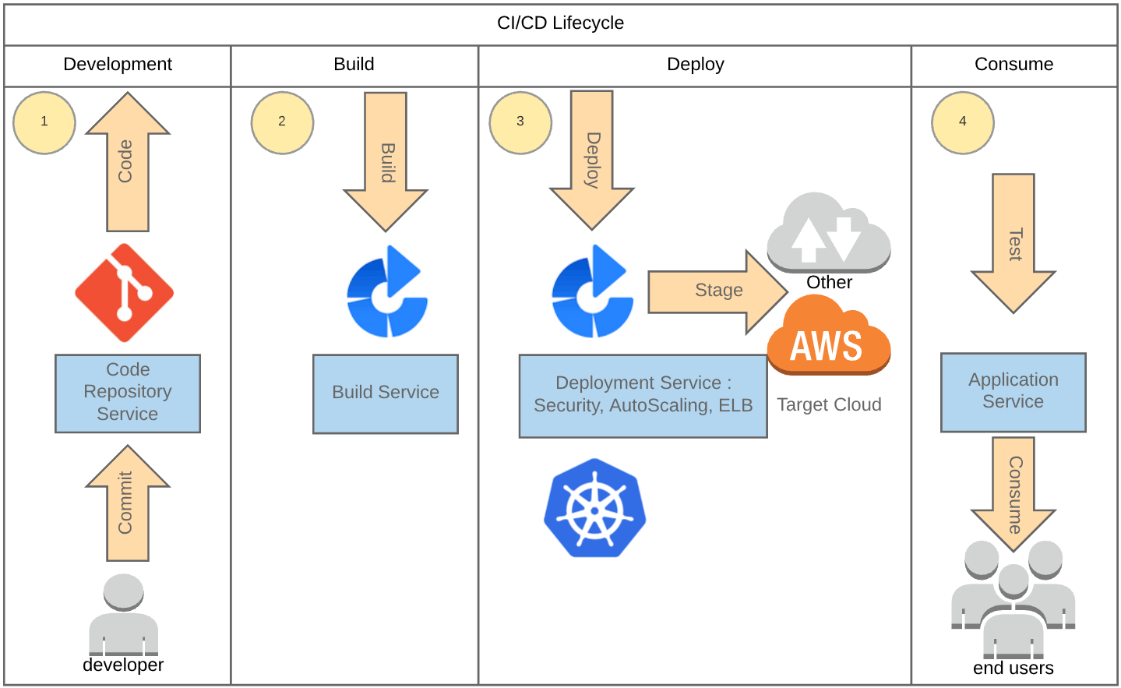
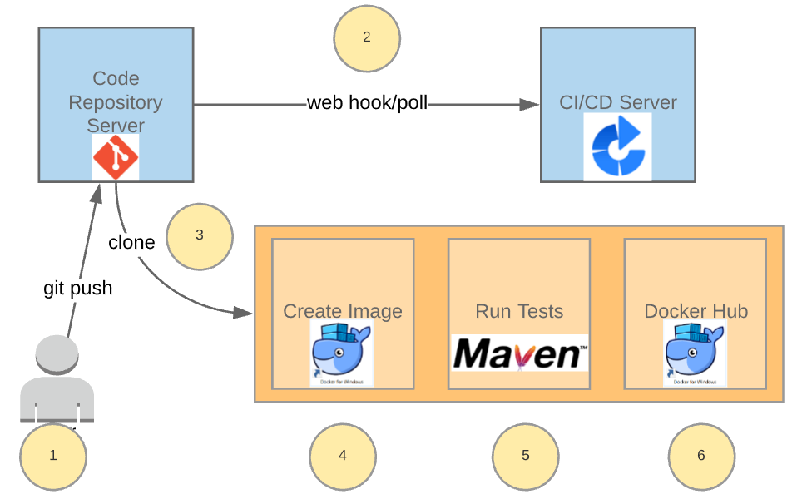
A continuous integration, test, and deployment solution With docker
Developer updates workspace
Jenkins receives notification
Developer clones the workspace
Creates the image
Runs the test suite
Pushes the image to Docker Hub.
Developer pulls the image from Docker Hub to run on dev environment
Environments view of the CI/CD lifecycle
Notes:
1 – Code Repository Service: AWS Code Commit, git, stash, etc. (previously 2000 Subversion)
2 – Build Service: AWS Code, Jenkins or Bamboo. Another very flexible and highly configurable service is Go CD for complex deployment workflows and pipelines.
3 – Deployment Service: Here Bamboo coupled with Kubernetes. Also possible with AWS Code Deploy, Docker Swarm, Mesos or CoreOs.
# For Docker + Kubernetes Kubernetes can be used at Deployment Phase to automate deployments, scale services…
The various parts of the Kubernetes Control Plane, such as the Kubernetes Master and kubelet processes, govern how Kubernetes communicates with your cluster. The Control Plane maintains a record of all of the Kubernetes Objects in the system, and runs continuous control loops to manage those objects’ state. At any given time, the Control Plane’s control loops will respond to changes in the cluster and work to make the actual state of all the objects in the system match the desired state that you provided.
For example, when you use the Kubernetes API to create a Deployment object, you provide a new desired state for the system. The Kubernetes Control Plane records that object creation, and carries out your instructions by starting the required applications and scheduling them to cluster nodes–thus making the cluster’s actual state match the desired state.

Slide 8
Thank you
“Good design is obvious.
Great design is transparent”
G. Sparano

