Slide 1

Twitter
By Maumita Saha

Slide 2

What is TWITTER?
social media platform
mobile-device Application software
Microblogging
Post Tweets
140 characters long
follow other users
retweet information

Slide 3
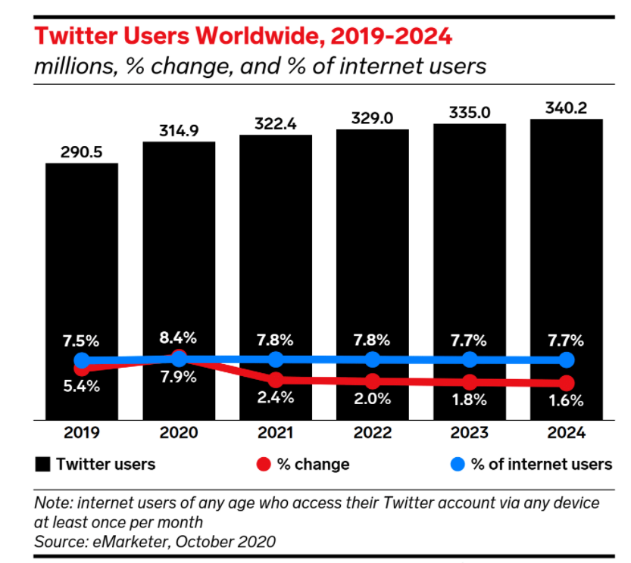
Founder Jack Dorsey, Noah Glass, Biz Stone, and Evan Williams
Created in March 2006 and launched in July 2006
6th-ranked mobile app
ranks 7 (out of 9) digital platforms for digital trust
advertising audience of 353 million
predicted to grow 2.4% in 2021
90% of the U.S. population is familiar with Twitter
male users (70%) than female users (30%)

Slide 4
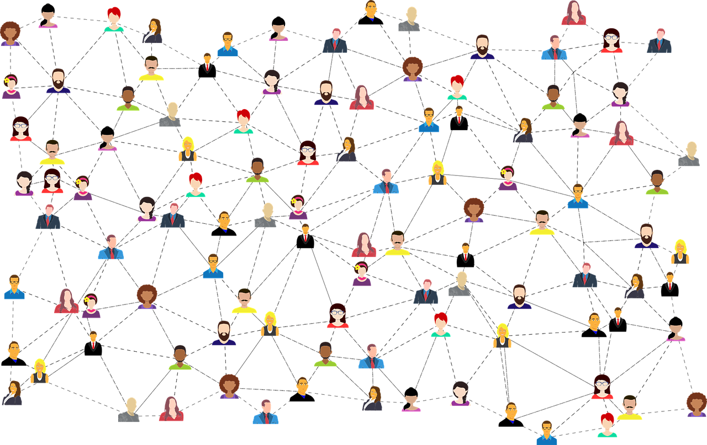
Why use Twitter?
easily to promote research
reach a large number of people
follow the work of other experts
up-to-date with the latest news
reach new audiences
seek feedback
express who you are as a person

Slide 5
Future of twitter
Twitter Will Become a Protected Public Utility
Newsrooms Will Dominate on your Twitter Feeds
Video Will Be an Integral Part of Future Twitter
The Character Limit Will Technically Cease to Exist
Future Tweets Will Be Searched on Search Engines

Slide 6
Conclusion
More advanced features
Changing customer demands
Needs of the users
New legislative acts that will limit the use of Twitter
Live streaming

Slide 7

QUESTIONS???

Slide 8
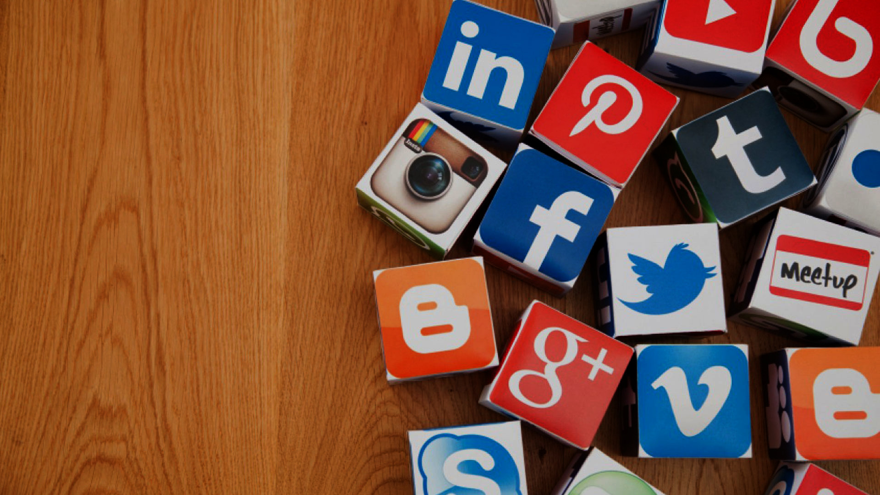
Thank You

