Slide 1
user-dashboard-take-home-assignment
localstorage
Communicate via Custom Event Handlers
dashboard-shell
user-list-micro-frontend
user-details-micro-frontend
- Vite config
Loads MFE runtime
Registers MFEs
Handles global routing
Route path="/users"
VIte Config
Manage internal states
Route path="/users/:id"
Vite Config
Manage internal states

Slide 2
This repository demonstrates a Micro-Frontend (MFE) architecture using Vite + React 18 + Module Federation.
The project includes three micro apps:
Shell: Main container with navigation. The main host application.
UserList MFE: Displays paginated user list with search.
UserDetails MFE: Displays selected user details. Shows detailed information of a selected user.
App | Folder | Port (Local) | Role
Shell | /shell | 5000 | Host container (routes + layout)
User List | /user-list | 5001 | Remote micro frontend
User Details | /user-details | 5002 | Remote micro frontend

Slide 3
dashboard-shell
Hosts the root-level router (e.g. React Router or custom navigation)
Dynamically loads micro-frontends via Module Federation
Will manage global application state (theme, authentication, etc.)
Handles cross-MFE communication through custom events
Persists selected user info or app state in localStorage
Manages lazy loading / error boundaries for MFEs
Provides shared dependencies (React, React DOM, Ant Design, etc.)
Handles authentication guards / route protection (if required)
Responsible for deployment orchestration (loading correct remote URLs)

Slide 4
user-list-micro-frontend
Fetches user data from REST API (or mock API)
Supports debounced search for better performance
Implements pagination and sorting
Emits custom event (e.g., userSelected) with user ID to shell
Can cache user data in localStorage for quick reloads
Is fully independent — can run standalone for development
Handles error and loading states gracefully
Optimized with React.memo and useMemo to prevent re-renders
Uses environment variables for configurable API endpoints
Contains unit tests for filtering, pagination, and event dispatch

Slide 5
user-details-micro-frontend
Listens for custom event (userSelected) to load user details
Fetches user details via API or local cache
Displays structured data (profile info, contact, address, etc.)
Persists last-viewed user in localStorage
Manages own routing (/users/:id)
Handles not-found or invalid user states
Can update user details (if write access is required)
Includes loading skeletons for better UX
Completely isolated build — can be deployed independently

Slide 6
Tech Stack
Frontend Framework: React 18 + TypeScript
Bundler: Vite
Module Federation Plugin: @originjs/vite-plugin-federation
Routing: React Router v6
Styling: SCSS Modules
State Management: React hooks and props drilling (lightweight communication)
Inter-app Communication: Local Storage + Custom Events
Tooling: ESLint + Prettier for code quality

Slide 7
How to run?
dashboard-shell
  npm run dev
  Output: http://localhost:5000/
user-list-micro-frontend
  http-server dist -p 5001 -c-1 –cors
  Output: Available on:
    http://192.168.1.1:5001
    http://127.0.0.1:5001
user-details-micro-frontend
  http-server dist -p 5002 -c-1 –cors
  Output: Available on:
    http://192.168.1.1:5002
    http://127.0.0.1:5002

Slide 8
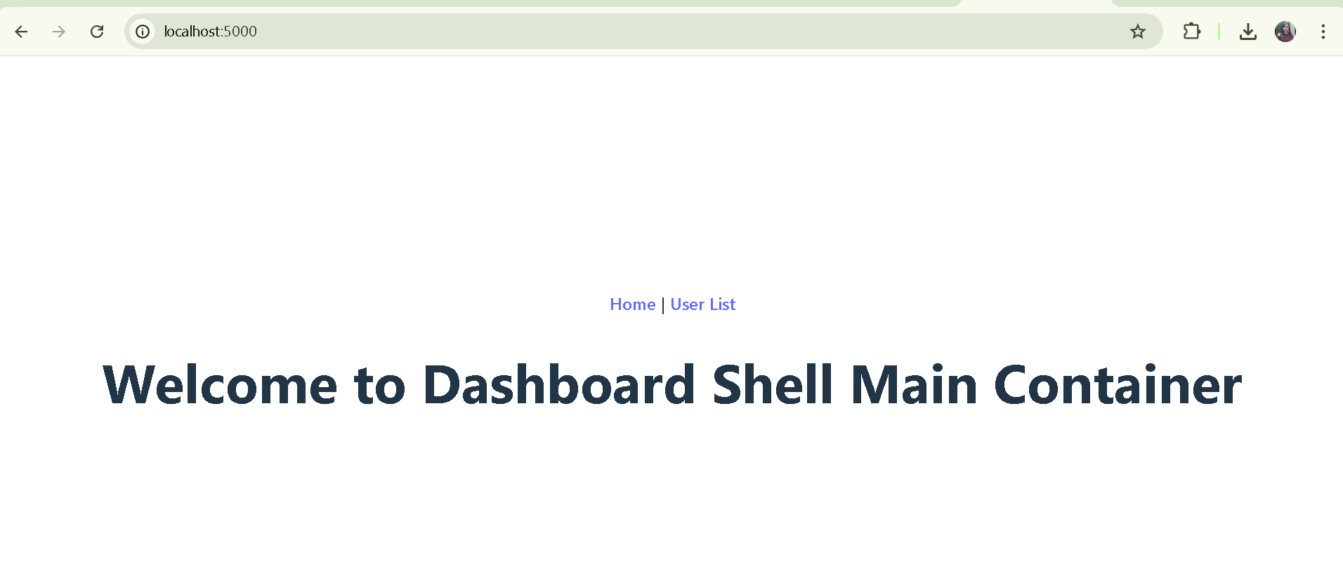
Home Page

Slide 9
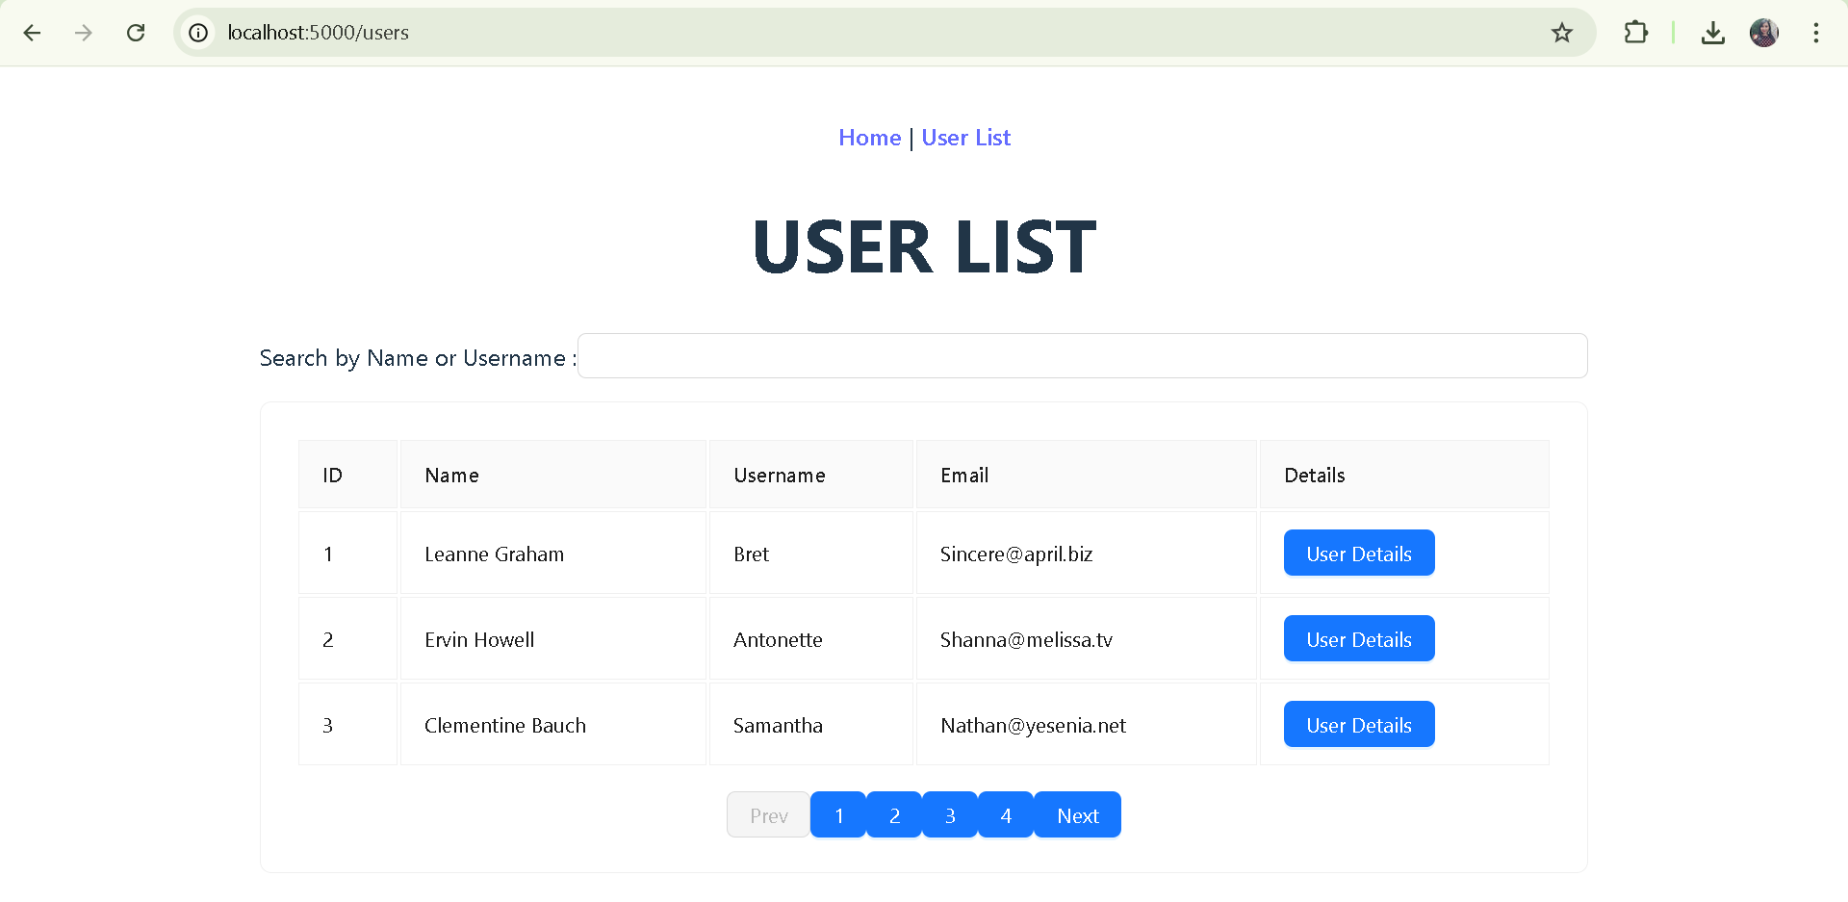
User Lists (On click of User List)

Slide 10
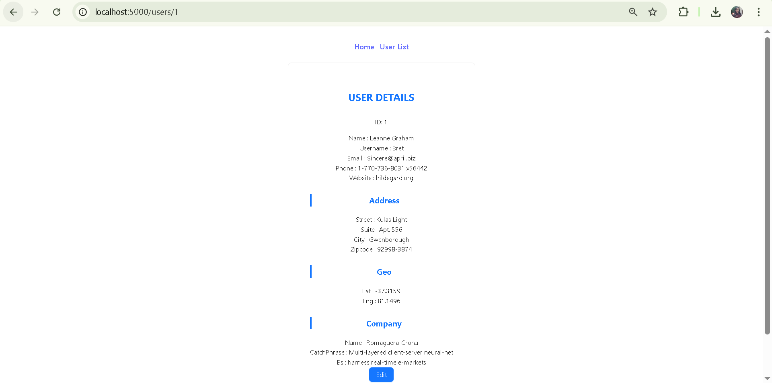
On click of 'User Details'button

Slide 11
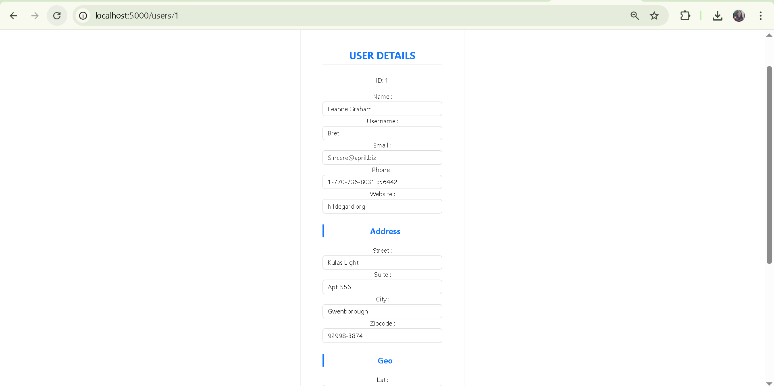
On click of EDIT in 'User Details' section

Slide 12
Deployed in vercel https://mfe-user-management-system-erwz8peji-maumita-sarkars-projects.vercel.app/
First import the git project to Vercel.
Vercel Dashboard > Go to Project Settings → Build & Development Settings >
  Build Command: npm run build
  Output Directory: dist
  Root Directory = dashboard-shell

Slide 13
