Slide 1
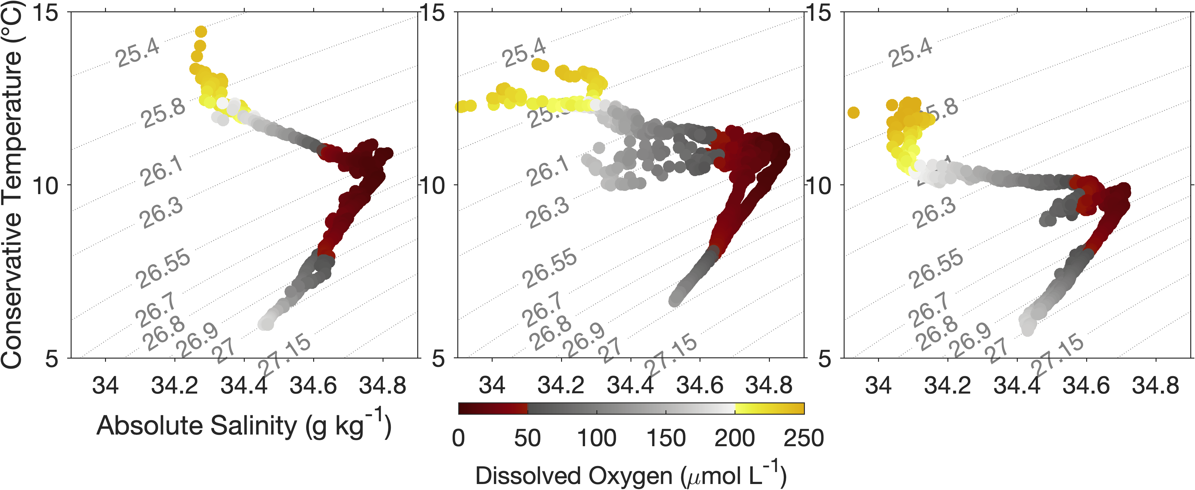
(a) January
(b) July
(c) October
(1)
(2)
(3)
(4)
(5)
(6)
(7)

Slide 2
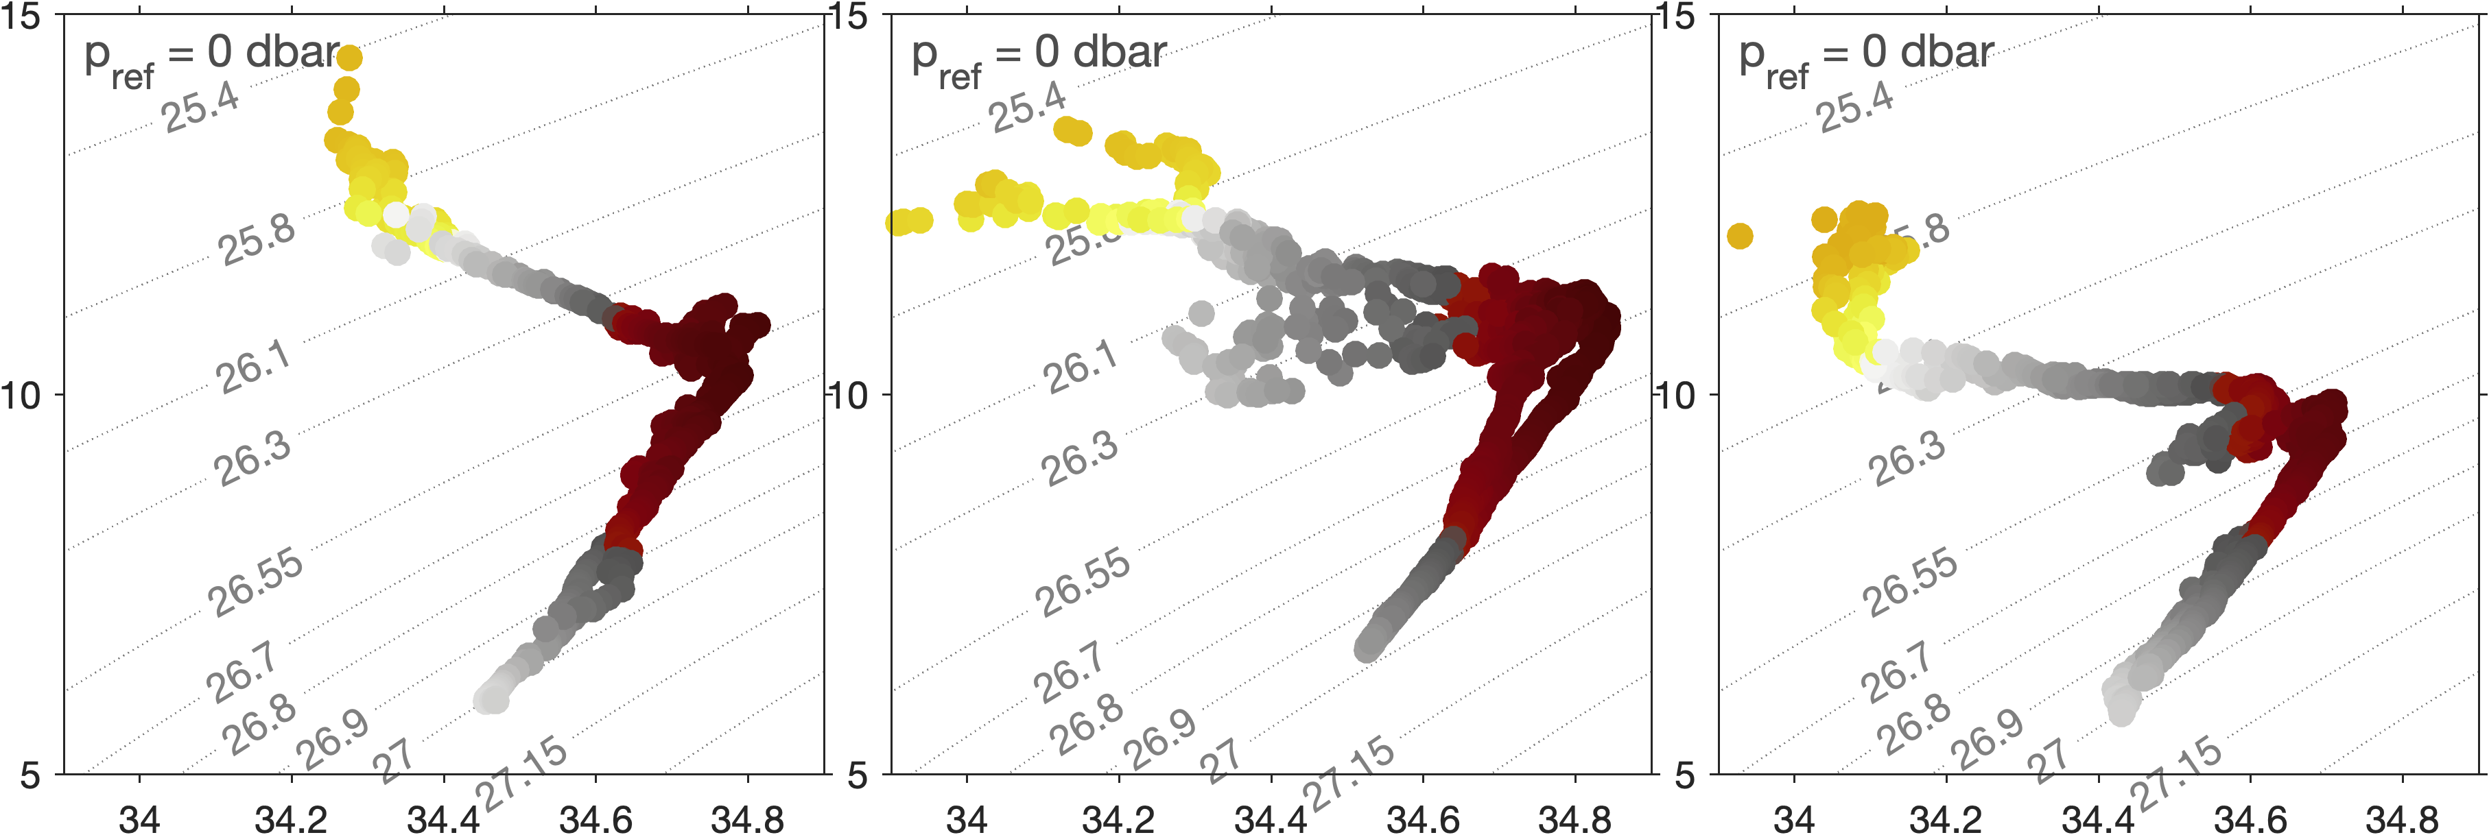
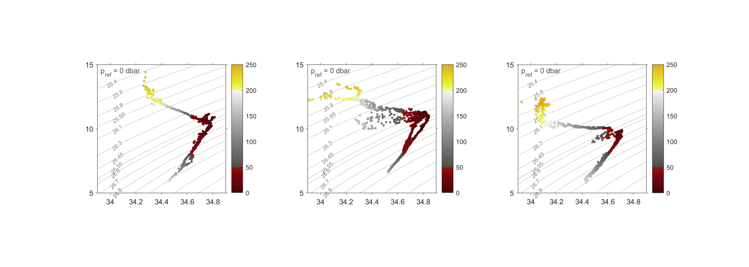
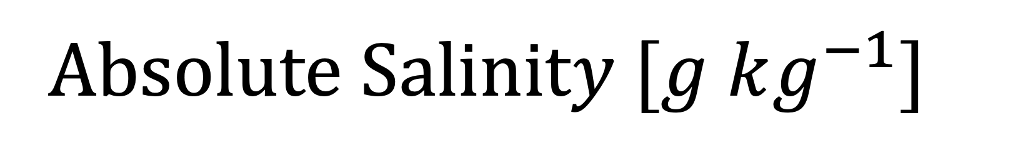


(a) January
(b) July
(c) October
(1)
(2)
(3)
Conservative Temperature $[°C]$
(4)
(5)
(6)
Dissolved Oxygen$[μM]$
(7)
A$bsolute Salinity [g kg^{−1}]$

