Slide 1
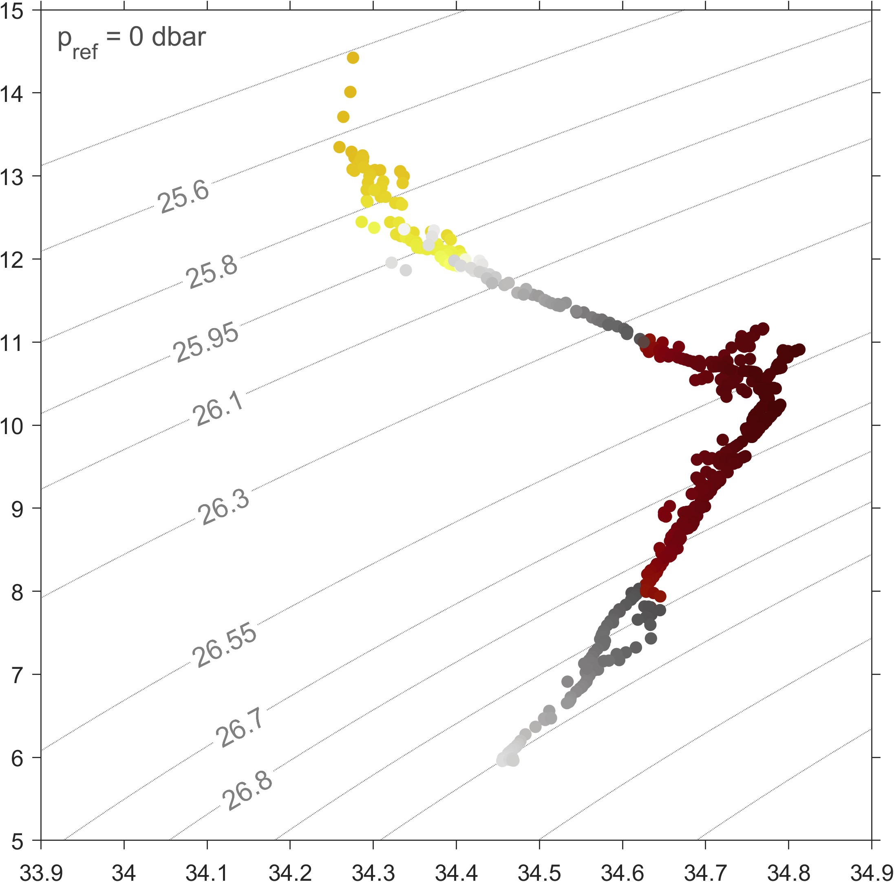
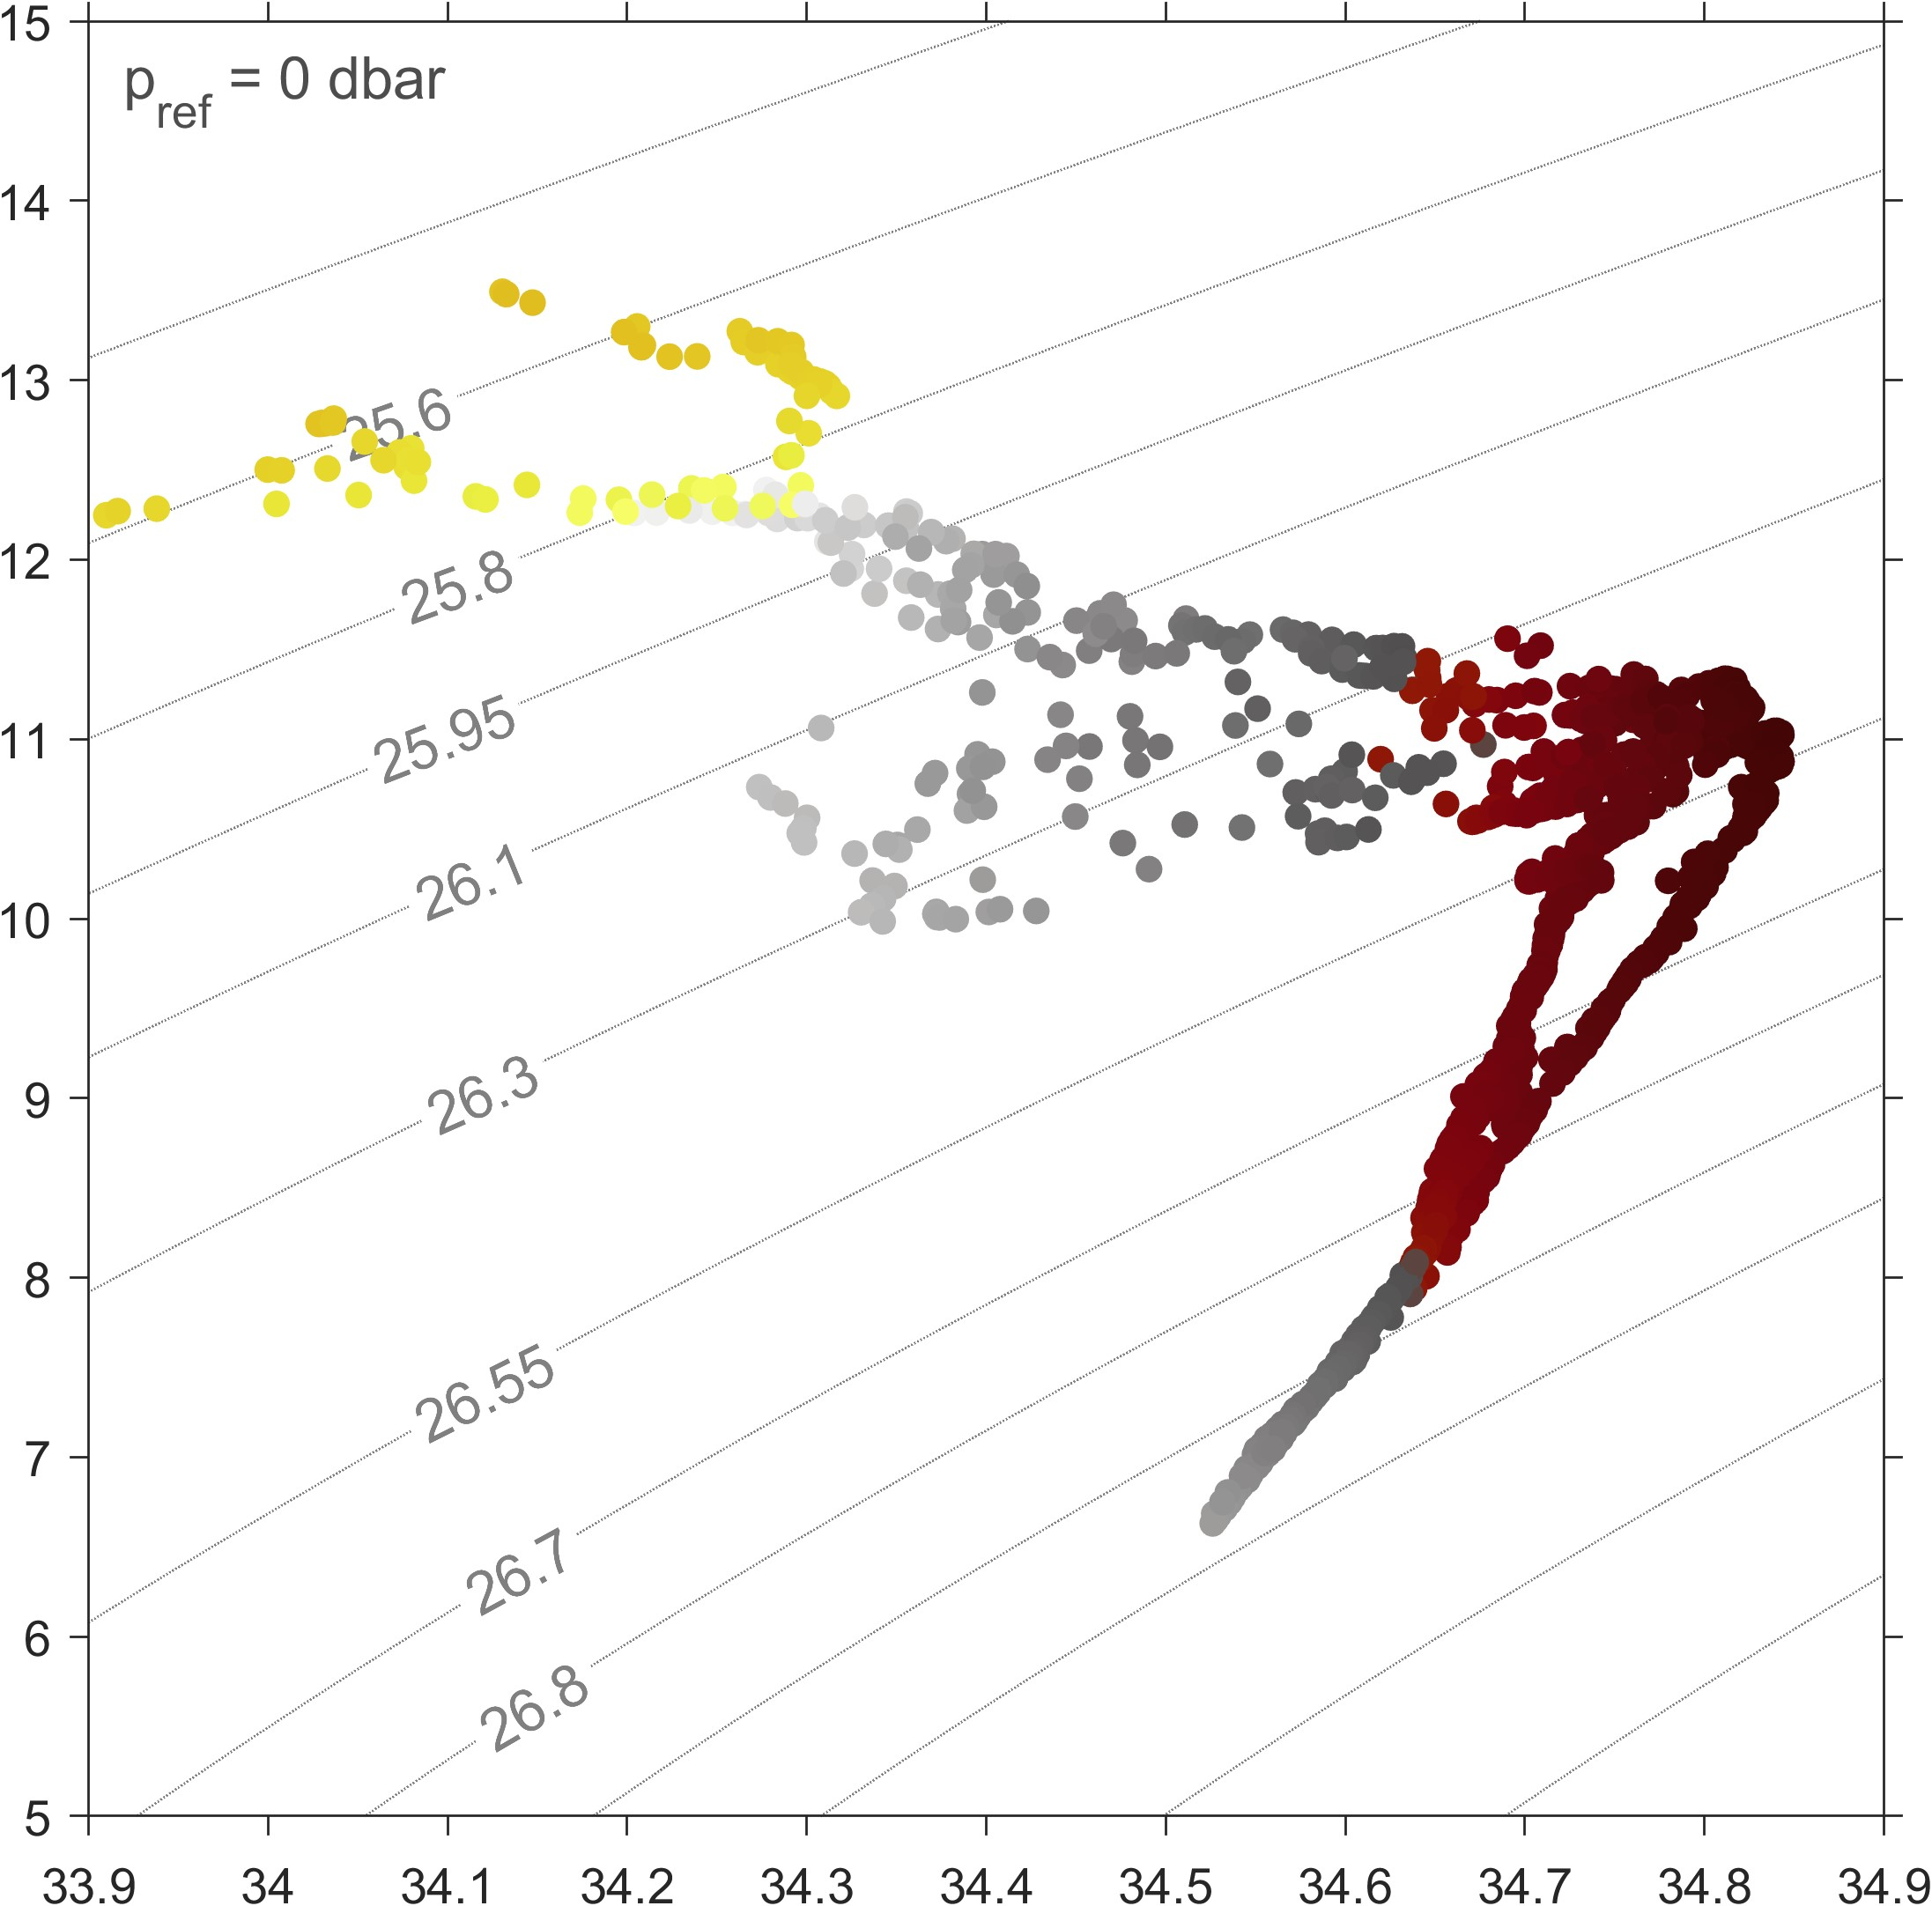
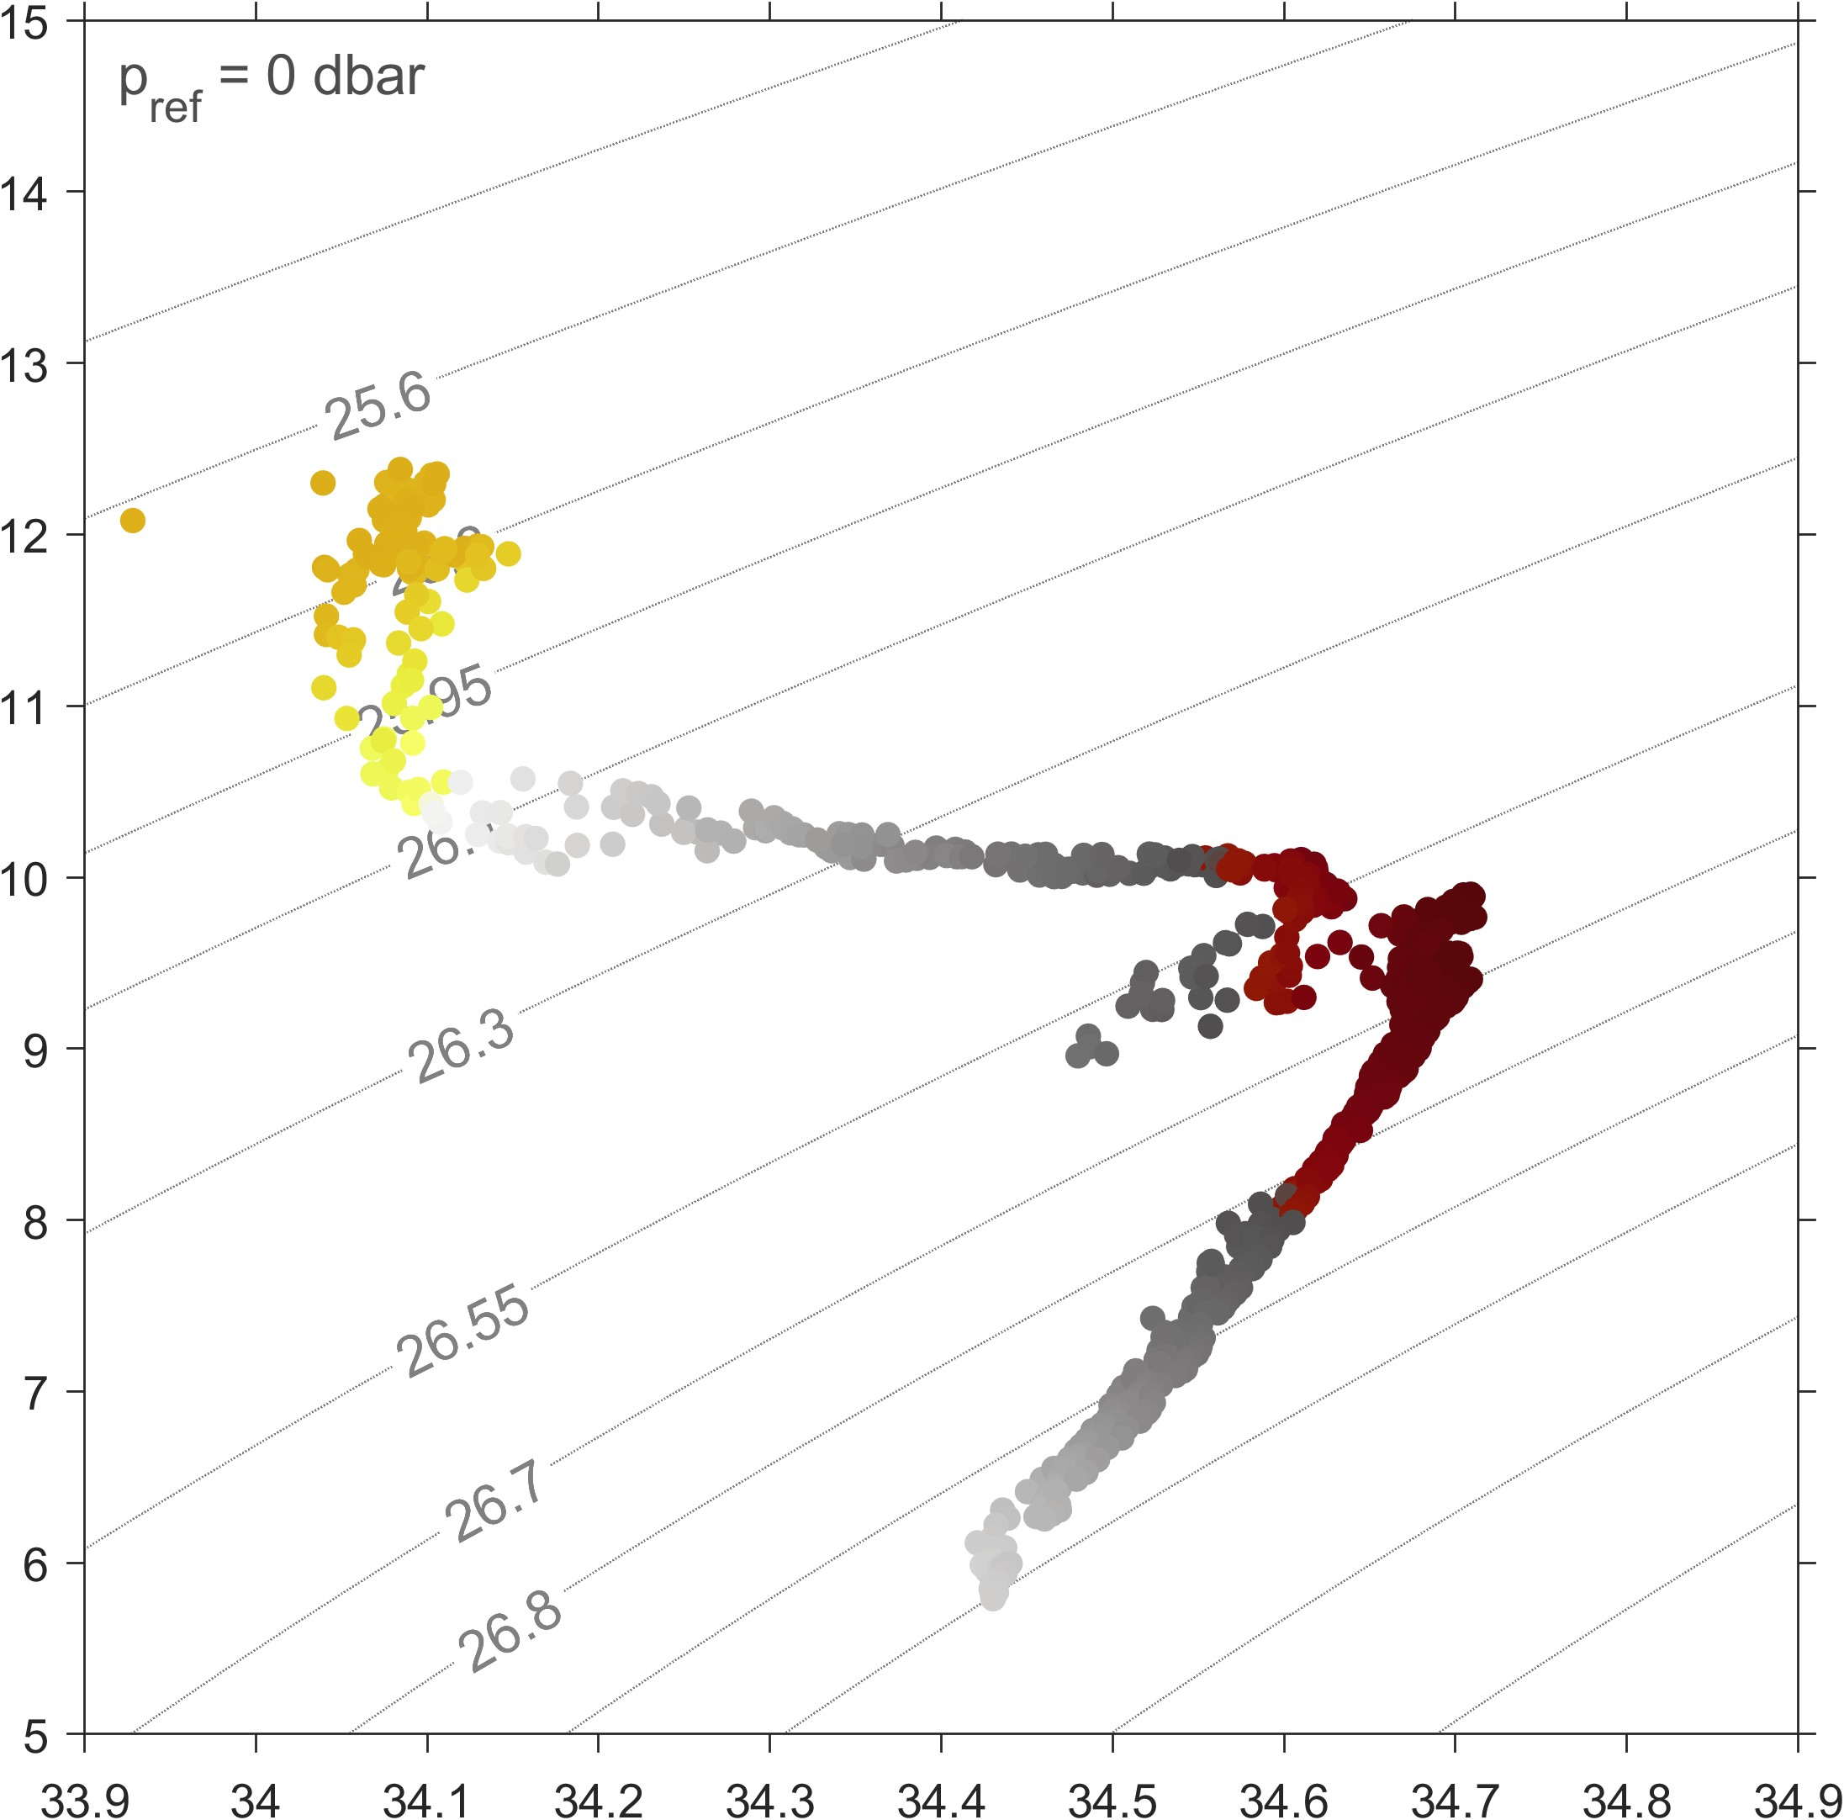
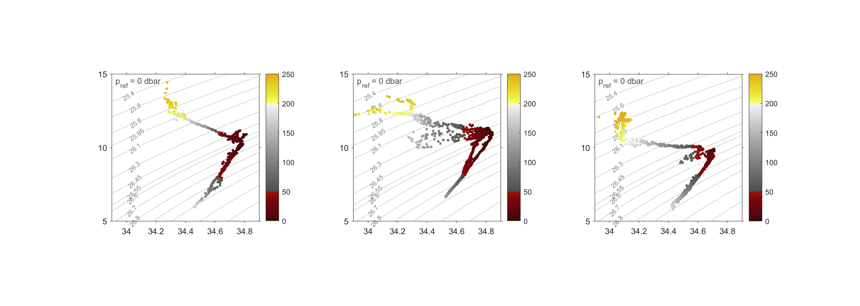


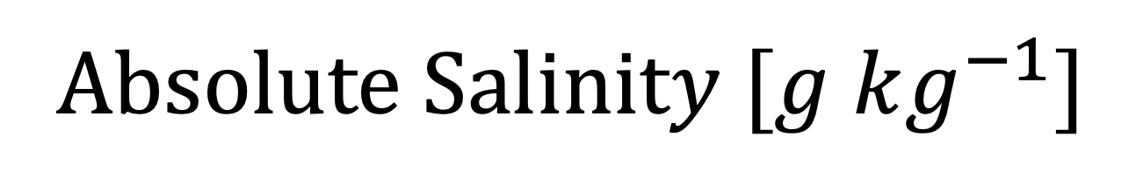
15
15
15
January
July
October
13
(1)
13
13
(2)
(3)
11
11
11
Conservative Temperature $[°C]$
(4)
(5)
(6)
9
9
9
Dissolved Oxygen$[μM]$
(7)
7
7
7
5
5
5
33.9
34.1
34.3
34.5
34.7
34.9
33.9
34.1
34.3
34.5
34.7
34.9
33.9
34.1
34.3
34.5
34.7
34.9
A$bsolute Salinity [g kg^{−1}]$

