Slide 1
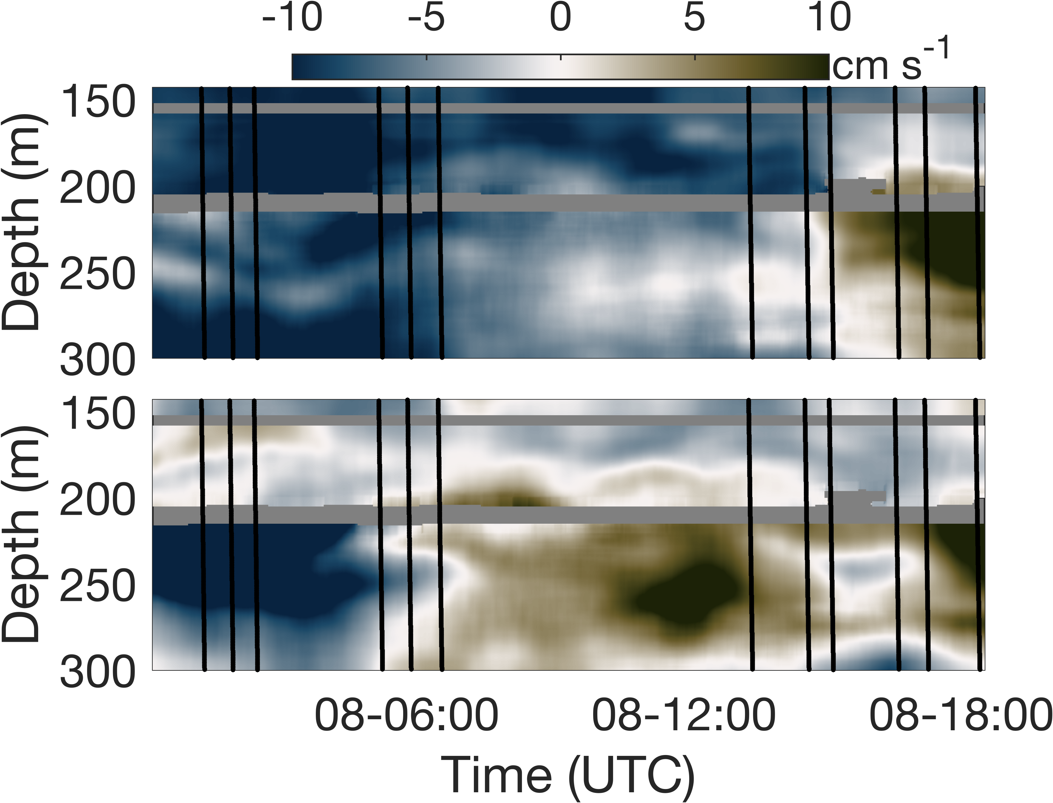
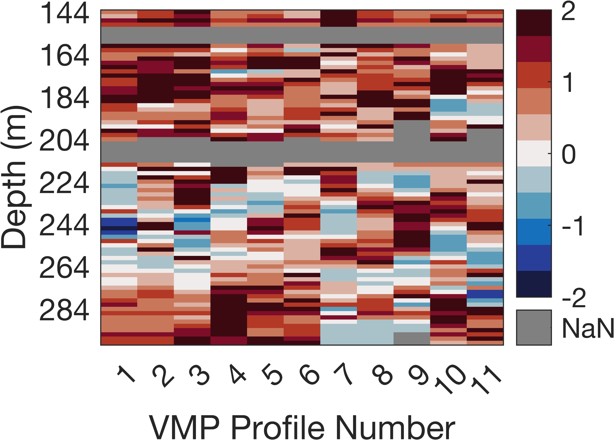
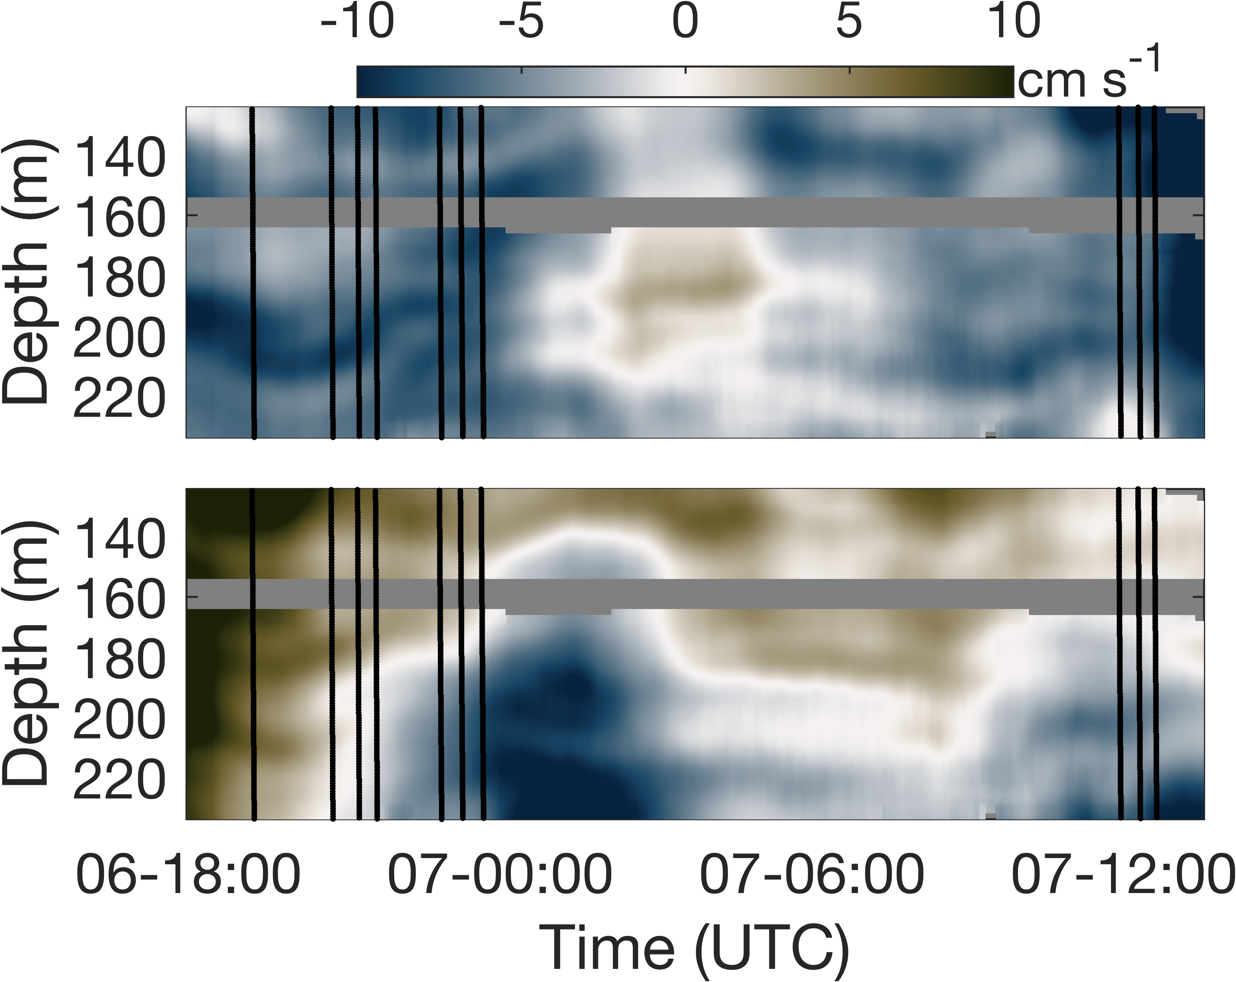
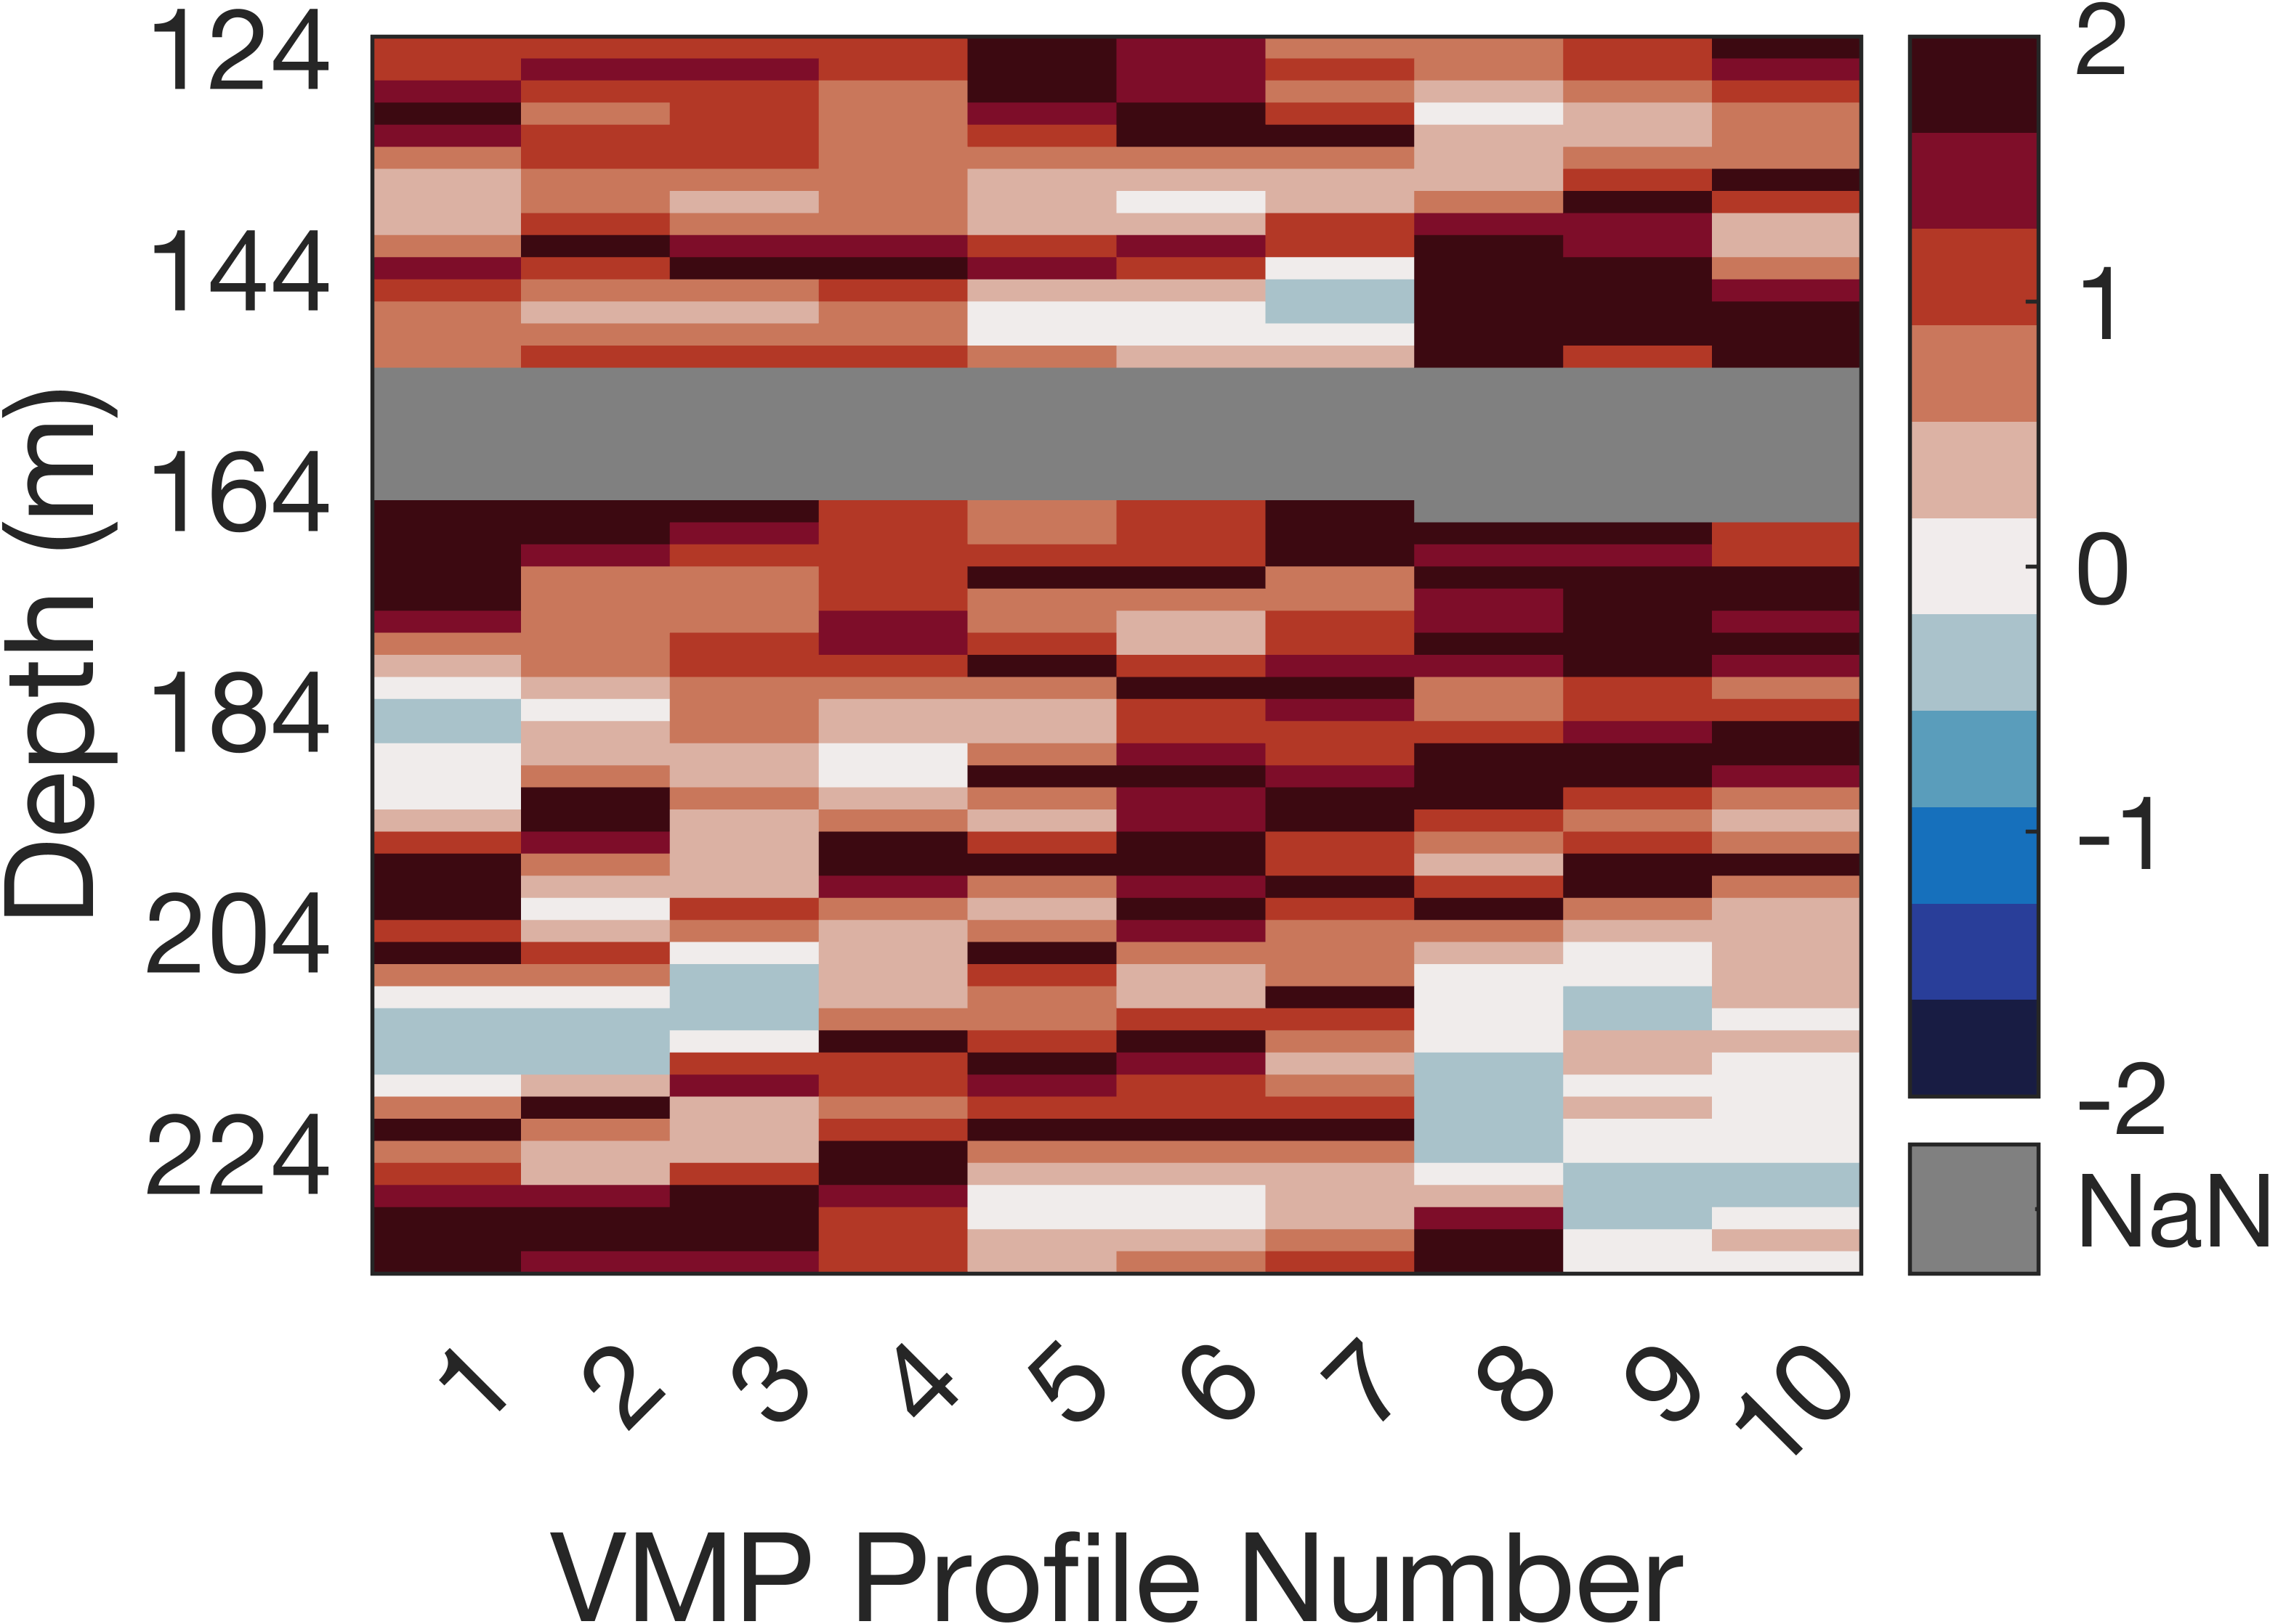
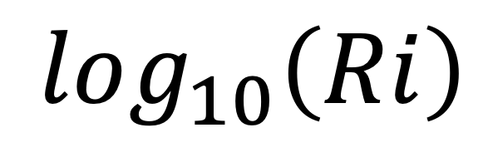

(a1)
(a2)
$$log_{10}\left(Ri\right)$$
(b1)
(b2)
$$log_{10}\left(Ri\right)$$

Slide 2
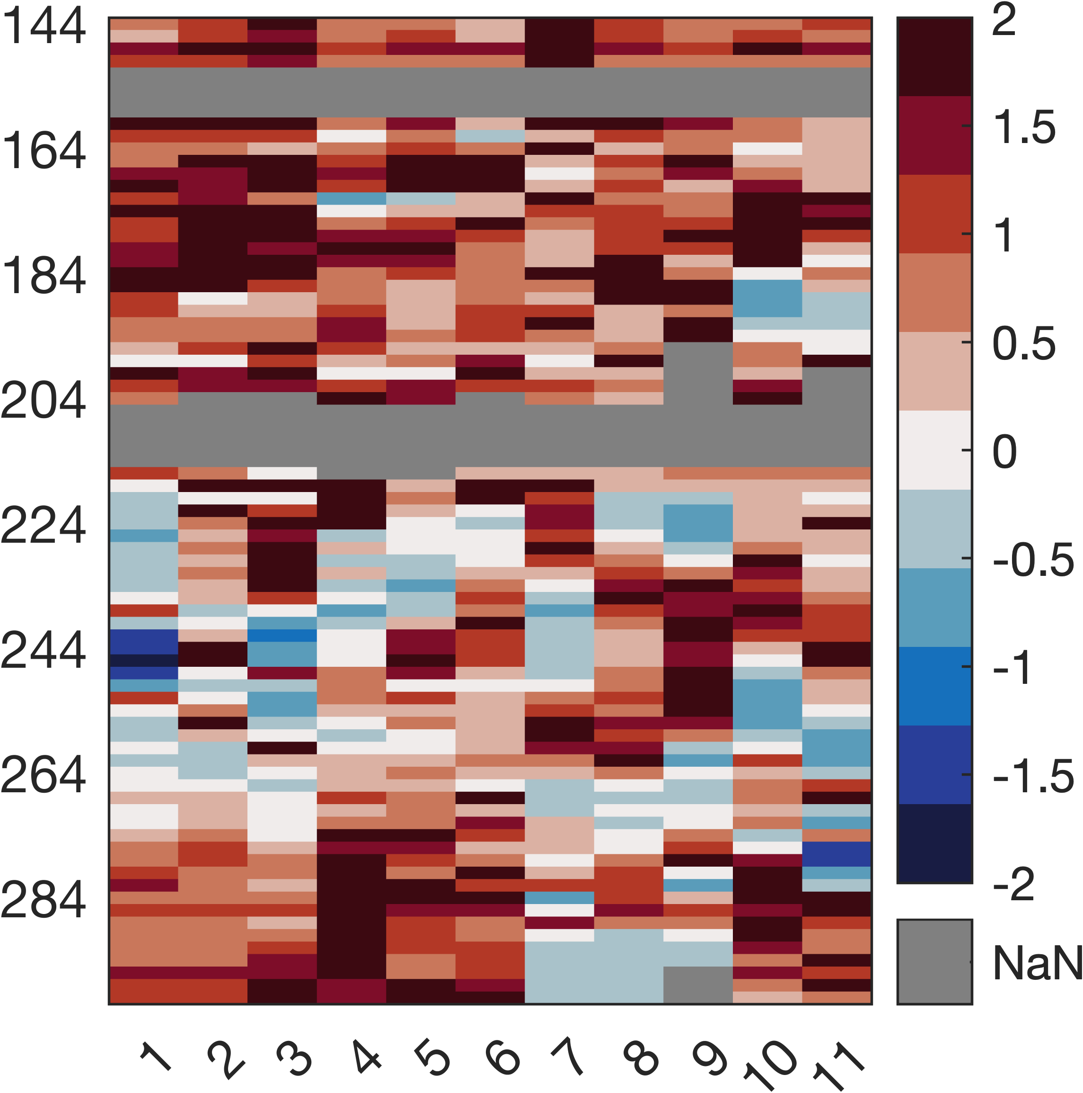
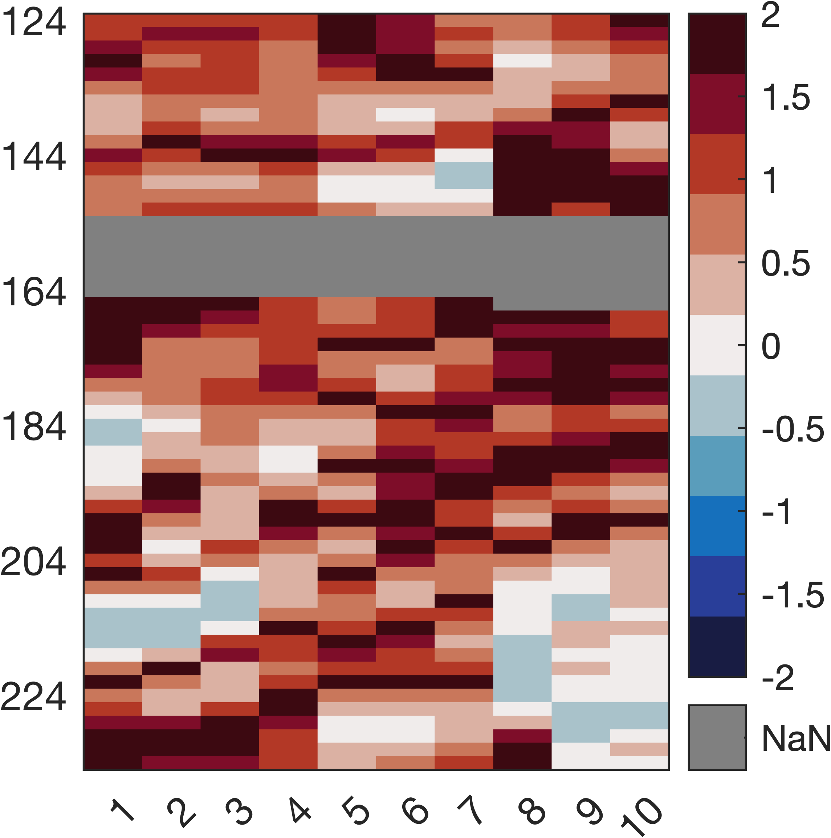

Pressure [dbar]
Pressure [dbar]
$$log_{10}\left(Ri\right)$$
VMP Profile number
VMP Profile number

