Slide 1
grantMaster Code-A-Thon 2026 By: Code Miners Team Central Piedmont Community College Maura Carter, David Diza, Zoe Ramirez, Jaime Delgado-Guzman

Slide 2
Table of Contents
Leadership & Team
Executive Summary/Problem
S-Curve/Process and Steps
Solution
Explanation of the grantMaster tool
Timeline/Flowchart
Charts/Tables/Output Images
Thank you & Contact Information

Slide 3
Code Miners: Team Members and Leadership
We are the Code Miners Team from Technology Division at Central Piedmont Community College, Charlotte, NC.
Jaime Delgado-Guzman: CPCC Python Certificate student with background in _______.
Maura Carter: CPCC AI Fundamentals Certificate student with a background in statistical modeling.
David Diza: CPCC Computer Software Developer student with a background in _________.
Zoe Ramirez: CPCC Student with a background in _____________________.
IMAGE?

Slide 4
Executive Summary/Problem
Each year, tens of thousands of dollars in student grant money go unclaimed. Students often need funding for college, and this can be a major barrier to matriculation or degree completion.
Grantors want to give out grant money, but cannot do so unless students apply.
Students often do not know about available grants, even if they are in an active search, and oftentimes, financial aid offices at universities are unaware of all the grants available to include in student aid packages or make known for students to apply
The result is unclaimed funds, and students are either unable to afford to matriculate to any college, students attending a college that is less expensive but may not have their intended field of study, students matriculating but not having the funds to cover the cost of the entire degree program to graduation, or students taking out enormous student loans to finance their education
Currently, there is over $ 3 trillion in unpaid student loan debt. Students are severely hindered in their future careers, often when they graduate with massive amounts of student loan debt, if they have found no other ways to finance their education

Slide 5
Problem: Thousands of dollars in grant money go unclaimed each year.
Designs are chosen carefully for branding and accessibility best practices; do not change the font, text size, or colors. Avoid text smaller than 14 points bold. Do not use white text on a gold background, or gold text on a white background.
Add alt text (alternative text) for all images, unless they are purely decorative.
Check the reading order by using either the Reading Order Pane (for Windows desktop users) or the Selection Pane (for Mac users or the browser version of PowerPoint). Reading order cannot be confirmed by the visual order of the elements of a slide.
Hide or delete any slides you do not plan to use. Keep in mind that deleting a slide may also remove its associated Master Slide if no other slides are using it.
For more detailed instructions, refer to the PowerPoint Accessibility Guide or the CMPR Accessibility Guidelines.

Slide 6
S-Curve: Process with steps along the way (and who).
First,
Second,
Next,
Lastly,

Slide 7
Solution: An application that automatically applies qualified students.
The grantMaster tool is opted into when students apply for admission to the college of their choice.
This tool uses student data and grant data to automatically apply the student to applicable grants for which they meet the application requirements for
Students receive an email notifying them of which grants were applied to, or which grants could be applied to if the students submit an additional piece of information, such as a resume or essay attachment.
Universities could see an increase in matriculation and student retention, as students receive more grant funding for their education and less reliance on student loans or self-financing.
Universities can use this as a marketing tool to increase application rates and university admissions
Universities would see an increase in alumi starting more stable and lucrative careers of their choosing with less financial pressure of having to repay large student loans, in addition to alumni giving back to the college

Slide 8
Charts/Tables/Output
Final Layout/output
See Admissions Form, Output emails to students about auto applications or essays needed.

Slide 9
Timeline
Add Text here

Slide 10
Thank you & Contact Information
Thank you for consideration of the grantMaster application. We appreciate your time.
Please contact us if you have questions
LinkedIn:
Email:
Phone:

Slide 11
Problem: Thousands of dollars in grant money go unclaimed each year.
Designs are chosen carefully for branding and accessibility best practices; do not change the font, text size, or colors. Avoid text smaller than 14 points bold. Do not use white text on a gold background, or gold text on a white background.
Add alt text (alternative text) for all images, unless they are purely decorative.
Check the reading order by using either the Reading Order Pane (for Windows desktop users) or the Selection Pane (for Mac users or the browser version of PowerPoint). Reading order cannot be confirmed by the visual order of the elements of a slide.
Hide or delete any slides you do not plan to use. Keep in mind that deleting a slide may also remove its associated Master Slide if no other slides are using it.
For more detailed instructions, refer to the PowerPoint Accessibility Guide or the CMPR Accessibility Guidelines.

Slide 12

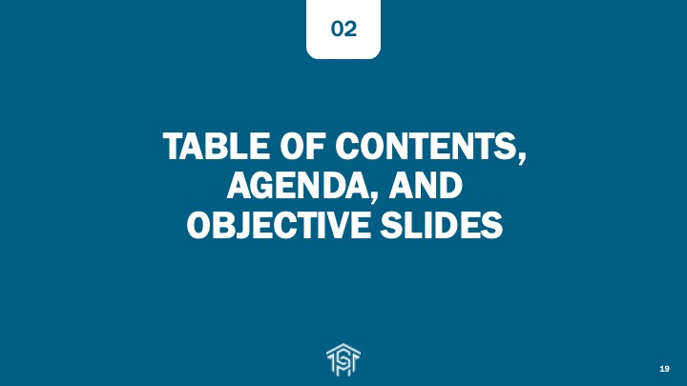

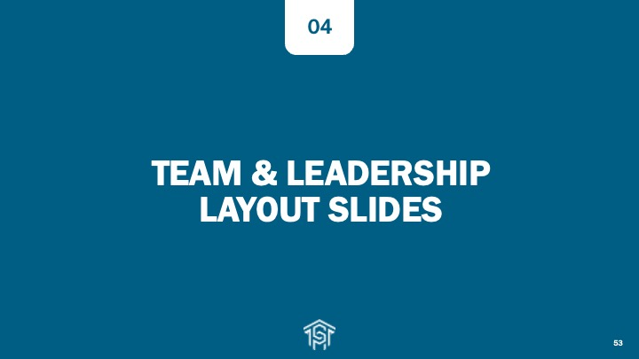
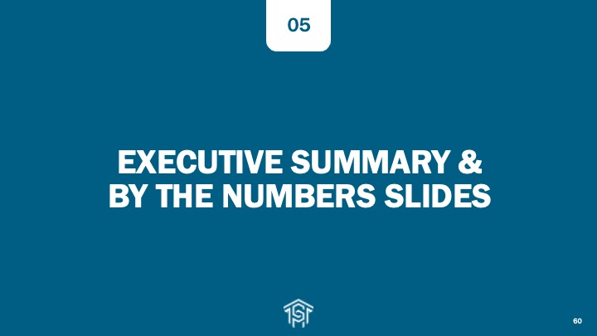





Slide Template Categories at a Glance

Slide 13






SAFETY MOMENT
We are meeting at:
[Add the address of your meeting’s building, include room number, and change this text to black.]
Who will fulfill each role in an emergency?
Call 6911
or 911
Use
AED/CPR
Meet Emergency
Personnel
Evacuate
Lead out/Last out
Evaluate your own response in these situations:
Active Shooter
Run, Hide, Fight
(Lock and Barricade)
Shelter in Place
Notes:
In the upper right corner of this slide, add the street address of your meeting’s building and include the meeting’s room number. Also change the text color from magenta to black.

Slide 14
TITLE SLIDES & SECTION DIVIDERS
01

Slide 15
Title Slide with Central Piedmont Logo
There is also a Title Slide without the Central Piedmont Logo

Slide 16
Title Slide Gray Background Plus Logo
There is also a Second Gray Background Title Slide that Does Not Have a Logo in Lower Left Corner

Slide 28
TABLE OF CONTENTS, AGENDA, AND OBJECTIVE SLIDES
02

Slide 42
TEXT & IMAGE LAYOUT SLIDES
03

Slide 57
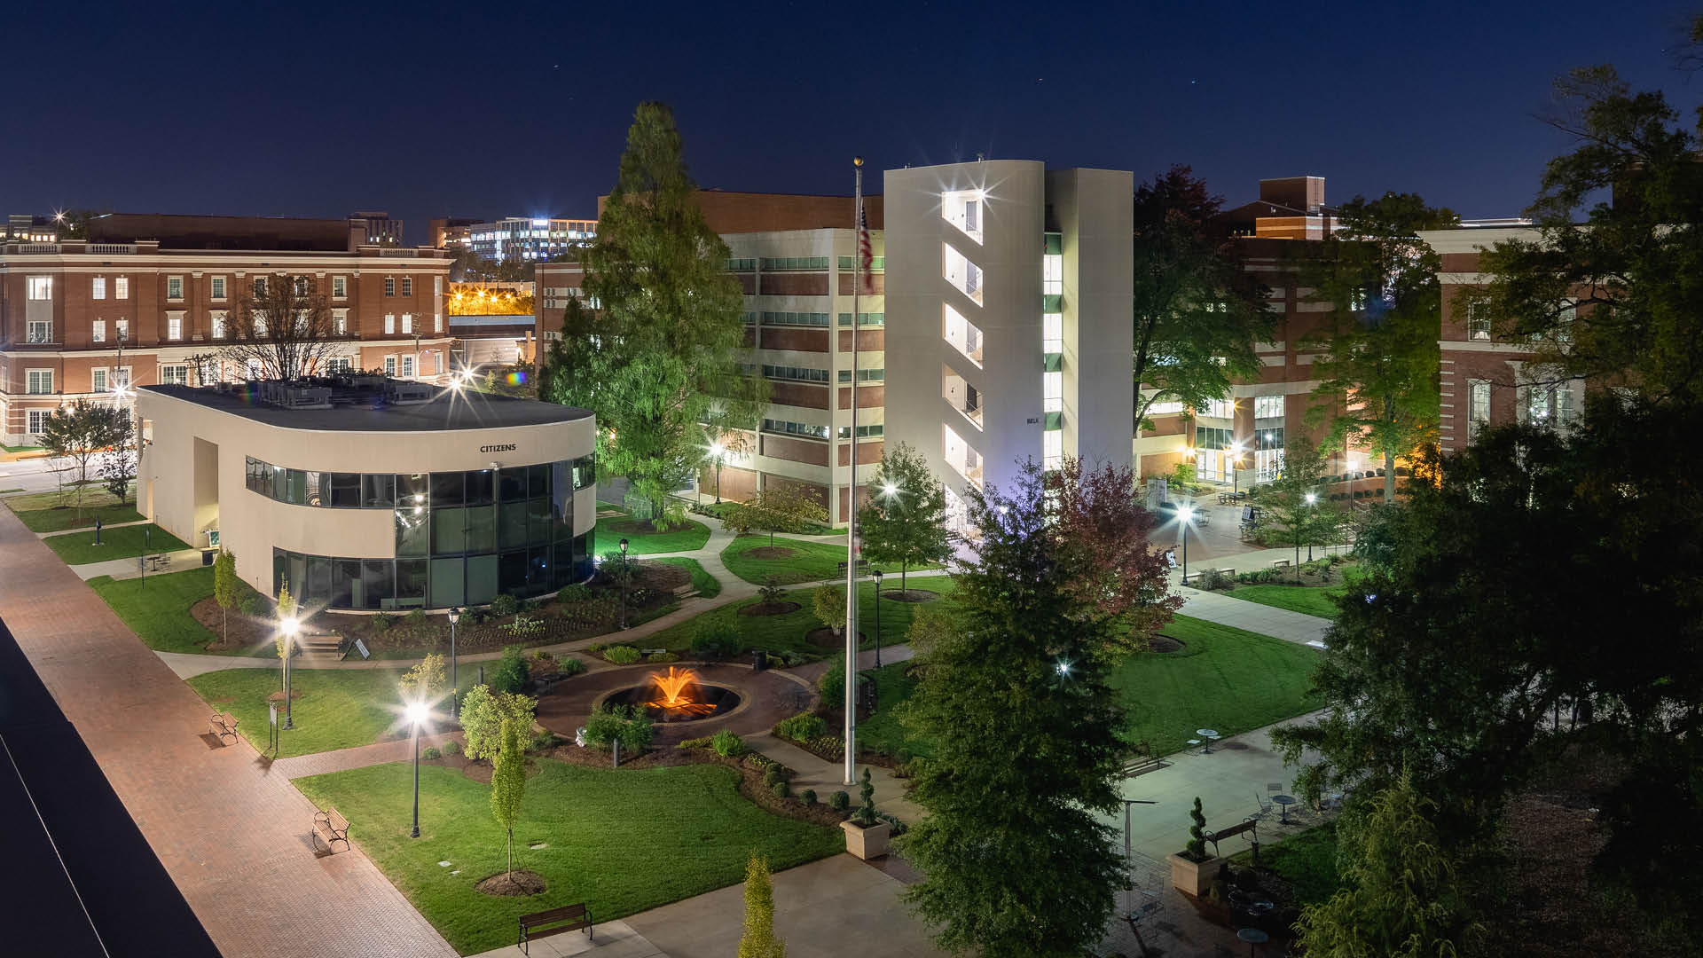
Gold overlay over photo

Slide 59
Gray overlay over photo

Slide 61
Blue overlay over photo

Slide 64
TEAM & LEADERSHIP LAYOUT SLIDES
04

Slide 71
EXECUTIVE SUMMARY & BY THE NUMBERS SLIDES
05

Slide 89
QUOTE LAYOUT SLIDES
06

Slide 104
CHARTS, TABLES, & STAT SLIDES
07

Slide 111
[value]
[value]
[value]
[value]
[value]
[value]
[value]
[value]

Slide 114
TIMELINE & INFOGRAPHIC SLIDE LAYOUTS
08

Slide 119
MEDIA LAYOUT SLIDES
09

Slide 129
THANK YOU & CONTACT SLIDES
10

Slide 135
Thank You!

Slide 136
Questions?

Slide 137



704-330-2722
cpcc.edu
1201 Elizabeth Ave, Charlotte, NC 28204

Slide 138



704-330-2722
cpcc.edu
1201 Elizabeth Ave, Charlotte, NC 28204

Slide 139

Add a title for a screen reader

Slide 140

Add a title for a screen reader

