Slide 1
grantMaster Unlocking Billions in Unclaimed Student Grants Bank of America Code-A-Thon 2026 Code Miners Team: Jaime Delgado-Guzman | Maura Carter | David Diza | Zoe Ramirez

Slide 2
📋Table of Contents
1. The Problem
2. The Solution: grantMaster
3. How It Works
4. Backend: Technical Engine
5. Frontend Demo
6. Student Experience & Output
7. Impact
8. Security & Trust
9. Closing

Slide 3
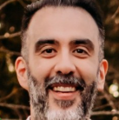
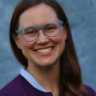
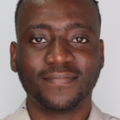

👥Who We Are: Code Miners Team Members
Jaime Delgado-Guzman
Maura Carter
David Diza
Zoe Ramirez
Lead Developer
I am a CPCC Python Certificate student, with a background in data analysis and engineering. I am the Code Miners’ lead code developer for grantMaster and video editor.
Technical Concept Refiner
I am a CPCC Artificial Intelligence Fundamentals Certificate student with a background in statistics and data science. I am responsible for refining the technical concept of grantMaster and the presentation.
Code Tester
I am a CPCC Computer Software Developer student, with a background in Java and multiple programming languages. I am the code reviewer and tester for grantMaster.
Logistics Coordinator
I am a CPCC Certificate Student in Cyber Security. I provide organization and communication for the Code Miners team, in addition to workflow logistics for grantMaster.

Slide 4
The Problem: Billions in Student Grant Money Go Unclaimed
🎓 Students don’t know what grants they qualify for to pay for college
💰 Grants require extensive time, research, and complex applications
🏦 Grantors can’t distribute funds without completed applications
Result:
⛓️ Massive student loan debt & financial burden
🛑Lower enrollment, retention, and graduation rates
Students don’t finish their degrees
💸Over $3 trillion in student loans, impacting entire generations
🚫Underserved students are left out of free funding for college – lack of access

Slide 5
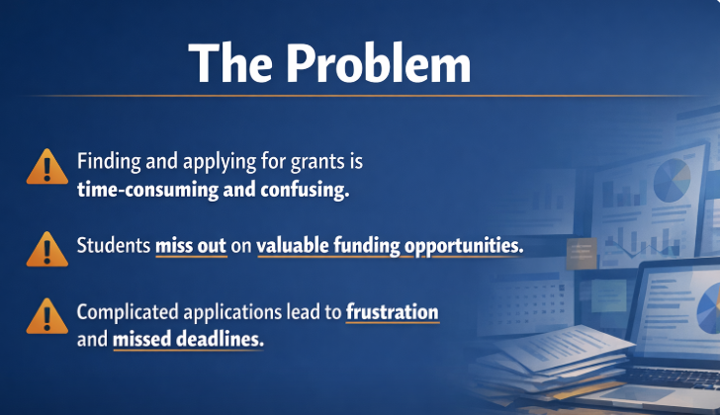

Slide 6
The Solution: grantMaster – Automated Grant Matching
grantMaster provides easy access to grant funding to pay for college
Students opt in with one checkbox during college registration
grantMaster Automatically:
Identifies eligible grants
Notifies students
Applies to grants when possible
Flags missing requirement (essay, resume, portfolio, etc.)
This removes friction entirely from the process
“Students do nothing. grantMaster does everything.”

Slide 7
How It Works: Simple, End-to-End Automation
🏫 To get started, the Colleges:
1. Subscribe to grantMaster
2. Add “Opt In” checkbox to student registration forms
3. Sign the data sharing agreement with grantMaster
4. Securely shares data
🎓 The Students:
1. Opt in at college registration – One checkbox!
2. Receive an email notification of grant opportunities and auto applications
[1] Subscribe → [2] Opt-In Checkbox Added → [3] Data Sharing Agreement → [4] Student Opt-In → [5] Secure Data Sharing → [6] dataMaster Matching Engine → [7] Student Notification Email
The entire pipeline is the prototype, starting with the college subscribing, and ending with the student receiving an email.

Slide 8
Backend: Technical Engine Behind grantMaster Pipeline
Core Components:
🔒 Secure data ingestion from colleges via API/database connection
🧠 Matching algorithm:
Compares student attributes (GPA, major, demographics, etc.) against grant eligibility rules
⚙️ Automation layer:
Triggers automatic applications whenever possible
Flags missing requirements
✉️Output:
Generates personalized student emails, containing relevant grant information
Tech Highlights:
Python-based processing pipeline
Structured data handling & filtering, with rule-based matching
Scalable architecture for multiple institutions
[Data Ingestion] → [Matching Algorithm] → [Automation Layer] → [Output]
This is where our actual code lives – the matching and automation logic.

Slide 9
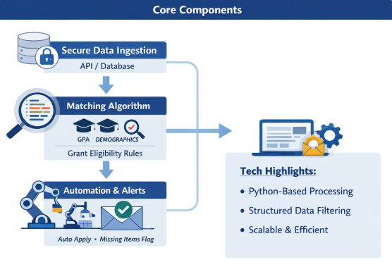
Backend Diagram 1

Slide 10
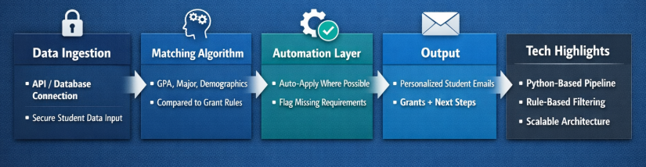
Backend Diagram 2

Slide 11
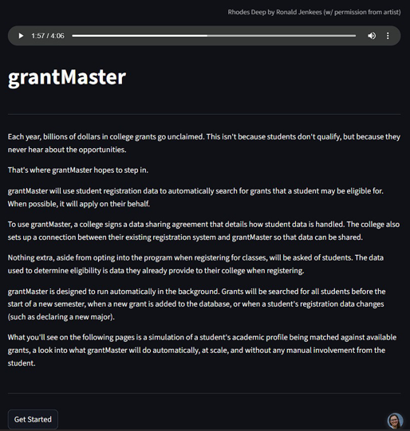
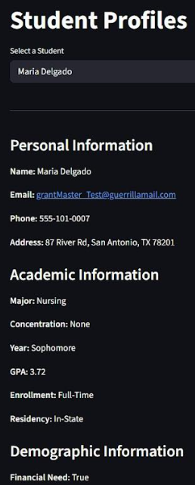
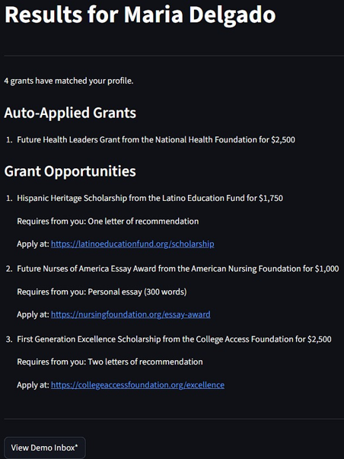
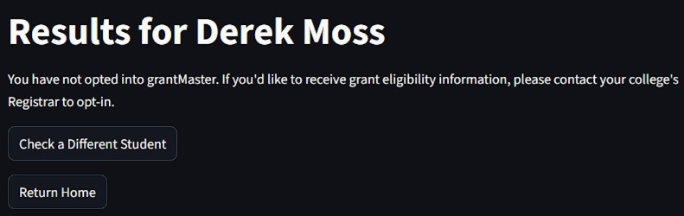
Frontend Demo – For Testers To See our Concept – this is Not the prototype.
Maria was Auto-Applied to 1 grant, and notified of 3 additional grants she qualifies for, which require letters of recommendation or essays.
opted in
Derek did not opt in to grantMaster, so when you select him and click “grants,” nothing shows up. His data was not run.
On dropdown menu of students, select a student to see their data. Next, click the “grants” button to see which grants were found for that student.

Slide 12
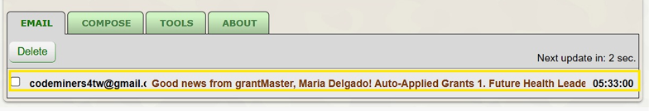
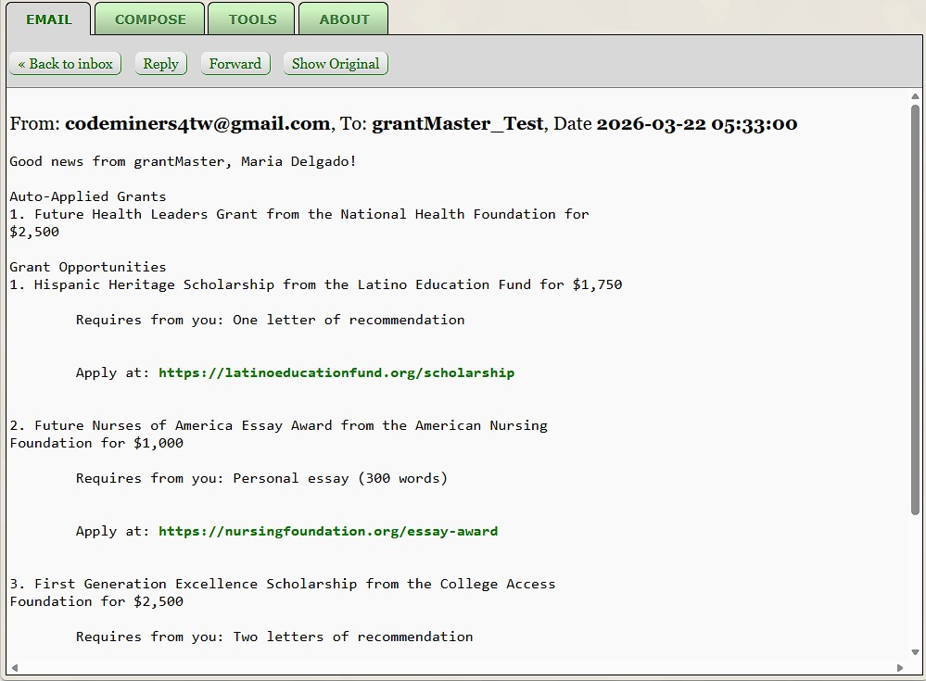
Student Experience: No Login, No Portal, No Extra Steps
🎓 Students simply receive an email in their inbox. Zero Friction!
✉️ Email includes:
Eligible grants
Auto-applied grants
Missing requirement items
Direct links to submit applications
Grant dollar $ amounts
Students do not interact with a grantMaster Frontend.
. This meets students where they already are – their inbox.

Slide 13
Why It Matters: Real Impact
🎓 Students:
Increased access to funding to finish degrees
Reduced reliance on loans and debt
🏫 Colleges:
Higher enrollment
Improved retention and graduation rates
🌎 Society:
More equality and inclusion in the distribution of grant funds
Reduction in the $3T student debt burden and its impacts
Billions of dollars can finally reach the students they were intended for.
Helps students finish college and start their lives and careers without financial burden.

Slide 14
Security & Trust: Secure. Opt-In. Student-Controlled.
Explicit student consent (opt-in checkbox)
Data sharing agreements with institutions & colleges
Secure backend handling & encryption
No unnecessary student exposure
No persistent storage of sensitive student data
Students remain fully in control of their data.

Slide 15
Closing: grantMaster Unlocks Opportunity
🎁Converts unused funds into real access
⚡ Requires near-zero effort from students
🔓 Eliminates barriers to grant funding, including for underserved students
🗺️ Scales across colleges and universities nationwide
🔮 Future Vision:
🌎 Nationwide adoption across institutions
🔗 Integration with financial aid systems
Thank you for your consideration of grantMaster.
Contact Information: LinkedIn: www.linkedin.com/in/mauracarter | Email: mcarte60@email.cpcc.edu

Slide 16
END/STOP HERE//

Slide 18
(other version) grantMaster Unlocking Billions in Unclaimed Student Grants Bank of America Code-A-Thon 2026 Code Miners Team: Jaime Delgado-Guzman | Maura Carter | David Diza | Zoe Ramirez

Slide 19
(0a) - Table of Contents
Code Miners Team & Leadership
Executive Summary & Problem
Solution: grantMaster Service
Process & Steps
Data Security & Opt-In
Backend
Frontend Demo
Outcome and Student Email
Summary & Contact Information

Slide 20
(1a) - Code Miners Team Members and Leadership
We are the Code Miners Team from the Technology Division at Central Piedmont Community College, Charlotte, NC.
Jaime Delgado-Guzman, Lead Developer: CPCC Python Certificate student, with a background in data analysis and engineering. Jaime is the Code Miners’ lead code developer for grantMaster and video editor.
Maura Carter, Concept Refiner: CPCC Artificial Intelligence Fundamentals Certificate student with a background in statistics and data science. Maura is responsible for refining the concept of grantMaster and leading the slide deck presentation.
David Diza, Code Tester: CPCC Computer Software Developer student, with a background in java and programming languages. David was the code reviewer and tester for grantMaster.
Zoe Ramirez, Logistics Coordinator: CPCC Certificate Student in Cyber Security. Zoe organized the team communication and workflow logistics for Code Miners.

Slide 21
(2a) - Executive Summary & Problem
Each year, billions of dollars in student grant money go unclaimed.
Students may qualify, but they don’t know these grants exist.
Grantors want to give out grant money, but cannot do so unless students apply.
The result is unclaimed funds, and students are either unable to afford to matriculate or graduate from college, in addition to students taking out enormous student loans to finance their education
Currently, there is over $ 3 trillion in unpaid student loan debt.
Students are severely hindered in their future careers when they graduate with massive amounts of student loan debt, if they have found no other ways to finance their education

Slide 22
(3a) - Solution: An application that automatically notifies of grants.
All students have to do is check one box to opt in.
This service automatically notifies students of available grant opportunities
Informs students when they need to submit an additional piece of information, such as a resume or essay attachment
It automatically applies students to grants, whenever applicable
.

Slide 23
(4a) - Process for Colleges and Students
College
1) Subscribe to grantMaster
2) Enter a data sharing agreement with grantMaster
3) Set up a secure data connection
4) Add a checkbox to the student registration form, so students can opt-in and consent to grantMaster
Student
1) Just that one checkbox! (Opt-in, at college registration)
Receive an email notification of grant opportunities, to their inbox.

Slide 24
(5a) Backend
Data
Code
IMAGE

Slide 25
(6a) - Output
(IMAGE) Output email to students
List of auto-applied grants
Essays/items still needed
Link to apply

Slide 26
(7a) -

Slide 27
(8a) – Security & Trust: Secure. Opt-In. Student-Controlled
Explicit student consent (opt-in checkbox)
Data sharing agreements with colleges
Secure backend data handling
Minimal student exposure (no accounts needed, no stored student data)

Slide 28
(9a) - Summary
The prototype is the entire data pipeline for the college subscribing, students opting in, data processed, emails generated, and ending with students receiving an email notification about grant opportunities to their inbox
Students never interact with a grantMaster frontend, nor do they have to log in or have a portal – no extra steps are required of the student
Students obtain substantial funds which allows them to afford college degree tuition.
Universities see an increase in student enrollment, retention, and graduation rates. As students receive more grant funding for their education and less reliance on student loans or self-financing.
Universities can use this as a marketing tool to increase application rates and university admissions by helping students get their degree more cost-effectively.
Universities would see an increase in alumni starting more stable and lucrative careers of their choosing, with less financial pressure of having to repay large student loans, in addition to alumni giving back to the college

Slide 29
Thank you & Contact Information
Thank you for your consideration of grantMaster. We appreciate your time.
Please contact us if you have questions
LinkedIn:
Email:
Phone: (980) 226-6382

Slide 31
Presentation
Code Miners Team & Leadership
Executive Summary & Problem
Solution: grantMaster Tool
Process & Steps
Data Security & Opt-In
Backend
Frontend & Demo
Outcome and Student Email
Summary & Contact Information

Slide 32
END//// START OF GENERAL CPCC SLIDE TEMPALTES
SLIDE TEMPLATES
___________________________________________________

Slide 35
Subscribe
1
2
3
4

Slide 38

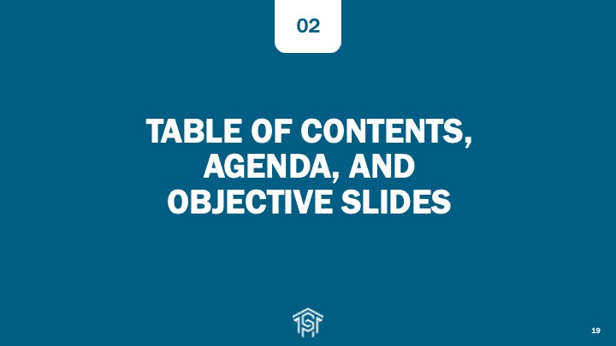

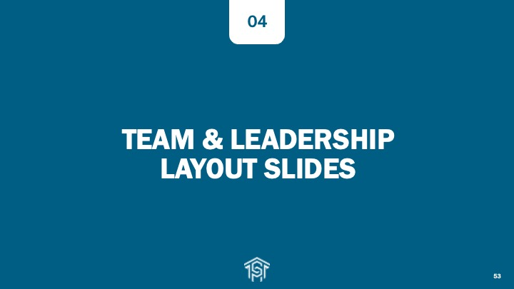
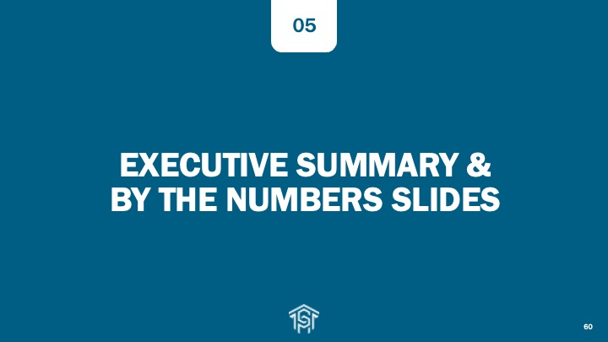

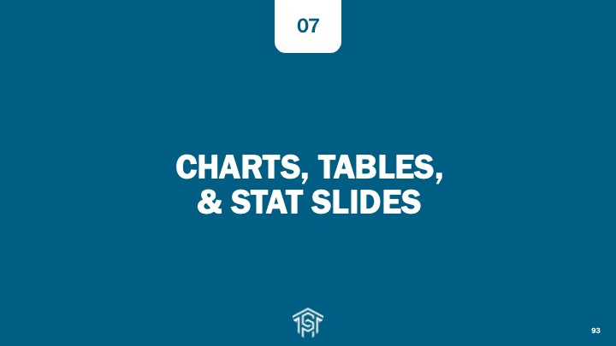



Slide Template Categories at a Glance

Slide 39






SAFETY MOMENT
We are meeting at:
[Add the address of your meeting’s building, include room number, and change this text to black.]
Who will fulfill each role in an emergency?
Call 6911
or 911
Use
AED/CPR
Meet Emergency
Personnel
Evacuate
Lead out/Last out
Evaluate your own response in these situations:
Active Shooter
Run, Hide, Fight
(Lock and Barricade)
Shelter in Place
Notes:
In the upper right corner of this slide, add the street address of your meeting’s building and include the meeting’s room number. Also change the text color from magenta to black.

Slide 40
TITLE SLIDES & SECTION DIVIDERS
01

Slide 41
Title Slide with Central Piedmont Logo
There is also a Title Slide without the Central Piedmont Logo

Slide 42
Title Slide Gray Background Plus Logo
There is also a Second Gray Background Title Slide that Does Not Have a Logo in Lower Left Corner

Slide 54
TABLE OF CONTENTS, AGENDA, AND OBJECTIVE SLIDES
02

Slide 63
TEXT & IMAGE LAYOUT SLIDES
03

Slide 78
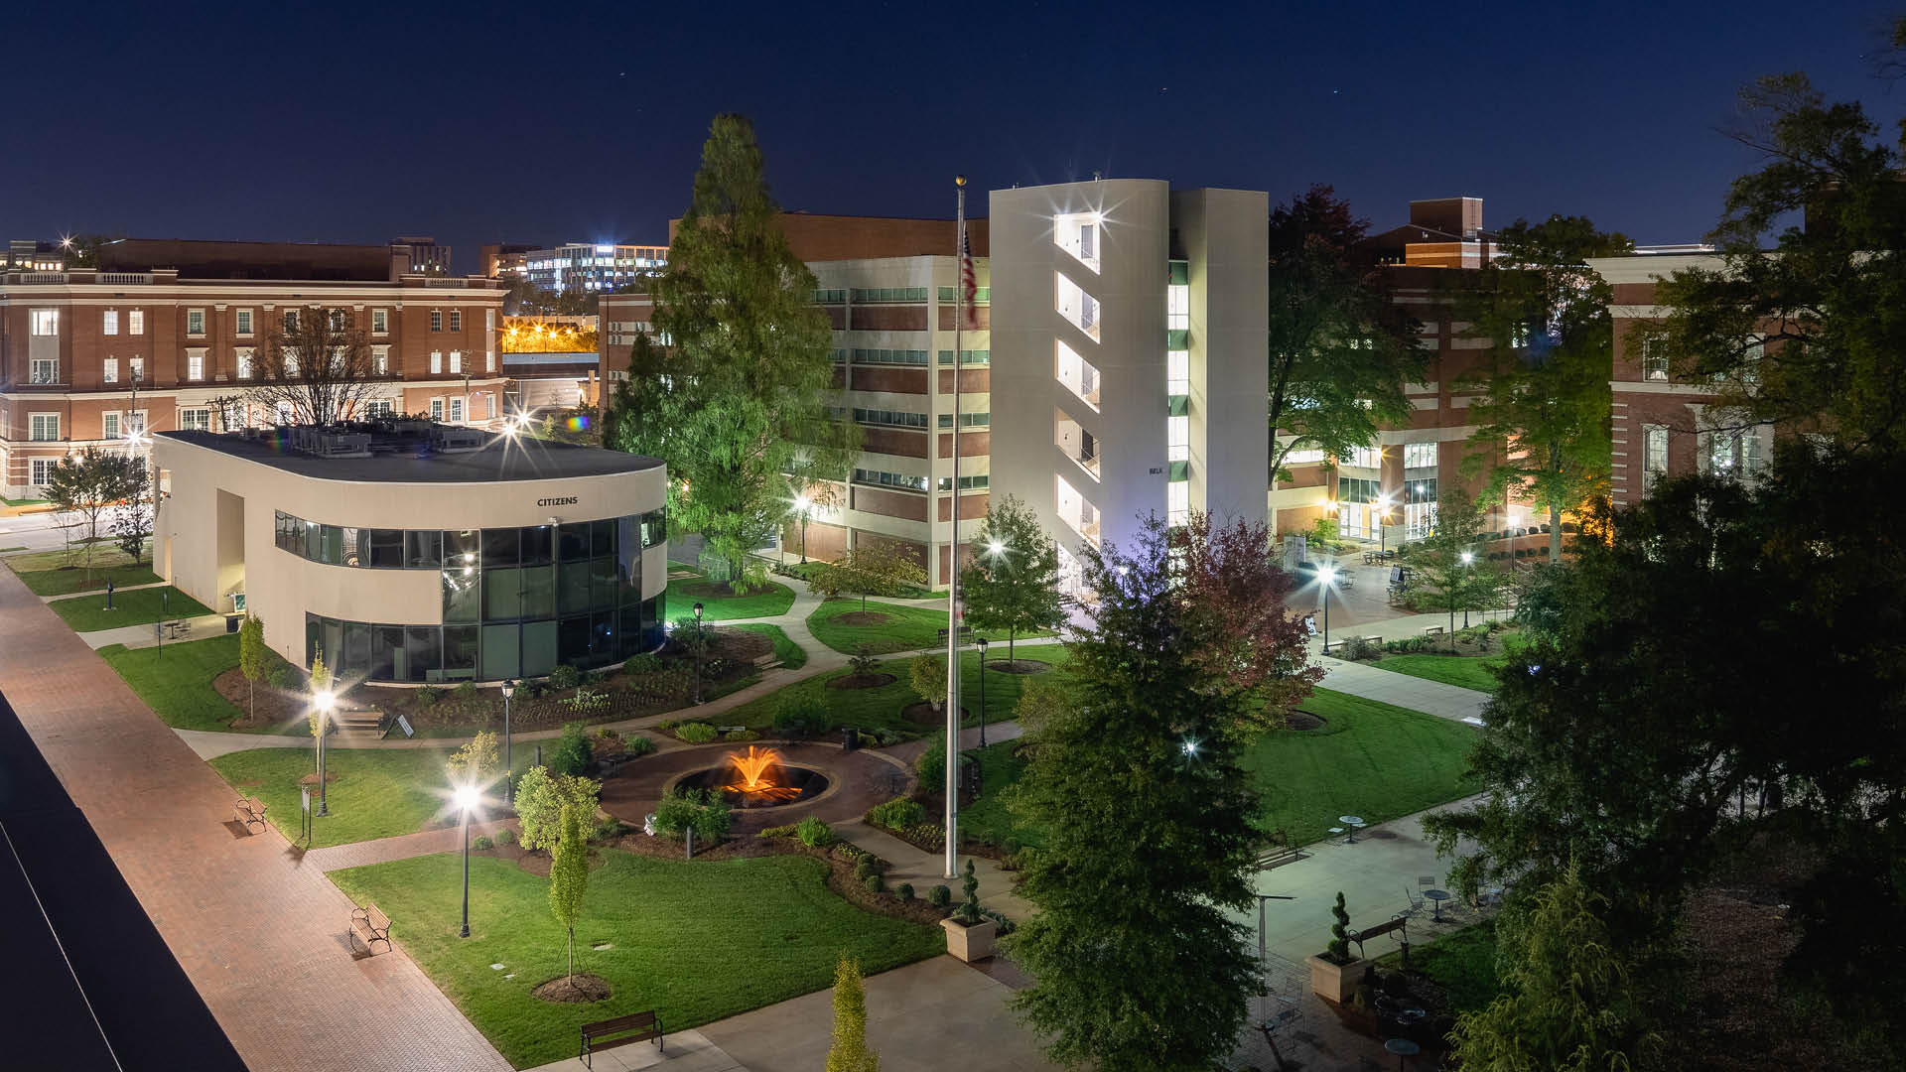
Gold overlay over photo

Slide 80
Gray overlay over photo

Slide 83
Blue overlay over photo

Slide 86
TEAM & LEADERSHIP LAYOUT SLIDES
04

Slide 87
Lead Developer
Concept Refiner
Code Tester
Logistics Coordinator

Slide 92
EXECUTIVE SUMMARY & BY THE NUMBERS SLIDES
05

Slide 110
QUOTE LAYOUT SLIDES
06

Slide 125
CHARTS, TABLES, & STAT SLIDES
07

Slide 132
[value]
[value]
[value]
[value]
[value]
[value]
[value]
[value]

Slide 135
TIMELINE & INFOGRAPHIC SLIDE LAYOUTS
08

Slide 140
MEDIA LAYOUT SLIDES
09

Slide 150
THANK YOU & CONTACT SLIDES
10

Slide 156
Thank You!

Slide 157
Questions?

Slide 158



704-330-2722
cpcc.edu
1201 Elizabeth Ave, Charlotte, NC 28204

Slide 159



704-330-2722
cpcc.edu
1201 Elizabeth Ave, Charlotte, NC 28204

Slide 160

Add a title for a screen reader

Slide 161

Add a title for a screen reader

