Slide 1
To what extent does our willingness to rely on eyewitness accounts depend on our emotional responses
group members: Maura, Anabelle, Tristan

Slide 2
MEMORY

Slide 3
EMOTION

Slide 4
CASE STUDY
A guy saw an old lady being robbed and he was then questioned by the police officer to re-tell the story of what happened and how the robber looked like so he could sketch and put up in the wanted to make a wanted flyer.

Slide 5
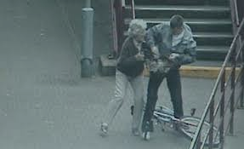

Slide 6


Slide 7
How can the police officer rely of this eye witness?

Slide 8
Memory Decay

