Slide 1

MAURO FRAGALE
21/10/2026
DAPT29

Slide 2

THE SCENARIO
This project imagines an advisory consultant collaborating with a public lighting and road safety corporation.
The objective is that of identifying the Italian municipalities with the highest concentration of traffic accidents in order to address nighttime or low-visibility safety issues by strategically allocating grants for public lighting upgrades.
Data is automatically fetched from the ISTAT APIs, merged with SITUAS sources on population, and normalized into pro capite rates to ensure fair comparison across urban and rural settings alike.
Moreover, a forecasting of 2030 accident rates via an unsupervised learning model is employed to isolate the cities where the largest increase in accidents is expected, so that such municipalities can be the primary target of the public lighting improvement project.

Slide 3
DATA PIPELINE
DATA FROM
ISTAT
Downloaded data from the source via the requests module.
UNDERSTANDING DATA
Analyzed the columns, their meaning and their importance (or lack thereof).
DATA CLEANING
Selected only the useful columns, merged and reordered them.
DATA FROM
SITUAS
Downloaded data from the source via the integrated download link.
JOINING AND FINALIZING DATA
Merged the cleaned data with the 2024 data from SITUAS.
EXPORTING THE FINAL CSV
Exported the final dataframe in csv format.

Slide 4
EXPLORATORY DATA ANALYSIS
DESCRIPTIVE ANALYSIS
General information on the columns (kurtosis, skewedness, standard deviation…)
DISTRIBUTION HISTOGRAMS
Distribution charts of accidents, injuries and deaths to recognize a pattern
TEMPORAL ANALYSIS
Distribution of accidents across years and analysis of any unnatural drops
DISTORTION ON POPULATION SIZE
Effects of low and high numbers of inhabitants on adjusted rates
LOW
POPULATION
A low number of accidents distorts the pro capite rate to unnatural results
HIGH
POPULATION
The number of accidents and their consequences is natually higher

Slide 5
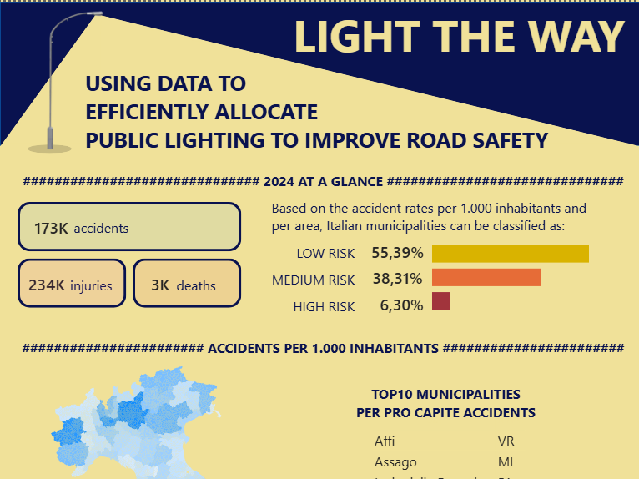
CLUSTERING, REGRESSION AND STORYTELLING
CLUSTERING ANALYSIS
Grouped municipalities using unsupervised learning based on adjusted rates in order to identify distinct classes of risk.
LINEAR REGRESSION
Statistical modeling to forecast trends and predict accident rates for 2030.
POWER BI STORYTELLING
Designed a visual dashboard.

