Slide 1

AgentLevy
The open-source reference protocol for verifiable agent commerce.
Consensus EasyA · May 5–7, 2026 · A working demo, with code.
GITHUB.COM/MAURATHAT/AGENTLEVY-BASE-UOR

Slide 2

The Gap: Identity ≠ Work Integrity
"Agent commerce assumes good faith. Production cannot."
Today's stack tells you who you're transacting with — DID registries, agent-platform credentials, same-vendor logs. None of it tells you what was actually done. The audit collapses the moment a vendor disappears, a registry de-lists an agent, or a counterparty disputes the log.
A registered, KYC'd agent can still lie about what it computed — and you have no way to re-check. A settlement primitive for agent commerce must make the work itself cryptographically verifiable, with no trusted third party at the verify step.

Slide 3

Why We Built It — vs. What Exists
Yes, things exist in this space. None of them solve the work-integrity problem. They tell you who, We tell you what – verifably forever.
Coinbase x402
Virtuals Protocol (ACP)
HTTP-layer payment rail. Says the money moved. AgentLevy says the work matched the spec, here's the math. Composable, not competitive.
Platform-bound to Base + Virtuals tokens. A marketplace primitive, not a settlement primitive. AgentLevy is chain-neutral, token-free, audit-first.
DID / KYC Registries
Web3 Oracles
Tell you who the agent is. Silent on what the agent actually did.
Trusted-oracle model. AgentLevy needs no oracle — the cert chain is the oracle.

Slide 4

What We Built
AgentLevy is a protocol-layer demo where two AI agents negotiate and execute a KYC compliance task, sign each step with content-addressed derivation certificates, settle on Base via a hashlock USDC escrow, and anchor every cert to Hedera Consensus Service — producing an audit trail verifiable from public keys alone, across two independent ledgers, with no trusted intermediary.
TaskSpec + DerivationCert
Hashlock Escrow on Base
Dual-signed work contract + delivery (UOR-Passport content-addressed). ✅ 128 tests passing.
Conditional USDC release on sha256(cert) == hashlock. ✅ Deployed Sepolia.
AWS Lambda + Bedrock
Hedera HCS Anchor
Sanctions screening agent — stateless, key-free, scales to zero. ✅ Live.
Tamper-evident cert timestamping. ✅ Live topic 0.0.8856047.

Slide 5
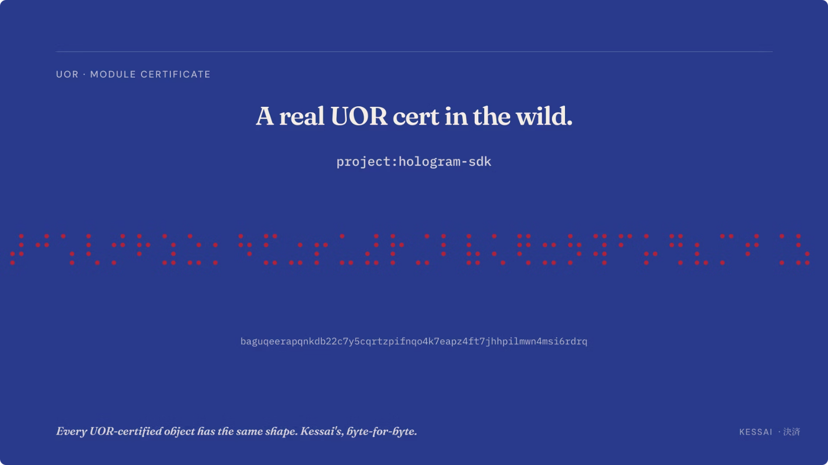
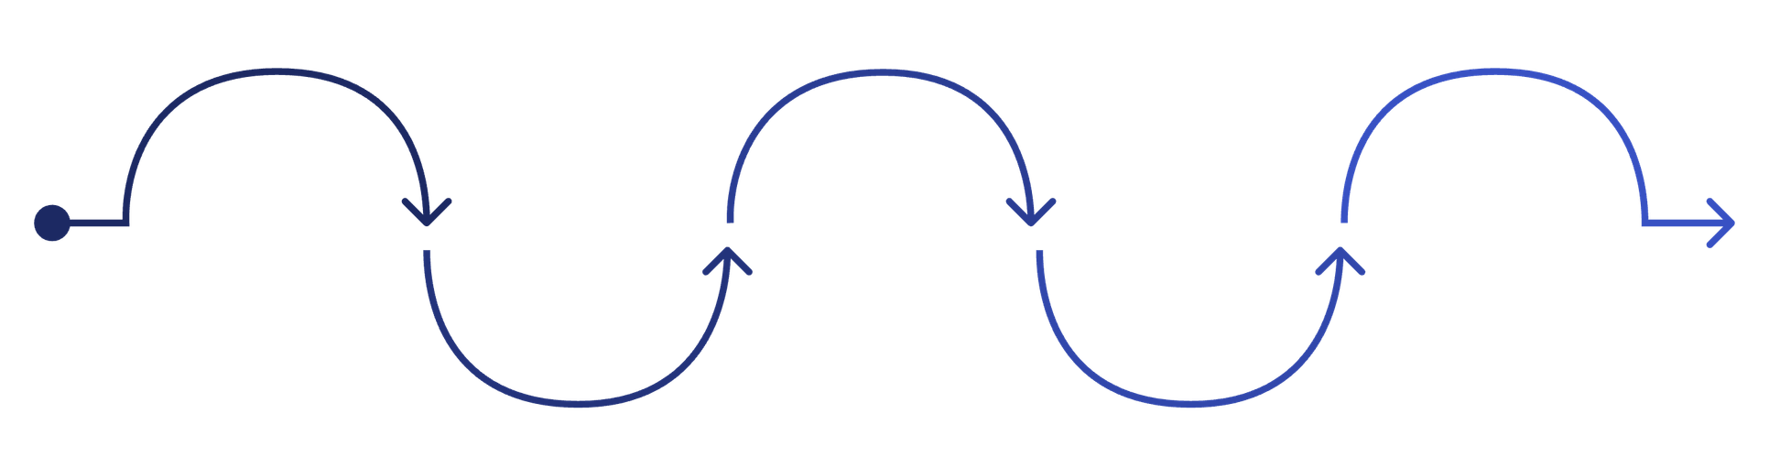
The KYC Demo: Three Agents, Five Artifacts, Two Chains
Beneficial Extract
Cert Anchoring
Buyer Escrows
Sanctions Screening
Release on Match
Compliance Agent extracts owners via Claude Haiku
DerivationCerts anchored to Hedera HCS
Buyer Agent escrows USDC on Base
Sanctions Agent screens using AWS Lambda
Escrow releases when cert hash matches
No oracles. No off-chain settlement. No trust in any agent or vendor. The audit itself becomes a signed cert — recursive verifiability. Math.

Slide 6
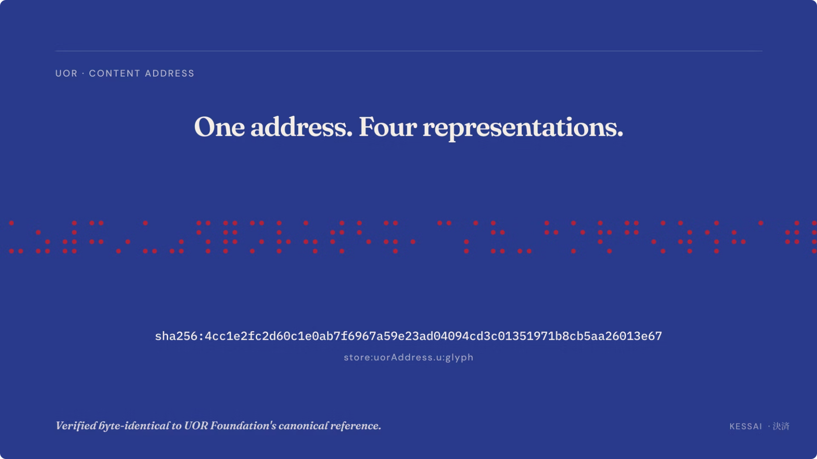
The Cert Chain Anatomy
Every artifact has a content address — sha256:<64 hex> — derived from JCS-RFC8785 + NFC canonical bytes. Verified byte-identical to UOR Foundation's reference implementation.
Why UOR-Passport Format?
Every Arrow Is a Hash Reference
Every address is publicly resolvable by any UOR-aware tool — no translation, no vendor-specific format. The address outlives the vendor, the agent, and any single chain.
Tampering with any cert breaks the chain at the address-resolution step — not just the signature step. That's the audit-trail invariant.
PRISM ring algebra (Q(31), 256-bit, MIT-licensed)
JCS-RFC8785 + NFC canonicalization
Live cross-validated vs. mcp.uor.foundation
TaskSpec → signed by buyer + seller
DerivationCert (compliance) → references sanctions cert by content address
DerivationCert (sanctions) → output_address → SanctionsResult

Slide 7




Two-Ledger Settlement
Base settles. Hedera anchors. AWS Lambda runs the agent. KIRO IDE audits. Independent witnesses, independent runtimes.
Base Sepolia — Settlement
Hedera Testnet — Audit Anchor
AWS Lambda + Bedrock
KIRO IDE + AgentLevy MCP
HashlockEscrow ~100 LoC Solidity. require(sha256(certPayload) == hashlock) releases USDC. No oracles. No off-chain settlement.
Every cert's content address submitted to HCS topic 0.0.8856047 — authoritative consensus timestamp + sequence number as independent witness.
Stateless sanctions agent calling Claude Haiku 4.5 via Bedrock. Pay-per-invocation, scales to zero, key-free.
Five verification tools in your IDE: verify_cert + verify_hedera_anchor + verify_base_escrow + audit_cert_chain + emit_audit_cert. The audit becomes a signed cert too.

Slide 8

The Verification Math
Anyone holding (buyer_pubkey, compliance_pubkey, sanctions_pubkey, 5 certs) can independently verify — no vendor needs to still exist, no agent needs to still be active. The audit verifies in 2046 the same way it verifies today.
01
02
03
Signatures Valid
Content Addresses Resolve
Back-References Resolve
Ed25519 verify against canonical bytes for every cert.
Recompute SHA-256 over canonical bytes; match against the reference.
task_spec_address, input_addresses, subcontract_cert_addresses all point at real, verifiable objects.
04
05
Hedera Witnessed
Escrow Released
Mirror Node REST returns the message body matching the cert's content_address + consensus timestamp.
Base Sepolia tx history confirms HashlockEscrow funded with hashlock X and released after submission of cert X.

Slide 9

Risk Mitigations: Smart Contracts + LLMs
The two scariest failure modes in agent-driven onchain commerce are exactly the two we engineered away from.
Smart-Contract Risk → Minimal Surface
LLM Risk → Bounded + Schema-Locked
HashlockEscrow is ~100 lines of Solidity — one conditional release rule. No oracle, no time-dependent branches, no external calls beyond ERC-20 USDC transfer. Auditable in a single afternoon. Hashlock pre-commitment means the buyer locks in the expected cryptographic outcome at funding.
4-turn hard cap on buyer↔compliance negotiation
Schema-validated outputs only via Anthropic tool use (Pydantic)
Temperature = 0 by default for determinism
Fixture cache for stage demos — byte-identical replay
Wrong-keypair rejection at sign time
128 tests across primitives + HCS + LLM stack
LLMs can still fabricate data within the schema. The cert chain proves the work happened, not that inputs were correctly interpreted. The Solidity escrow has no production audit yet — pilots will go through a top-tier security firm before any mainnet deployment.

Slide 10
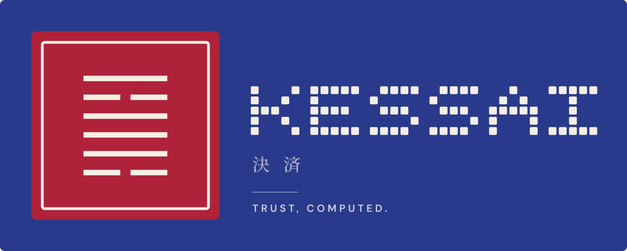
Standards-Aligned, Open Protocol → Kessai Product
The Standards We Co-Authored
Roadmap Highlights
VTEAI — Verified Task Escrow + Attestation Interface. ERC draft, CC0, April 2026. AgentLevy is the first reference implementation.
UOR-ADDR-1 — Universal Object Reference Address. Chain-agnostic content addressing for agent commerce.
PRISM — UOR Foundation's algebraic ring-coordinate system. MIT-licensed, vendored. One address, four representations.
XRPL sibling implementation (XLS-100 SmartEscrow + RLUSD) — same protocol, new adapter
AgentCore Memory upgrade for stateful fraud detection agents
Enterprise pilots: mid-market banks, KYC vendors, M&A escrow, healthcare, legal e-discovery
dNFT + SmartEscrow: AI model pay-per-inference with cryptographic enforcement
Content addresses are byte-identical to UOR Foundation's canonical reference — live cross-checked May 6, 2026.
AgentLevy → Kessai
The open-source protocol is AgentLevy. The commercial layer is Kessai — enterprise SaaS, visualizer UI, regulatory-evidence packs, channel licensing. Same protocol, productized.
📦 GitHub
🌐 Standards
🤝 Hiring
github.com/maurathat/AgentLevy-Base-UOR
VTEAI ERC draft + UOR-ADDR-1 community proposal
2 senior engineers — Python SDK + multi-chain settlement (pre-seed open)

