Slide 1
Introduction to Electric and Electronics
Chapter 10 –
Operational Amplifiers and Applications

Slide 2
Learning Objectives
Learning Objectives
To understand the characteristics of operational amplifier and differential amplifier.
To understand the operation of the ideal op-amp.
To be able to recognize and analyze fundamental op-amp.
To understand the application of op-amps in the development of LPF, HPF, and BPFs.
To be able to understand the use of op-amps to construct differentiator and integrator circuits
To understand multistage amplifier circuits

Slide 3
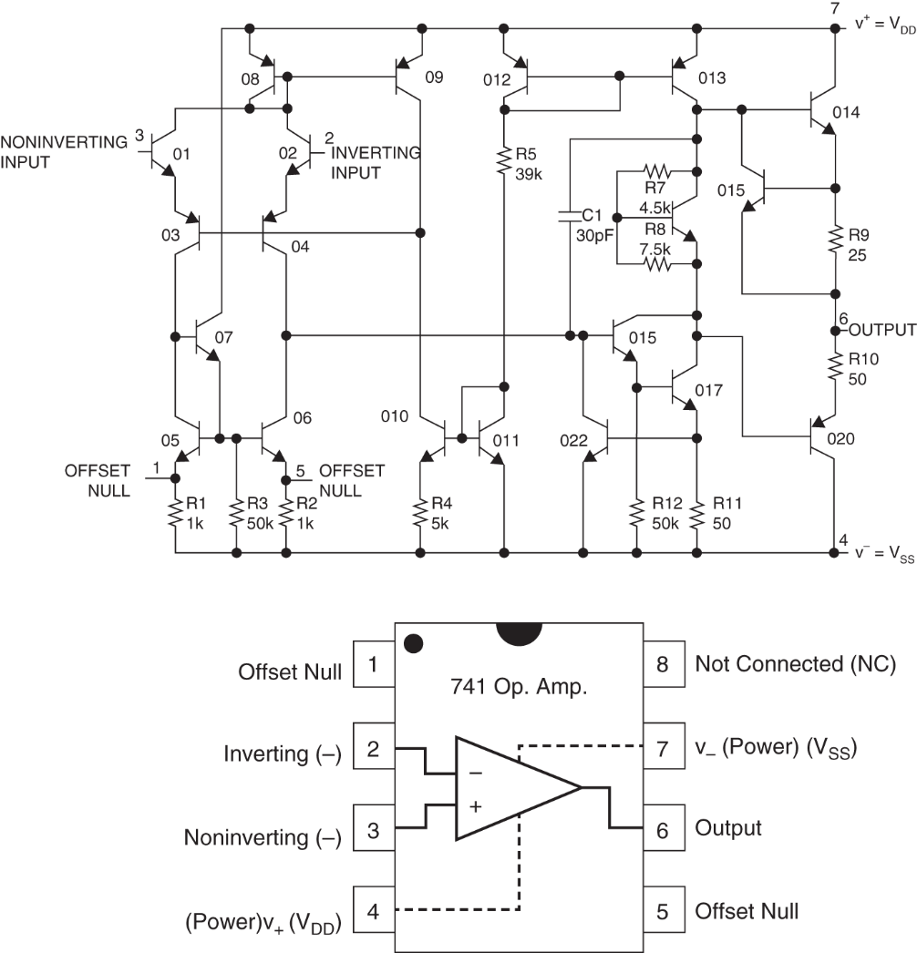
Introduction
Introduction
Operational Amplifier(op amp)

Slide 4
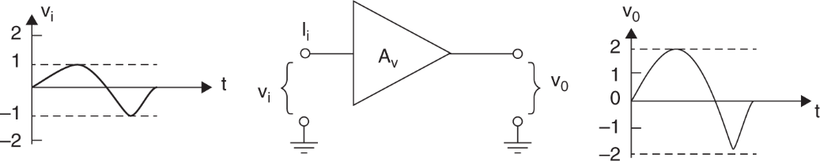
Introduction
Operational Amplifier(op amp)
One of the basic building blocks for constructing analog systems
Used for a variety of purposes
A voltage amplifier with an extremely high voltage gain
An ideal linear voltage amplifier

Slide 5
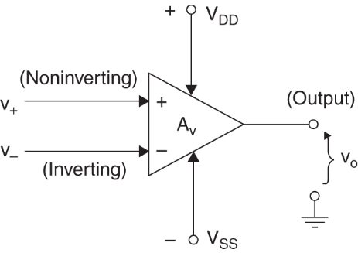
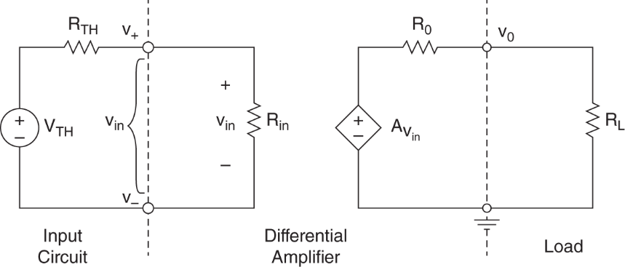
Differential Amplifier
Differential amplifier
v_{in} is voltage difference between two input

Slide 6
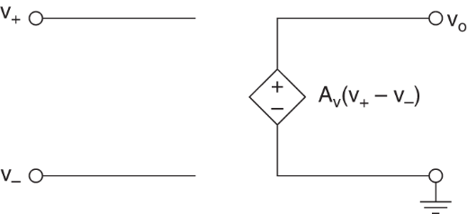
Ideal Op Amp
Ideal Op Amp
Noninverting terminal, i₊, v₊
Inverting terminal, i₋, v₋
Infinite input resistance R_{i}=∞
Open loop gain A_{v}→ ∞
V_{o} = A_{v}(v₊ - v₋ )
i₊ = i₋ = 0

Slide 7
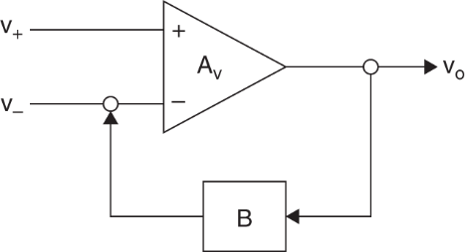
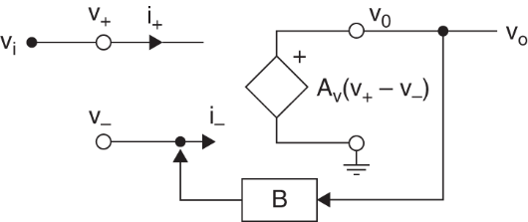

Ideal Op Amp
Negative feedback
a large class of useful circuits with op amps.
closed-loop gain, A_{F}
$$A_{F}=\frac{V_{o}}{V_{i}}=\frac{1}{B}$$
Op amp with feedback circuit Circuit model of ideal op amp with feedback

Slide 8
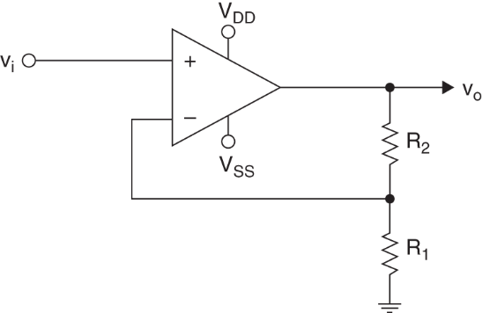
Noninverting Amplifier
Noninverting Amp
feedback to the noninverting input
input voltage
negative feedback causes
no current flows into input, therefore
closed-loop voltage gain

Slide 9
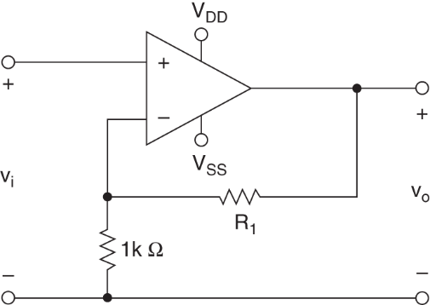
Noninverting Amplifier
Example 10.1
closed-loop voltage gain

Slide 10
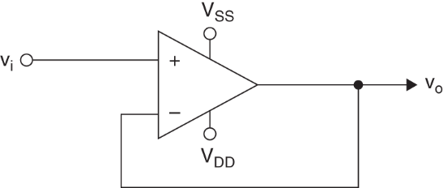
Unity-gain Buffer
Unity-gain Buffer
output voltage is same as input voltage
input voltage
closed-loop gain

Slide 11
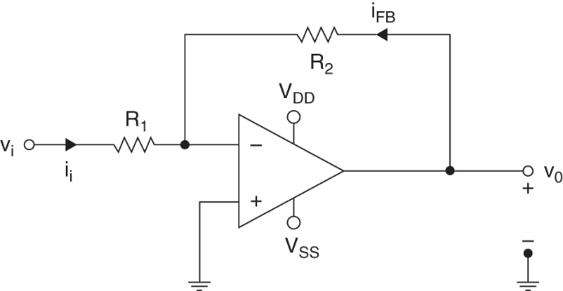
Inverting Amplifier
Inverting Amp
feedback to the inverting input
negative feedback causes
current through R₁
current through R₂
closed-loop gain

Slide 12
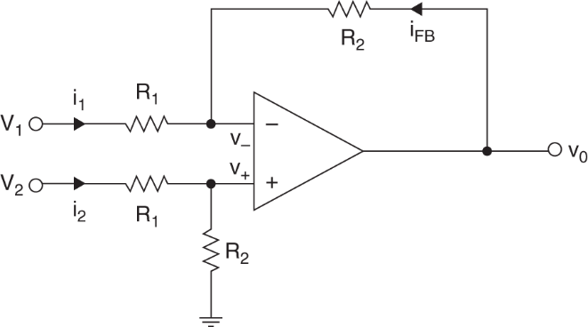
Differential Amp
Differential Amp
Differential Amp
voltage
current
output vol.
CMRR
Common Mode Rejection Ratio
how nearly ideal a diff amp is.

Slide 13
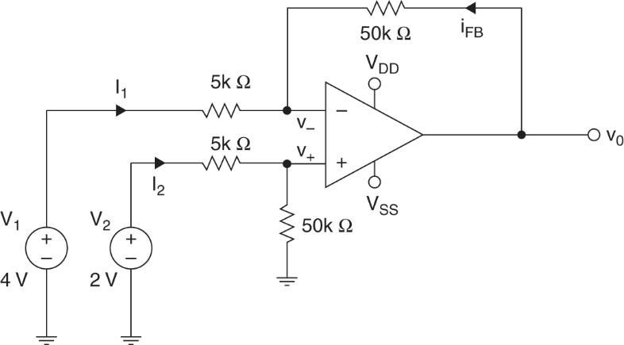
Differential Amp
Example 10.3

Slide 14
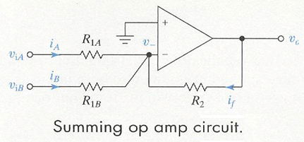
Summing Circuit
Summing Circuit
current
KCL
output vol.

Slide 15
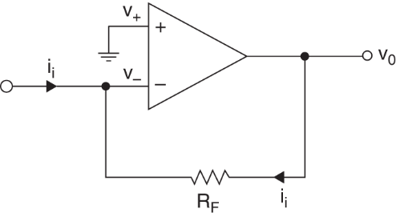
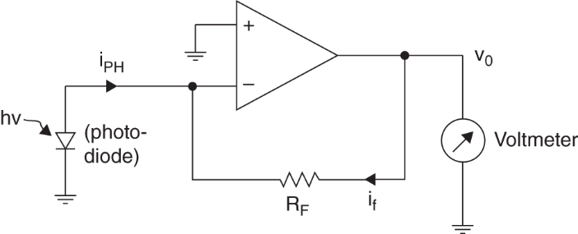
Current-to-Voltage Converter
Current-to-Voltage Converter
current
voltage
transresistance
Example 10.4

Slide 16
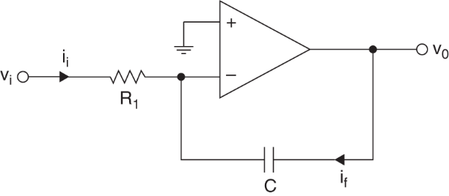
Integrator
Integrator
current
combining
output vol.

Slide 17


Differentiator
Differentiator

Slide 18

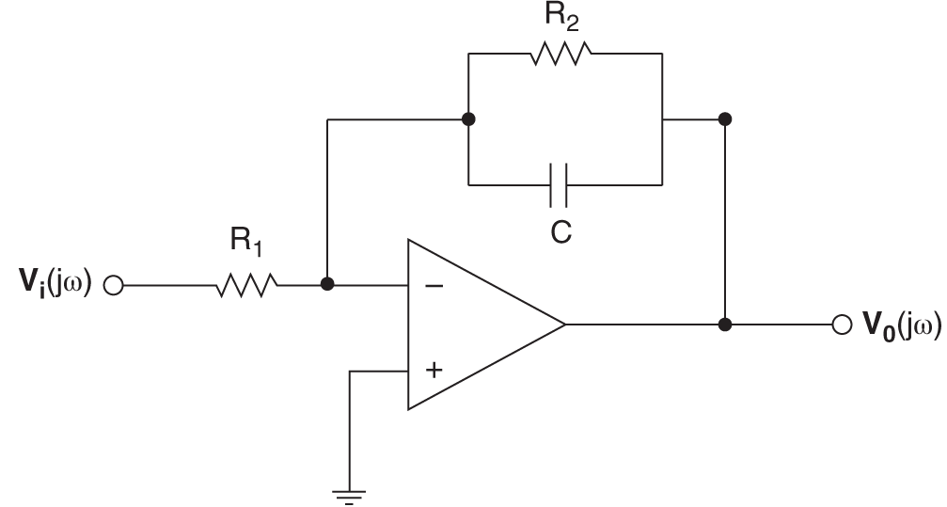
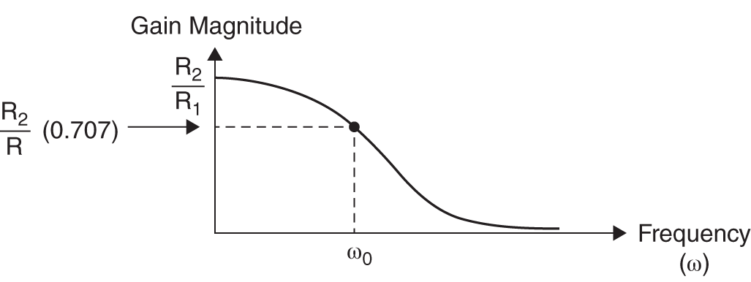
Active Filter
Active Filter
complex voltage gain here and therefore
half-power point

Slide 19
Homework
Homework
Read Text Chapter 11.
Prepare Presentation

