Slide 1
Introduction to Electric and Electronics
Homework #5

Slide 2
Homework #5
Homework #5
Solve Problems 11.2, 11.4, 11.7, 11.28, 11.38
Submit by 17th December.

Slide 3
Homework #5
Problem #1, 2
(a) What are the two primary types of transistors? (b) What is the goal or purpose of a transistor in analog circuits?
(a) Sketch a cross-section drawing of an n-channel enhancement mode MOSFET. (b) Draw two common circuit symbols for this device.

Slide 4
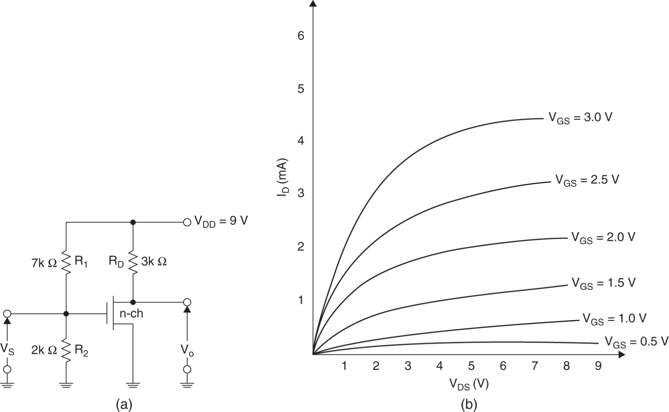
Homework #5
Problem #3
3. (a) Draw the load line for the amplifier. (b) Determine the Q-point.
Figure P11.79

Slide 5
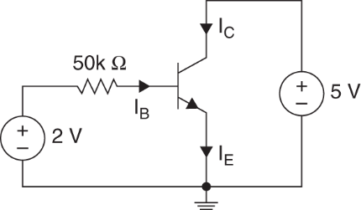
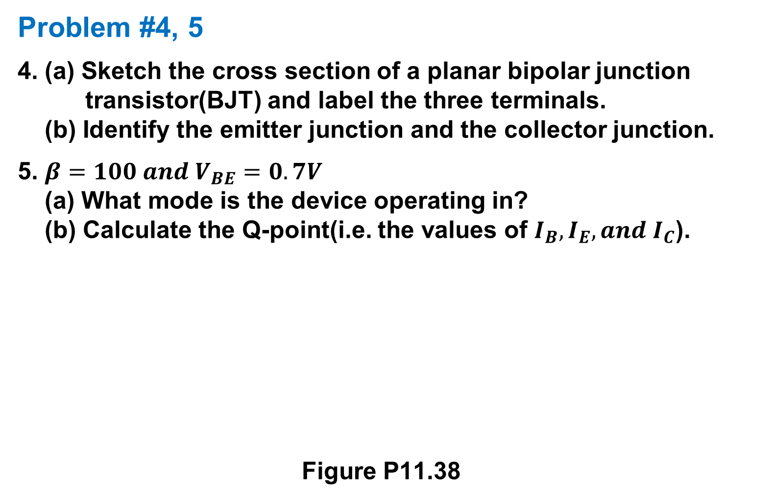
Homework #5
Problem #4, 5
4. (a) Sketch the cross section of a planar bipolar junction transistor(BJT) and label the three terminals. (b) Identify the emitter junction and the collector junction.
5. $β=100 and V_{BE}=0.7V$ (a) What mode is the device operating in? (b) Calculate the Q-point(i.e. the values of $I_{B}, I_{E}, and I_{C}$).
Figure P11.38

