Slide 1
Introduction to Electric and Electronics
Chapter 4 – Homework

Slide 2
Homework #3
Homework #3
Solve Problems Solve Problems 4.6, 4.22, 4.42, 4.54
Submit by 31st October.
Read Text Chapter 5.
Prepare Presentation

Slide 3
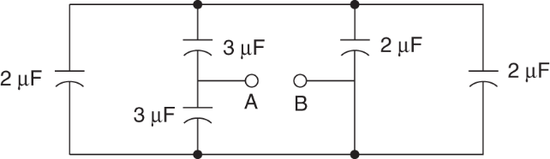
Homework #3
Problem #1
Determine the capacitance at the terminals A-B.
Figure P4.6

Slide 4
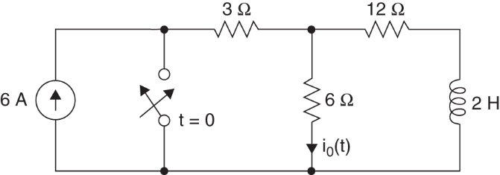
Homework #3
Problem #2
Find i_{o}(t) for t>0.
Figure P4.42

Slide 5
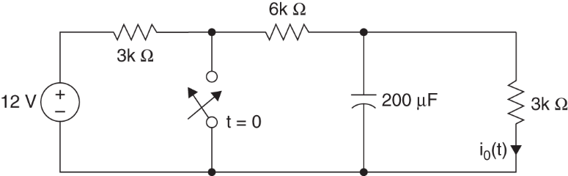
Homework #3
Problem #3
Find i_{o}(t) for t>0.
Figure P4.22

Slide 6
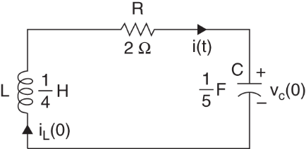
Homework #3
Problem #4
Find i(t) for t>0. Here the initial conditions are i_{L}(0)=2A and v_{C}(0)=4V.
Figure P4.54

