Slide 1
Introduction to Electric and Electronics
Chapter 3 – Homework

Slide 2
Homework #2
Homework #2
Solve Problems 3.12, 3.22, 3.43, 3.50, 3.52 Submit by 22th October.
Read Text Chapter 4.
Prepare Presentation

Slide 3
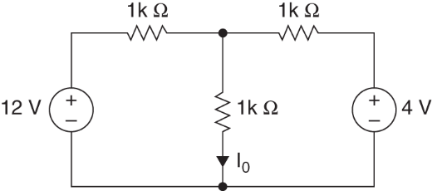
Homework #2
Problem #1
Use nodal analysis to determine I_{o} in the circuits in Figure P3.12 Figure P3.12

Slide 4
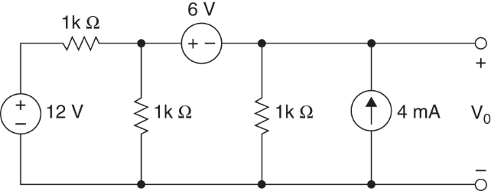
Homework #2
Problem #2, #3, #4
Determine V_{o} in the network in Figure P3.22
Use loop analysis
Use superposition
Use Thevenin’s theorem
Figure P3.22

Slide 5
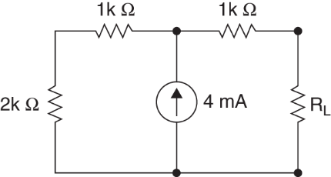
Homework #2
Problem #5
Find R_{L} for maximum power transfer and the amount of power transferred in the network in Figure P3.52 Figure P3.52

