Slide 1
Introduction to Electric and Electronics
Chapter 3 –
Circuit Analysis Techniques

Slide 2
Learning Objectives
Learning Objectives
To understand how to apply Ohm’s law and Kirchhoff’s laws to analyze circuits
To be able to determine voltages and currents anywhere in the network using both nodal and loop analysis
To be able to effectively apply both superposition and Thevenin’s theorem in network analysis
To understand and apply maximum power transfer

Slide 3
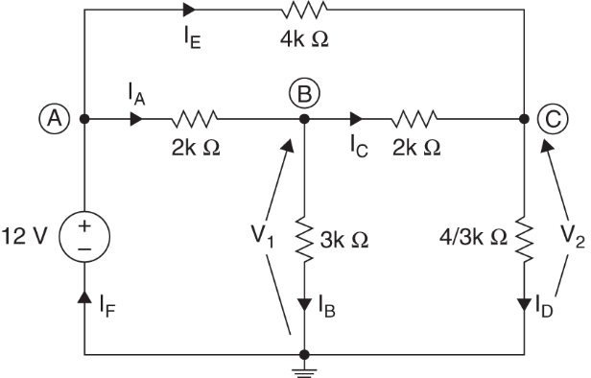

Nodal Analysis
Nodal Analysis
Consider the right circuit
To know the circuit is to know the node voltage $V_{A},V_{B}{, V}_{C}$ and the branch current $I_{A},I_{B}{, I}_{C},I_{D},I_{E}{, I}_{F}$
If we know $V_{B}=6V,V_{C}=4V$ $I_{B}=\frac{6}{3k}=2mA, { I}_{D}=\frac{4}{4/3k}=3mA,$ (Ohm’s law) and $I_{A}=\frac{12−6}{2k}=3mA, { I}_{C}=\frac{6−4}{2k}=1mA$ (Ohm’s law) and $I_{E}=I_{D}−I_{C}=2mA, { I}_{F}=I_{A}+I_{E}=5mA$ (KCL)

Slide 4
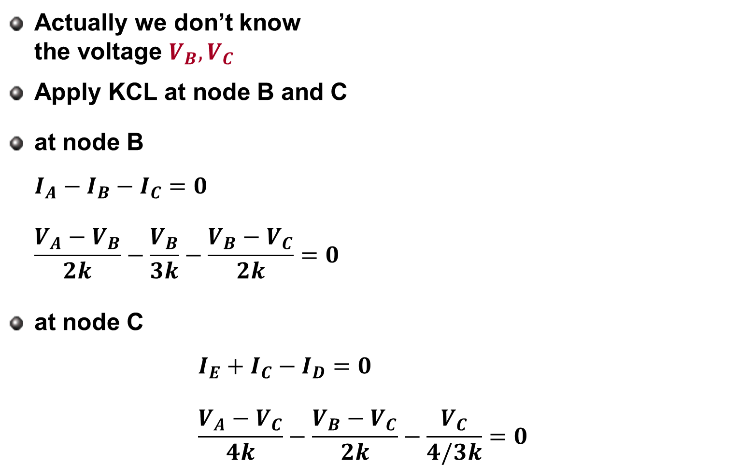
Nodal Analysis
Actually we don’t know the voltage $V_{B}{, V}_{C}$
Apply KCL at node B and C
at node B $I_{A}−I_{B}−I_{C}=0$ $\frac{V_{A}−V_{B}}{2k}−\frac{V_{B}}{3k}−\frac{V_{B}−V_{C}}{2k}=0$
at node C $I_{E}+I_{C}−I_{D}=0$ $\frac{V_{A}−V_{C}}{4k}−\frac{V_{B}−V_{C}}{2k}−\frac{V_{C}}{4/3k}=0$

Slide 5
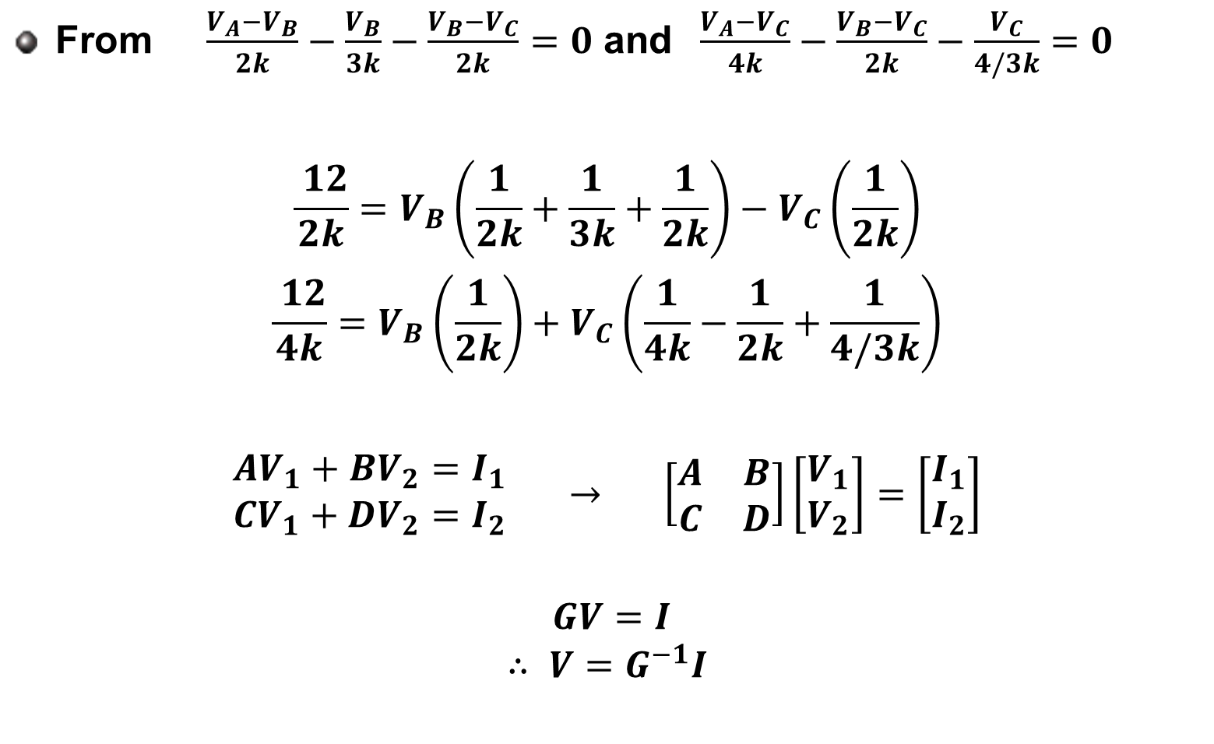
Nodal Analysis
From $\frac{V_{A}−V_{B}}{2k}−\frac{V_{B}}{3k}−\frac{V_{B}−V_{C}}{2k}=0$ and $\frac{V_{A}−V_{C}}{4k}−\frac{V_{B}−V_{C}}{2k}−\frac{V_{C}}{4/3k}=0$
$$\frac{ 12}{2k}=V_{B}\left(\frac{1}{2k}+\frac{1}{3k}+\frac{1}{2k}\right)−V_{C}\left(\frac{1}{2k}\right)$$
$$\frac{ 12}{4k}=V_{B}\left(\frac{1}{2k}\right)+V_{C}\left(\frac{1}{4k}−\frac{1}{2k}+\frac{1}{4/3k}\right)$$
$$\begin{matrix}AV_{1}+BV_{2}=I_{1} \\ CV_{1}+DV_{2}=I_{2}\end{matrix} → \left[\begin{matrix}A & B \\ C & D\end{matrix}\right]\left[\begin{matrix}V_{1} \\ V_{2}\end{matrix}\right]=\left[\begin{matrix}I_{1} \\ I_{2}\end{matrix}\right]$$
$GV=I$ $$∴ V=G^{−1}I$$

Slide 6
Nodal Analysis
The Nodal Analysis technique
If instead of focusing on the voltages of the circuit elements, one looks at the voltages at the nodes of the circuit, the number of simultaneous equations to solve for can be reduced.
Given a circuit with n nodes, without voltage sources, the nodal analysis is accomplished via three steps:
Select a node as the reference node. Assign voltages v₁,v₂,…v_{n-1} to the remaining n-1 nodes, voltages are relative to the reference node.
Apply KCL to each of the n-1 non-reference nodes. Use Ohm’s law to express the branch currents in terms of node voltages
Solve the resulting n-1 simultaneous equations to obtain the unknown node voltages.
The reference, or datum, node is commonly referred to as the ground since its voltage is by default zero.

Slide 7
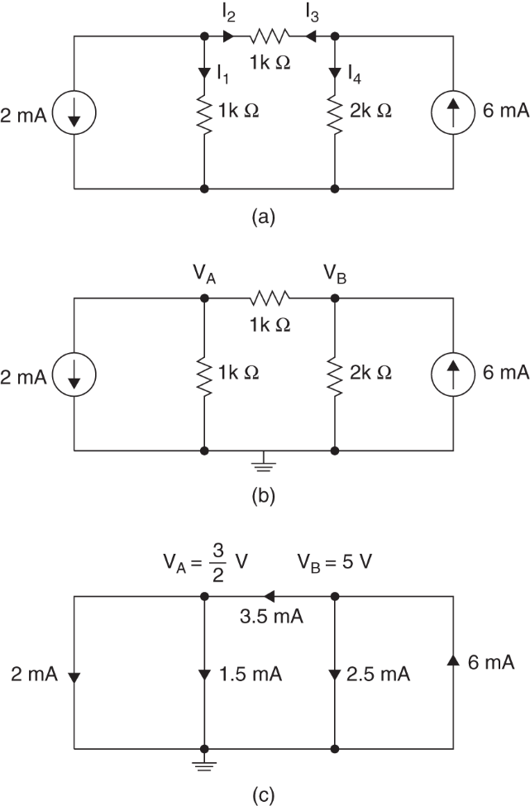
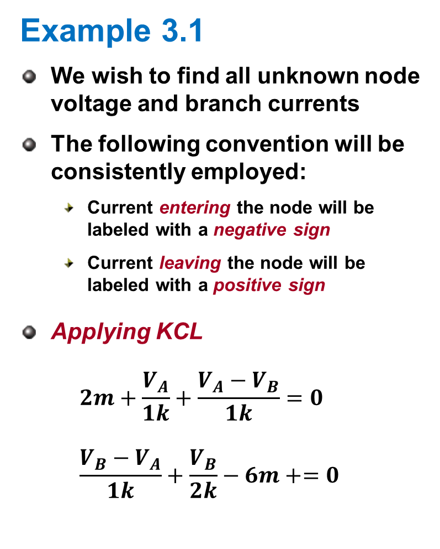
Example 3.1
Example 3.1
We wish to find all unknown node voltage and branch currents
The following convention will be consistently employed:
Current entering the node will be labeled with a negative sign
Current leaving the node will be labeled with a positive sign
Applying KCL $2m+\frac{V_{A}}{1k}+\frac{V_{A}−V_{B}}{1k}=0$ $\frac{V_{B}−V_{A}}{1k}+\frac{V_{B}}{2k}−6m+=0$

Slide 8
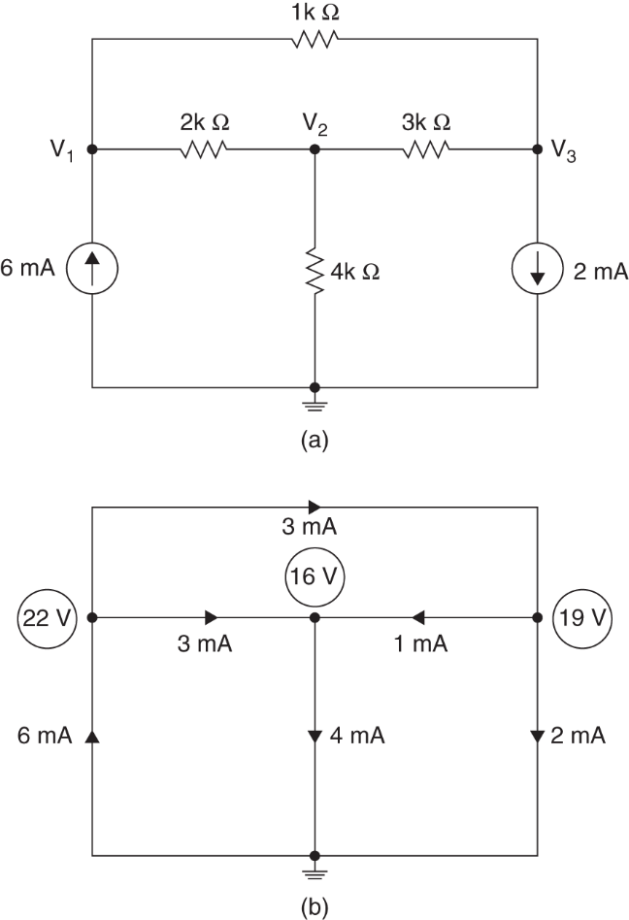
Example 3.2
Example 3.2
Find all unknown node voltage and branch currents
V₁: -6m + (V₁-V₂)/2k + (V₁-V₃)/1k = 0
V₂: (V₂-V₁)/2k + V2/4k + (V₂-V₃)/3k = 0
V₃: (V₃-V₁)/1k + (V₃-V₂)/3k +2m = 0

Slide 9
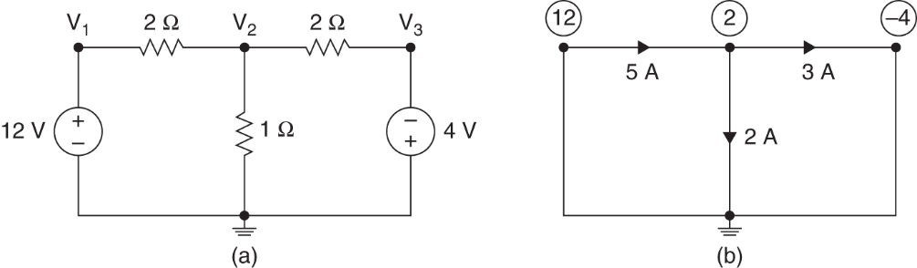
Nodal Analysis with Voltage Source
Nodal Analysis with Voltage Source
Example 3.3
We know V₁ and V₃. Then?

Slide 10
Supernode
Supernode
A supernode is formed by enclosing a voltage source (dependent or independent) connected between two non-reference nodes and any elements connected in parallel with it.
Why?
Nodal analysis requires applying KCL
The current through the voltage source cannot be known in advance (Ohm’s law does not apply)
By lumping the nodes together, the current balance can still be described

Slide 11
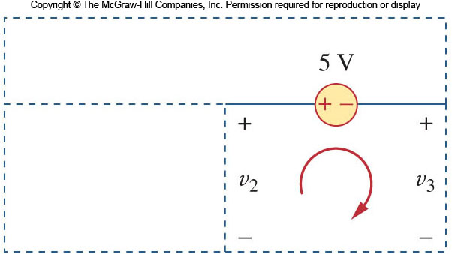
Supernode
Analysis with a Supernode
In order to apply KVL to the supernode in the example, the circuit is redrawn as shown.
Going around this loop in the clockwise direction gives:
Note the following properties of a supernode:
The voltage source inside the supernode provides a constraint equation needed to solve for the node voltages
A supernode has no voltage of its own
A supernode requires the application of both KCL and KVL

Slide 12
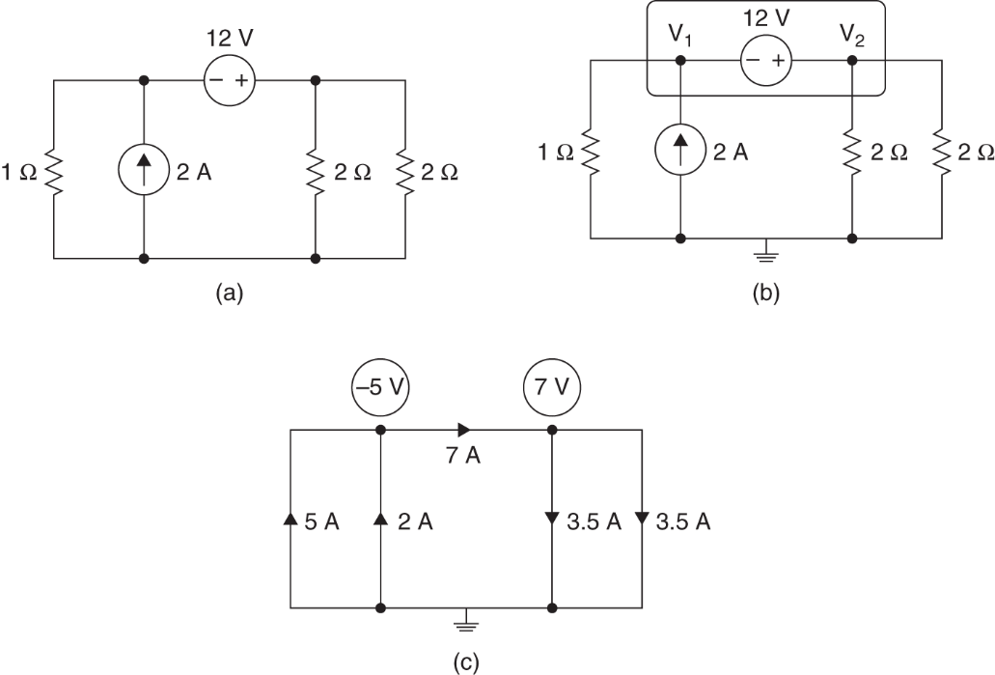
Supernode
Example 3.4
Consider the network below.

Slide 13
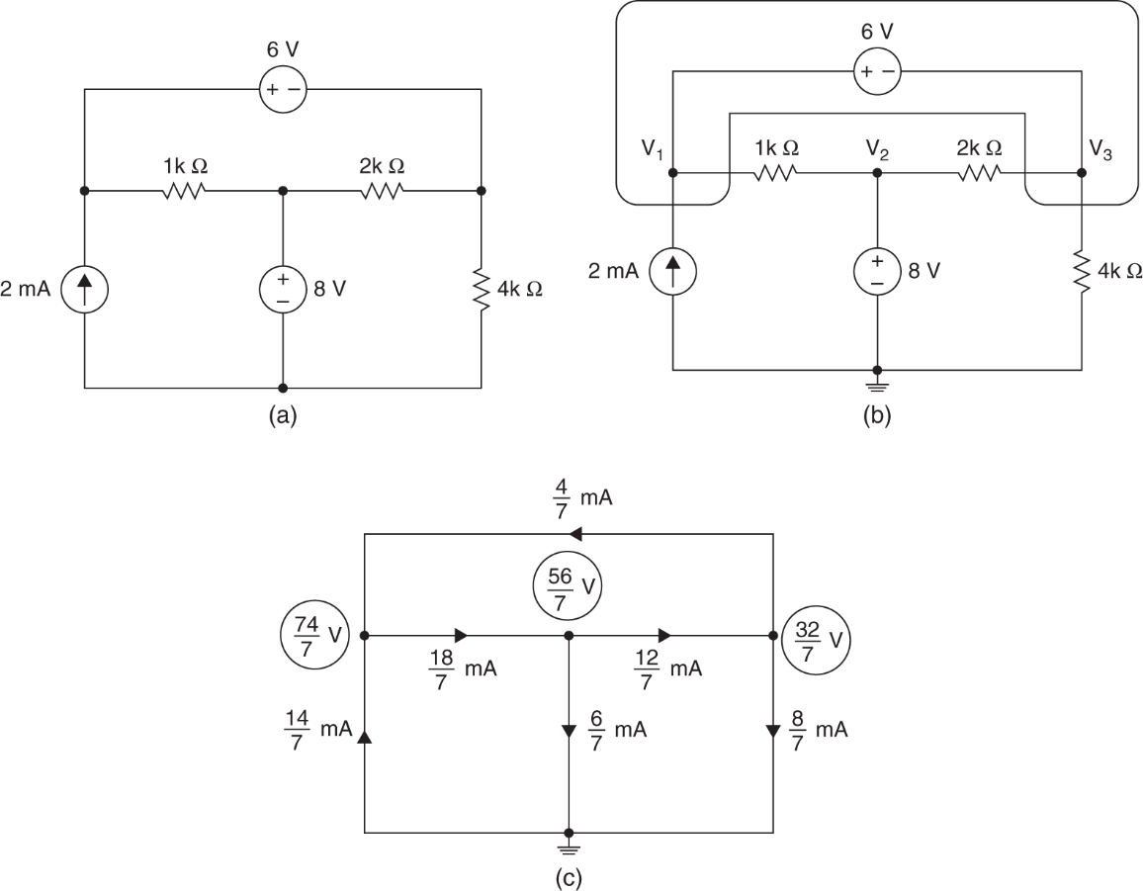
Supernode
Example 3.5
Consider the network below.

Slide 14
Loop/Mesh Analysis
Loop/Mesh Analysis
Another general procedure for analyzing circuits is to use the loop/mesh currents as the circuit variables.
Recall:
A loop is a closed path with no node passed more than once
A mesh is a loop that does not contain any other loop within it
Mesh analysis uses KVL to find unknown currents
Mesh analysis is limited in one aspect: It can only apply to circuits that can be rendered planar.
A planar circuit can be drawn such that there are no crossing branches.

Slide 15
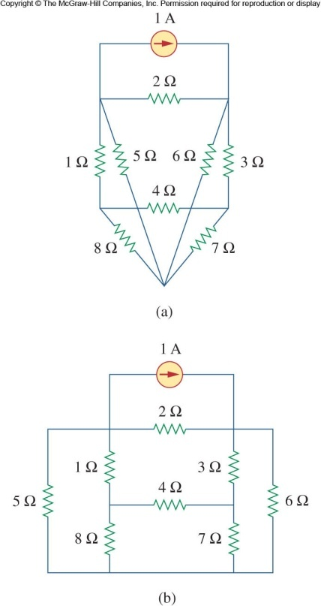
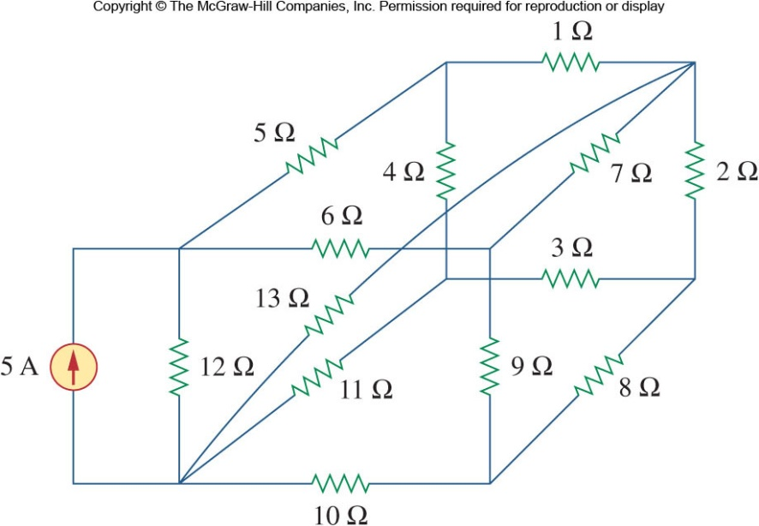
Loop/Mesh Analysis
Planar vs Nonplanar
The figure on the left is a nonplanar circuit: The branch with the 13Ω resistor prevents the circuit from being drawn without crossing branches
The figure on the right is a planar circuit: It can be redrawn to avoid crossing branches
14

Slide 16
Mesh Analysis
Mesh Analysis Steps
Mesh analysis follows these steps:
Assign mesh currents i₁,i₂,…i_{n} to the n meshes
Apply KVL to each of the n mesh currents.
Solve the resulting n simultaneous equations to get the mesh currents

Slide 17
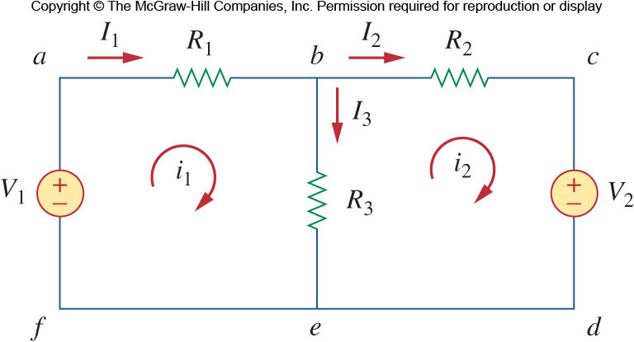
Loop/Mesh Analysis
Mesh Analysis Example
The above circuit has two paths that are meshes (abefa and bcdeb)
The outer loop (abcdefa) is a loop, but not a mesh
First, mesh currents i₁ and i₂ are assigned to the two meshes.
Applying KVL to the meshes:

Slide 18
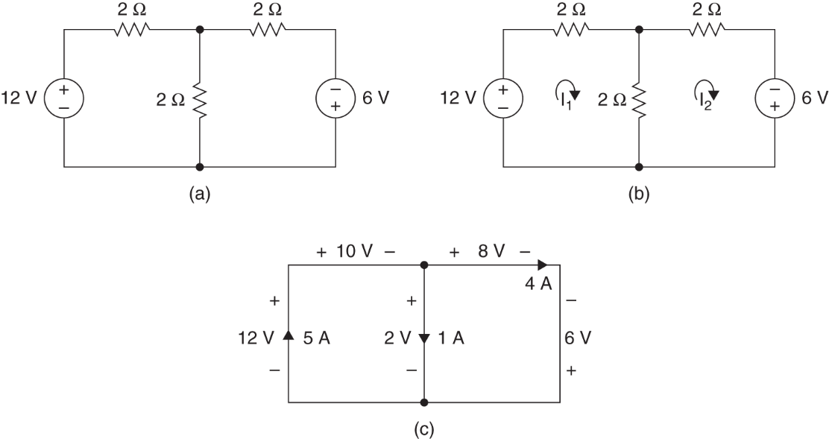
Loop/Mesh Analysis
Example 3.6

Slide 19
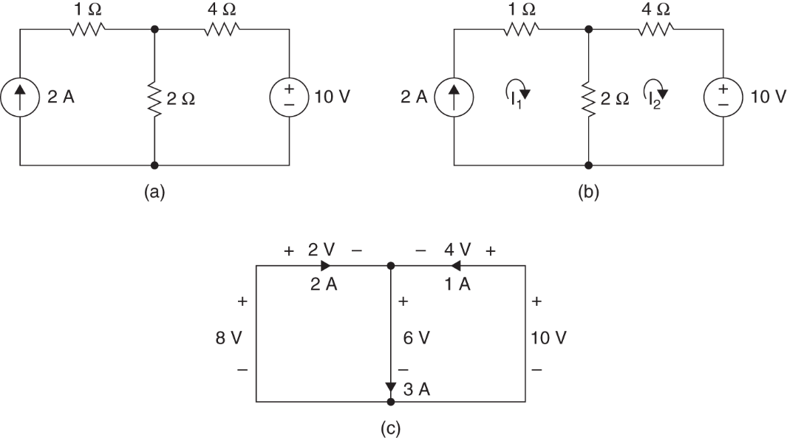

Mesh Analysis with Current Source
Mesh Analysis with Current Source
Consider the circuit shown.
We know the current I₁ already. $I_{1}=2A$

Slide 20
Supermesh
Supermesh
Similar to the case of nodal analysis where a voltage source shared two non-reference nodes, current sources (dependent or independent) that are shared by more than one mesh need special treatment
The two meshes must be joined together, resulting in a supermesh.
The supermesh is constructed by merging the two meshes and excluding the shared source and any elements in series with it
A supermesh is required because mesh analysis uses KVL
But the voltage across a current source cannot be known in advance.
Intersecting supermeshes in a circuit must be combined to for a larger supermesh.

Slide 21
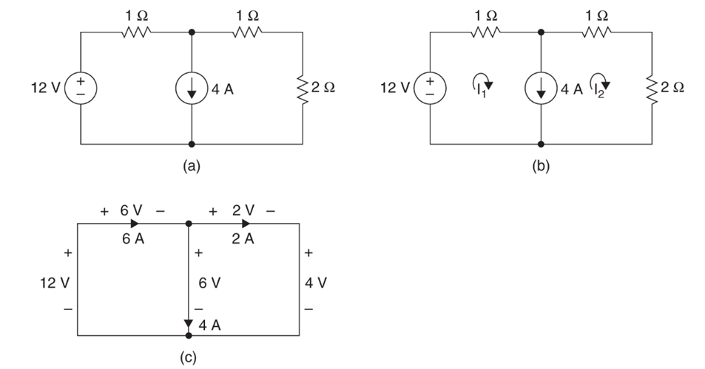

Supermesh
Example 3.8
$$I_{1}−I_{2}=4A$$

Slide 22
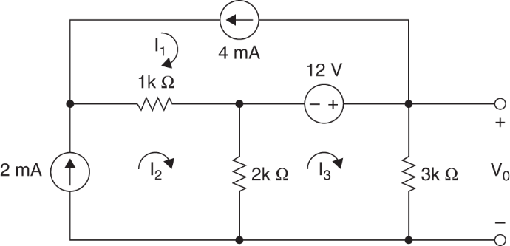
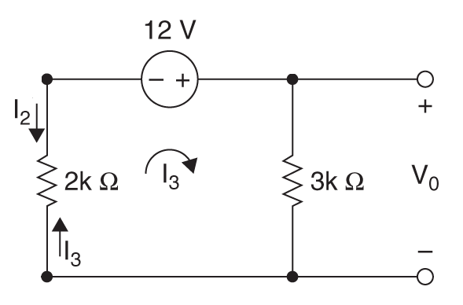



Supermesh
Example 3.9
$$I_{1}=−4mA$$
$$I_{2}=2mA$$
$${(I_{3}−I}_{2})2k−12+I_{3}3k=0$$

Slide 23
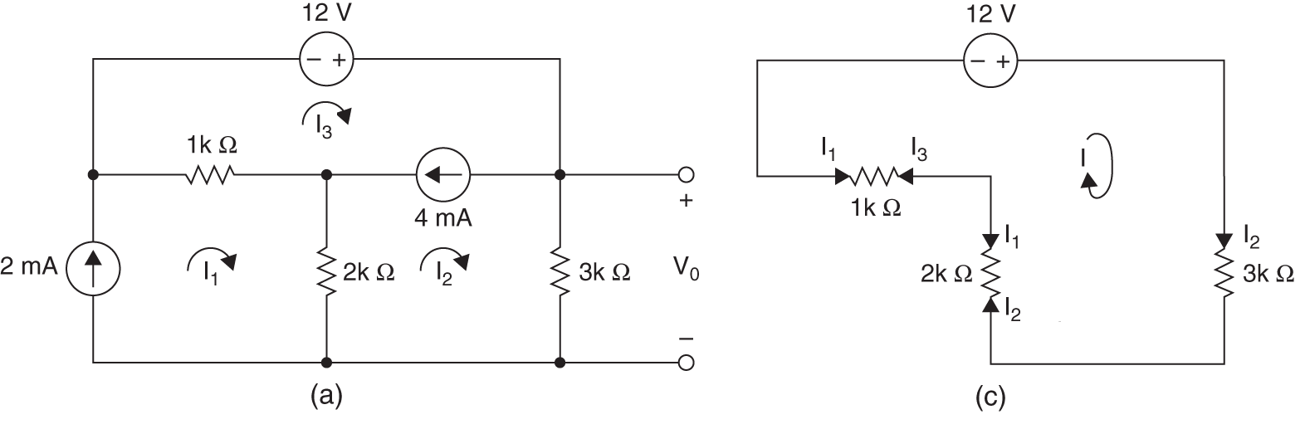


Supermesh
Example 3.10
$$I_{1}=2mA$$
$$I_{3}−I_{2}=4mA$$
$${(I_{3}−I}_{1})1k−12+I_{2}3k+{(I_{2}−I}_{1})2k=0$$

Slide 24
Nodal Versus Mesh Analysis
Nodal Versus Mesh Analysis
Selecting an Appropriate Approach
In principle both the nodal analysis and mesh analysis are useful for any given circuit.
What then determines if one is going to be more efficient for solving a circuit problem?
There are two factors that dictate the best choice:
The nature of the particular network is the first factor
The second factor is the information required

Slide 25
Nodal Versus Mesh Analysis
Mesh analysis when…
If the network contains:
Many series connected elements
Voltage sources
Supermeshes
A circuit with fewer meshes than nodes
If branch or mesh currents are what is being solved for.
Mesh analysis is the only suitable analysis for transistor circuits
It is not appropriate for operational amplifiers because there is no direct way to obtain the voltage across an op-amp.

Slide 26
Nodal Versus Mesh Analysis
Nodal analysis if…
If the network contains:
Many parallel connected elements
Current sources
Supernodes
Circuits with fewer nodes than meshes
If node voltages are what are being solved for
Non-planar circuits can only be solved using nodal analysis
This format is easier to solve by computer

Slide 27
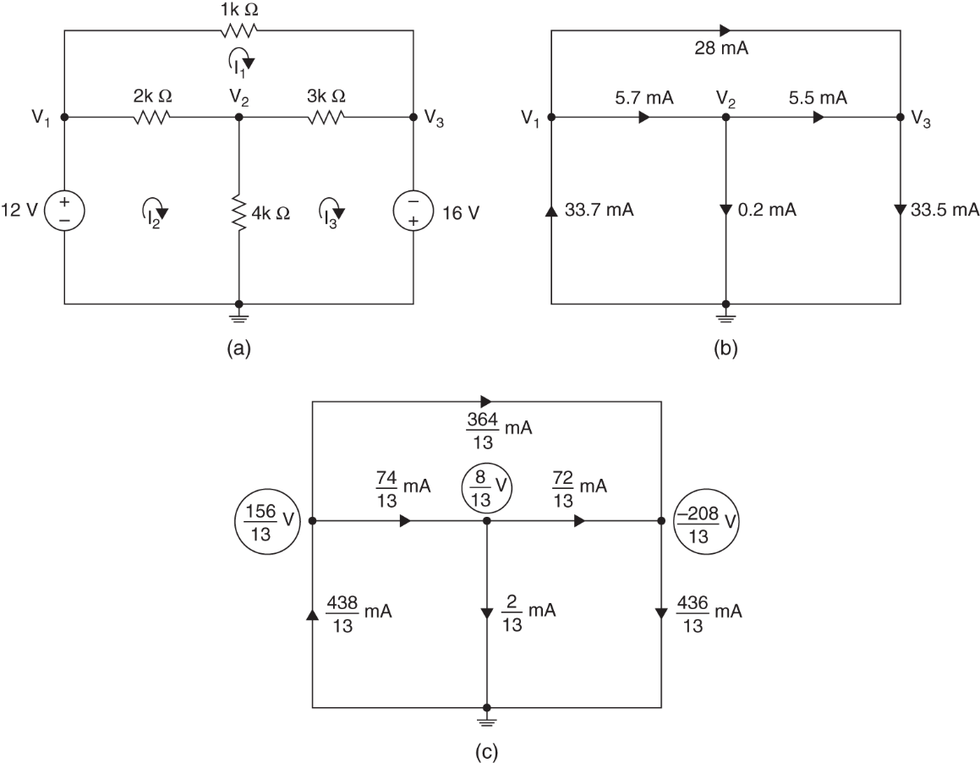
Nodal vs. Mesh Analysis
Example 3.11
# of node = 1
# of mesh = 3

Slide 28
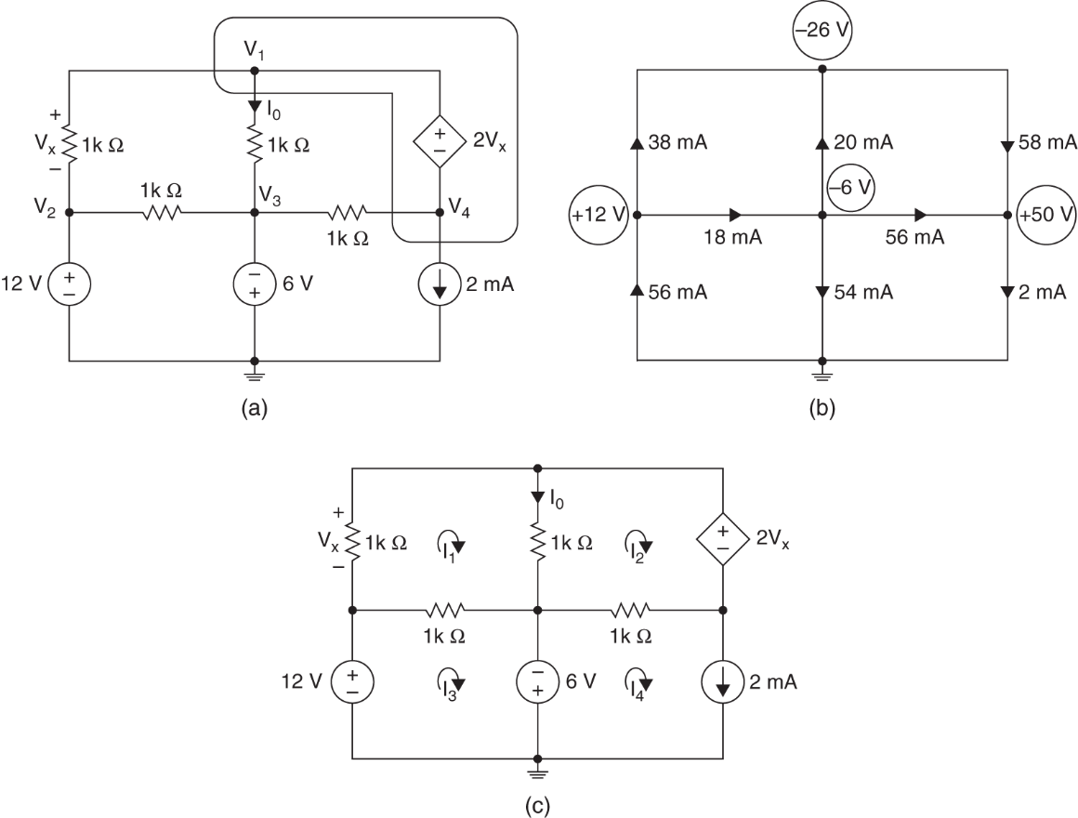
Nodal vs. Mesh Analysis
Example 3.12
# of node = 2
# of mesh = 3

Slide 29
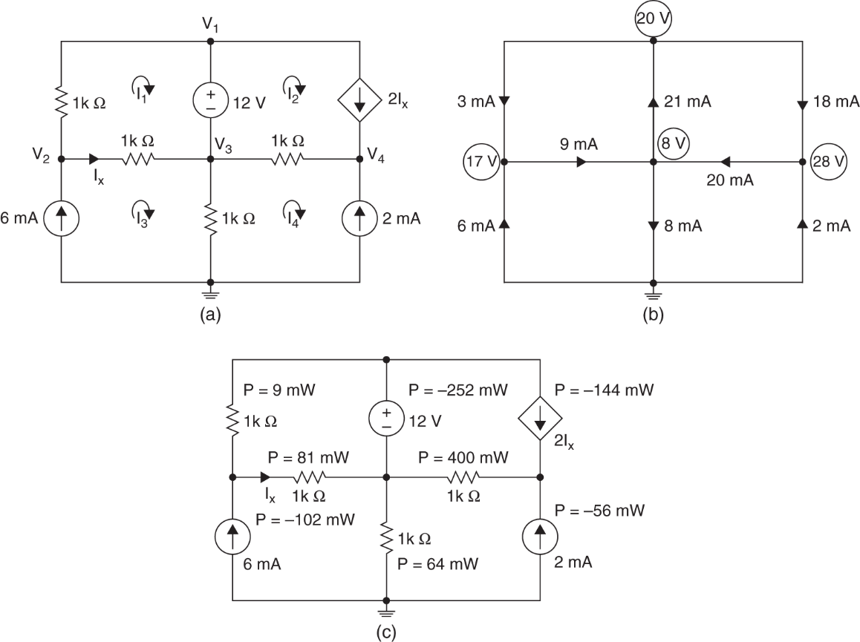
Nodal vs. Mesh Analysis
Example 3.13
# of node = 3
# of mesh = 1

Slide 30
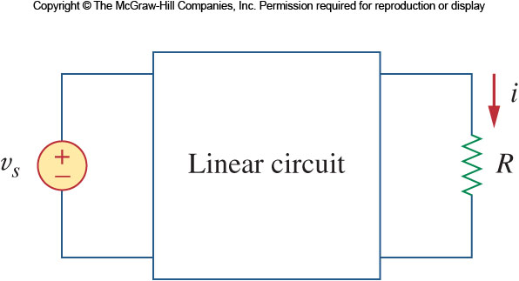
Linearity Property
Linearity Property
Linearity in a circuit means that as current is changed, the voltage changes proportionally
It also requires that the response of a circuit to a sum of sources will be the sum of the individual responses from each source separately
A resistor satisfies both of these criteria

Slide 31
Superposition
Principle of Superposition
A linear circuit with multiple independent sources
The voltage or current at any point in the network is equal to the algebraic sum of the contributions of each source acting along.
In calculating the contribution of an individual source, the remaining sources in the network must be made zero.
Made zero means
a voltage source by replacing it with a short circuit
a current source by replacing it with a open circuit

Slide 32
Superposition
Applying Superposition
Using superposition means applying one independent source at a time
Dependent sources are left alone
The steps are:
1. Turn off all independent sources except one source. Find the output voltage or current.
2. Repeat step 1 for each of the other independent sources.
3. Find the total contribution by adding algebraically all the contributions due to the independent sources.

Slide 33
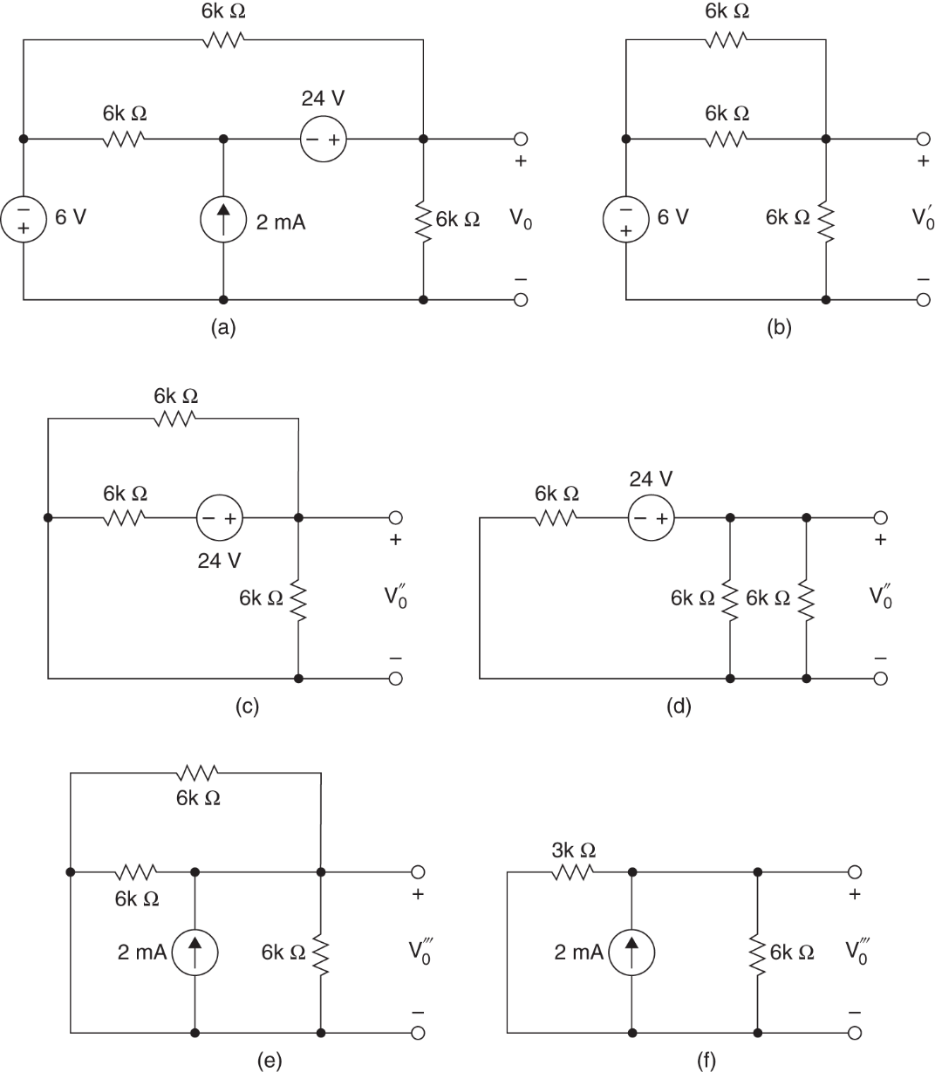
Superposition
Example 3.14

Slide 34
Thevenin’s Theorem
Thevenin’s Theorem
In many circuits, one element will be variable
An example of this is mains power; many different appliances may be plugged into the outlet, each presenting a different resistance
This variable element is called the load
Ordinarily one would have to reanalyze the circuit for each change in the load

Slide 35
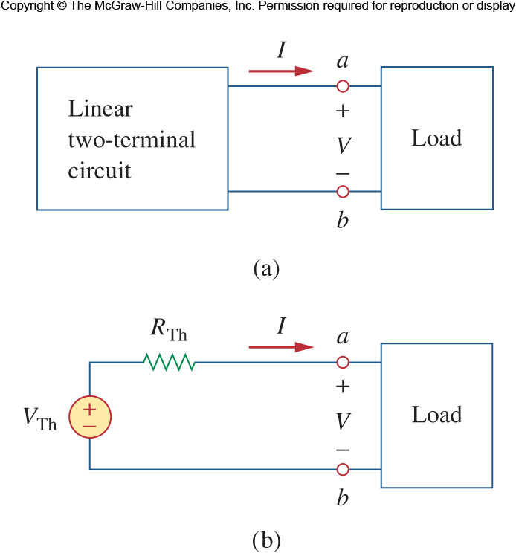
Thevenin’s Theorem
Thevenin’s Theorem II
Thevenin’s theorem states that a linear two terminal circuit may be replaced with a voltage source and resistor
The voltage source’s value is equal to the open circuit voltage at the terminals
The resistance is equal to the resistance measured at the terminals when the independent sources are turned off.

Slide 36
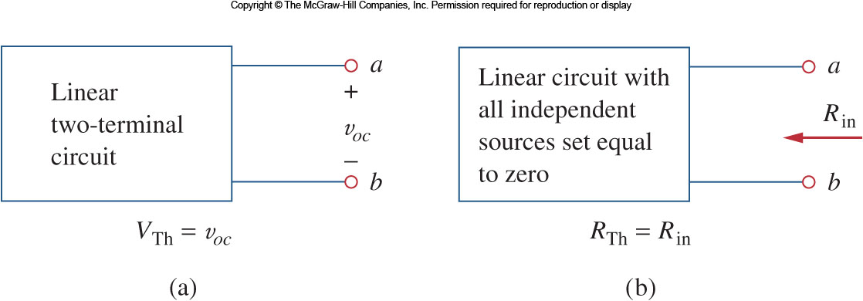
4.5 Thevenin’s Theorem
Thevenin’s Theorem III
There are two cases to consider when finding the equivalent resistance
Case 1: If there are no dependent sources, then the resistance may be found by simply turning off all the sources

Slide 37
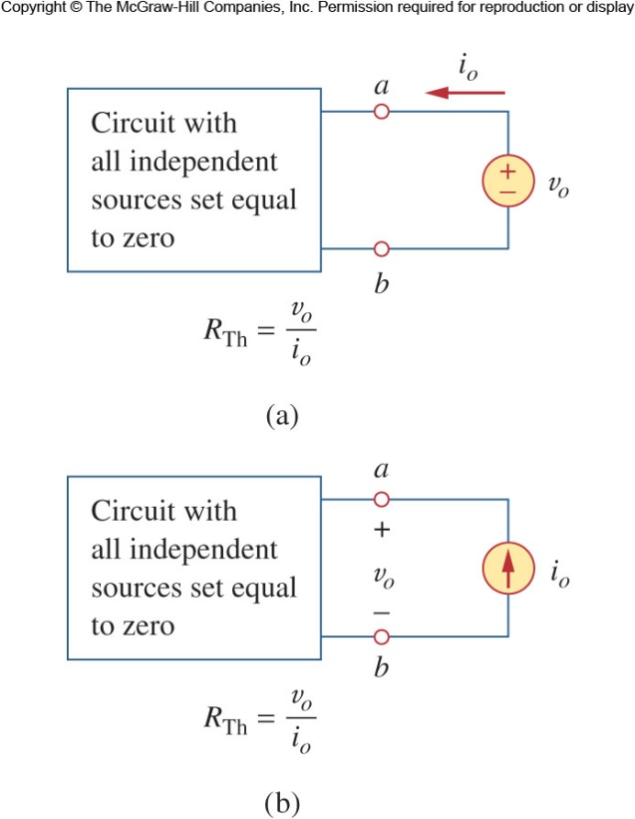
4.5 Thevenin’s Theorem
Thevenin’s Theorem IV
Case 2: If there are dependent sources, we still turn off all the independent sources.
Now apply a voltage v₀ (or current i₀)to the terminals and determine the current i₀ (voltage v₀).

Slide 38
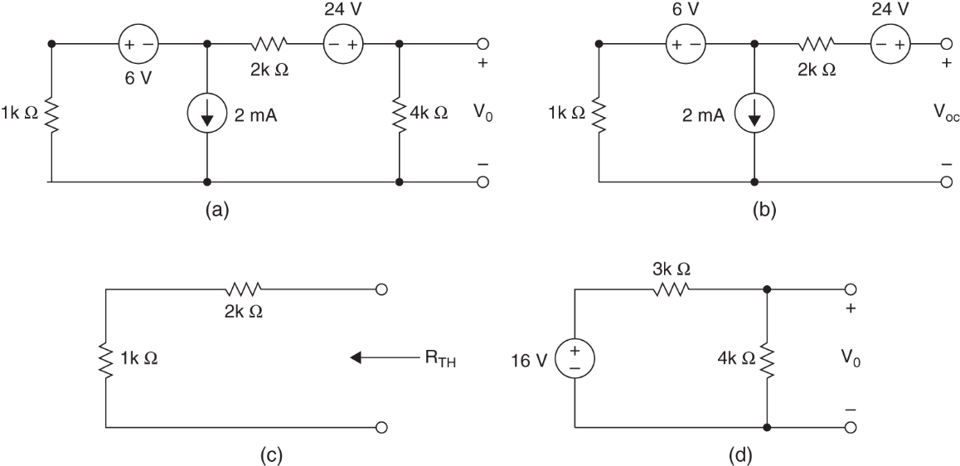
Thevenin’s Theorem
Example 3.15

Slide 39
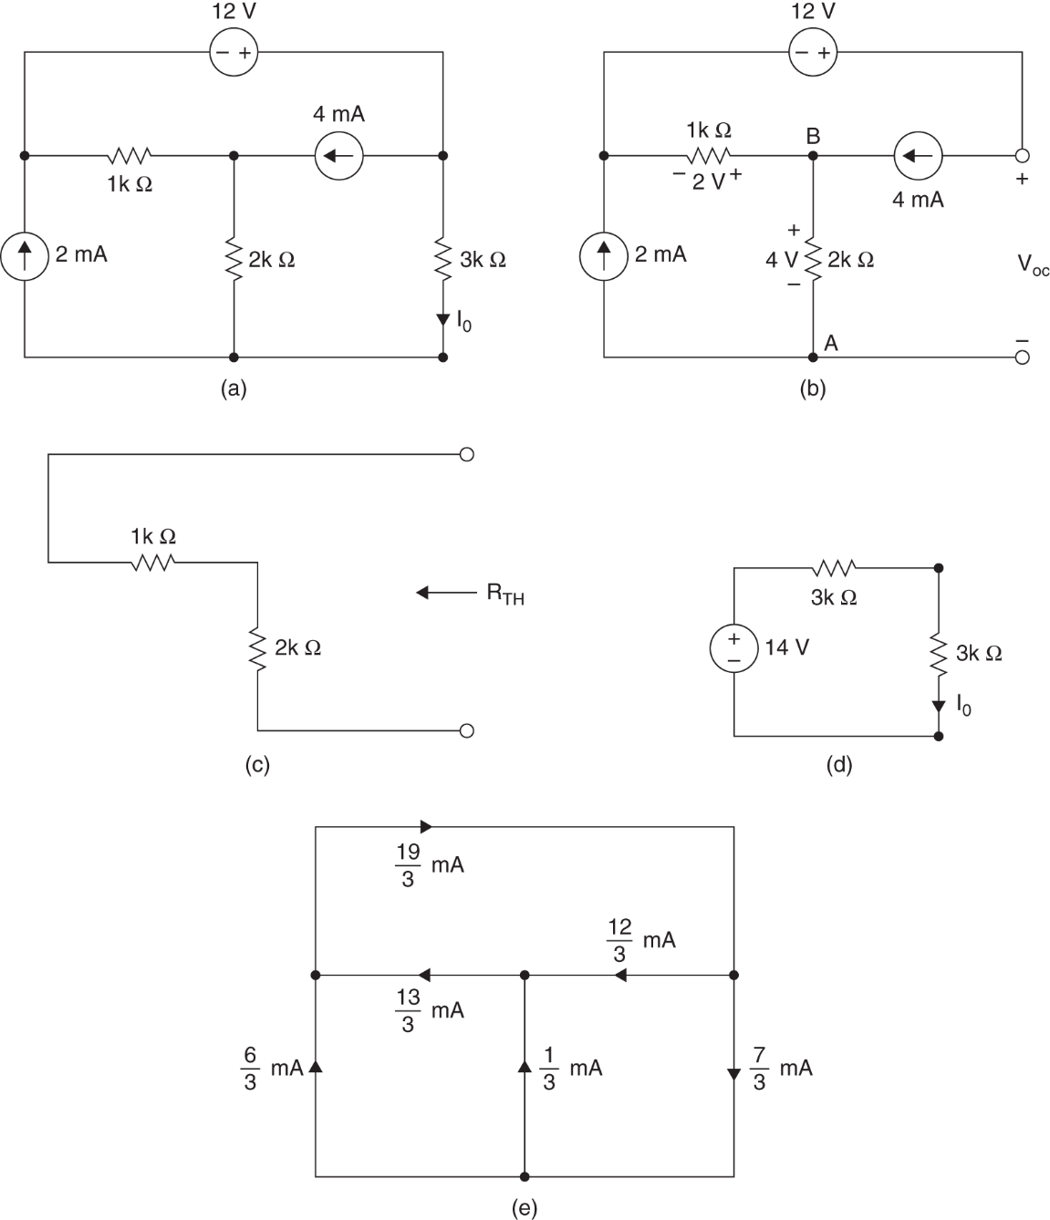
Thevenin’s Theorem
Example 3.16

Slide 40
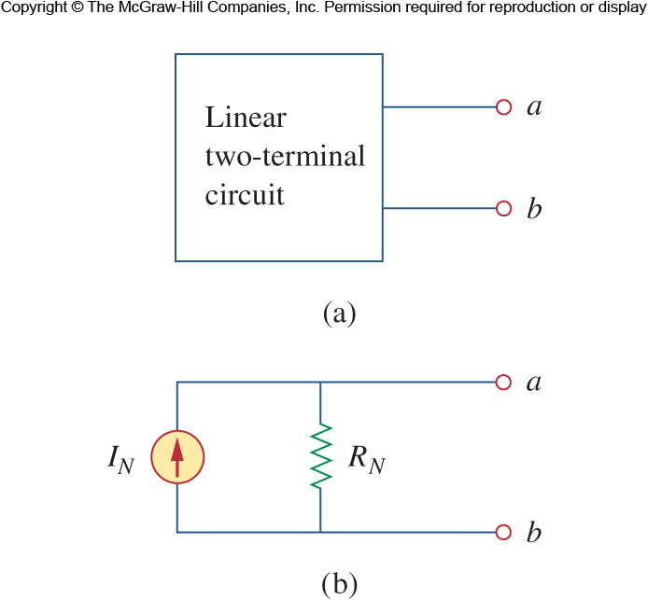
Norton’s Theorem
Norton’s Theorem
Similar to Thevenin’s theorem, Norton’s theorem states that a linear two terminal circuit may be replaced with an equivalent circuit containing a resistor and a current source
The Norton resistance will be exactly the same as the Thevenin

Slide 41
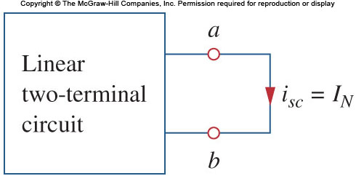
4.6 Norton’s Theorem
Norton’s Theorem II
The Norton current I_{N} is found by short circuiting the circuit’s terminals and measuring the resulting current

Slide 42
4.6 Norton’s Theorem
Norton vs. Thevenin
These two equivalent circuits can be related to each other
One need only look at source transformation to understand this
The Norton current and Thevenin voltage are related to each other as follows:
With V_{TH}, I_{N}, and (R_{TH}=R_{N}) related, finding the Thevenin or Norton equivalent circuit requires that we find:
The open-circuit voltage across terminals a and b.

Slide 43
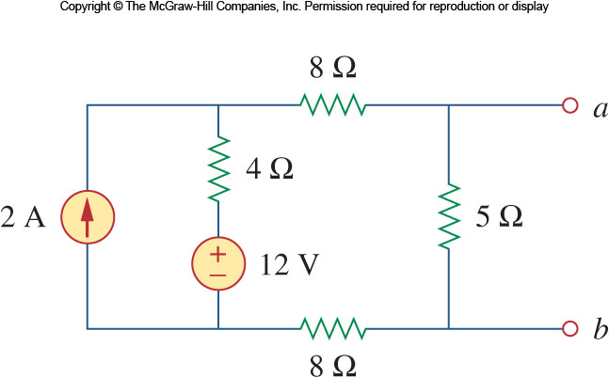
4.6 Norton’s Theorem
Norton vs. Thevenin II
The short-circuit current at terminals a and b.
The equivalent or input resistance at terminals a and b when all independent sources are turned off.
Ex

Slide 44
Maximum Power Transfer
Maximum Power Transfer
In many applications, a circuit is designed to power a load
Among those applications there are many cases where we wish to maximize the power transferred to the load
Unlike an ideal source, internal resistance will restrict the conditions where maximum power is transferred.

Slide 45
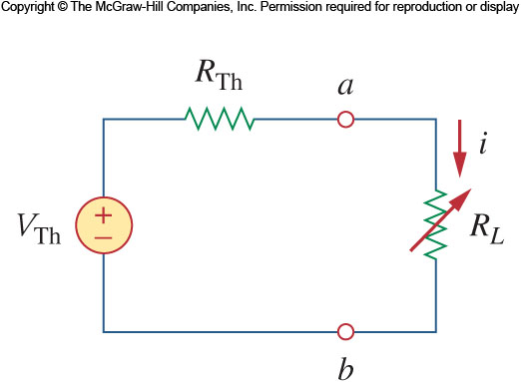
Maximum Power Transfer
Maximum Power Transfer II
We can use the Thevenin equivalent circuit for finding the maximum power in a linear circuit
We will assume that the load resistance can be varied
Looking at the equivalent circuit with load included, the power transferred is:

Slide 46
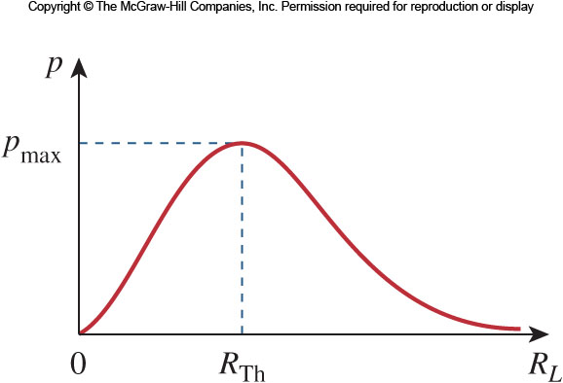
Maximum Power Transfer
Maximum Power Transfer III
For a given circuit, V_{TH} and R_{TH} are fixed. By varying the load resistance R_{L}, the power delivered to the load varies as shown
You can see that as R_{L} approaches 0 and ∞ the power transferred goes to zero.
In fact the maximum power transferred is when R_{L}=R_{TH}

Slide 47
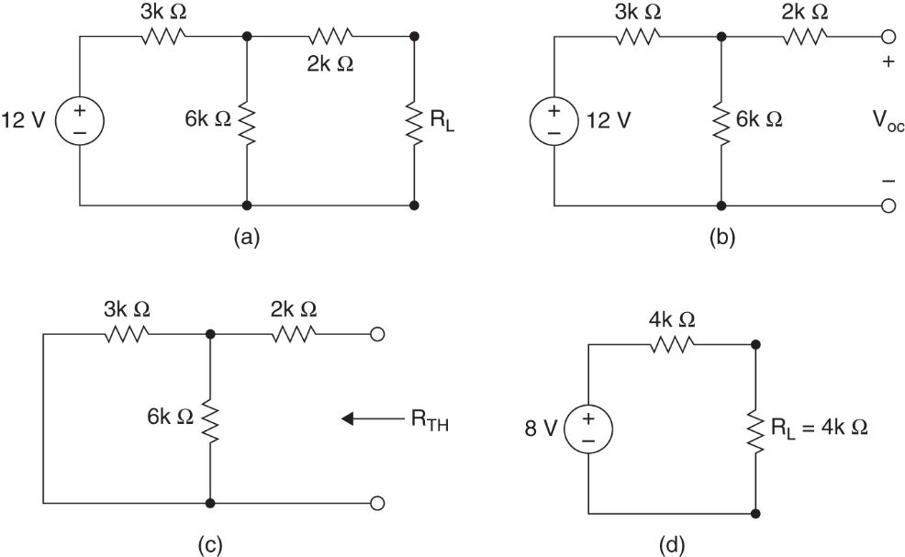
Maximum Power Transfer
Example 3.17

Slide 48
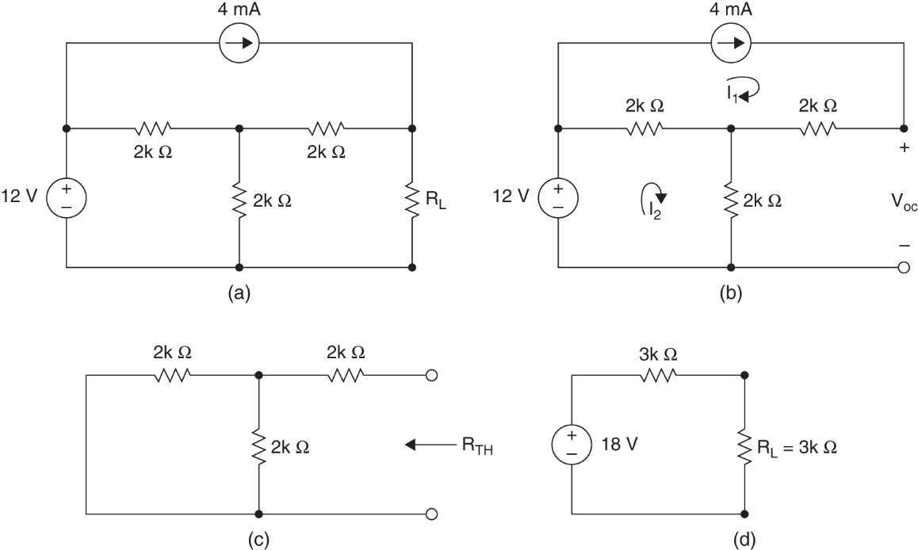
Maximum Power Transfer
Example 3.18

Slide 49
Homework
Homework
Solve Problems 3.12, 3.22, 3.43, 3.50, 3.52
Read Text Chapter 4.
Prepare Presentation

