Slide 1
Introduction to Electric and Electronics
Chapter 11 –
Analog Electronics

Slide 2
Learning Objectives
Learning Objectives
To recognize the impact on society of transistors and integrated circuits
To gain a understanding of the basics of analog signals and circuits
To develop an understanding of how MOS and BJT transistors operate
To learn to analyze MOS and BJT analog circuits
To understand large-signal analysis with load lines, integrated with small signal analysis

Slide 3
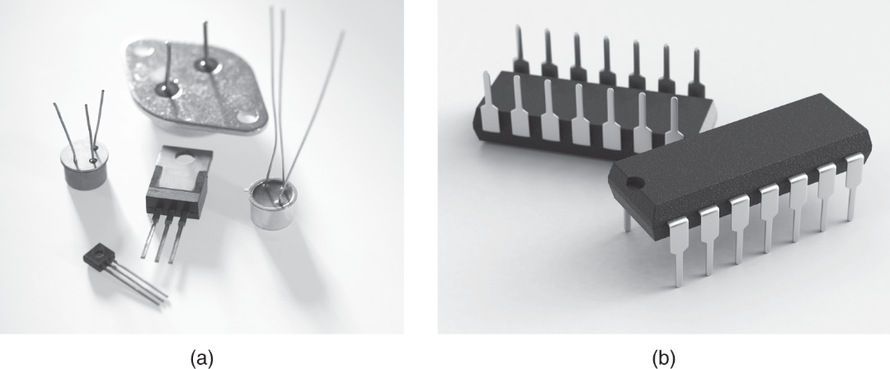
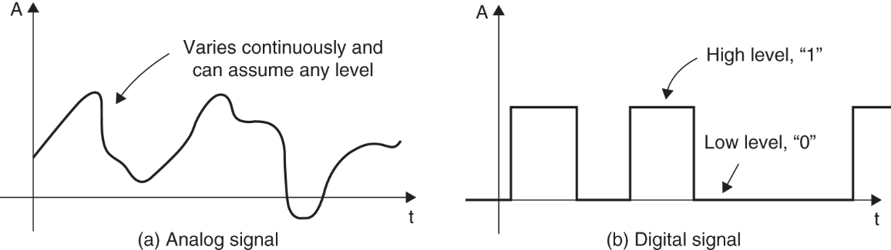
Introduction
Introduction
The functions of a transistor
electronically controlled switch in digital circuits
electronic amp in analog circuits
Types of transistors
FET : field effect transistor, controls current by voltage
BJT : bipolar junction transistor, controls current by voltage

Slide 4
Introduction
Amplifiers
Smaller-signal amplifiers
voltage variations are reasonably small
a few hundreds of millivolts
can be approximated by linear circuit models
Large-signal amplifiers
voltage swings are large
several volts or more
used to provide high levels of signal output(stereo amp)
similar to switching circuits

Slide 5
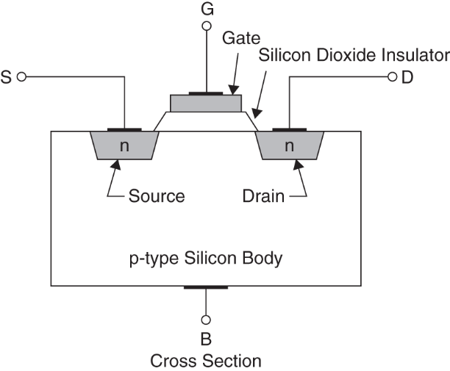
MOSFET
MOSFET
MOSFET : metal-oxide-semiconductor FET
most commonly used
MOS transistor
Types of MOSFET
n-channel and p-channel
Enhancement mode and depletion mode

Slide 6
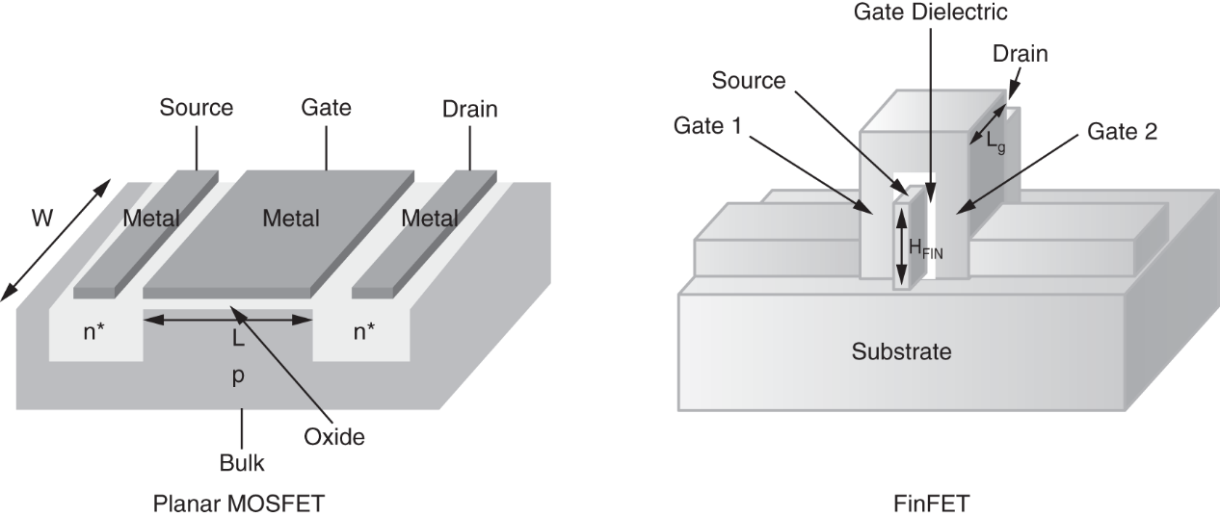
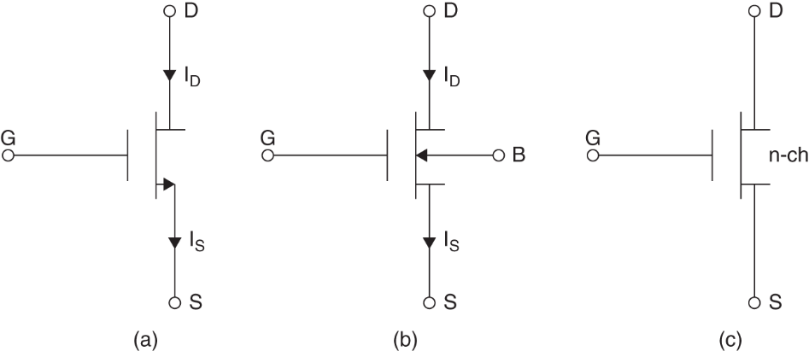
MOSFET
MOSFET Structure and Symbols

Slide 7
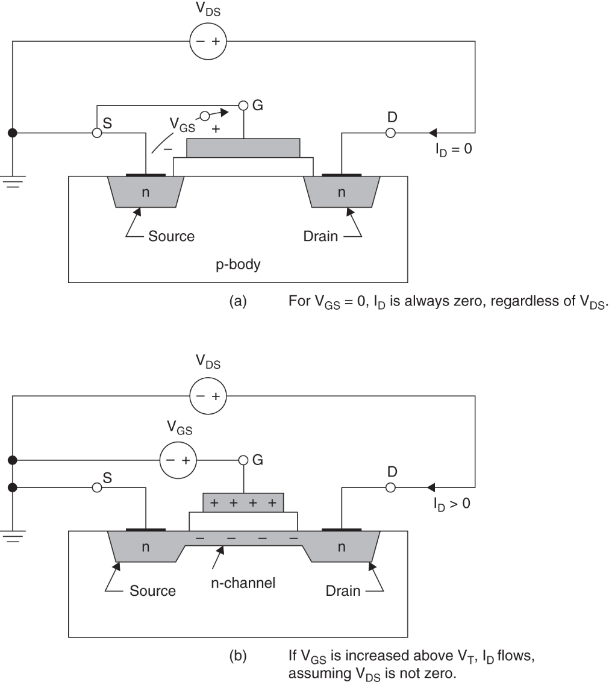
MOSFET
MOSFET Device Operation
i_{D} : drain current
current through S-D loop
controlled by gate-to-source voltage V_{GS}
V_{T} : threshold voltage
if V_{GS} > V_{T}, then i_{D}>0

Slide 8
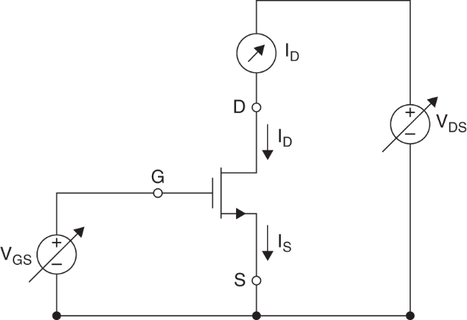
MOSFET
Output characteristic curves
V-I curves of transistors
Given V_{GS}, sweeping V_{DS}, and output I_{D}
I_{S} = I_{D}

Slide 9
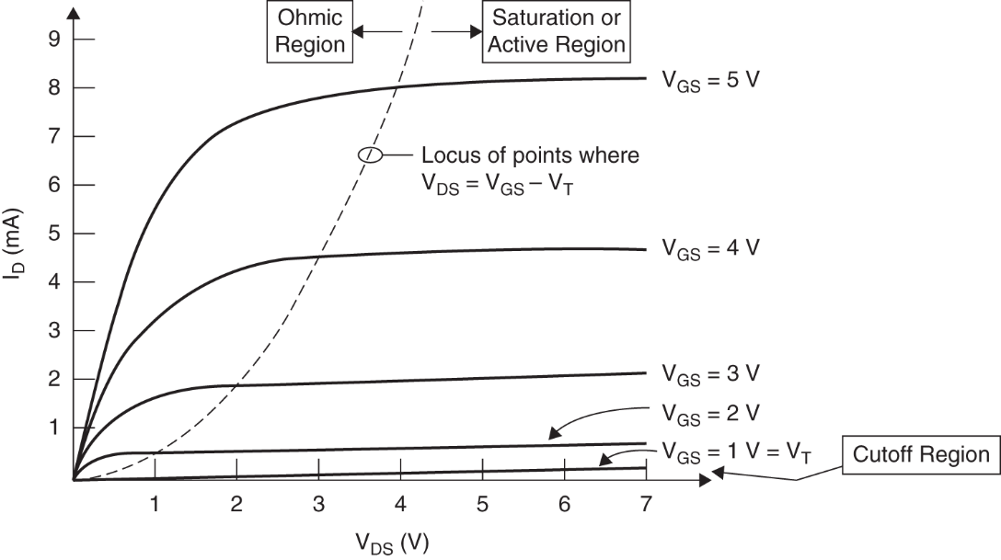
MOSFET
Regions of Operation
ohmic region : I_{D} rise with increasing V_{DS}
active or saturation region : I_{D} remains almost constant with increasing V_{DS}
cutoff region : I_{D} = 0, V_{GS} < V_{T}

Slide 10
MOSFET
Drain current
ohmic region
Saturation region
Cutoff region

Slide 11

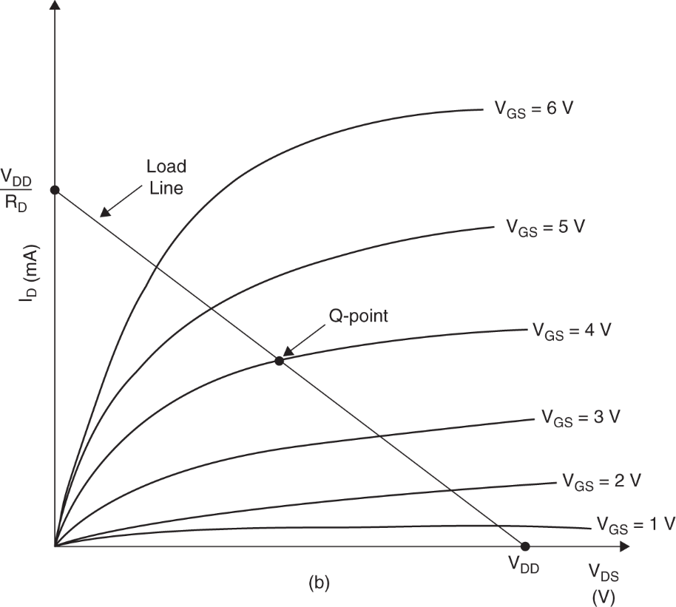
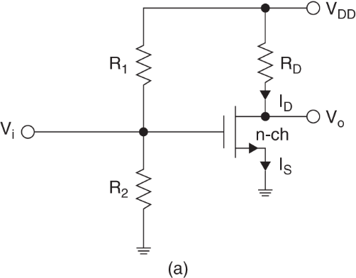
MOSFET
Biasing Techniques
Lode line
Q-point

Slide 12
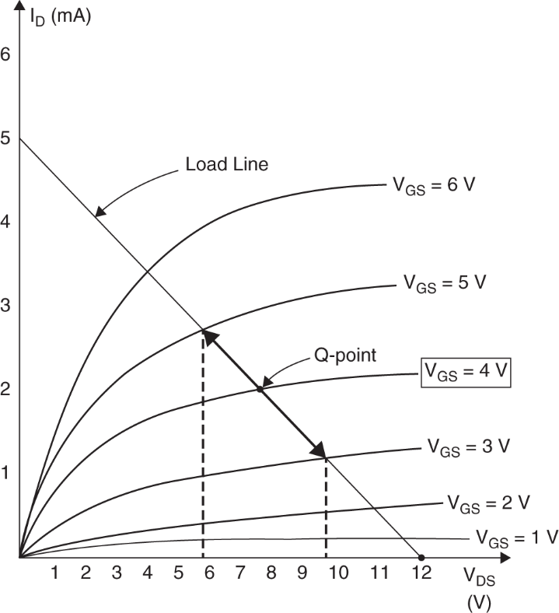

MOSFET
Example 11.1
Determine Q-point

Slide 13
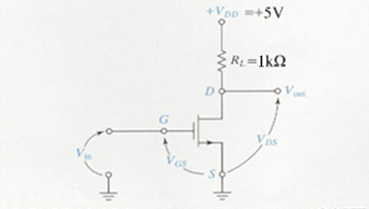
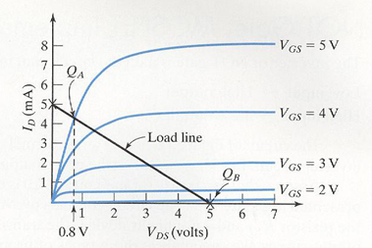
MOSFET
The NOT Gate: MOSFET Implementation
NOT Gate(Inverter)
Low input → High output
High input → Low output
Load line
From load line

Slide 14


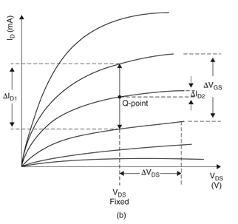
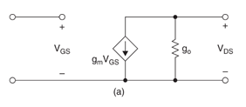
MOSFET
Small-signal analysis of MODFET circuits

Slide 15

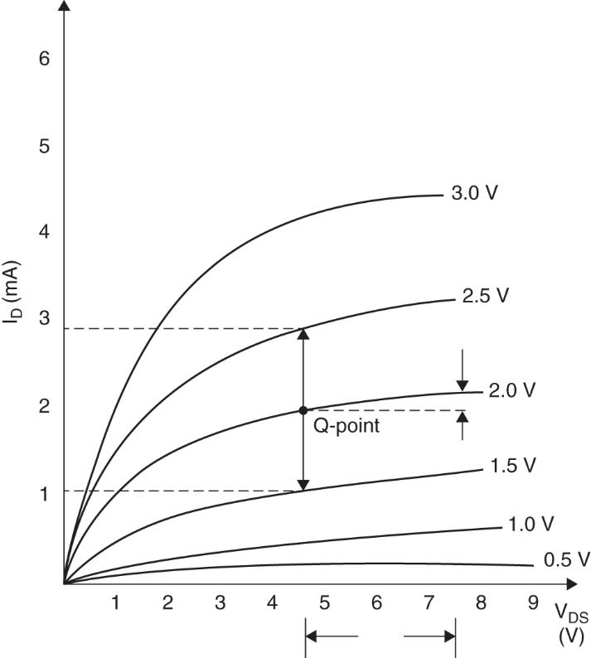


MOSFET
Example 11.3
Find

Slide 16
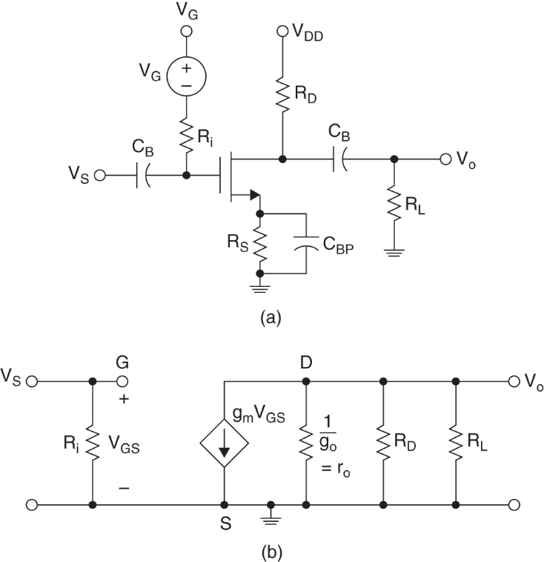
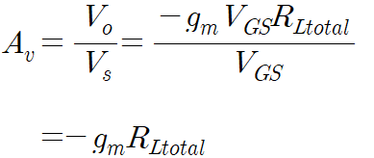
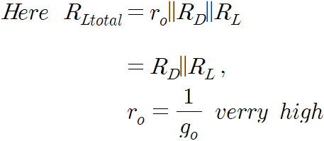
MOSFET
Common source amplifier

Slide 17
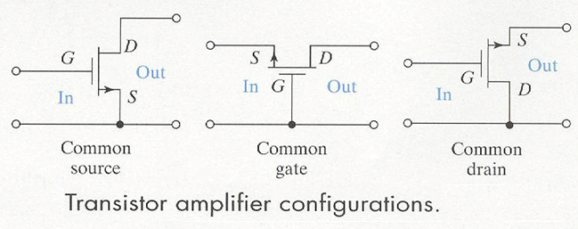
MOSFET
Other FET Amplifier Configurations

Slide 18
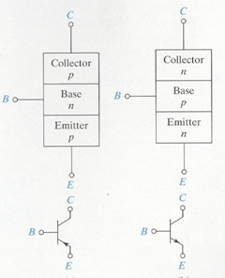
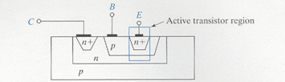
BJT
BJT(Bipolar Junction Transistor
BJT Structure
bipolar junction transistor
two p-n junction diodes fabricated very close
PNP transistor and NPN transistor
base (B) : center region of BJT
emitter (E) : emitting carriers
collector (C) : collecting carriers

Slide 19
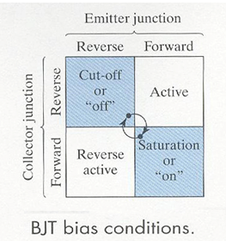
BJT
BJT Device operation
four possible bias conditions
emitter junction
collector junction
cutoff or off : open switch
on or saturated : closed switch

Slide 20
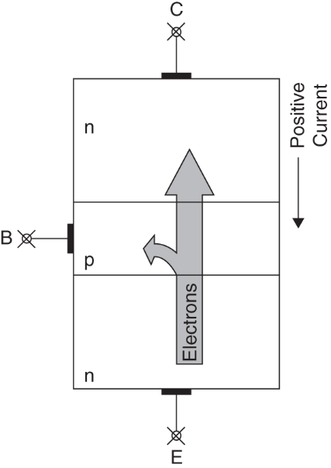
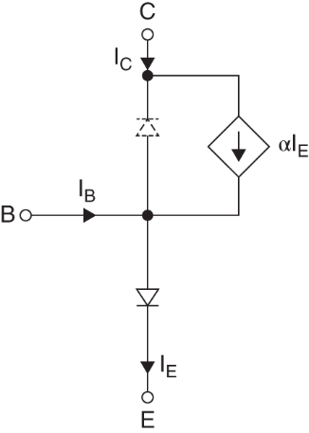
BJT
BJT in the Active Region
two diodes are extremely close together
collect current exists even though the collector junction is reverse biased
Forward common base (CB) current transfer ratio

Slide 21
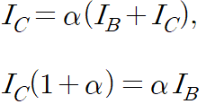

BJT
BJT in the Active Region (continue)
Turn-on voltage
Emitter current
Collect current
Common emitter current gain

Slide 22
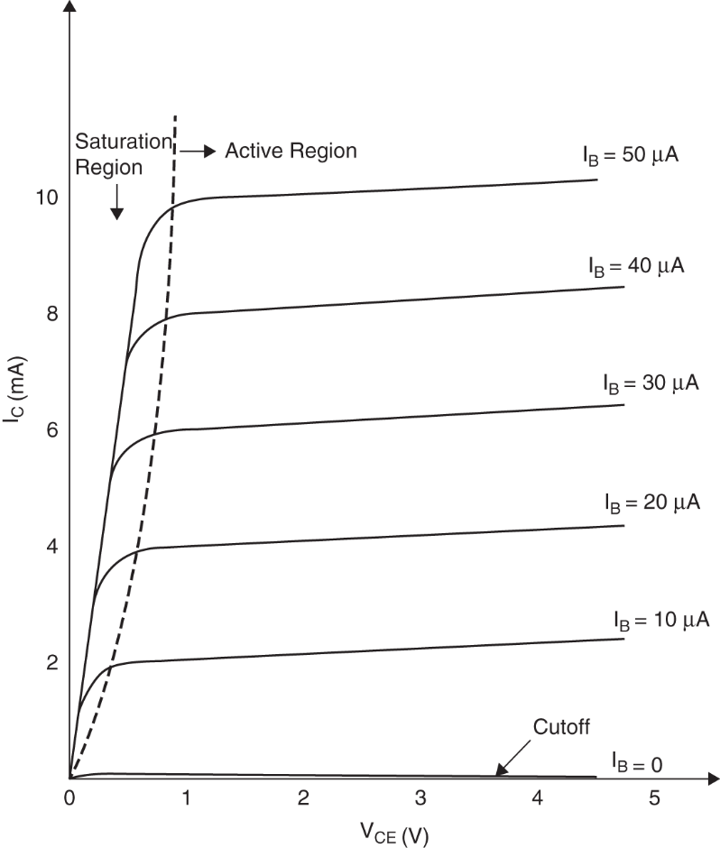
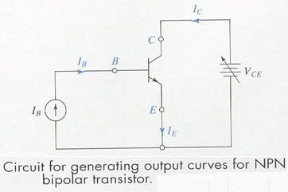
BJT
Output characteristic curves
There are three regions in BJT output curves
cut-off region, saturation region, active region

Slide 23
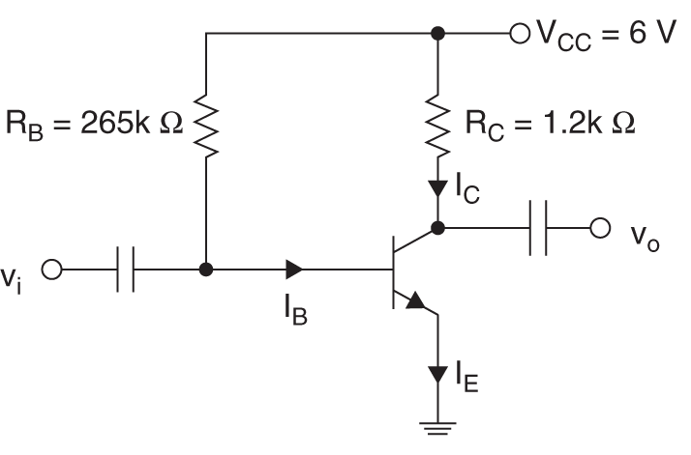
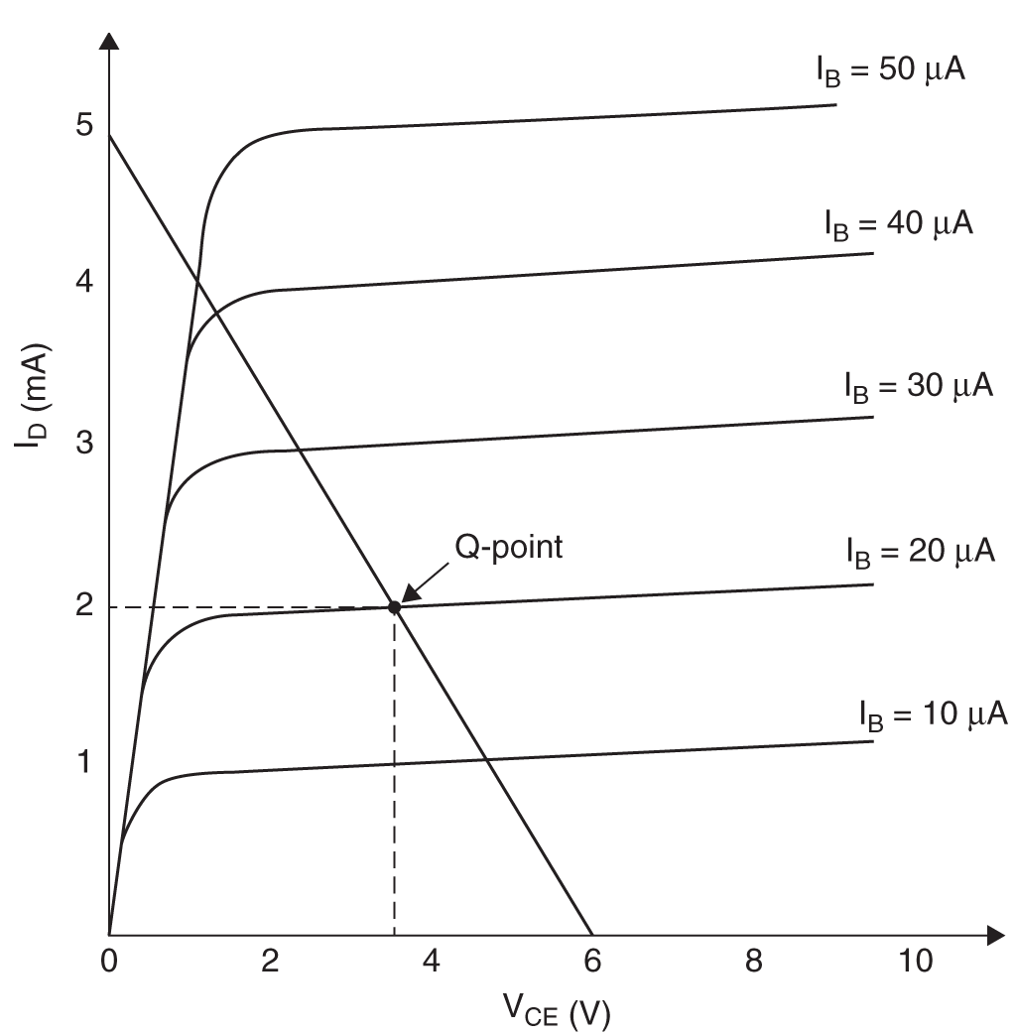
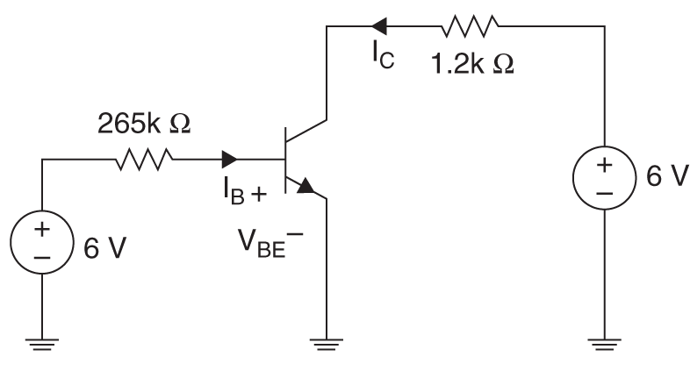
BJT
Example 11.6 (Q-point)

Slide 24
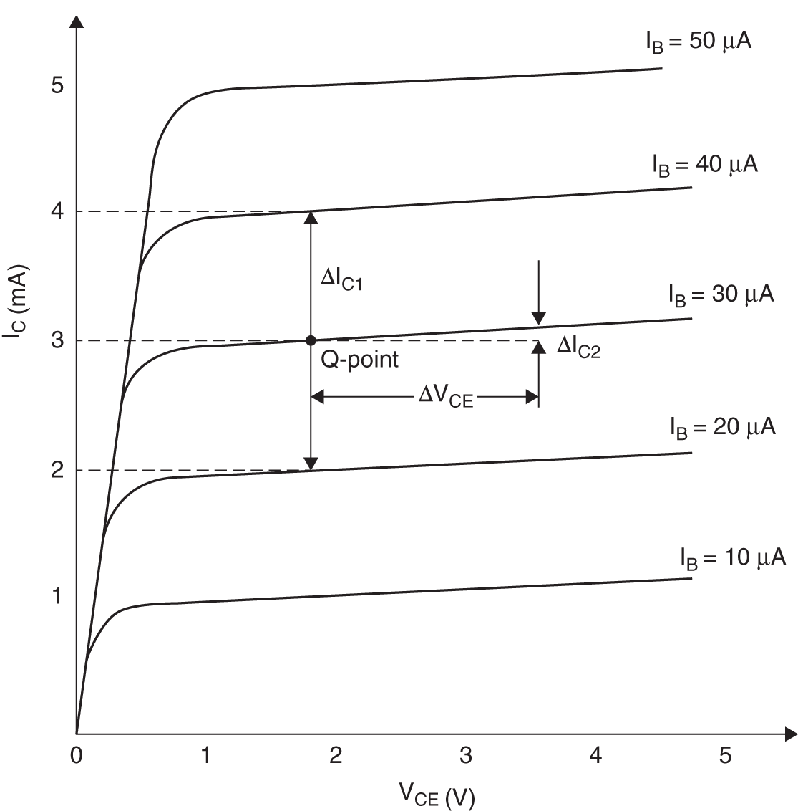
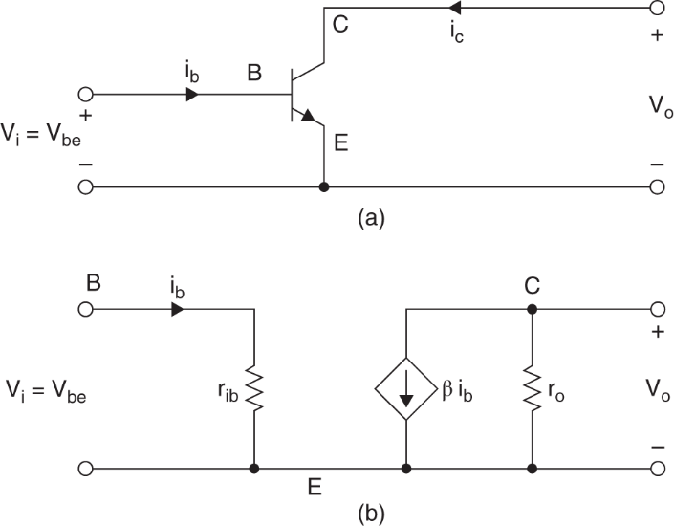
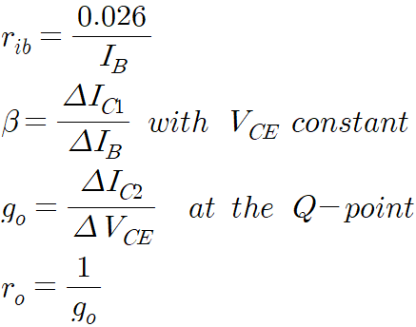
BJT
Small signal analysis
Equivalent Circuit

Slide 25
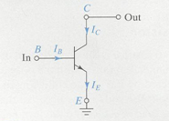
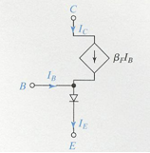
BJT
Common Emitter (CE) Configuration
⇒
CE configuration equivalent circuit
collector current
here is forward CE current transfer ratio

Slide 26
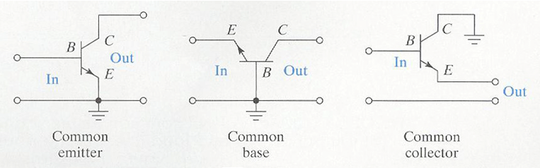
BJT
Other BJT Amp Configurations
BJT Circuit configuration

Slide 27
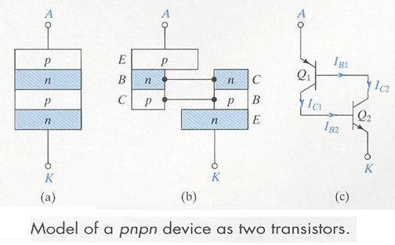
Thyristors, SCRs and Motor Control
Thyristors, SCRs, and Motor Control
Thyristors and SCRs
four layer structure (pnpn)
Control large amount of power with only a small amount of control energy.

Slide 28
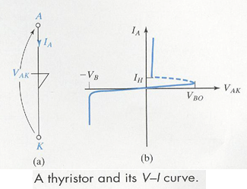
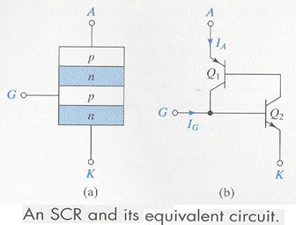
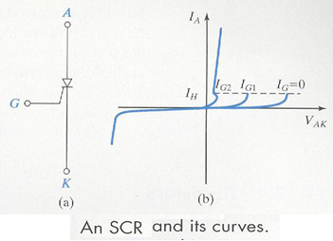
Thyristors, SCRs and Motor Control
Thyristors
Breakover voltage
SCRs
Silicon-controlled rectifiers
Control connection G

Slide 29
Homework
Homework
Solve Problem 11.2, 11.4, 11.7, 11.28, 11.38
Prepare Final Exam.

