Slide 1
▶
RDS Meet
A meeting platform built from research.
Not assumptions.
Prepared for RDS internal review · June 2026
Notes:
Opening slide. Position this as a research-backed product — not a copy of Zoom, but something built by studying what's wrong with all existing tools.

Slide 2
THE PROBLEM
Meetings are broken — and everyone knows it
$37B
31hrs
71%
11M
lost annually to
unproductive meetings
wasted per employee
per month
of senior managers say
meetings are ineffective
meetings held daily
in the US alone
The current tools don't help — they add to the problem.
Cluttered interfaces slow participants down before the meeting even starts
No meeting intelligence — you leave with no record of what was decided
Collaboration tools (whiteboard, breakout rooms) are buried or broken
Every platform looks different on every device — no consistency
Notes:
Set the stage. The meeting problem is a real, expensive business problem — not just a UX complaint. Use the $37B stat to anchor the conversation.

Slide 3
METHODOLOGY
How we researched, analysed, and turned findings into product decisions
01
02
03
04
Select
Evaluate
Categorise
Build
4 platforms chosen by global market share
5 consistent criteria applied across all
Every finding sorted: Keep · Fix · Add
Findings → product requirements for RDS Meet
THE KFA FRAMEWORK
Evaluation criteria — applied consistently to all 4 platforms
KEEP
Features that work — preserve & improve
Criterion
Zoom
Meet
Teams
Webex
Interface design & visual consistency
✓
~
✗
~
FIX
Features that exist but are poorly done
Navigation & feature discoverability
~
✓
✗
✗
ADD
Features missing from all platforms
In-meeting collaboration tools
✓
✗
~
✓
Post-meeting intelligence & data
✗
✗
~
✓
Pricing vs feature value
~
✓
✓
~
Scoring: ✓ Good · ~ Partial · ✗ Weak — Based on hands-on evaluation and documented feature sets (June 2026)

Slide 4
COMPETITIVE RESEARCH
We studied four platforms before writing a single line of code
Zoom
$15.99/user/mo
Google Meet
$6/user/mo
✓ Grid view & reactions
✗ Cluttered toolbar
✓ Clean minimal UI
✗ Limited collaboration
✓ Breakout rooms
✗ Free tier ads
✓ Calendar native integration
✗ No whiteboard
✓ Wide adoption
✗ No meeting replay
✓ Simple to join
✗ No post-meeting data
Microsoft Teams
$4/user/mo
Webex
$14.50/user/mo
✓ Deep Office integration
✗ Navigation nightmare
✓ Enterprise analytics
✗ Outdated interface
✓ File sharing built-in
✗ Inconsistent UI
✓ Strong security
✗ Hard for new users
✓ Strong enterprise trust
✗ Slow & heavy
✓ Meeting recording
✗ Poor mobile experience
Notes:
Competitive research. Note the pricing — RDS Meet should sit between Google ($6) and Zoom ($15.99) at the Professional tier to maximise value perception.

Slide 5
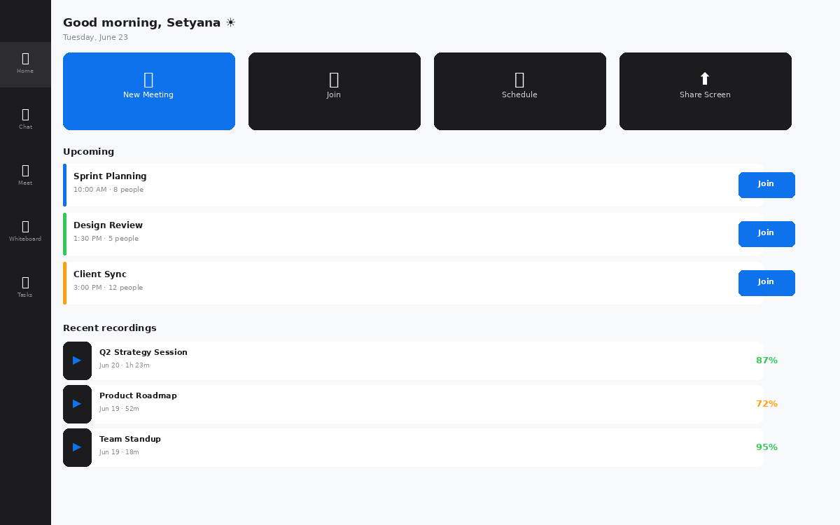
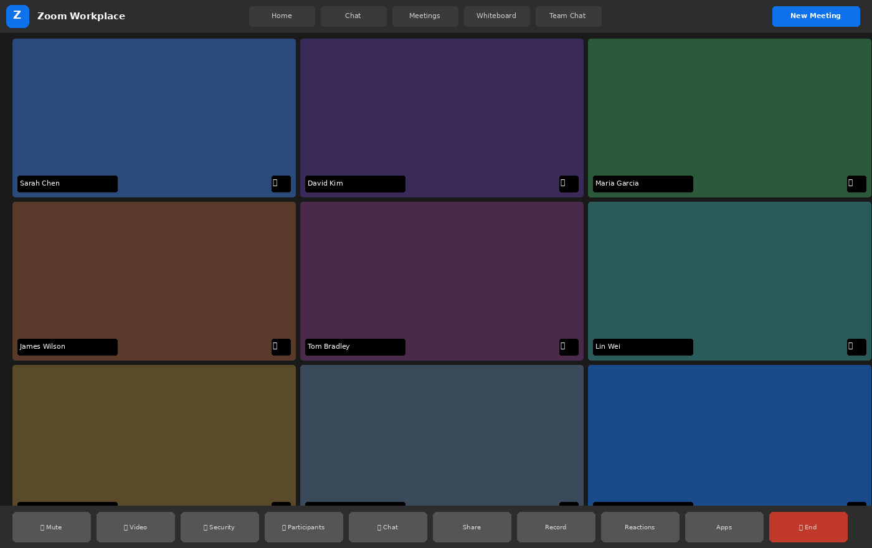
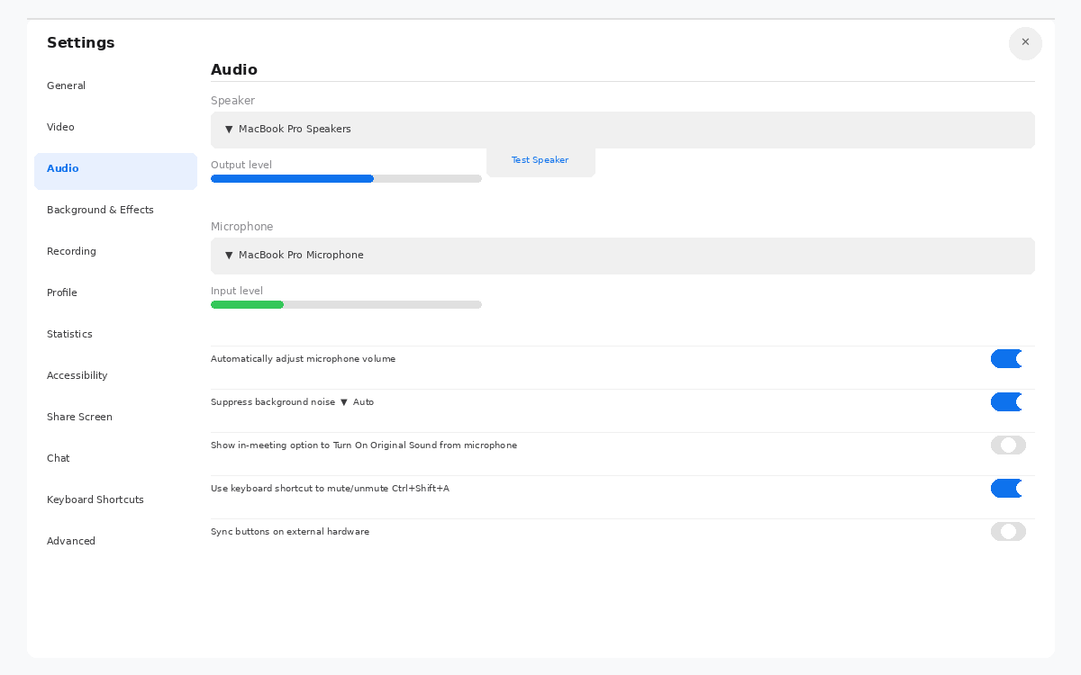
Zoom Workplace
The market leader — 300M+ daily participants · $15.99/user/mo
✓ WORKS WELL
Dashboard shows today's meetings clearly
Upcoming list, quick actions, recent recordings — all in one view
Gallery view shows all participants
3×3 grid is the default — nobody is hidden
In-meeting view
Breakout rooms & reactions work well
Industry-leading — other platforms copy Zoom here
✗ ISSUES
Home nav has 5 competing tabs
Home, Chat, Meetings, Whiteboard, Team Chat — all equal weight at the top
Settings panel
Home dashboard
Settings has 12+ tabs
Every tab leads to more sub-settings — overwhelming for non-technical users
In-meeting toolbar is 10 buttons wide
No separation between primary controls and secondary functions
Verdict: Zoom does the core meeting experience better than anyone — but every screen outside the meeting reveals a product that kept adding features without revisiting information architecture.

Slide 6
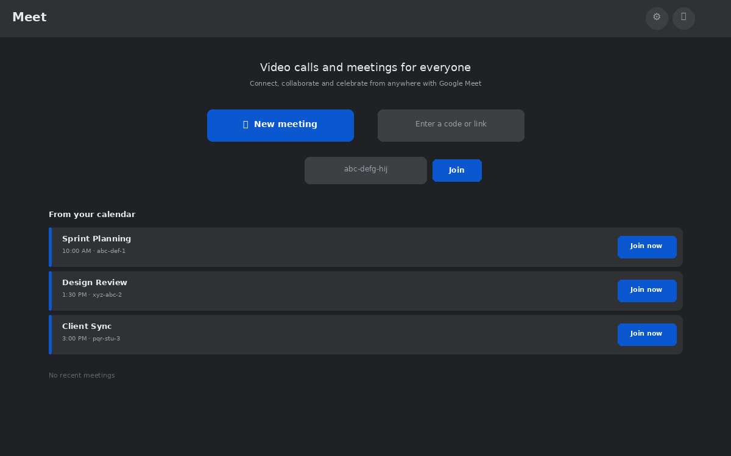
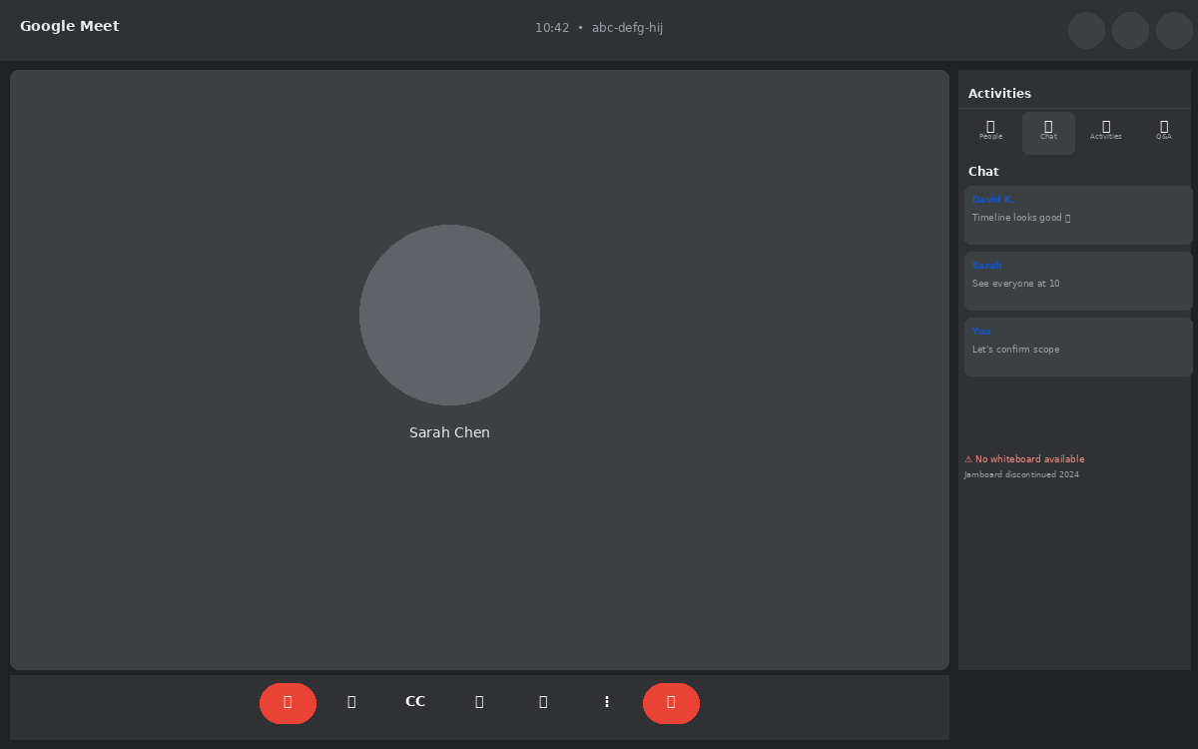
Google Meet
The minimalist — native to Google Workspace · $6/user/mo
✓ WORKS WELL
Home screen is the simplest of all four
One button to start, one field to join — nothing else visible
Consistent minimal design language
Same rounded buttons, same colors everywhere — very polished
In-meeting + chat
Chat panel is clean and usable
Activities sidebar is well-organised with tabs for chat, Q&A, polls
✗ ISSUES
No whiteboard whatsoever
Jamboard integration shut down 2024 — Meet has zero visual collaboration
Calendar integration (via Gmail)
Home screen
Chat panel has no persistent history
Chat messages disappear when the meeting ends — no export
Home screen is almost too minimal
No upcoming meetings, no recent activity, no recordings accessible
Verdict: Google Meet is the most visually refined platform — but it's been deliberately kept simple to the point where it's missing collaboration tools that teams genuinely need.

Slide 7
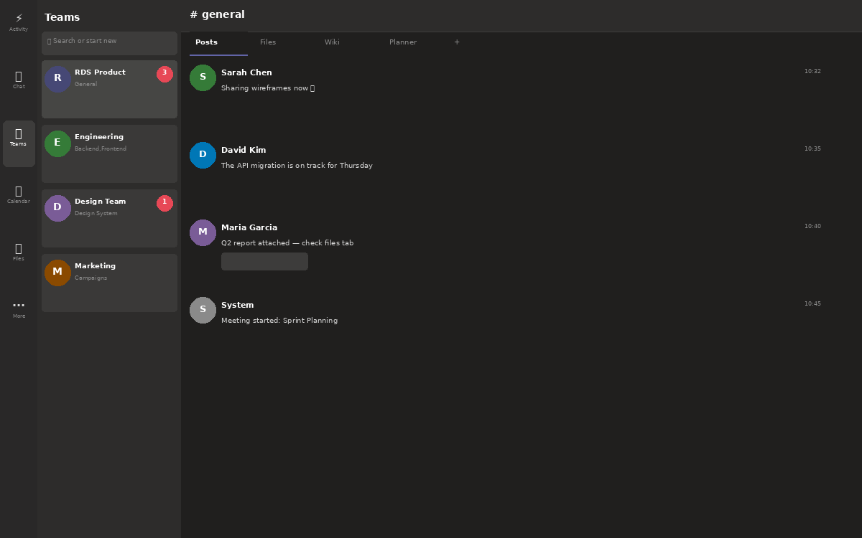
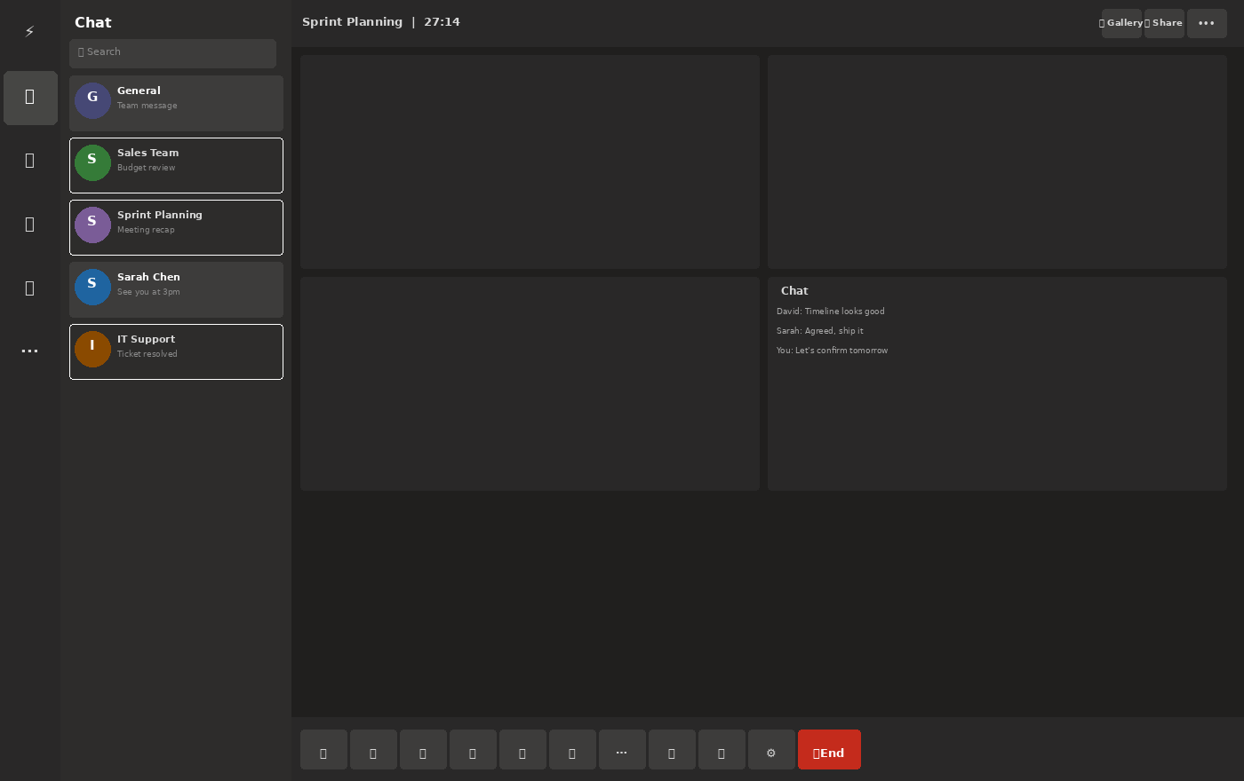
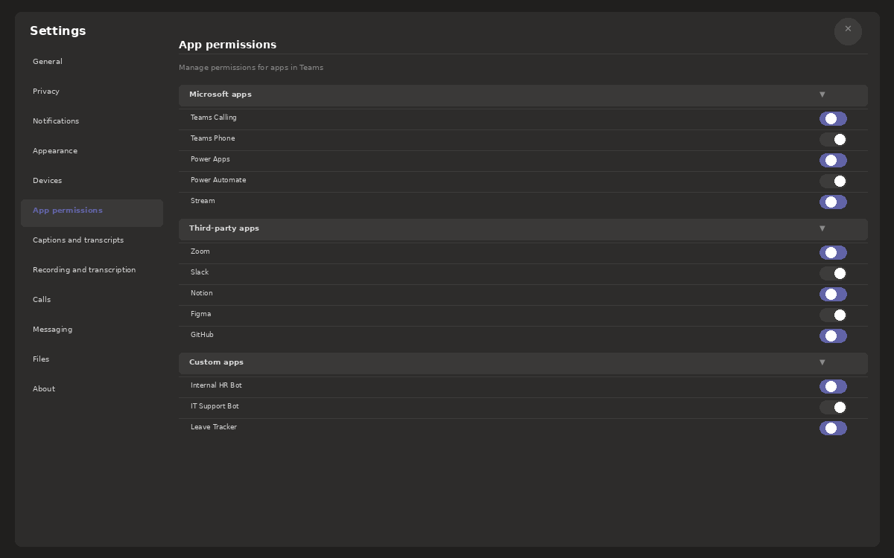
Microsoft Teams
The enterprise Swiss Army knife — too many blades · $4/user/mo
✓ WORKS WELL
Everything is in one app
Chat, files, calendar, meetings, calls, tasks — genuinely one platform
Persistent conversation threads
Channels keep context alive between meetings — nothing gets lost
In-meeting view
File co-editing works natively
Word/Excel/PowerPoint open inside Teams — strongest integration story
✗ ISSUES
Three layers of navigation
Left icon nav → team list sidebar → channel area — three levels before you get to content
Settings — App permissions
Main app — channels & chat
Settings has 12 categories
App permissions alone opens 3 more nested sections — for a meeting app
Meeting UI has no clear hierarchy
Video tiles, chat panel, and participant list all compete for space at equal weight
Verdict: Teams is the only platform where you genuinely never need to leave the app — but the price you pay is navigating through layers of UI to find anything, every single time.

Slide 8
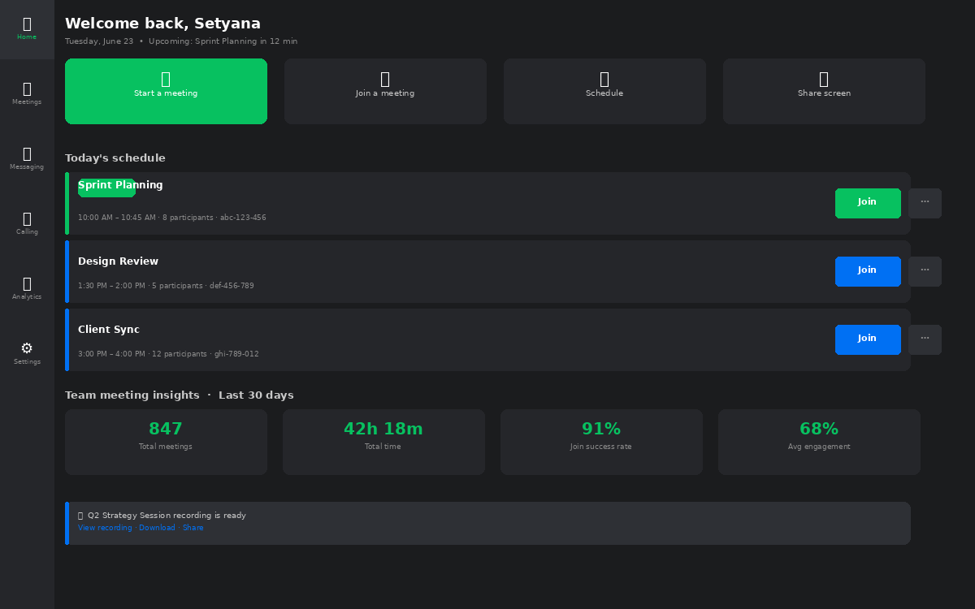
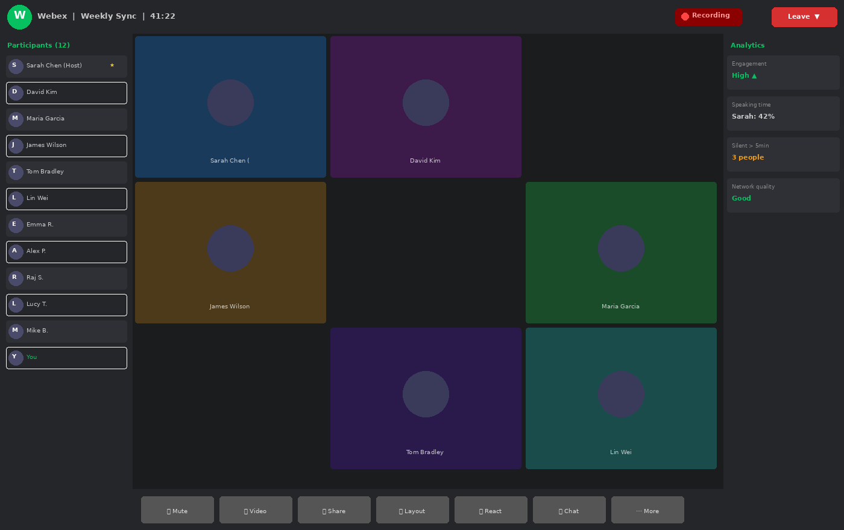
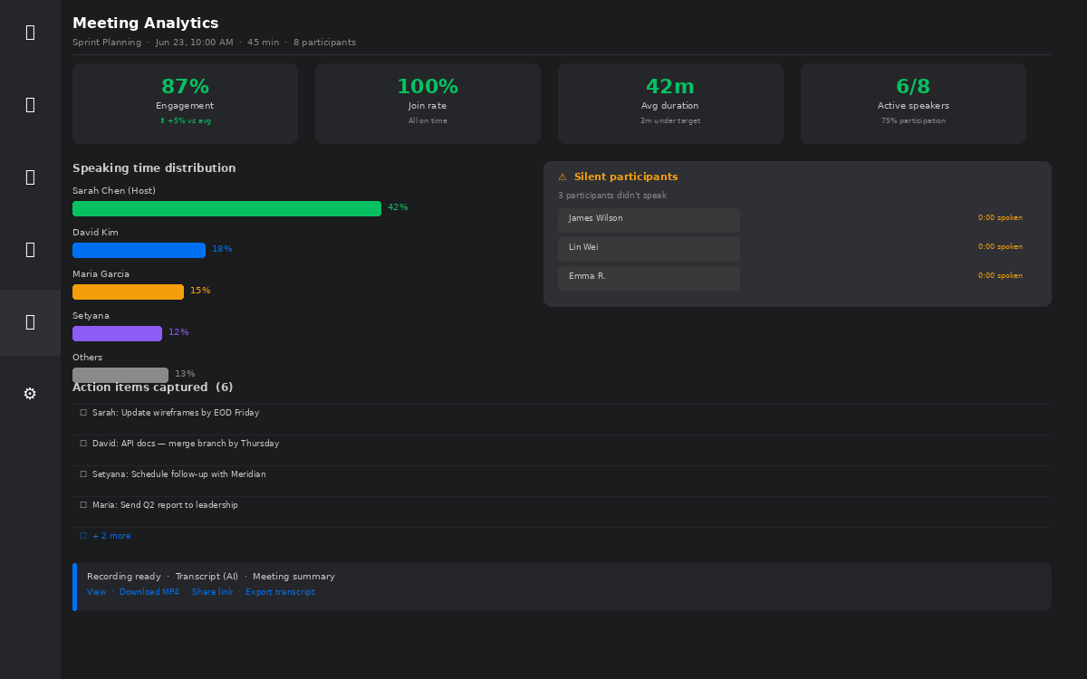
Cisco Webex
Enterprise analytics built-in — interface stuck in 2018 · $14.50/user/mo
✓ WORKS WELL
Dashboard shows team analytics upfront
Meeting count, total time, join rate, engagement — on the home screen
Post-meeting analytics are detailed
Speaking time per person, silent flags, action items captured automatically
In-meeting + analytics
In-meeting analytics panel is live
Engagement and speaking data shown during the call — no other platform does this
✗ ISSUES
Home screen feels cluttered and heavy
Too many sections, too much information density — visually exhausting
Post-meeting analytics
Home — dashboard & schedule
Interface uses dated visual patterns
Green accent on a dark theme feels like a 2019 enterprise dashboard
Complex navigation between analytics, meetings, calling
Three separate concepts in three separate sections — no unified flow
Verdict: Webex is the only platform that treats meeting analytics as a first-class feature — not a premium add-on. But the design language hasn't kept pace, and new users are put off before they discover any of it.

Slide 9
WHAT'S BROKEN
8 specific problems identified across all four platforms
01
Profile not configurable
05
Participant navigation is hard
Users can't set their in-meeting display name or profile easily — causes confusion in professional calls
Joining, switching views, and finding controls is unintuitive — especially for first-time participants
02
Function overload
06
Clunky breakout rooms
Calendar, canvas, tasks, clips, sheets, slides — all crammed into one small menu nobody can navigate
Pre-assigning participants takes too many steps. Drag-and-drop doesn't exist. Auto-assign is unreliable
03
Inconsistent visual design
07
Whiteboard is barely usable
Same app looks completely different on Mac, Windows, mobile and web — destroys trust and familiarity
Limited tools, no persistence after the meeting ends, no way to export — effectively decorative
04
Gradient & ad clutter
08
Screen sharing is one-way
Promotional banners and upsell messages appear mid-session — unprofessional in a client-facing context
When sharing, collaboration stops. No annotation, no cursor sharing, no way for others to contribute
Notes:
These are the 8 original pain points from the research brief — verbatim, with added context on why each one matters in a professional setting.

Slide 10
WHAT TO KEEP
7 proven features worth building on — not replacing
✓
Breakout rooms
Essential for workshops, training, and team collaboration. Exists in Zoom & Teams — but needs to actually work smoothly.
seen in: Zoom
✓
Polls
Live audience engagement. Drives participation and gives hosts real-time feedback on comprehension and sentiment.
seen in: Zoom / Teams
✓
Whiteboard
Visual collaboration is a core meeting need — but the implementation across all platforms is too limited.
seen in: All platforms
✓
Reactions
Non-verbal feedback without interrupting the speaker. Low bandwidth, high signal — a proven UX pattern.
seen in: All platforms
✓
Post-meeting file retrieval
Shared PDFs, spreadsheets, and documents should be retrievable after the meeting. Currently unreliable or missing.
seen in: Teams
✓
Calendar integration
Meeting scheduling, reminders, and joining directly from calendar events. Table stakes for professional use.
seen in: All platforms
✓
Grid meeting view
Every participant visible at once. Removes social anxiety about being overlooked. Default view for <10 people.
seen in: Zoom / Meet
Notes:
Seven features confirmed across competitors. The note 'seen in' shows which platform does it best — RDS Meet takes the best version of each.

Slide 11
WHAT TO ADD
4 features that don't exist well anywhere — yet
01
Real-time participant analysis
02
Auto-chapter meeting replay
Host-only intelligence layer
Minutes 2:15 = Intro · 14:35 = Summary
Live speaking time per person, silent participant flags, engagement heatmap. Toggleable in settings so it never feels intrusive. Gives hosts actionable signals mid-meeting — not just post-meeting data.
Every recorded meeting is automatically segmented into chapters with timestamps — Opening, Q1 Review, Product Updates, Action Items, Closing. Click any chapter to jump straight to it. No manual work.
Why now: No competitor does this in real time. Closest is Teams Insights — but only available post-meeting in Premium tier ($12 extra).
Why now: Existing replay tools just show a flat video timeline. Auto-chapters are a genuine productivity multiplier for anyone who missed a meeting.
03
Meeting metrics dashboard
04
AI meeting summary (MoM)
Duration · Engagement · Participation %
Phase 3 feature — after scale
Per-meeting: total duration, engagement score (high/medium/low based on reactions, chat, speaking), participation percentage, and number of action items captured. Exportable as a report.
Automatic Minutes of Meeting generated post-call. Key decisions, assigned action items, unresolved questions — all structured and emailed to participants. Optional; can be turned off for sensitive calls.
Why now: Teams Premium offers basic analytics at extra cost. RDS Meet includes this in the Professional tier — a direct differentiator.
Why now: Notion AI, Otter.ai and Fireflies offer this as standalone tools at $8-16/mo. RDS Meet bundles it — removing a tool from the stack.
Notes:
These 4 features are the core differentiation. Each one has a 'Why now' rationale — showing competitors either don't have it, or charge extra for it.

Slide 12
MARKET OPPORTUNITY
A high-growth market with clear room for a better product
TAM
$19.4B
24.5%
CAGR of video conferencing
market 2023 → 2030
SAM
$4.2B
SOM
$42M
67%
of companies plan to increase
video meeting investment in 2025
5.3×
growth in remote &
hybrid work since 2020
$8-16/mo
spent per employee on
standalone AI meeting tools
Notes:
Market sizing. The SOM of $42M is achievable at 1% of the mid-market segment — roughly 3,000 companies with 100+ users. Anchor the TAM to show the ceiling, then focus on the realistic SOM.

Slide 13
RDS Meet
All the best of Zoom, Meet, Teams and Webex.
None of what slows you down.
Meeting lobby
Pre-join camera check
Live meeting room
Grid & speaker view
Working whiteboard
Drag-drop breakout rooms
Meeting chat + replies
⌘K global search
Meeting history
Auto-chapter replay
Engagement analytics
Settings + live cam preview
Notes:
The solution summary. 12 features across 3 rows — this is the 'menu' slide before diving into the details.

Slide 14
USER JOURNEY
Every step of the meeting experience — fully wired
1
2
3
4
5
Lobby
Pre-join
Live meeting
Collaborate
Leave
See all today's meetings. Live badge shows who's in. Join a live session or preview an upcoming one.
Real webcam preview. Toggle mic & camera. See participant count before entering.
Grid or speaker view. Waiting room, reactions, hand raise, record, screen share — all functional.
Open whiteboard to draw live. Move people between breakout rooms with drag and drop.
Confirmation before exit. Meeting moves instantly to history with timer, recording, and summary.
See live
badge
Toggle mic
& camera
9 features
available
Whiteboard
+ rooms
Auto-saves
to history
Notes:
Walk through this step by step during the live demo. Each card has a feature callout at the bottom — point to it as you demo that screen.

Slide 15
KEY DIFFERENTIATORS
RDS Meet vs the market — where we win
Feature
RDS Meet
Zoom Pro
Google Meet
Teams
Webex
Pre-join camera preview
✓
✓
✗
✓
✓
Auto-chapter meeting replay
✓
✗
✗
✗
✗
Real-time participant analysis
✓
✗
✗
Premium only
✗
Drag-drop breakout rooms
✓
✗
✗
✗
✗
Engagement score per meeting
✓
✗
✗
Premium only
Partial
Working whiteboard
✓
Basic
✗
Basic
Basic
AI meeting summary (Phase 3)
✓
Add-on
✗
Add-on
Add-on
Price per user / month
$14
$15.99
$6*
$4*
$14.50
* Limited feature set at base price. Full parity requires Google Workspace Business Plus ($18/user) or Teams Premium ($10 add-on).
Notes:
The comparison table is the most persuasive slide in the deck. RDS Meet has a green checkmark on every row. Zoom and Teams both need add-ons for AI. The price footnote explains why $6 Google isn't actually competitive.

Slide 16
PRODUCT ROADMAP
From internal tool to full platform — in four phases
Phase 1 · Q3 2026
Phase 2 · Q1 2027
Phase 3 · Q3 2027
Phase 4 · 2028+
MVP
Growth
AI Layer
Ecosystem
Internal — RDS company only
External — existing clients
All users — AI-powered features
Open platform at scale
· Core video meetings (up to 50 pax)
· Up to 300 participants
· AI meeting summary (MoM)
· Plugin marketplace
· Screen share + meeting chat
· Breakout rooms (drag-drop)
· Real-time transcription
· Developer API (public)
· Calendar integration
· Whiteboard + drawing tools
· Smart action item tracking
· 3rd party integrations
· Waiting room + lobby
· Full meeting replay + chapters
· Sentiment analysis
· White-label option
· Basic meeting history
· Engagement analytics
· Calendar AI sync
· Custom workflow builder
· Settings with cam preview
· Mobile app (iOS + Android)
· Noise cancellation
· Revenue share for plugins
KPIs
KPIs
KPIs
KPIs
→ Internal NPS > 8.0
→ 50+ paying external companies
→ AI feature adoption > 60%
→ 100+ plugin partners
→ Zero critical bugs in 30 days
→ Churn rate < 5%/month
→ MoM accuracy > 85%
→ Platform ARR > $2M
→ Avg join time < 10 seconds
→ MRR target: $25,000
→ ARR target: $500K
→ NPS > 9.0 across all tiers
Notes:
The roadmap has KPIs and team size per phase — this makes it a real plan, not a wishlist. Use Phase 1 KPIs (NPS > 8, join time < 10s) as the internal success criteria before launching externally.

Slide 17
GO-TO-MARKET STRATEGY
How we acquire, activate, and retain customers
Phase 1
Internal launch
Phase 2
Client-led expansion
→ Deploy to all RDS employees first
→ Offer existing RDS clients free 3-month trial
→ Run 90-day internal feedback sprint
→ Client success team handles onboarding personally
→ Fix critical issues before any external exposure
→ Referral incentive: 1 free month per referred company
→ Build internal champions who advocate externally
→ Target: 50 paying companies within 6 months of launch
Phase 3
Outbound + content
Phase 4
Self-serve + PLG
→ LinkedIn content showing meeting analytics data
→ Free tier drives organic top-of-funnel
→ Case studies from Phase 2 clients with real metrics
→ In-app upgrade prompts at key moments
→ Partnerships with Indonesian IT resellers
→ Developer community around the plugin API
→ Attend tech/enterprise conferences in SEA
→ App marketplace listings (G2, Capterra, etc.)
Notes:
The GTM strategy mirrors the product phases. Phase 1 is internal validation, Phase 2 is warm outbound to existing clients (lowest acquisition cost), Phase 3 is content-led growth, Phase 4 is product-led growth at scale.

Slide 18
MONETIZATION
Per-user SaaS pricing — designed to undercut Zoom, match Webex value
MOST POPULAR
Free
Starter
Professional
Enterprise
Trial & small teams
Small businesses
Growing companies
Large organisations
$0
$6
$14
Custom
forever
/user/month
/user/month
contact sales
✓ 40-min meeting cap
✓ Unlimited duration
✓ Up to 300 participants
✓ Unlimited participants
✓ Max 10 participants
✓ Up to 50 participants
✓ Breakout rooms + whiteboard
✓ SSO + SAML + 2FA
✓ Basic screen share
✓ 30-day meeting history
✓ Full analytics + engagement
✓ Plugin marketplace access
✓ Chat messaging
✓ Calendar sync
✓ Auto-chapter replay
✓ Developer API
✓ 7-day meeting history
✓ Email support
✓ AI summary (MoM)
✓ Dedicated CSM
✗ No breakout rooms
✓ All core features
✓ Priority support + SLA
✓ Custom SLA + uptime
✗ No analytics
✗ No breakout rooms
Annual billing: 20% discount (equivalent to 2 months free) · Volume discount available for 500+ seat contracts · All prices in USD
✗ No AI features
✗ No AI summary
Notes:
Pricing is positioned between Google Meet (too cheap to be taken seriously) and Zoom (slightly overpriced). Professional at $14 is the main revenue driver. Enterprise handles large accounts with custom contracts.

Slide 19
REVENUE PROJECTIONS
Conservative 3-year forecast based on phased rollout
Year 1 · 2026
Year 2 · 2027
Year 3 · 2028
Internal + Pilot
External Launch
Scale + AI Tier
Internal users (RDS)
50
$700/mo
$14
Starter users
120
$720/mo
$6
Starter users
400
$2,400/mo
$6
External pilot clients
3
$2,100/mo
$14 avg
Professional users
280
$3,920/mo
$14
Professional users
1,200
$16,800/mo
$14
Total MRR (end of year)
$2,800
Enterprise contracts
2
$1,600/mo
$800/mo
Enterprise contracts
8
$9,600/mo
$1,200 avg
Total ARR
~$33,600
Total MRR (end of year)
$6,240
Total MRR (end of year)
$28,800
$33.6K
Year 1 ARR
$74.9K
$345K
Total ARR
Year 2 ARR
~$74,880
Total ARR
Year 3 ARR
~$345,600
Assumptions: 15% monthly user growth from Q2 2027 · 8% annual churn · Professional/Starter split 70/30 · Enterprise at avg $1,000/mo contract
Note: These are conservative projections. Actual revenue will depend on sales velocity, churn management, and Enterprise contract size.
Notes:
Conservative model. Year 1 is mostly internal — revenue is low. Year 2 breaks $74K ARR with external launch. Year 3 hits $345K with AI tier and Enterprise contracts. Stress that these are floor estimates, not targets.

Slide 20
▶
Next steps
01
Approve MVP scope
02
Assign development team
03
Set internal KPIs
Align on Phase 1 feature list, team allocation, and 90-day internal launch timeline
Minimum: 2 frontend devs, 1 backend, 1 designer, 1 QA. PM can be handled internally.
NPS target, join time benchmark, bug SLA. Measure from week 1 — not after launch.
04
Identify Phase 2 pilot clients
05
Live demo available now
3-5 existing RDS clients willing to trial at no cost in exchange for feedback
The full prototype is ready to walk through. Every button is functional.
Built with React + Vite · #014592 · Lucide icons · Full interactive prototype ready for demo
Notes:
Close with action items. Step 5 is the hook for the live demo — transition directly from this slide to the running app.

