Slide 1

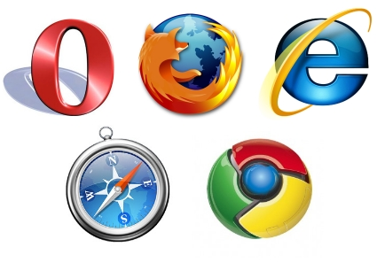
HOW BROWSERS WORK
By; Maureen Wachira.

Slide 2
BROWSER’S DEFINED
A web browser is a software application whose main function is to present the web resource you choose by requesting it from the server and displaying it on the browser window.

Slide 3
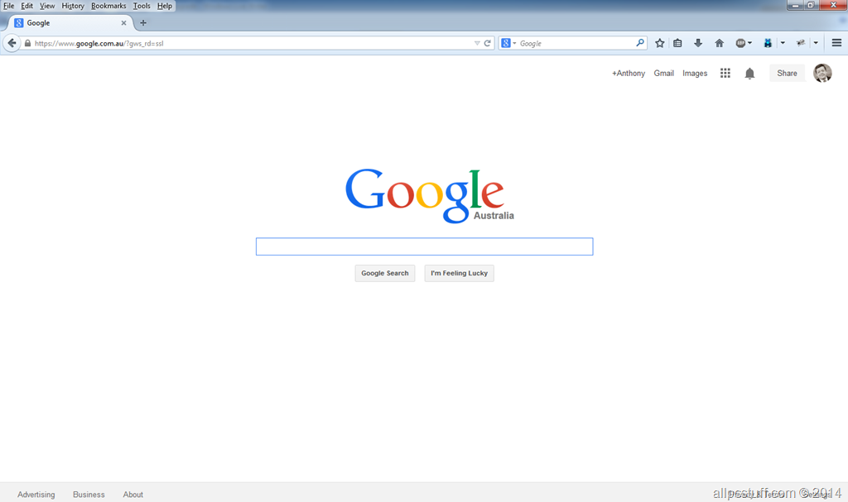
Browser User Interface

Slide 4
objective
Explore intrinsically what happens behind the scenes in your browser

Slide 5
WHY SHOULD YOU CARE?
Knowing makes you a better web developer!
Learning the internals of browser operations helps you make better decisions and know the justifications behind development best practices.

Slide 6
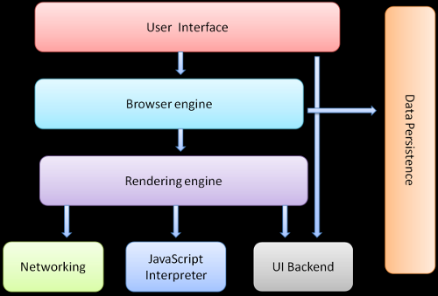
LET’S GET STARTED! BROWSER'S HIGH LEVEL STRUCTURE

Slide 7
WHAT EXACTLY HAPPENS?
Once you have typed the URL/web address into your browser, the first thing your browser does is;
STEP 1: The browser breaks the URL into three parts:
1.The protocol ("http://").The protocol identifies the method (set of rules) by which the resource is transmitted.
2.The domain name ("www.google.com ")
3.The file name e.g. ("howbrowserswork1.htm")

Slide 8
WHAT EXACTLY HAPPENS
STEP 2: DNS (Domain Name System) lookup
This means the DNS server translates a domain name into an IP address.

Slide 9
WHAT EXACTLY HAPPENS
STEP 3: Request Page
Once the browser has the IP address it sends an HTTP (Hypertext Transfer Protocol ) request to the web server at that address.

Slide 10
WHAT EXACTLY HAPPENS
STEP 4: HTML Parsing
The rendering engine will start parsing the HTML document and turn the tags to Document Object Model nodes in a tree called the "content tree" .
It will parse the style data, both in external CSS files and in style elements. The styling information together with visual instructions in the HTML will be used to create another tree –the render tree.

Slide 11
WHAT EXACTLY HAPPENS
STEP 5: Layout the Render tree
This means giving each node the exact coordinates where it should appear on the screen.

Slide 12
WHAT EXACTLY HAPPENS
STEP 6: Painting
painting is where the render tree will be traversed and each node will be painted using the UI backend layer and hence we are able to view the requested output.

Slide 13
Thank you.
https://github.com/maureenwaitherero/How-browsers-work/

