Slide 4
Enabling strict mode

Slide 5
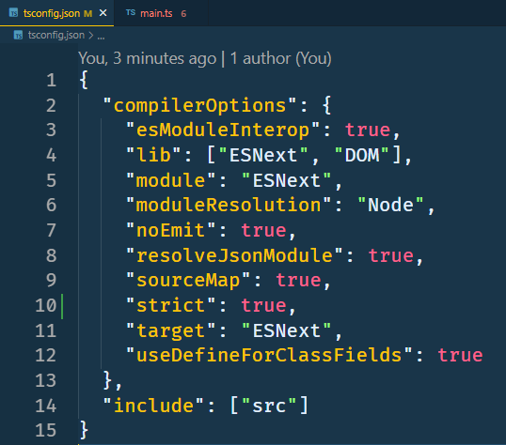

Slide 6
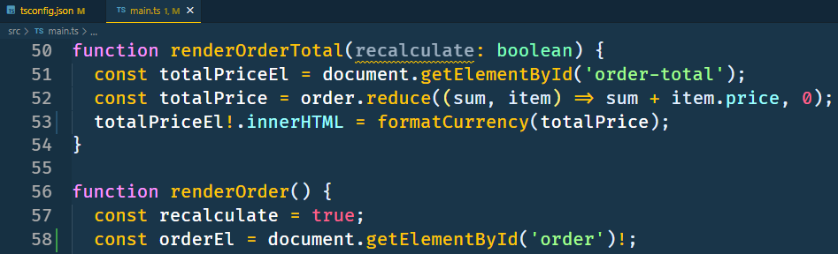
Using !

Slide 7
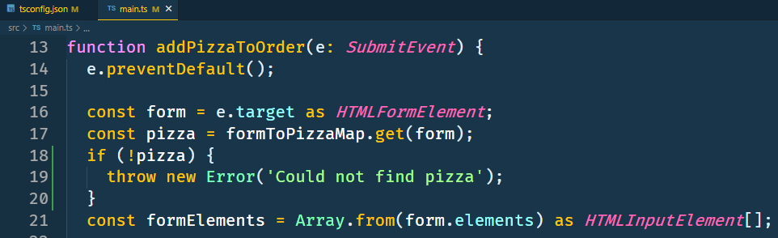

Slide 8
More strict features

Slide 10
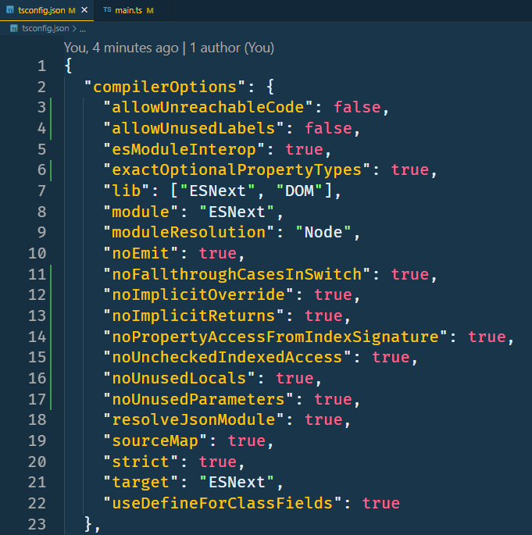

Slide 11
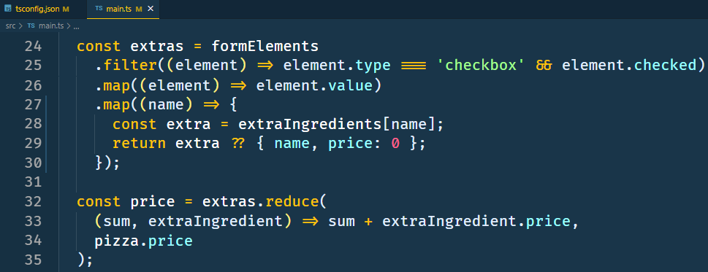
Unchecked Indexed Access

Slide 12
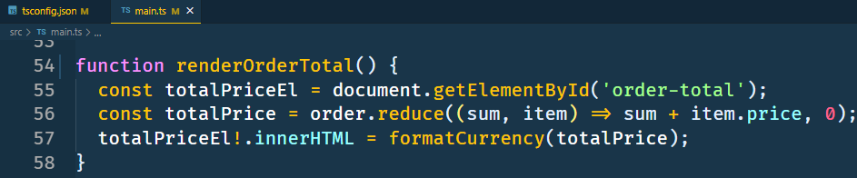
Unused Parameters

Slide 13
Validating data at the boundary

Slide 14
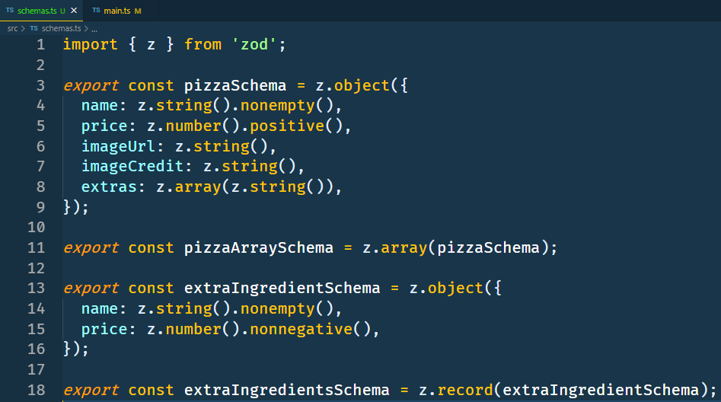

Slide 15
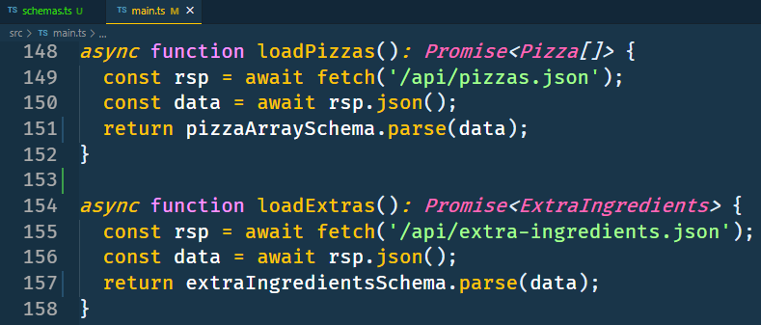

Slide 16
Inferring TS types

Slide 17
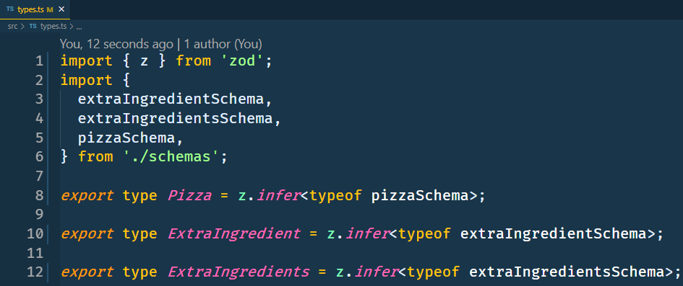

Slide 18
Unknown In Catch

Slide 19
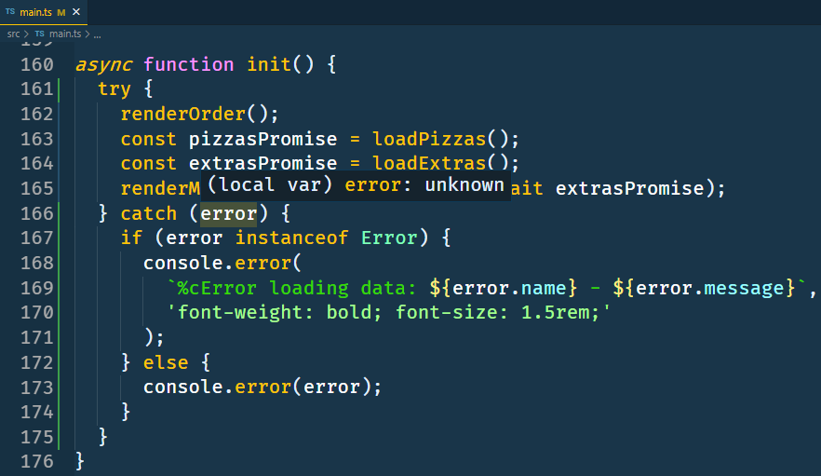

Slide 20
Mapped Types

Slide 21
Readonly

Slide 22
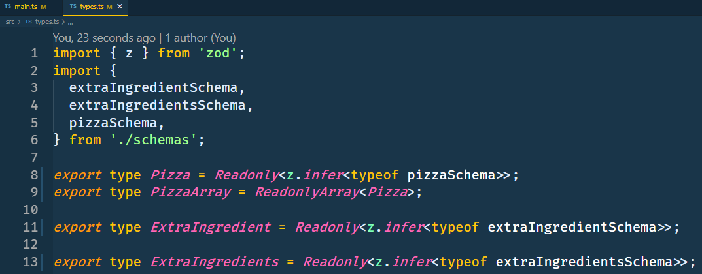

Slide 23
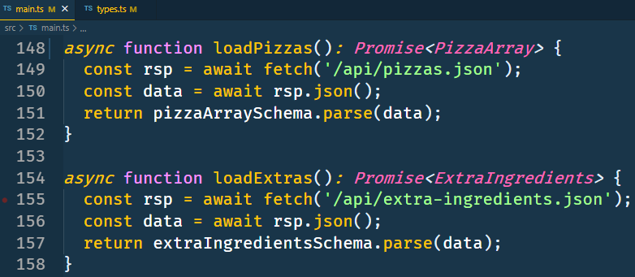

Slide 24
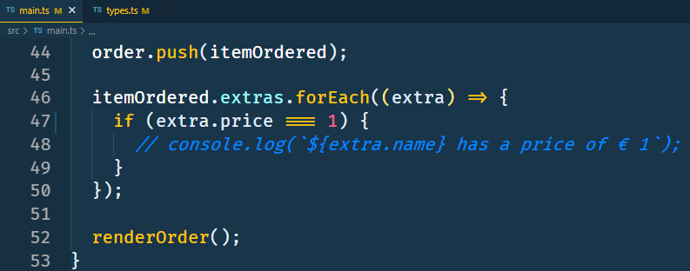

Slide 25
DeepReadonly

Slide 26
Recursive types are very powerful
Source: https://gist.github.com/basarat/1c2923f91643a16a90de638e76bce0ab

Slide 27
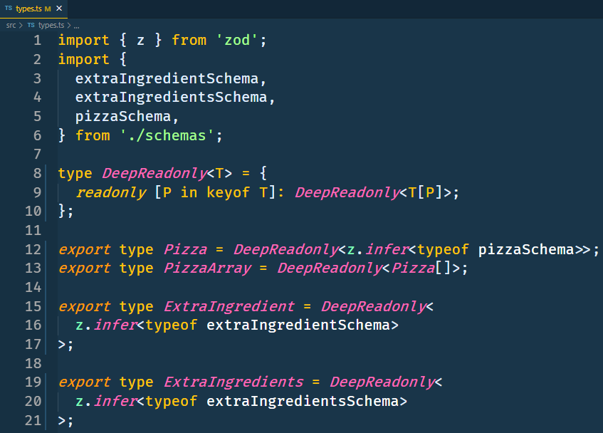

Slide 28
Indexed Access Types

Slide 29
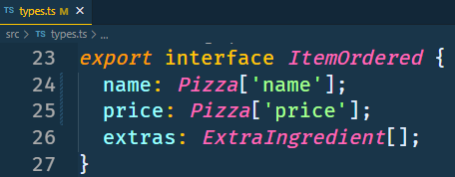

Slide 30
Type Mapping with Omit<> and Pick<>

Slide 31
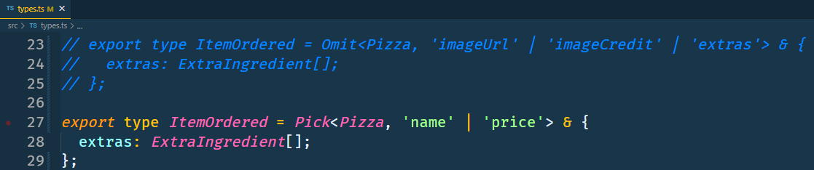

Slide 32
Displaying Types

Slide 33
Source: https://effectivetypescript.com/2022/02/25/gentips-4-display/

Slide 34
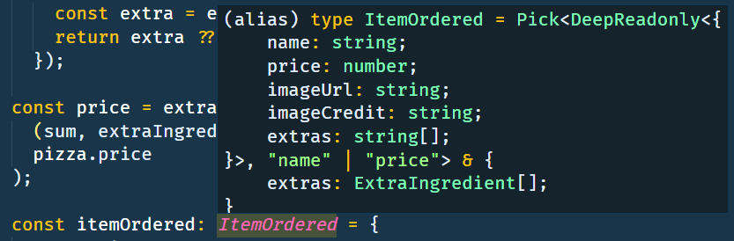

Slide 35
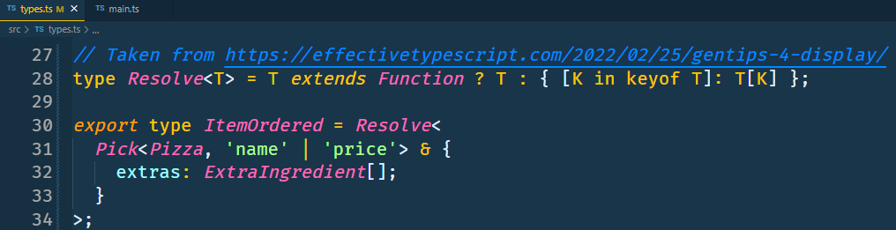

Slide 36
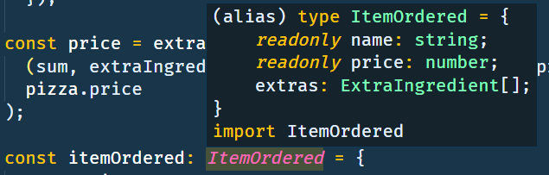

Slide 37
ReturnType

Slide 38
Opague

Slide 39
Type guards

Slide 40
Type Assertion Functions

Slide 41
Exhaustiveness Checking

Slide 42
Conditional Types

