Slide 1
Contribution Figure
El Niño

Slide 2
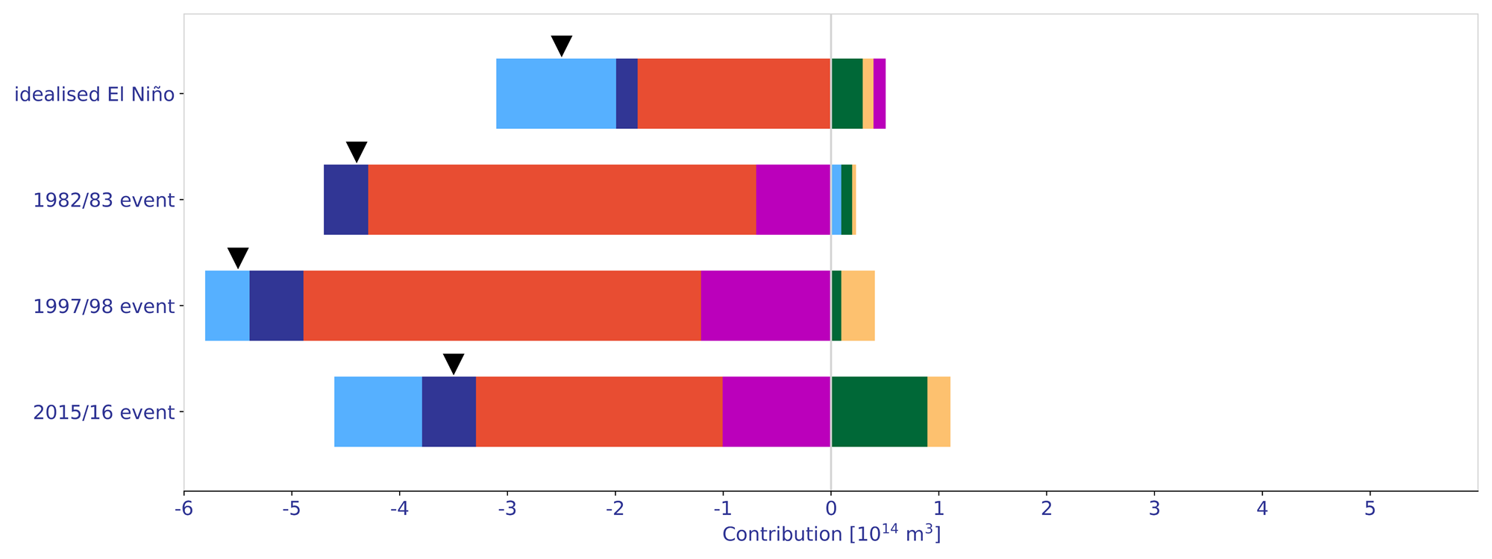
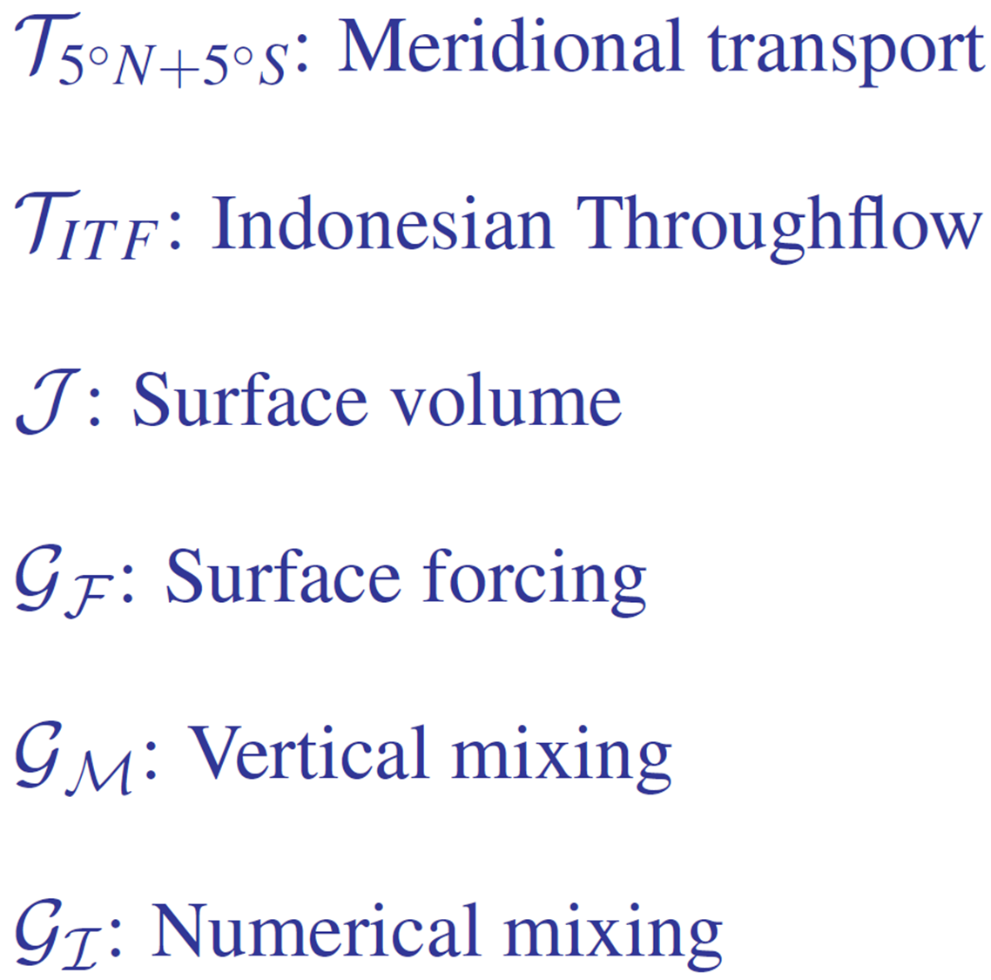

a) El Niño
discharge recharge
6%
13%, 3%, 4%
idealised El Niño
43%
71%
3%, 3%, 1%
10%
1982/83 event
10%
81%
16%
1%, 5%
1997/98 event
8%
8%
68%
22%
5%
2015/16 event
14%
23%
65%
30%
27%
-5 -4 -3 -2 -1 0 1 2 3 4 5
Contribution [10¹⁴ m³]

Slide 3
Contribution Figure
La Niña

Slide 4
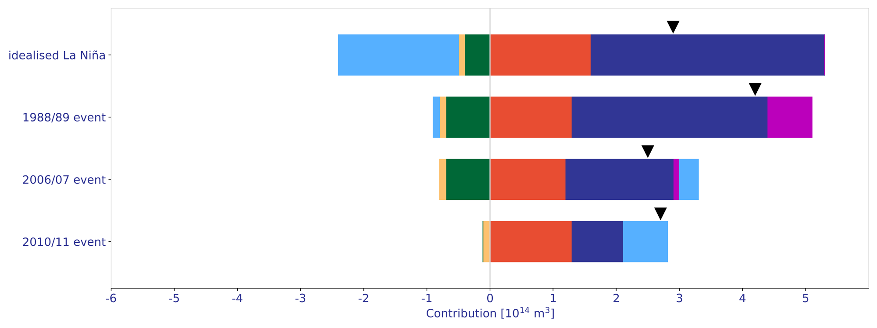
b) La Niña
3%,16%
idealised La Niña
65%
55%
128%
2%, 2%
1988/89 event
17%
31%
74%
16%
2%
2%, 11%
2006/07 event
29%
50%
67%
1%
2010/11 event
48%
25%
31%
-6 -5 -4 -3 -2 -1 0 1 2 3 4 5
Contribution [10¹⁴ m³]

