Slide 1
Schematic Discharge

Slide 2
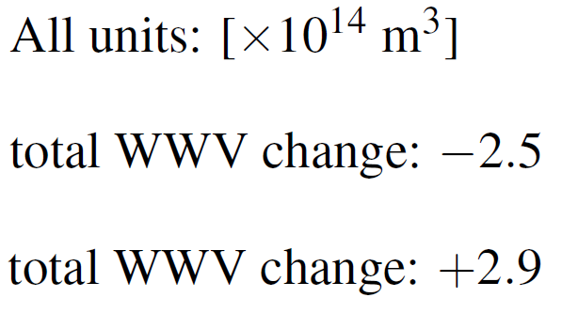
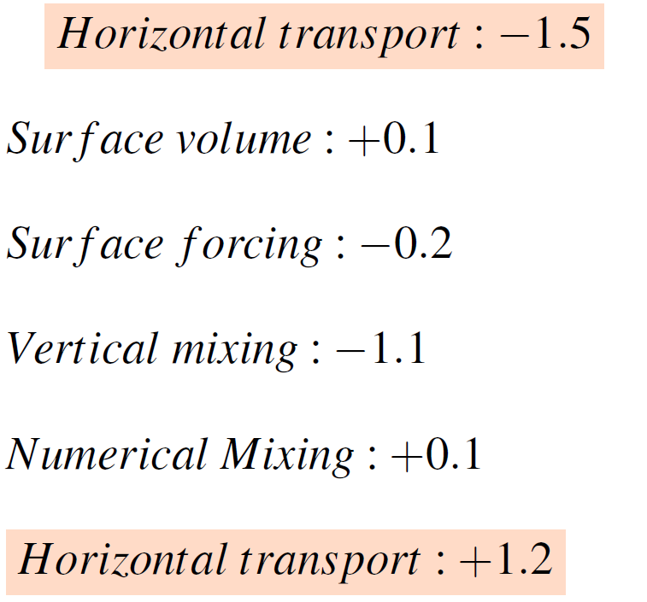

5°N
Equator
5°S
cooling
warming
300 m
116°E
80°W

Slide 3
Schematic Recharge

Slide 4
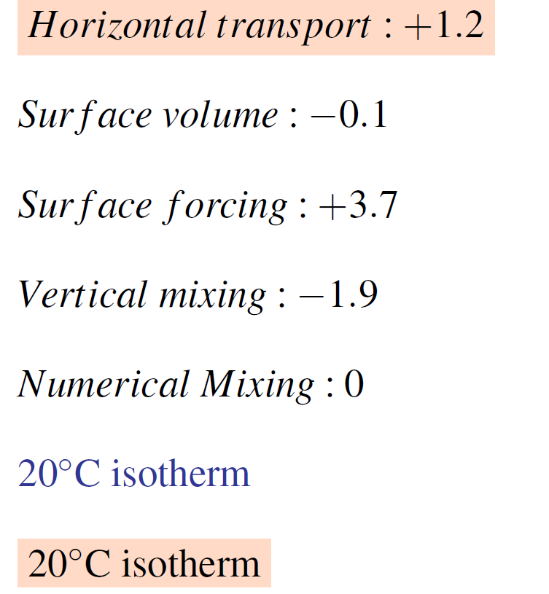
5°N
Equator
5°S
cooling
warming
300 m
116°E
80°W

