Slide 1



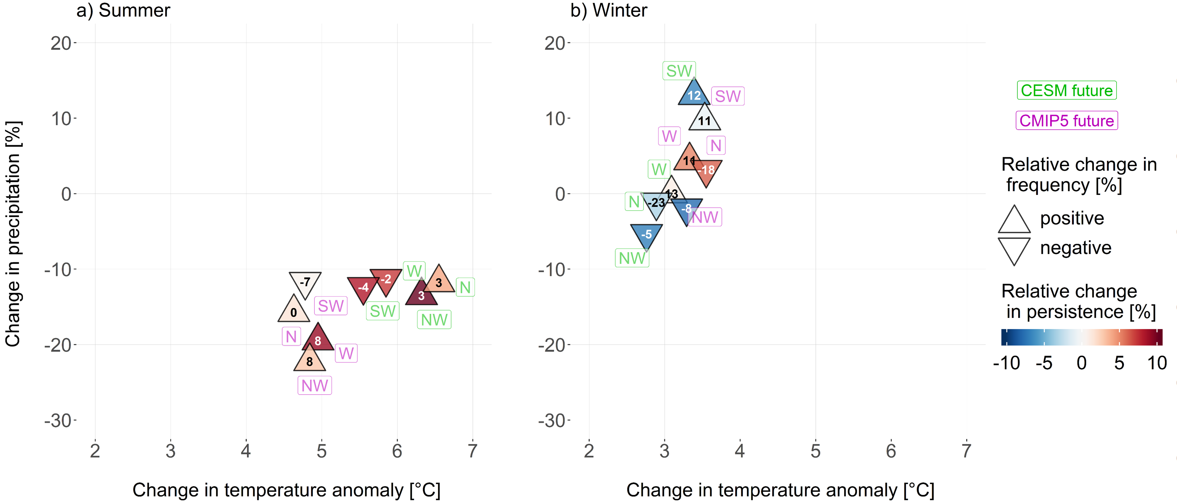

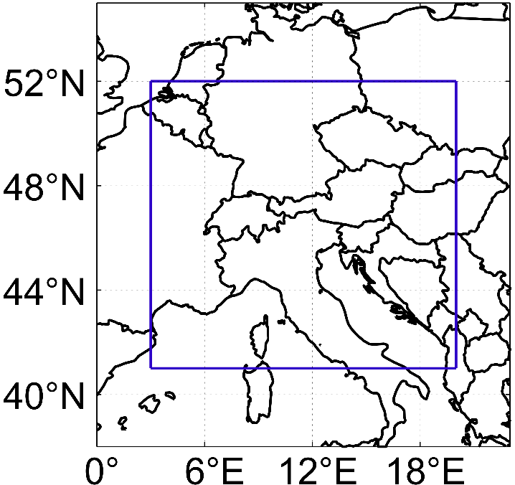
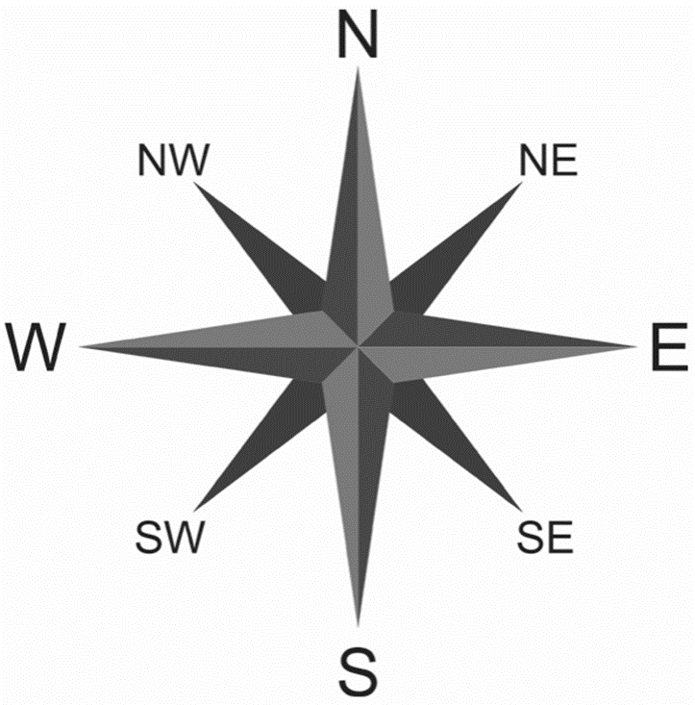
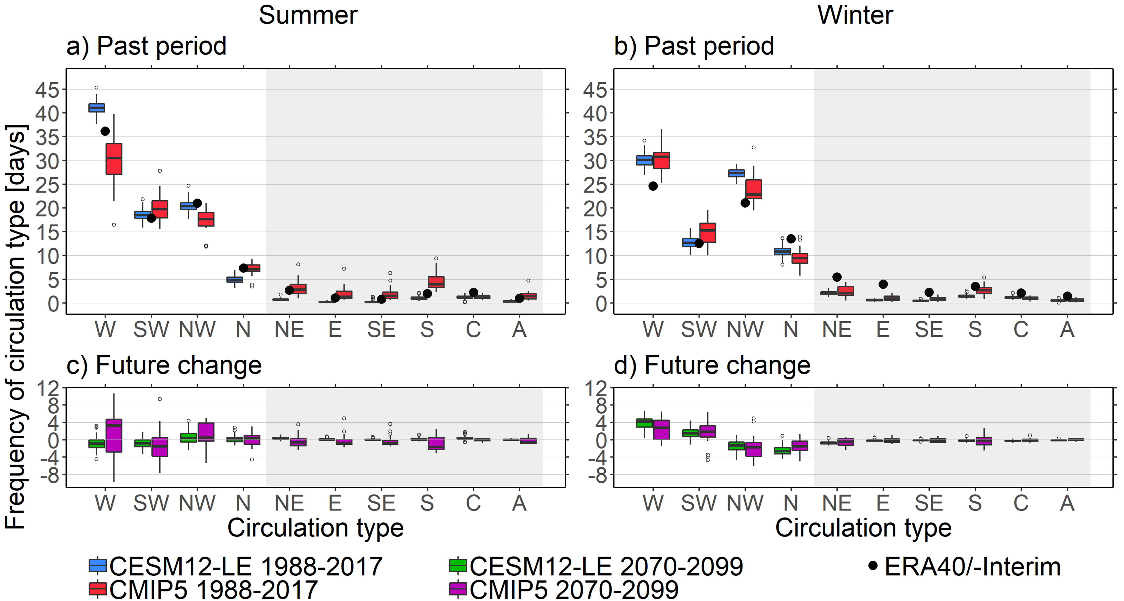
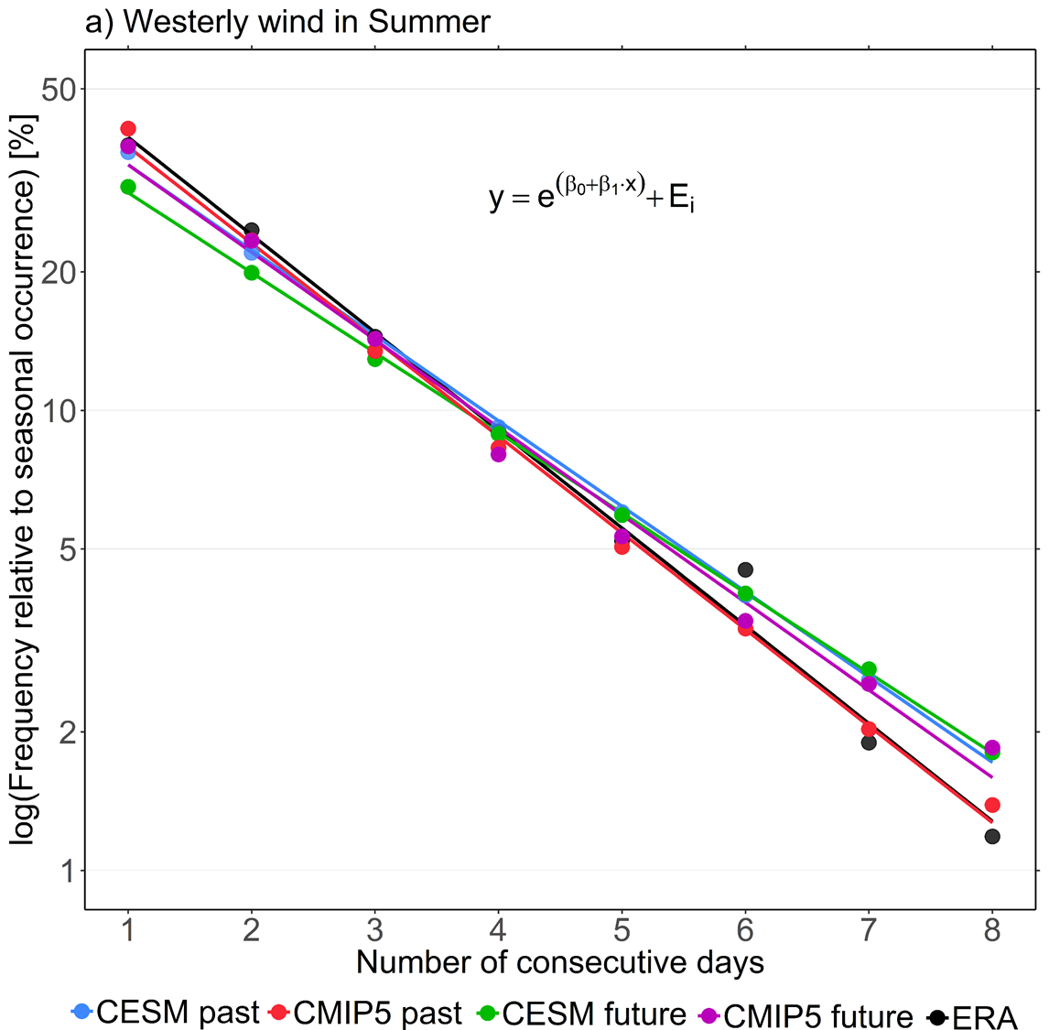


Changes in the Frequency and Persistence of Central European Circulation Types
Maurice F. Huguenin^{1,2,*}, Erich M. Fischer¹, Sven Kotlarski², Simon C. Scherrer², Cornelia Schwierz² and Reto Knutti¹
¹Institute for Atmospheric and Climate Science, ETH Zurich, Zurich, Switzerland
²Federal Office of Meteorology and Climatology, MeteoSwiss, Zurich, Switzerland
*E-mail: hmaurice@ethz.ch
08. – 12. April 2019
Motivation
Key Points and Summary Figure
Circulation types are key drivers of weather conditions in Central Europe
Persistent circulation types may favour extreme temperature anomalies, dry spells (e.g. summer 2018) and heavy rain- and snowfall events (e.g. January 2019)
Thus, we address the following research questions:
Is there an observed trend in the frequency or persistence of certain circulation types?
Can GCMs reproduce observed statistics of circulation types?
Is the frequency and persistence of the Central European circulation projected to change under global warming?
Climate models project warmer and drier summer conditions in Central Europe under unabated global warming independent of the circulation type..
The main circulation types (West, Southwest, Northwest and North) are projected to be slightly more persistent in summer, with an ambiguous signal in winter
Overall projected changes in the frequency and persistence are consistently small and likely within the range of internal variability
Model Data and Methods
We classify ten individual circulation types using daily geopotential height at 500 hPa over Central Europe from three model setups with the cost733class¹ classification software
GCM and reanalysis data:
ERA-40/-Interim | CESM12-LE | CMIP5
1 reanalysis product 1960-2017 | 1 model, 84 realisations 1960-2099 | 18 models, 23 realisations 1960-2099
historical + rcp85
a) b)
Fig. 1 In (a) the Central European classification domain 3°E – 20°E and 41°N – 52°N and in (b) the ten circulation types.
¹Demuzere, M., Kassomenos, P., & Philipp, A. Theoretical and Applied Climatology, 105, 143–166 (2011).
Fig. 4 Summary of projected temperature [°C], precipitation [%], frequency [%] and persistence [%] changes of the four main Central European circulation types in (a) summer and (b) winter for 2070-2099 relative to 1988-2017. The sign of the frequency change is given by the triangle shape and the magnitude of its change as the value
within in [%]. The persistence change is given as the shading of each triangle.
+ Cyclonic,
Anticyclonic
Frequency Changes
Persistence Changes
Models reproduce the observed frequency of circulation types reasonably well, but in winter somewhat overestimate westerlies/north-westerlies while underestimating northerly wind and the rarer circulation types
In summer, projected changes in the frequency of circulation types are consistently small in all models
CESM simulates a significant increase in westerlies during winter for the future time period
The length of a consecutive circulation type period and the seasonal frequency of that type are related by a logarithmic regression
We evaluate changes in the persistence as changes in the slope of the regression between the past and future time period
Westerly winds in summer are projected to become more persistent as the slope decreases
b)
future
past
+0.37%
+0.56 days
6.5
.pdf link: https://polybox.ethz.ch/index.php/s/X8bLMuTf8GU1d3C
E-mail: hmaurice@ethz.ch
Fig. 2 Frequency of the ten circulation types during (a) summer and (b) winter for the time period 1988-2017. In (c) and (d) is the projected change in the models for the future time period 2070-2099 relative to the past period given as an absolute value. The shaded area indicates the rare circulation types.
Fig. 3 In (a) the frequency of consecutive westerly wind (W) periods relative to the seasonal average for the past (1988-2017) and future (2070-2099) time period on a logarithmic y-axis with a logged response regression fit. In (b) an inset for the CMIP5 data showing the changes to a consecutive 6.5-day-long time period. Subfigure (b) is not to scale.

