Slide 1

Introduction to LaTeX
CCRC Fun Seminar Series
25th March 2024
slides based on those of
Byungwon Woo & Andrei Gurtov

Slide 2
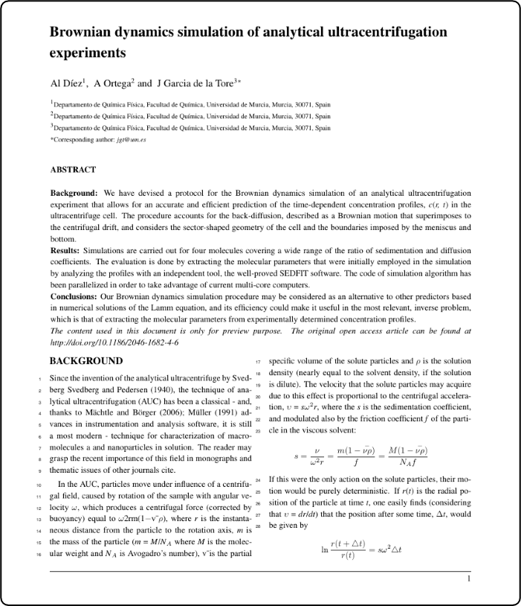
What is LaTeX?
document preparation system for high-quality typesetting
produce technical or scientific documents, but it can be used for almost any form of publishing
  CV, lecture/book summaries, lab reports, …

Slide 3
Why Use LaTeX?
designed by academics and easily accommodates academic use
predefined layout makes it look like it’s done professionally
“No need to reinvent the wheel.”
Mathematical symbols and equations are easily integrated
Footnotes, references, table of content & bibliography too!

Slide 4
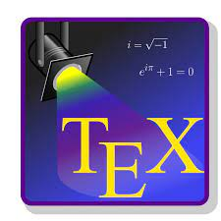

Installing LaTeX
MiKTeX
  MiKTeX is a typesetting system for Windows
  download from www.miktex.org for free
  install MiKTeX first, then any editor
Texstudio as editor
full license through UNSW

Slide 5
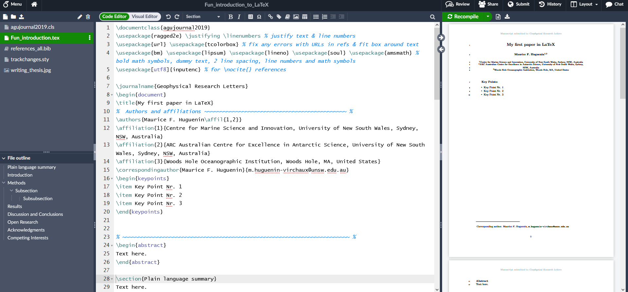

Slide 6
Basic document structure
The format of a document is pretty simple
  preamble
    documentclass
    packages
  front matter
    title/author
  body
    contents
  end
    bibliography

Slide 7
In the front matter
\begin{document}
\title{}
\author{}
\maketitle
\begin{abstract}
  …
\end{abstract}
\pagebreak

Slide 8
In the body
To begin a new section
\section{}
  Similarly, \subsection{}, \subsubsection{}, \subsubsubsection{}
  LaTeX does automatic numbering. If you don’t like it, use section*{}
\emph{}, \textbf{}
\singlespacing, \doublespacing, \onehalfspacing
\centering or \begin{centering} & \end{centering}

Slide 9
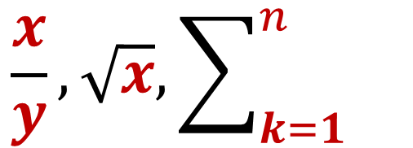
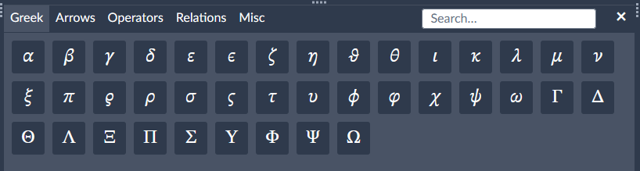
Footnotes, quotes & equations
\footnote{}
\begin{quote} & \end{quote}
` ’, `` ’’ for quotations
Mathematical Equations
  Math always in between $ & $
    Alternatively, \begin{equation} & \end{equation}
  $ 1+4=5 $
  \frac{x}{y}, \sqrt{x}, \sum_{k=1}^{n}
  ^{}, _{}
  \greek letters (e.g. \alpha or \Alpha)
  Overleaf has click and type functions
  for symbols too

Slide 10
Citations
\cite{bibtexkey} Pitman et al. (2022)
\citeA{bibtexkey} (Pitman et al., 2022)
for convenience, create a bibliography file, called bibtex file (.bib) and use it as needed
Mendeley
Zotero

Slide 11
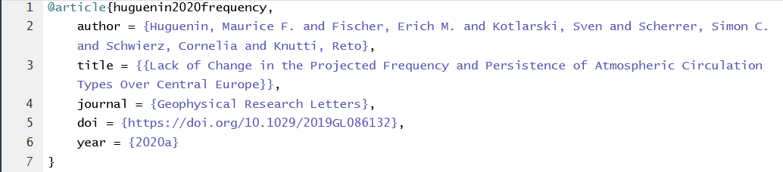
The .bib file

Slide 12
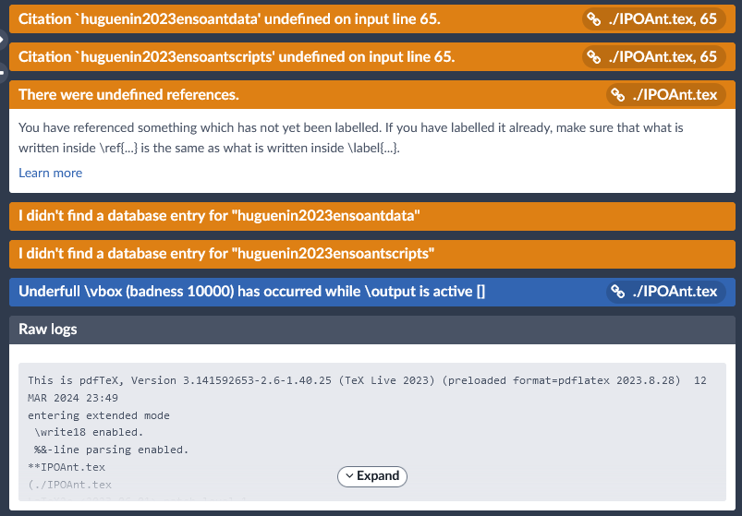

Common mistakes
  “end” doesn’t follow “begin”
  $ doesn’t follow $
  using commands from packages not defined in the preamble
  do not forget “\”s

Slide 13
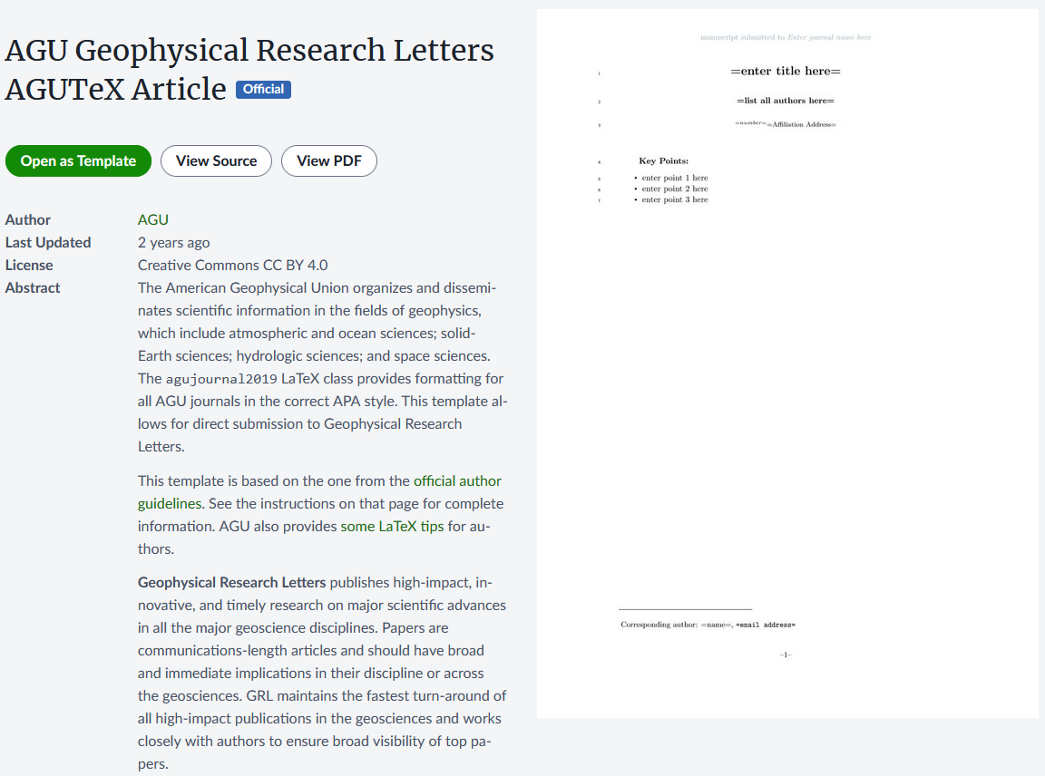

Let’s get started with your own manuscript
2nd search result

Slide 14
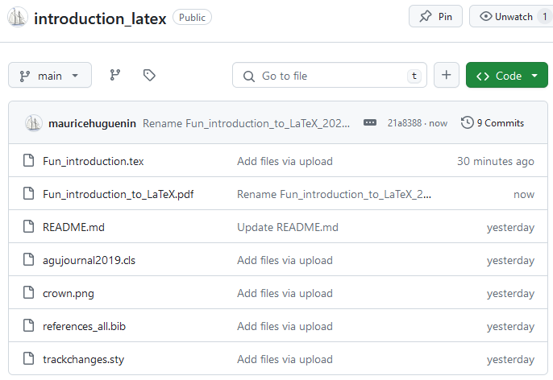

https://github.com/mauricehuguenin/introduction_latex

