Slide 1



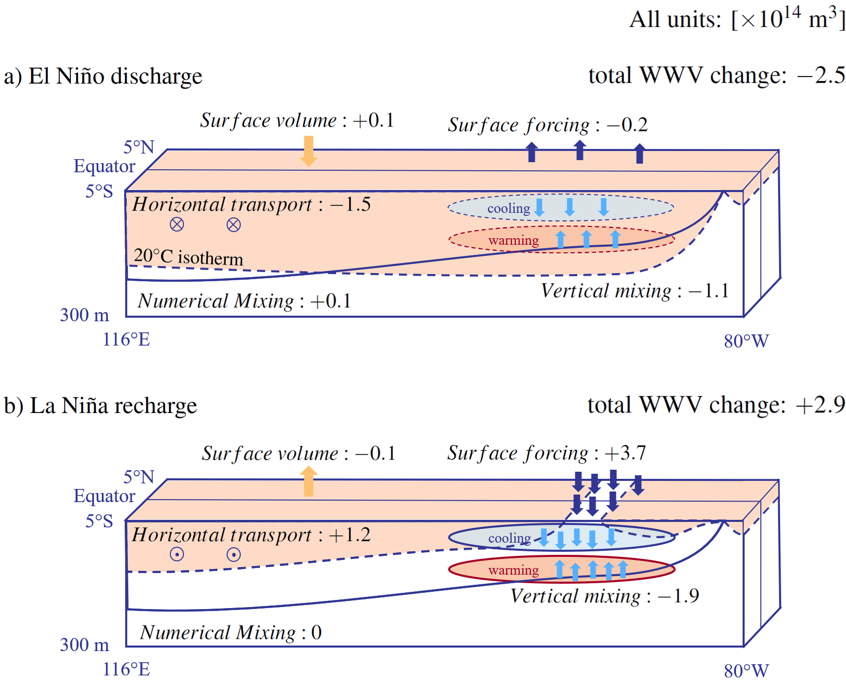
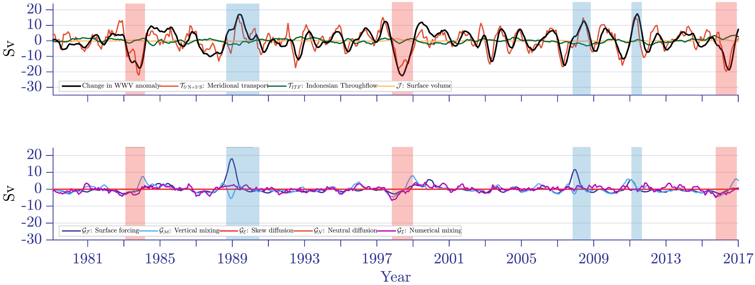
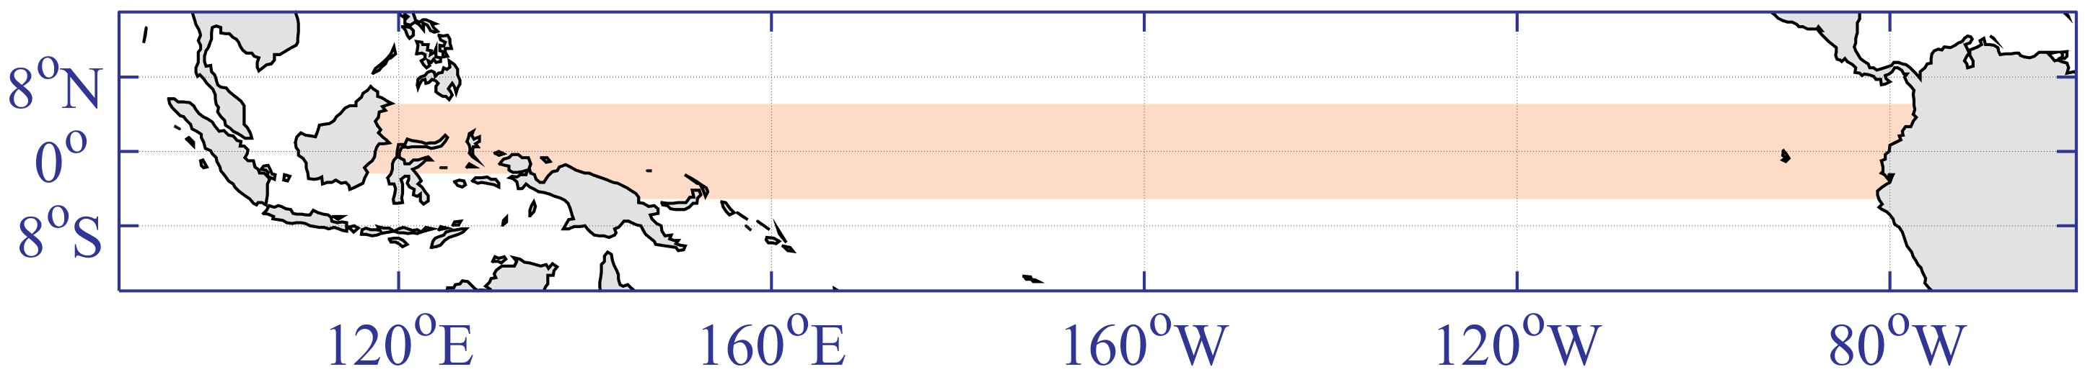
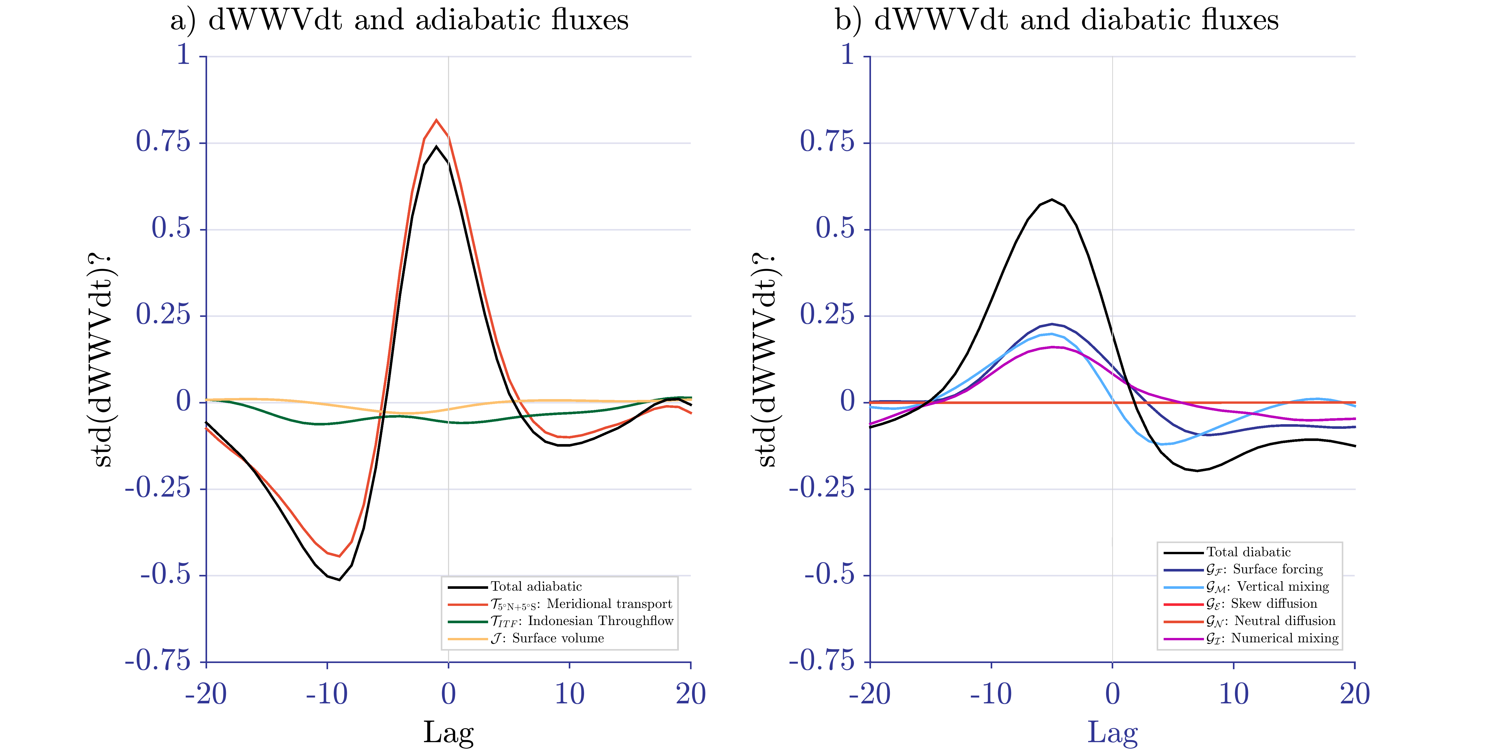
Discharge and Recharge of Ocean Heat during ENSO Events
Maurice F. Huguenin^{1,*}, Ryan M. Holmes^{1,2} and Matthew H. England¹
¹Climate Change Research Center and Australian Research Council Centre of Excellence for Climate Extremes, University of New South Wales, Sydney, Australia
²School of Mathematics and Statistics, University of New South Wales, Sydney, Australia
*E-mail: m.huguenin-virchaux@unsw.edu.au
link to .PDF
Asymmetric heat and warm water volume fluxes arise despite symmetric El Niño and La Niña events
CLEX workshop, 19. – 22. November 2019
EL NIÑO
LA NIÑA
Fig. 1 Schematics representing the discharge and recharge phases of Warm Water Volume (WWV) during idealised symmetric (a) El Niño and (b) La Niña events in the MOM5 model. WWV is a proxy for the equatorial Pacific’s upper ocean heat content and a key inclusion in ENSO forecasting. The overall contribution of each flux is given as a unit of 10¹⁴ m³.
a) adiabatic fluxes changing WWV
b) diabatic fluxes changing WWV
The Warm Water Volume Balance
Eq. 1 The individual WWV balance terms. We calculate numerical mixing as the residual.
Fig. 2 Time series of the (a) adiabatic and (b) diabatic WWV budget terms during a simulation with the ¼° ACCESS-OM2 model.
Fig. 1 The WWV region in the equatorial Pacific.
Take Home Messages:
This study presents a comprehensive analysis of individually calculated upper ocean heat and volume fluxes during ENSO
Adiabatic volume fluxes are mostly symmetric for El Niño and La Niña, diabatic fluxes show a strong asymmetry and peak three to six months earlier
The large event-to-event variability of the surface forcing flux during La Niña is linked to the shoaling of the 20°C isotherm in the eastern equatorial Pacific
Motivation:
Warm Water Volume (WWV, defined as the volume of water above 20°C in the equatorial Pacific) leads ENSO by six to eight months & is used for ENSO forecasts
To increase ENSO forecasting skill, we need to better understand what influences this key metric
Issue:
Diabatic fluxes cannot be assessed with conventional observational datasets
Method:
Simulating ENSO events in MOM5 / ACCESS-OM2, ¼° global ocean, sea ice models with 50 vertical depth levels and CORE-NYF + ERA-Interim / JRA55 forcing
Using the Water Mass Transformation framework to analyse the WWV balance terms
Fig. 4 Lag regression of (a) adiabatic and (b) diabatic balance terms onto the change in WWV.
Method:
simulating ENSO events in MOM5 / ACCESS-OM2, ¼° global ocean, sea ice models with 50 vertical depth levels and CORE-NYF + ERA-Interim / JRA55 forcing
using the Water Mass Transformation framework to analyse the WWV balance terms

