Slide 1



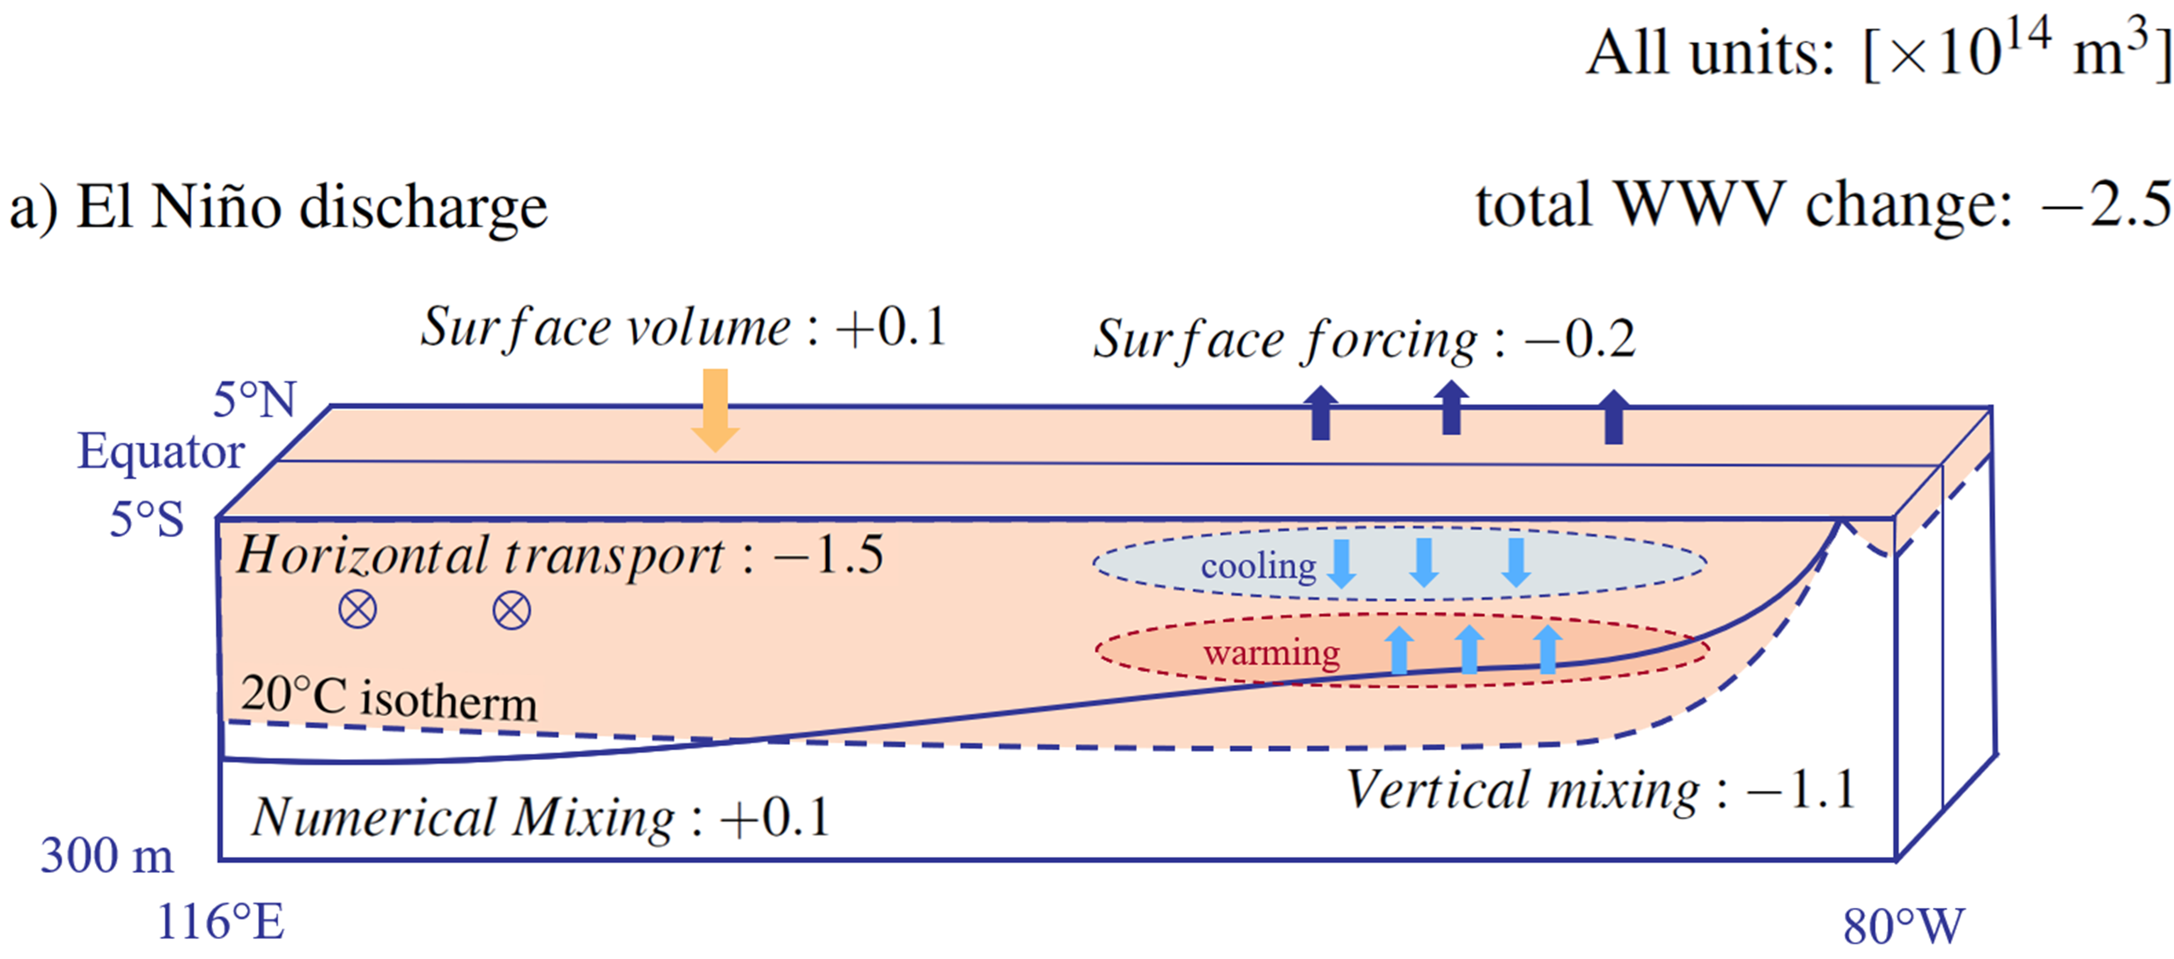
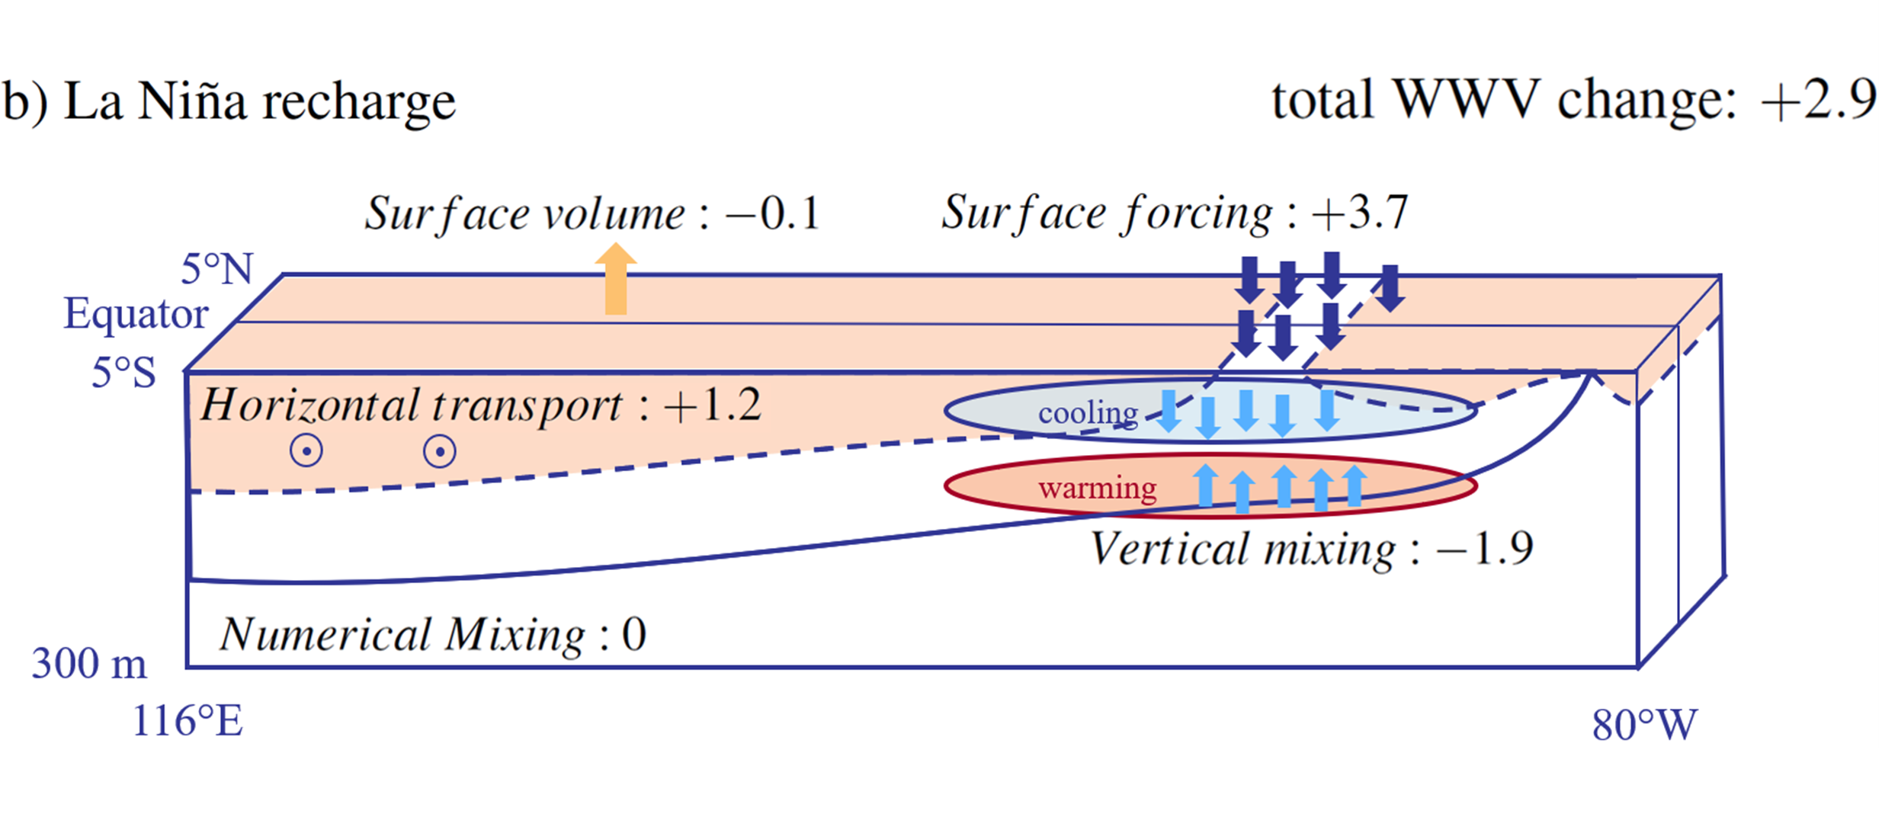
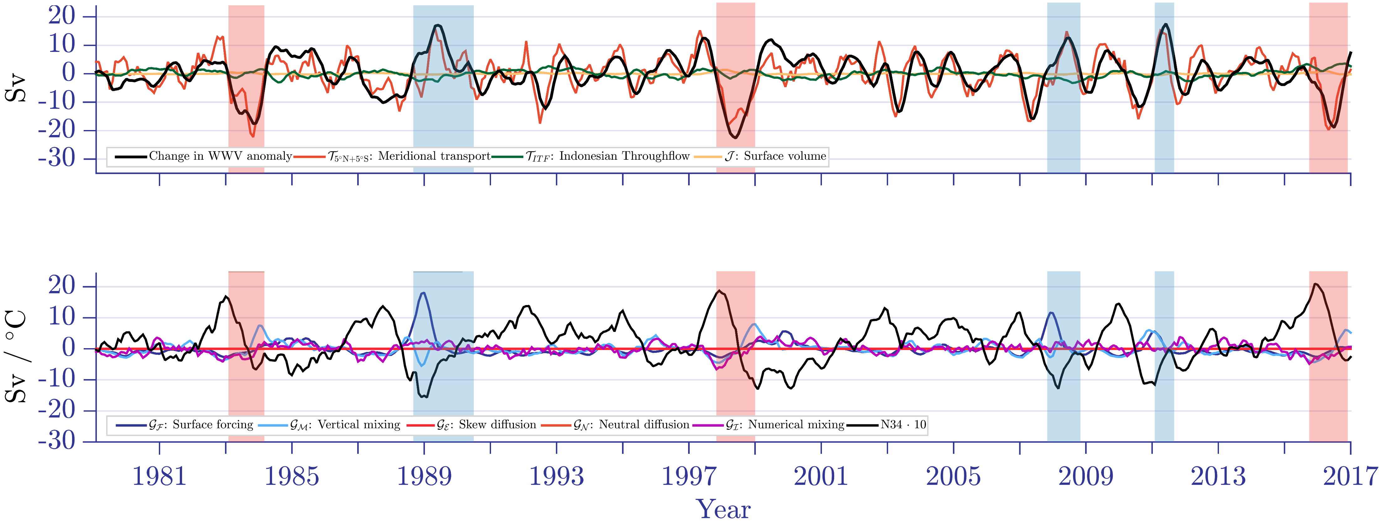
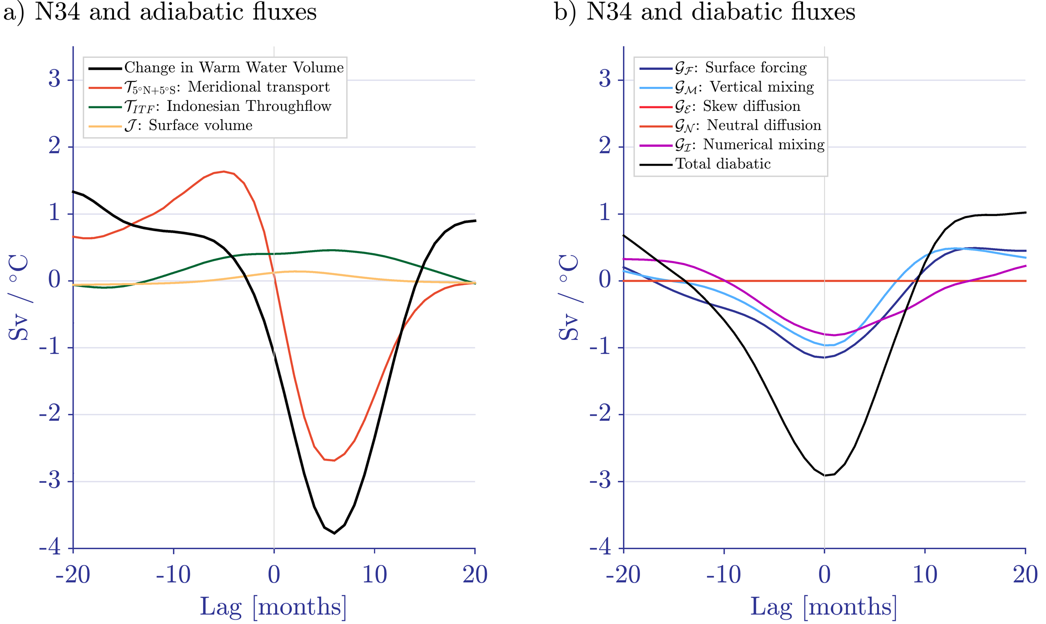

Discharge and Recharge of Ocean Heat during ENSO Events
Maurice F. Huguenin^{1,*}, Ryan M. Holmes^{1,2} and Matthew H. England¹
¹Climate Change Research Center and Australian Research Council Centre of Excellence for Climate Extremes, University of New South Wales, Sydney, Australia
²School of Mathematics and Statistics, University of New South Wales, Sydney, Australia
*E-mail: m.huguenin-virchaux@unsw.edu.au
link to .PDF
CLEX workshop, 19. – 22. November 2019
Warm Water Volume (WWV, i.e. the volume of water above 20°C in the Pacific) is a key inclusion in ENSO forecasting. Many factors influencing it remain a mystery.
Here, we simulate ENSO events in MOM5 / ACCESS-OM2, two ¼° global ocean, sea ice models with CORE-NYF + ERA-Interim / JRA55 forcing and use the Water Mass Transformation framework for analysis.
idealized El Niño
idealized La Niña
Fig. 1 Schematics representing the discharge and recharge phases of WWV during idealised symmetric (a) El Niño and (b) La Niña events in MOM5. The overall contribution of each flux is given as a unit of 10¹⁴ m³.
ENSO variability for 1979-2016
a) adiabatic fluxes changing WWV
b) diabatic fluxes changing WWV
Fig. 2 Time series of the (a) adiabatic and (b) diabatic WWV budget terms during a simulation with the ACCESS-OM2 model. The N34 index in (b) is multiplied by a factor of ten.
Take Home Messages
This study presents a comprehensive analysis of individually calculated upper ocean heat and volume fluxes during ENSO
Adiabatic volume fluxes are mostly symmetric for El Niño and La Niña, diabatic fluxes show a strong asymmetry and peak three to six months earlier
The large event-to-event variability of the surface forcing flux is linked to the shoaling of the 20°C isotherm in the eastern equatorial Pacific
Fig. 3 Lag regression of (a) adiabatic and (b) diabatic balance terms onto the change in WWV.

