Slide 1



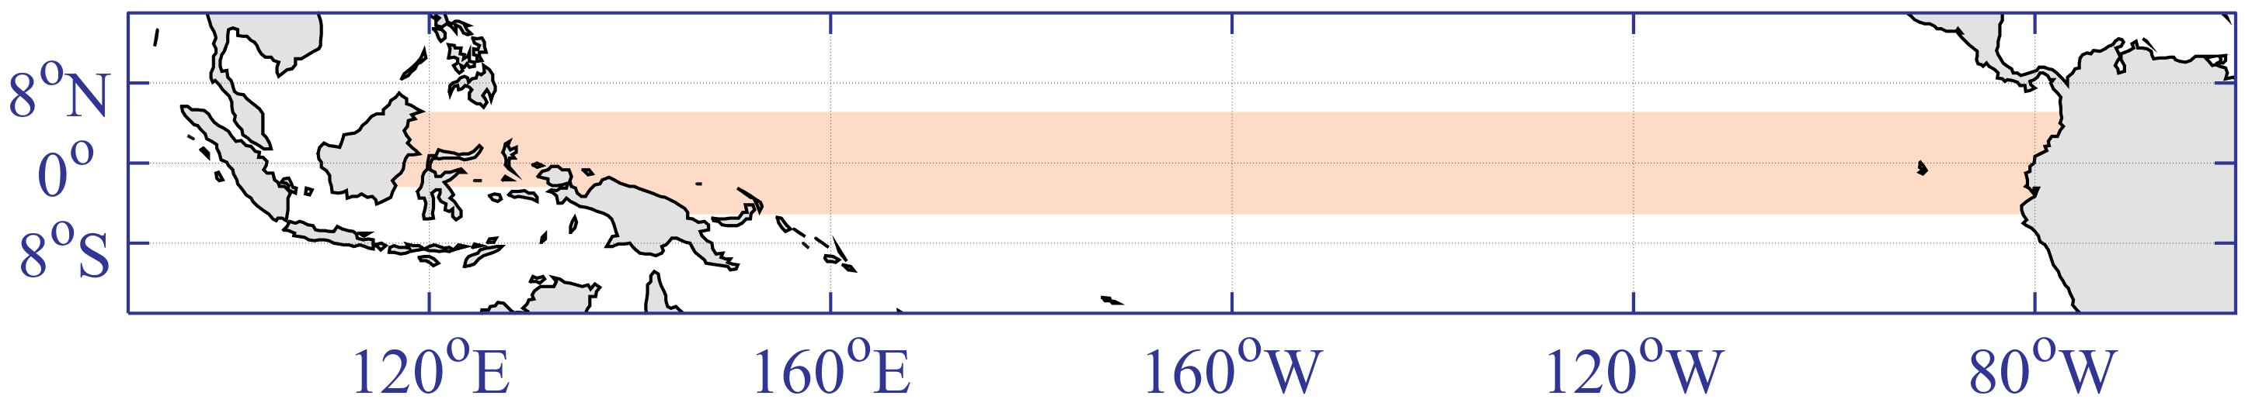
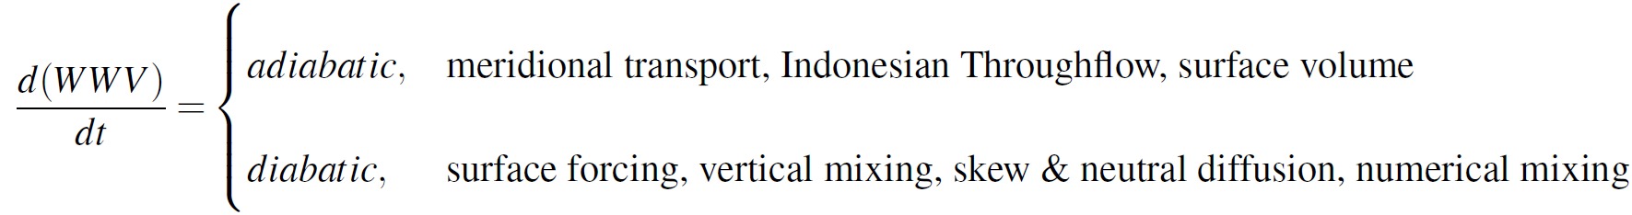
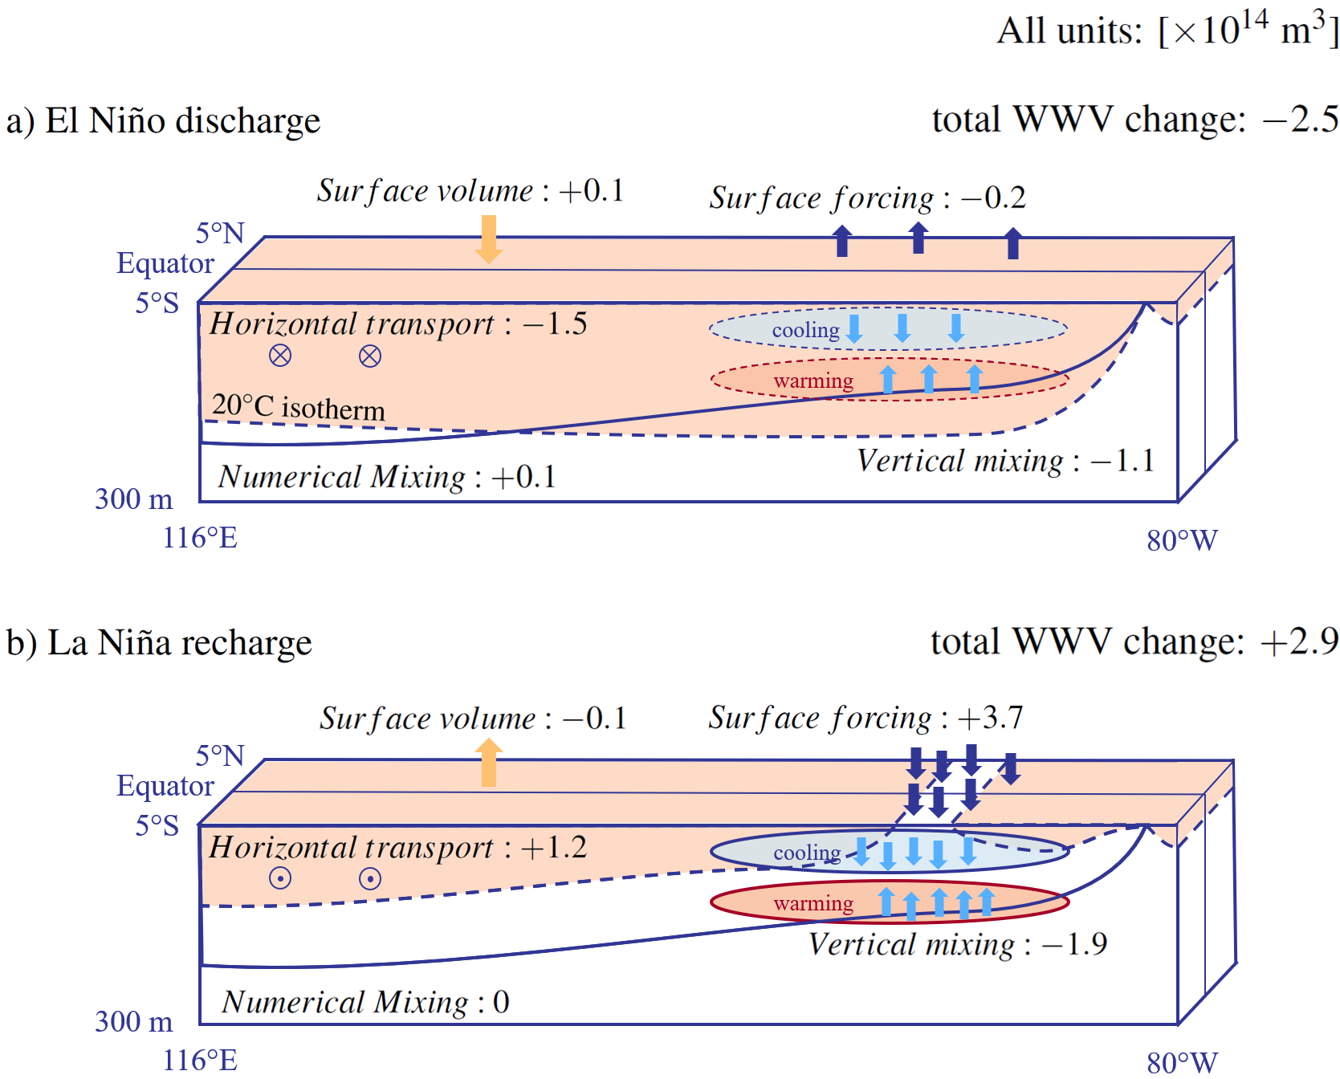
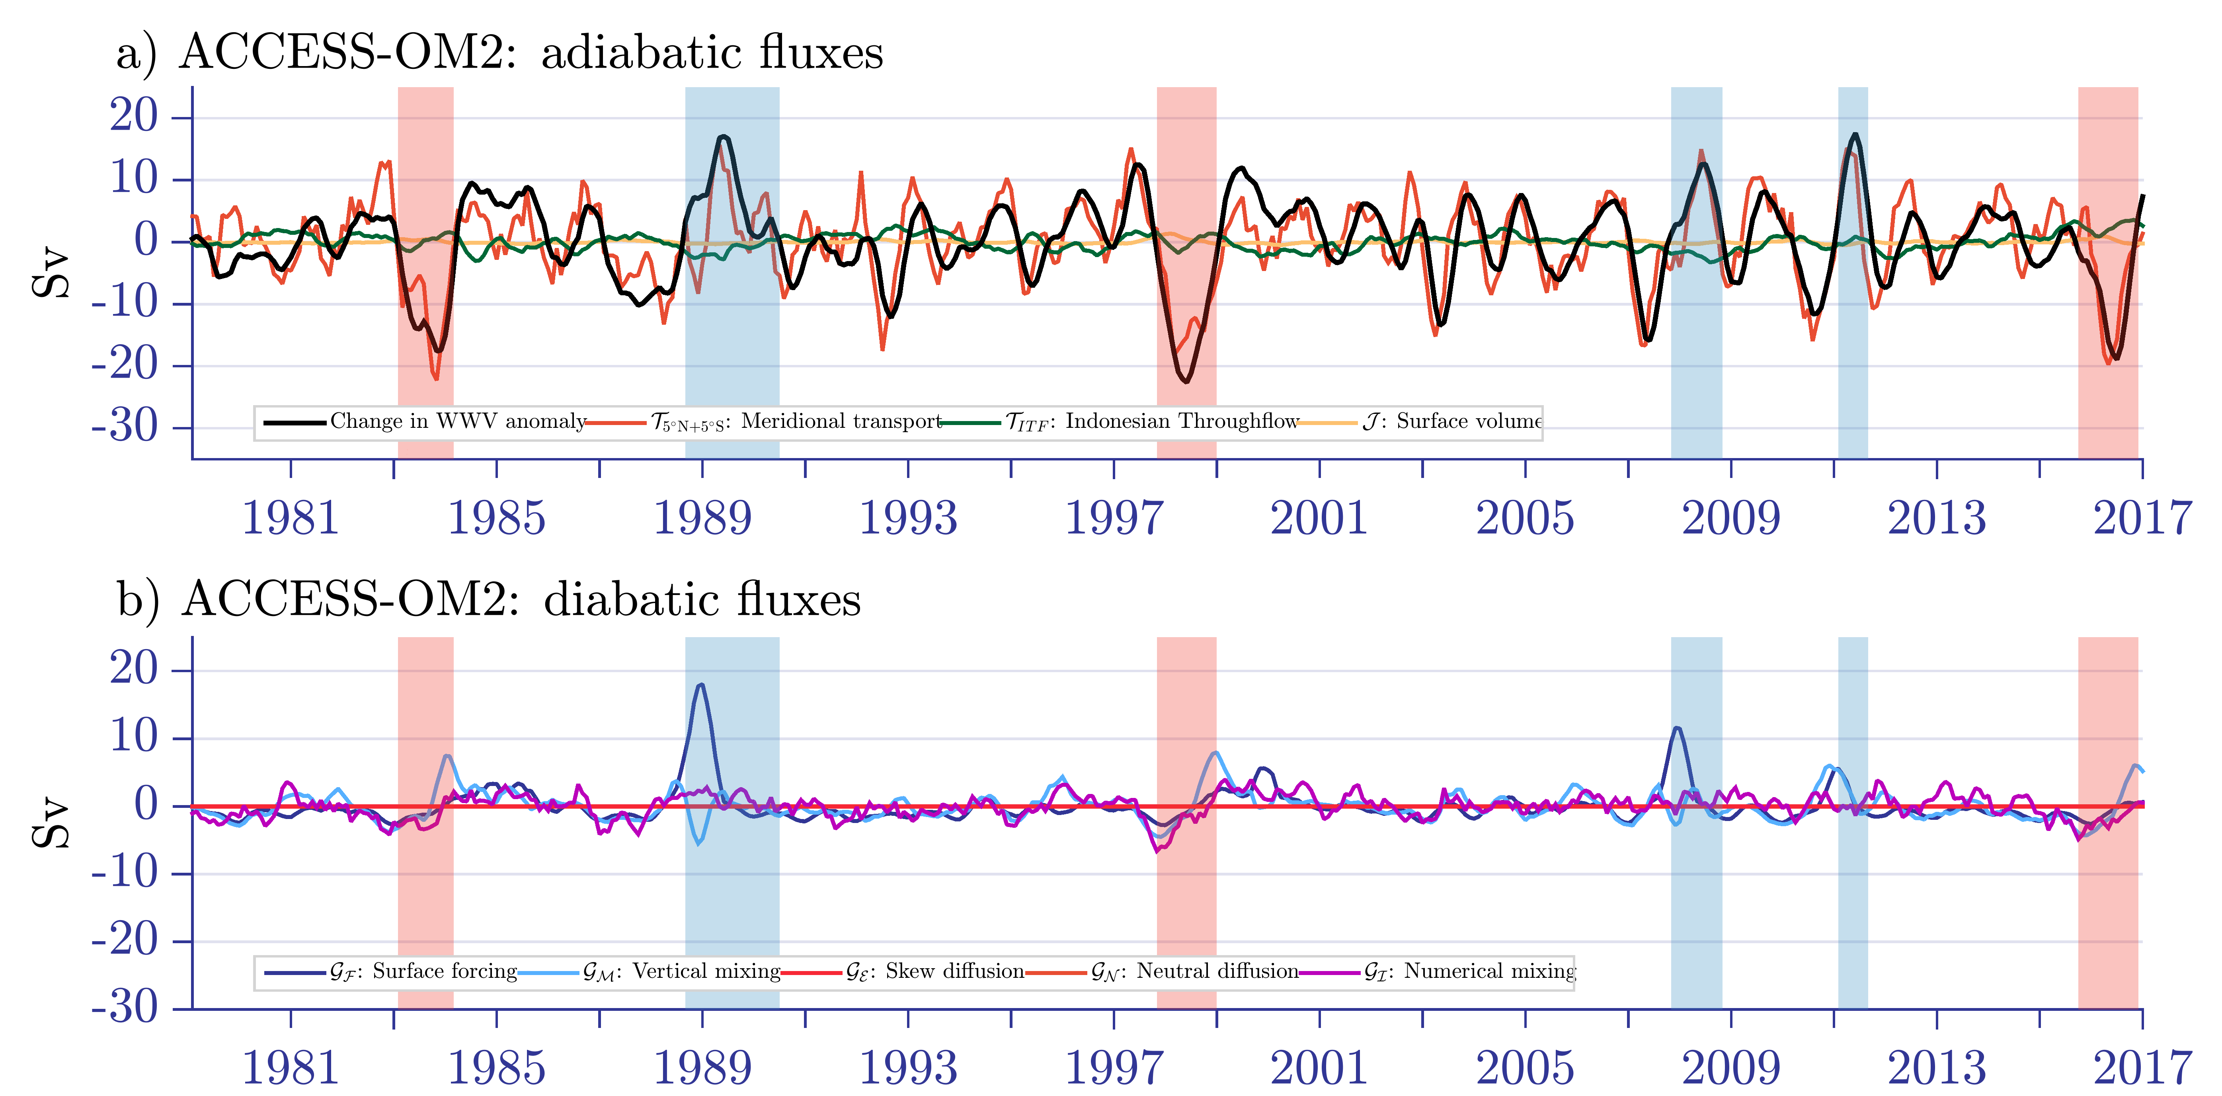
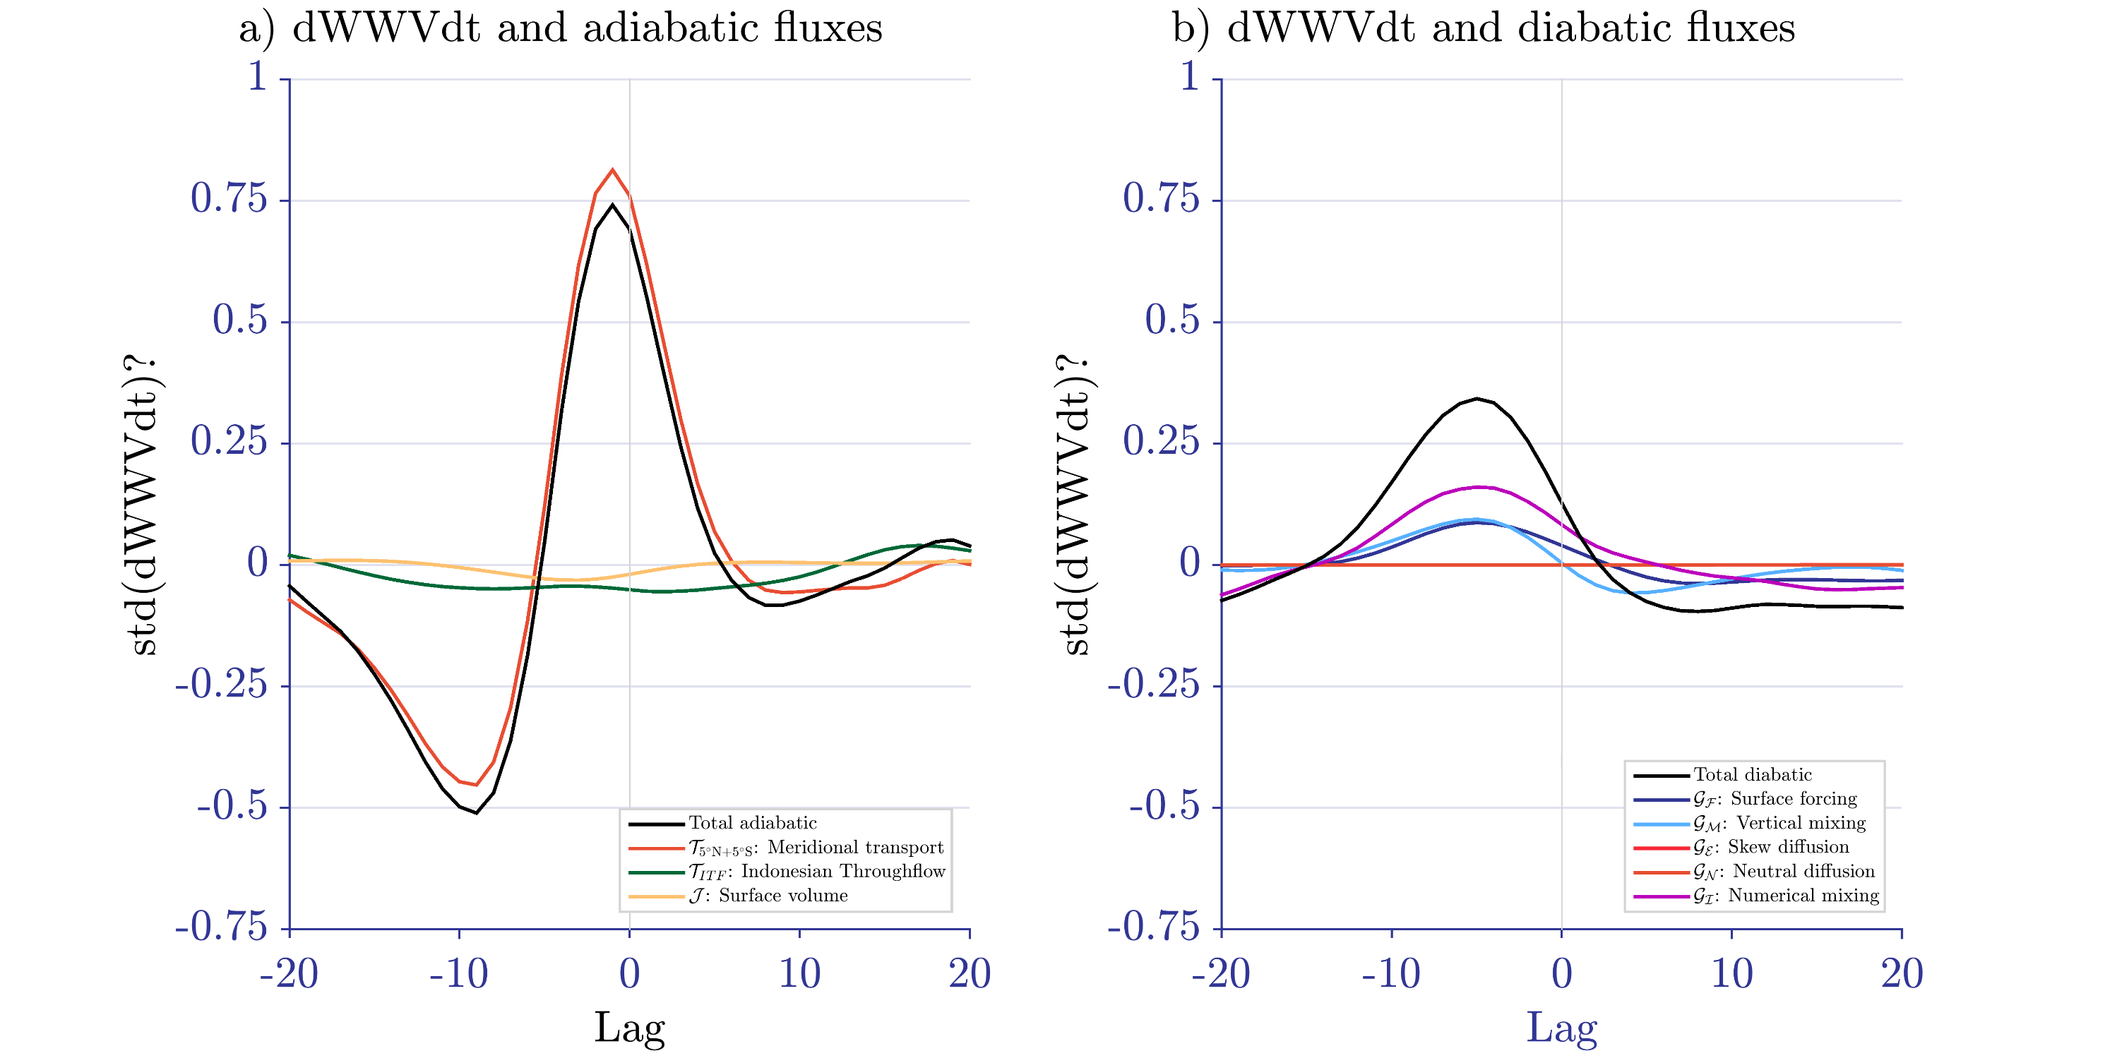
Discharge and Recharge of Ocean Heat during ENSO Events
Maurice F. Huguenin^{1,*}, Ryan M. Holmes^{1,2} and Matthew H. England¹
¹Climate Change Research Center and Australian Research Council Centre of Excellence for Climate Extremes, University of New South Wales, Sydney, Australia
²School of Mathematics and Statistics, University of New South Wales, Sydney, Australia
*E-mail: m.huguenin-virchaux@unsw.edu.au
link to .PDF
CLEX workshop, 19. – 22. November 2019
Motivation:
Warm Water Volume (WWV, defined as the volume of water above 20°C in the equatorial Pacific) leads ENSO by six to eight months & is used for ENSO forecasts
To increase ENSO forecasting skill, we need to better understand what influences this key metric
Issue:
Diabatic fluxes cannot be assessed with conventional observational datasets
Method:
Simulating ENSO events in MOM5 / ACCESS-OM2, ¼° global ocean, sea ice models with 50 vertical depth levels and CORE-NYF + ERA-Interim / JRA55 forcing
Using the Water Mass Transformation framework to analyse the WWV balance terms
The Warm Water Volume Balance
Fig. 1 The WWV region in the equatorial Pacific.
Eq. 1 The individual WWV balance terms. We calculate numerical mixing as the residual.
EL NIÑO
LA NIÑA
Fig. 2 Schematics representing the discharge and recharge phases of WWV during idealised symmetric (a) El Niño and (b) La Niña events. The overall contribution of each flux is given as a unit of 10¹⁴ m³.
Take Home Messages:
While adiabatic volume fluxes are mostly symmetric for El Niño and La Niña, the diabatic fluxes show a strong asymmetry
The large event-to-event variability of the surface forcing flux during La Niña is linked to the shoaling of the 20°C isotherm in the eastern equatorial Pacific
The diabatic volume fluxes peak three to six months prior to changes in the warm water volume and much sooner than the adiabatic fluxes
Fig. 3 Time series of the (a) adiabatic and (b) diabatic WWV budget terms during the 1979-2016 ACCESS-OM2 simulation.
Fig. 4 Lag regression of the (a) adiabatic and (b) diabatic WWV balance terms onto the change in WWV.

