Slide 1
How could we predict customer churn and understand the reasons behind it?
Mauricio Moreno

Slide 2





Meet Isabel
Location: Santander, rural area of Colombia
Occupation: Hairdresser
Needs: Generate additional income for her family
From home
During her spare time
Alternatives: Elenas, a social commerce marketplace
Notes:
Include the problem here and the solution in one slide as an overview

Slide 3
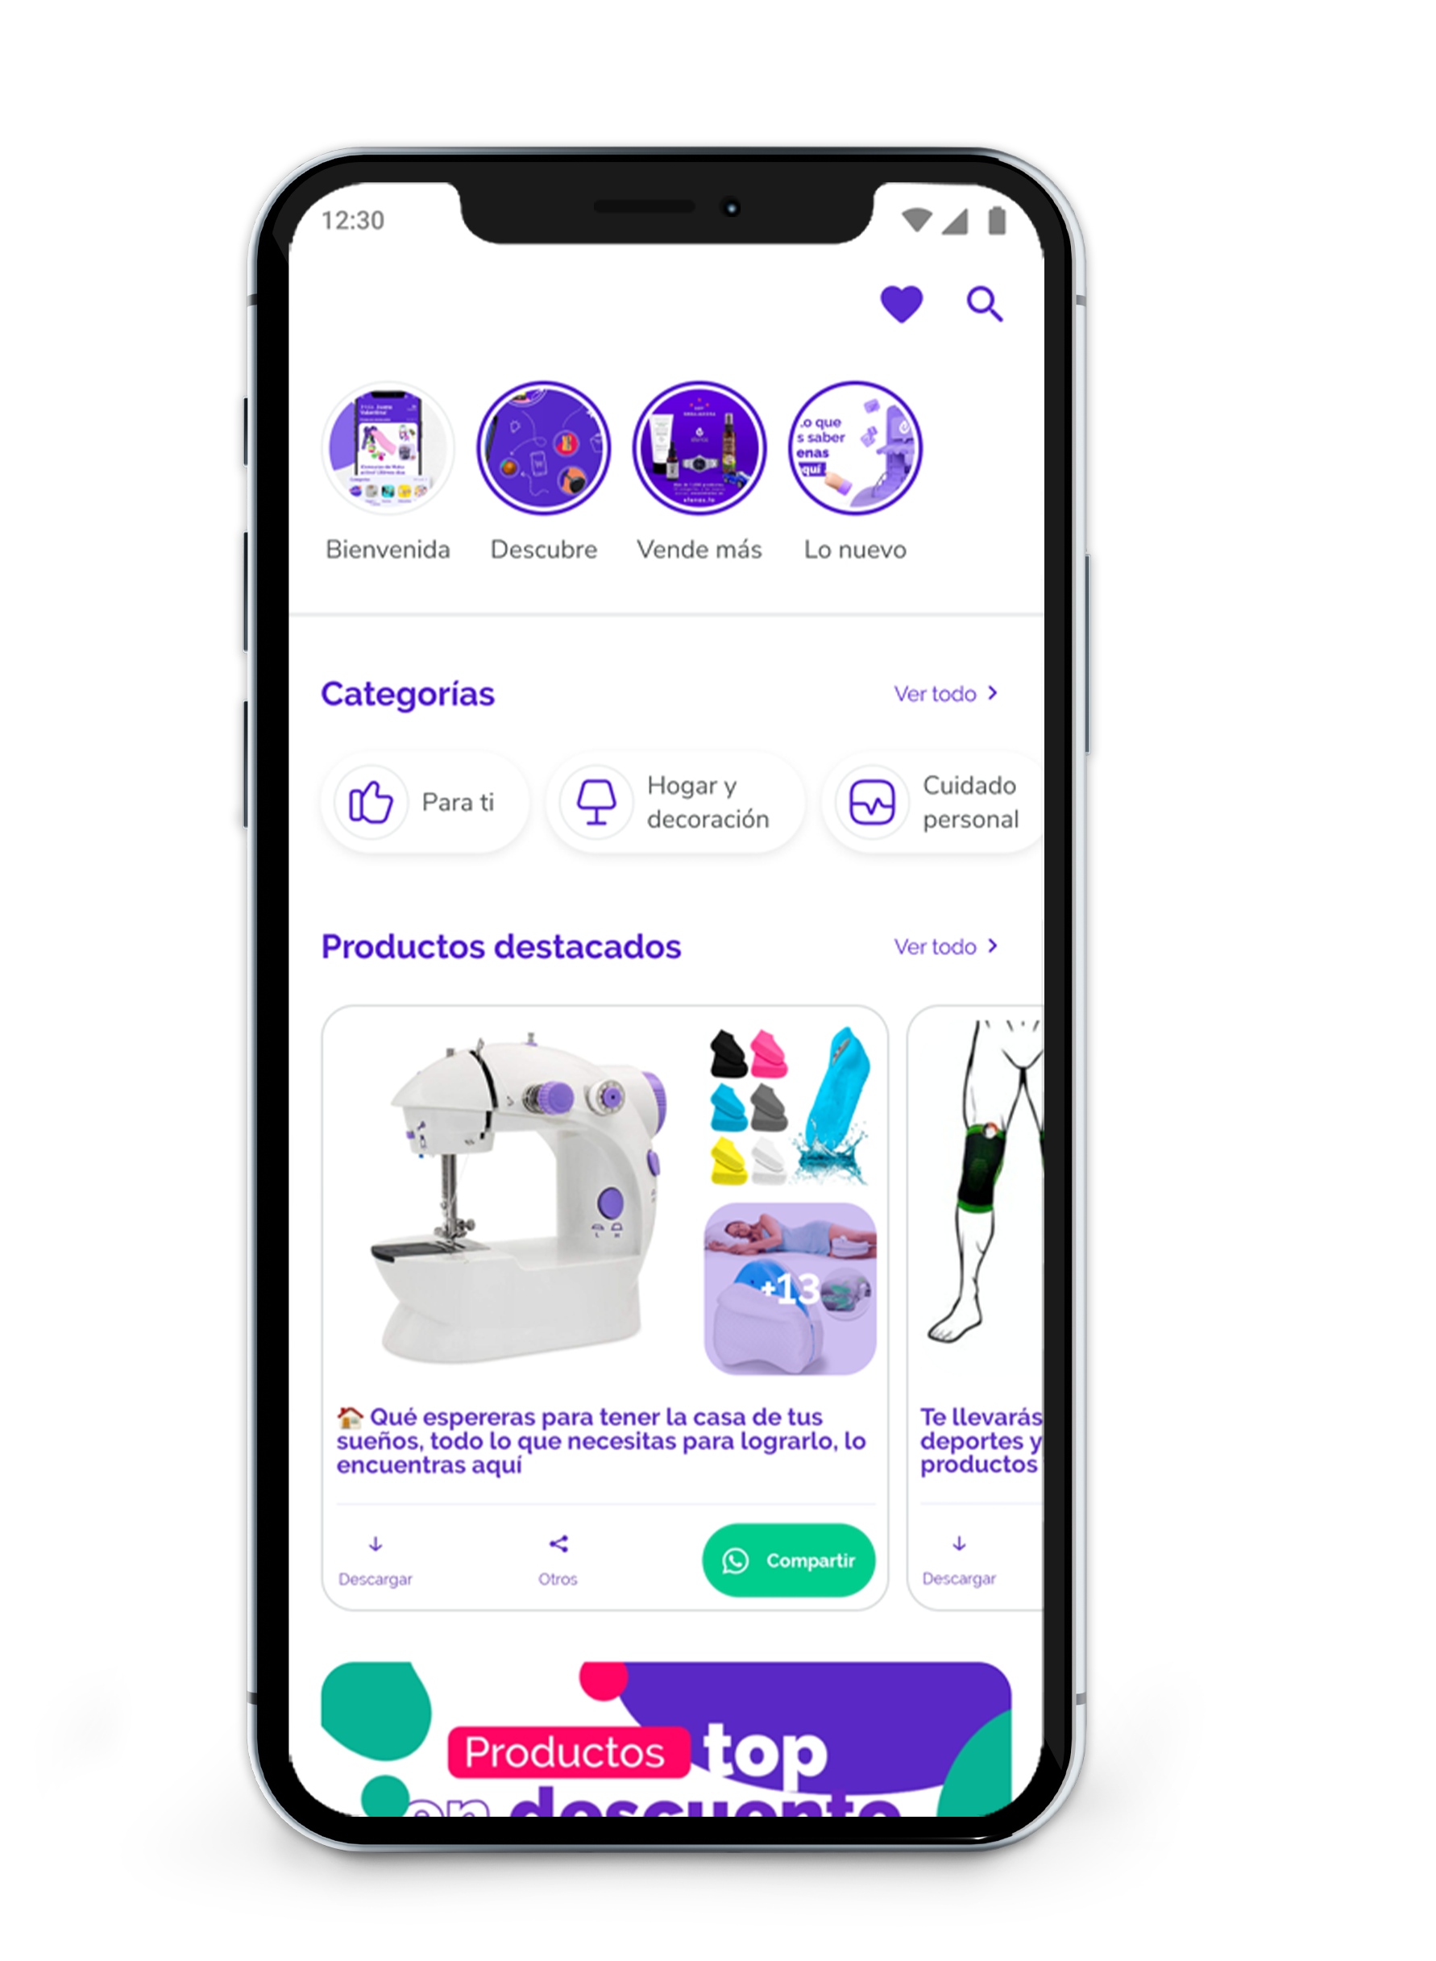
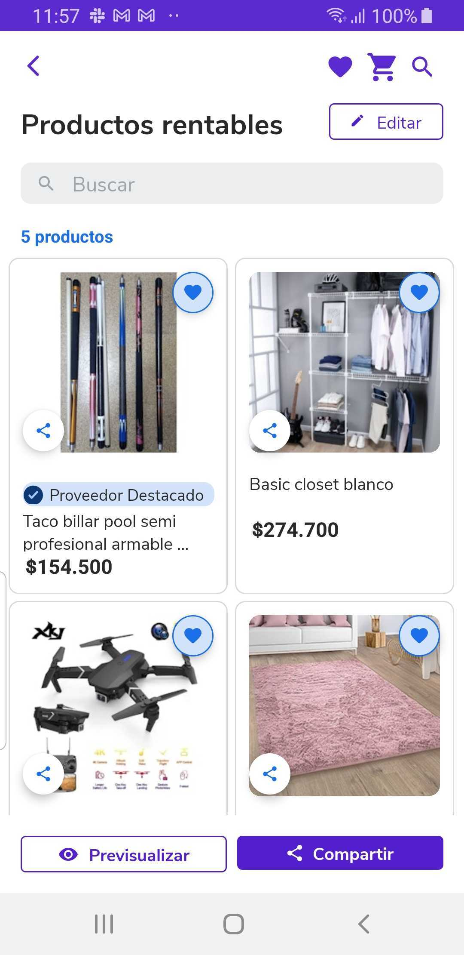

Isabel’s journey she started selling through Elenas, a Social commerce APP
Defined the earnings for her portfolio
Shared them on social media and with her neighbours
Received her weekly earnings on completed orders
Build online store
Share and promote
Place orders
Receive earnings
Created digital store
Had no down payments or fees
Placed the orders on the app, without inventory risk
Elenas ships the products to rural areas
Notes:
Include title, Isabel's journey
We want to understand how to support them not to leave the platform

Slide 4
Isabel’s challenges not earning what she is expecting for the last few months
Define the earnings for her portfolio
Shared them on social media and to her neighbors
Receive her weekly earnings on completed orders
Her problem
Bad couple of months, not earning what she is expecting
Doesn’t know whether to keep trying or churn
Build online store
Share and promote
Place orders
Receive earnings
Created digital store
No down payments or fees
Placed the orders on the app, without inventory risk
Elenas ships the products to rural areas
Notes:
Include title, Isabel's journey
We want to understand how to support them not to leave the platform

Slide 5
Elenas’ challenge the growth team has a KPI to retain Isabel and sellers like her
Define the earnings for her portfolio
Shared them on social media and to her neighbors
Receive her weekly earnings on completed orders
Her problem
Bad couple of months selling, not earning what she expected
Doesn’t know whether to keep trying or churn
Elenas’ growth team problem
Retention is one of the main KPIs
Lack of effective retention strategies
Build online store
Share and promote
Place orders
Receive earnings
Created digital store
No down payments or fees
Placed the orders on the app, without inventory risk
Elenas ships the products to rural areas
Notes:
Include title, Isabel's journey
We want to understand how to support them not to leave the platform

Slide 6
The process classification algorithm to predict customer (seller) churn
Data acquisition
Preprocessing
Modelling
Shared dump file with multiple tables – individual variables selected
Variables grouped in behavioural, transactional and operational columns
Logistic transformation, one hot-encoding and variables elimination to address multicollinearity
Classification problem: will this seller create an order next month?
Iterations with KNN, Random Forest and XGBoost
XGBoost selected as the final algorithm
Notes:
Remove the previous one
Classification problem, understand through a classification model

Slide 7






Accuracy: 94% Being correct on the selections Recall: 97% Finding all the churned sellers
Evaluation metrics Due to the business problem, recall is the most relevant metric
All the churned sellers
Prioritized metric
Notes:
Explain accuracy of 99 percent because most of the people churn

Slide 8
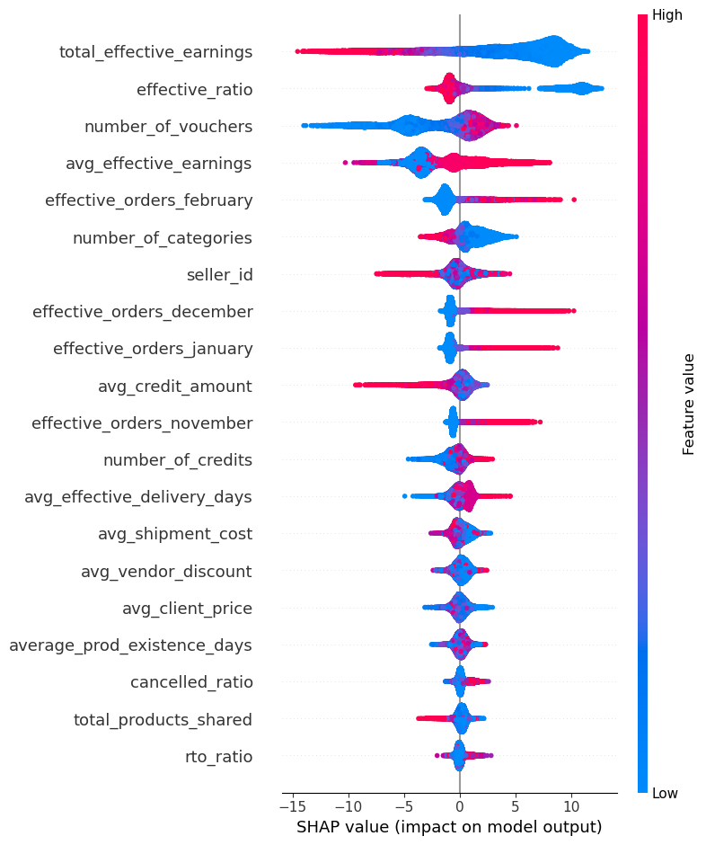
The metrics Elenas should prioritize to avoid Isabel from churning
Top 5 features for Isabel
To retain Isabel, Elenas should focus on recommending her high margin products of a specific category with low return rate
High
Total effective earnings
Effectives orders ratio
Number of vouchers
Feature value
Avg effective earnings
Number of categories
Low
Not churn
Churn
Impact on model’s output
Notes:
Things we must support to help isabell
Through the analysis we found the riskiest features for Isabel, and this is what we have to focus on to help her.
Make it clean for the top 3

Slide 9




Next steps
Prioritise retention efforts and spending by growth team
Recommend specific products to sellers likely to churn as non-monetary strategies
Follow up with high-relevance sellers likely to churn
Notes:
Algunos elementos clave
Retención, número y frecuencia de ventas, tiempos de activación-abandono, uso de aplicación, red de clientes, operaciones, ganancias para embajadoras, GMV.

Slide 10
Thank you

Slide 11

The Project consists on a series of algorithms to predict if a seller is going to churn (no orders created) for a specific month
Seller Definition
User created after October 2022
>= 1 created order
Target Variable
Binary classification >= 1 effective order between March 30 and April 28th
Distribución target variable
Imbalanced target variable
For a result to be considered as interesting, the accuracy has to be > 81%
47.704 Emprendedoras
8.944
No churn
38.760
churn
XGBoost

Slide 12
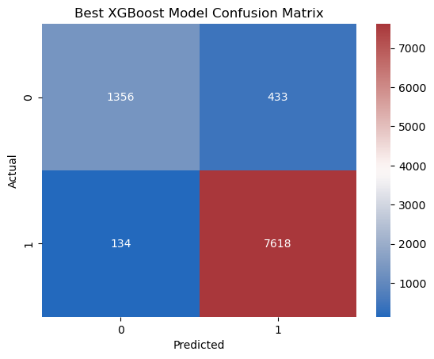
The optimized model was a XGBoost that achieved an accuracy of 94%, recall of 98% and specificity of 75%
Positive class predictions (churn)
Accuracy: 94% meaning that 94% of the model predictions are adequate
Recall: 98.2% The model identifies 98% of the churned sellers
Precision: 94% When the model classifies a seller as churned, it is correct 94% of the times
Negative class predictions (no churn)
True Negative Ratio: 75% of the non-churned sellers are correctly identified by the model
Negative predicted value: 91% Cuando el modelo predice que no hay churn, acierta el 91% de las veces
Notes:
This implies that the model is performing very well in terms of classifying instances, with a high true positive rate and a low false positive rate. It is considered to be an excellent result and generally implies a highly effective and reliable classification model.
Specificity – TNR recall for the negative class

Slide 13
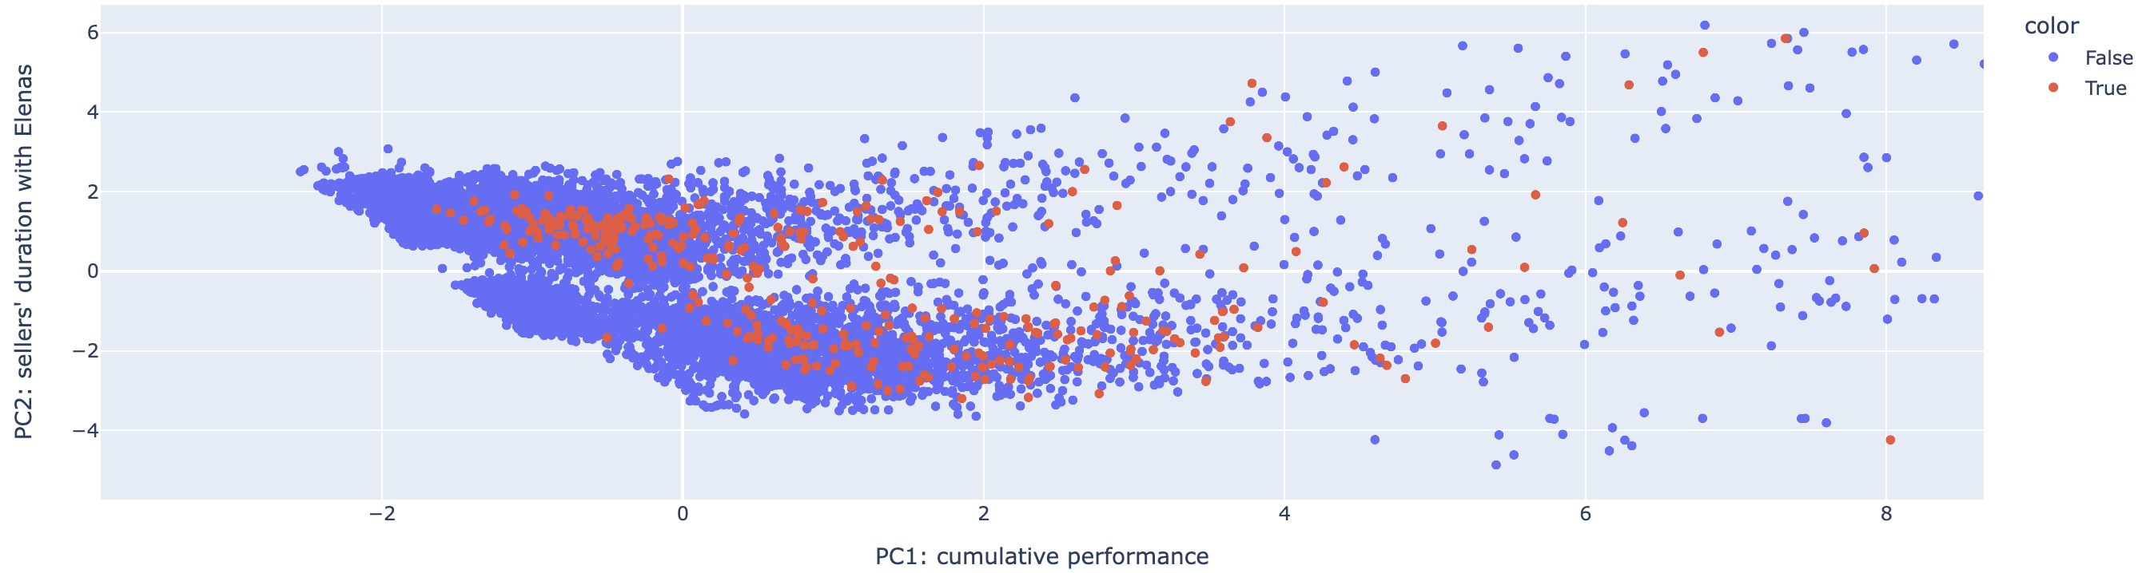
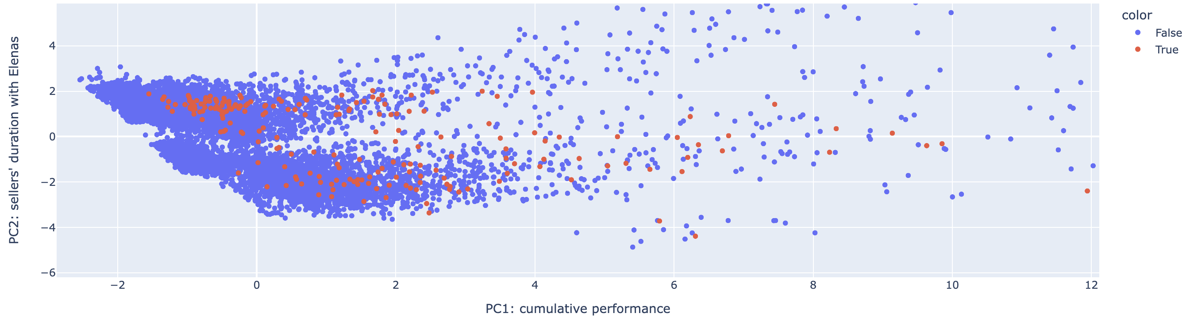
Some of the misclassifications are not explained by the current variables, but others should be identified by the model, which should be improved in a following iteration
False positive classifications
Positive class predictions (churn)
PC1 captures cumulative metrics, while PC2 represents duration-related features
The model effectively predicts the behavior of outliers
Distinct pattern is observed for misclassified false positives within the range of -1.1X to 0.08X
False positives exhibit a significantly higher average effective order ratio
Misclassified false negatives have higher average earnings per order, highlighting an area for improvement in future iterations
False negative classifications

